Slide 1
Rotary Centering Scan
Gulden Othman
8 March 2021

Slide 2
Overview
Making a plan for rotary centering scans to help find the uncertainty in rotary angle position

Slide 3
72 Degree rotation
We should use 72.0 deg as the “center point” for this scan
Collimator
Direction of linear travel
Source arm
Rotation
Taken from ./topview.pptx

Slide 4
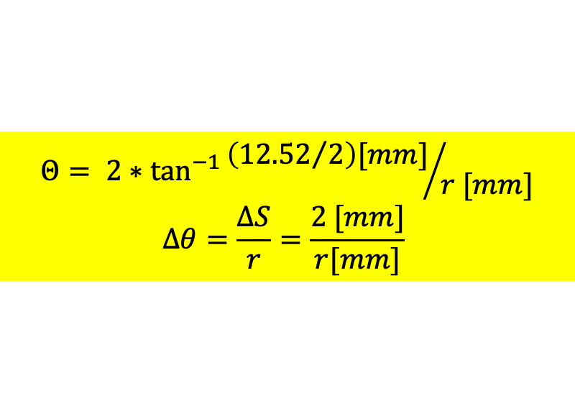

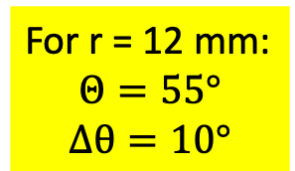
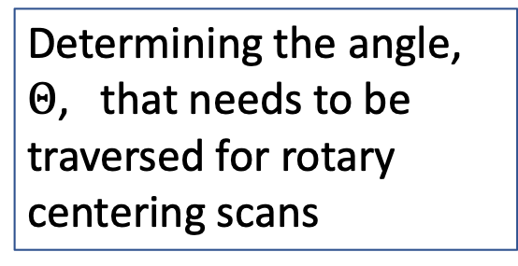
To scale
Rotary motor at -72.08 deg
$$Θ= 2∗\tan^{−1}{\left({12.52}/2\right)[mm]}/{r [mm]}$$
$$Δθ=\frac{ΔS}{r}=\frac{2 [mm]}{r[mm]}$$
Determining the angle, $Θ$, that needs to be traversed for rotary centering scans
(S = 2 mm if we want a spot every 2 mm)
9 mm
For r = 12 mm:
$$Θ=55°$$
$$Δθ=10°$$
Linear travel
6.5 mm
r
$$θ/2$$
`
= beam spot position
(12.52 mm)/2
Rotation

Slide 5
Proposal
“center” point for this scan is rotary = -72.08 deg
Upper limit: 72.08 + theta/2 + 2*delta_theta = 119.6 -> 120 deg
Lower limit: 72.08 – theta/2 – 2*delta = 24.5 deg -> 24 deg
Try to get scan every ~2 mm arc length -> ~ d_theta = 10 deg
Final proposal: -24 deg to -124 deg in 10 deg increments
11 scan positions
I estimate about 8 hours of lab time with 30 min run + 15 min in between to move motors

Slide 6
Other notes
Spot should start overlapping with front-end at rotary = -44.5 deg and overlap until rotary = -100 deg

Slide 7
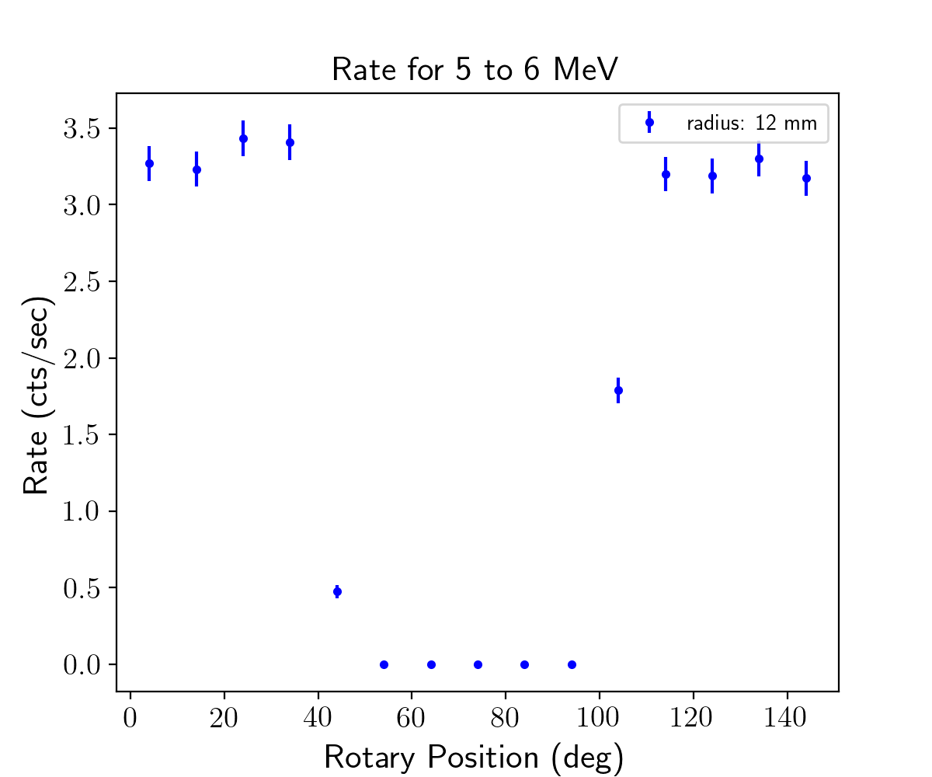

Slide 8
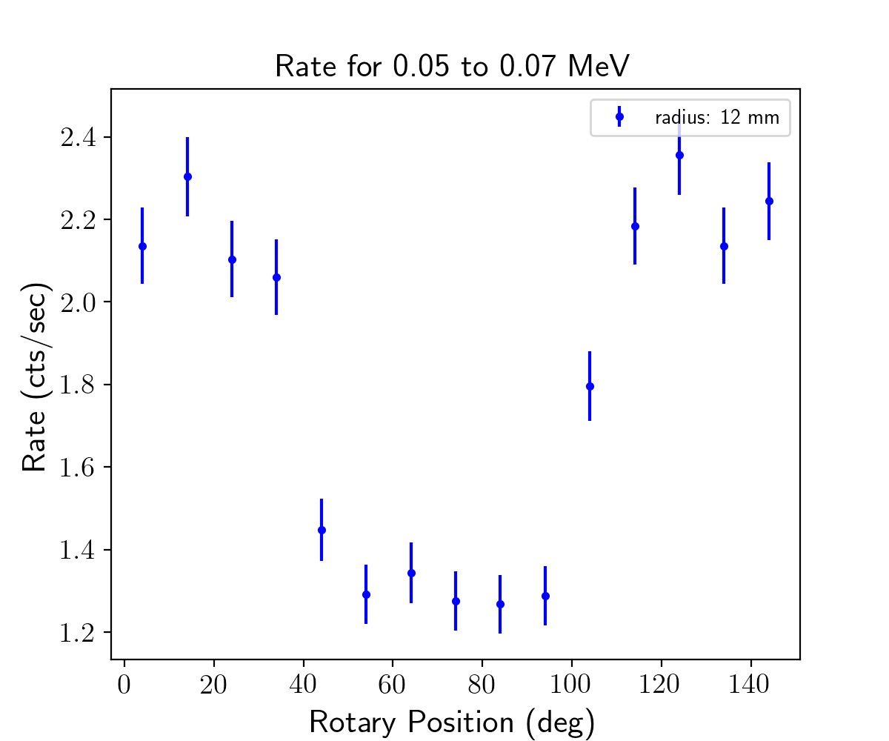

Slide 9
Moving source motor instead of linear
To get spot at 12 mm radius with the source centered above the p+ contact (ie linear motor centered) should rotate to:
rotate collimator to: 28.61 deg
theta_rot = 28.61 deg corresponds to theta_det = 61.39
For simplicity:
Rotate source motor to 29 deg -> theta_det = 61 deg

