Slide 1
Rotary motor rotation in sims
Gulden Othman 15 February, 2021

Slide 2
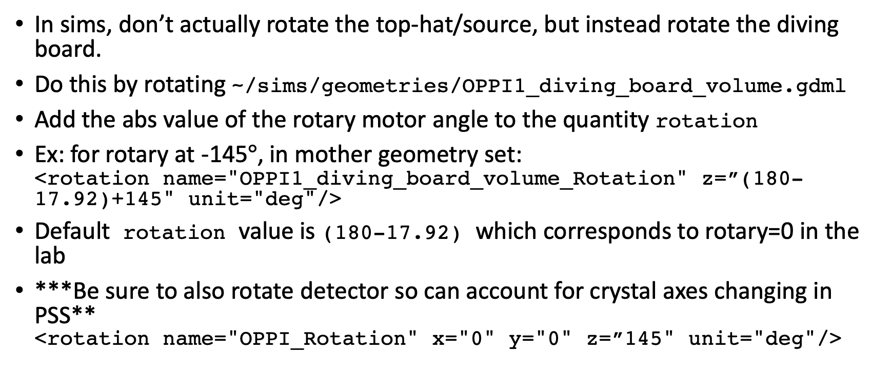
Rotation of top-hat in sims
In sims, don’t actually rotate the top-hat/source, but instead rotate the diving board.
Do this by rotating ~/sims/geometries/OPPI1_diving_board_volume.gdml
Add the abs value of the rotary motor angle to the quantity rotation
Ex: for rotary at -145$°$, in mother geometry set: <rotation name="OPPI1_diving_board_volume_Rotation" z=”(180-17.92)+145" unit="deg"/>
Default rotation value is (180-17.92) which corresponds to rotary=0 in the lab
***Be sure to also rotate detector so can account for crystal axes changing in PSS** <rotation name="OPPI_Rotation" x="0" y="0" z=”145" unit="deg"/>

Slide 3
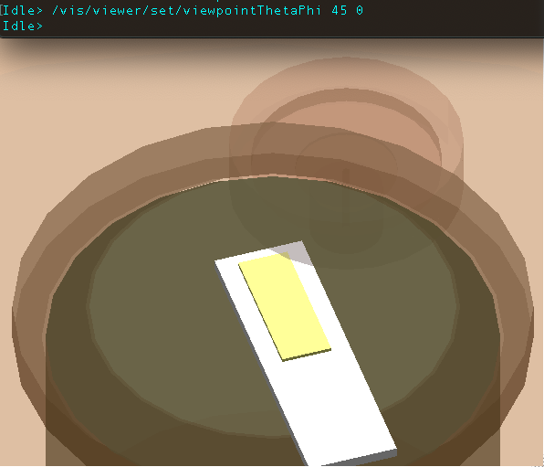
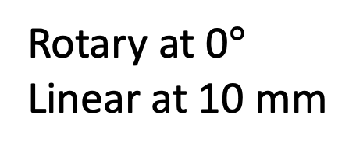
Rotary at 0$°$
Linear at 10 mm

Slide 4
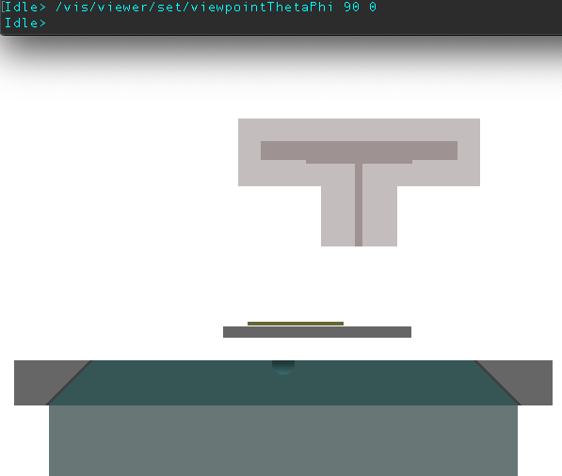
Rotary at 0$°$
Linear at 10 mm

Slide 5
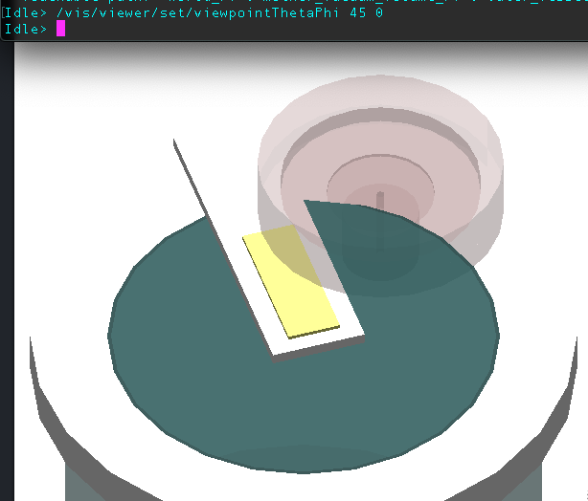
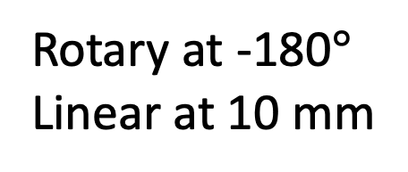
Rotary at -180$°$
Linear at 10 mm

Slide 6
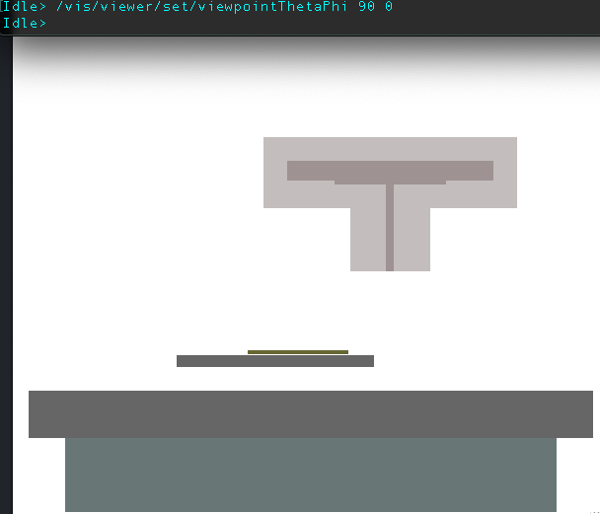
Rotary at -180$°$
Linear at 10 mm

Slide 7
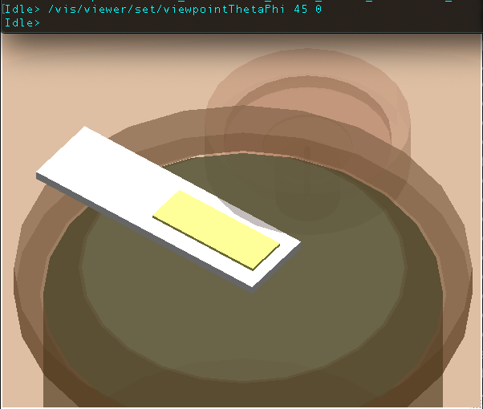
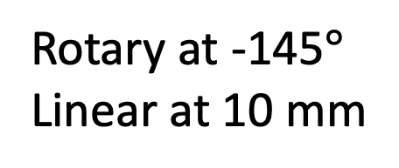
Rotary at -145$°$
Linear at 10 mm

Slide 8
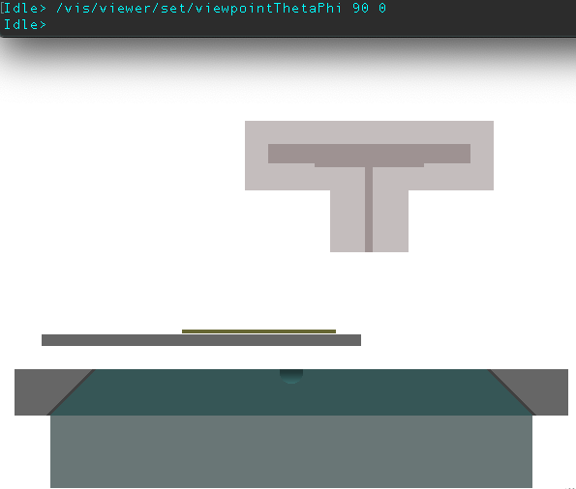
Rotary at -145$°$
Linear at 10 mm

