Slide 1
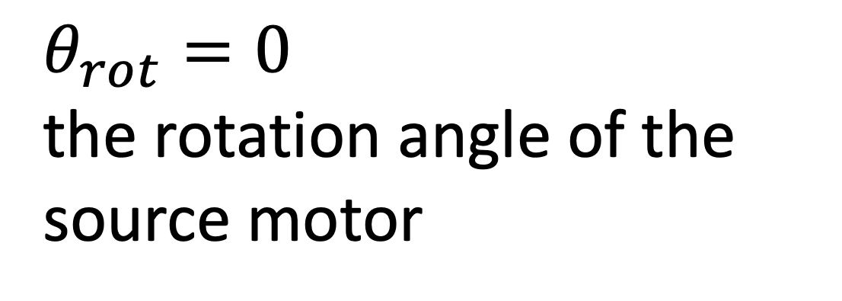
Collimator clearances and rotation: OPPI
$θ_{rot}=0$ the rotation angle of the source motor
18.87 mm
16.03 mm
1 mm
8.6 mm
7 mm
Don’t really need to worry about this point– At the lowest point, it’s still ~9 mm above the LMFE
16 mm
22 mm
6 mm to top of nylon screw
6.5 mm
Legend
Source center
Rotation axis
Important clearance dimensions
Scale: 1 mm real life = 1 cm in drawing
10 mm
scale
https://elog.legend-exp.org/UWScanner/200221_144719/IMG_8271.jpg

Slide 2
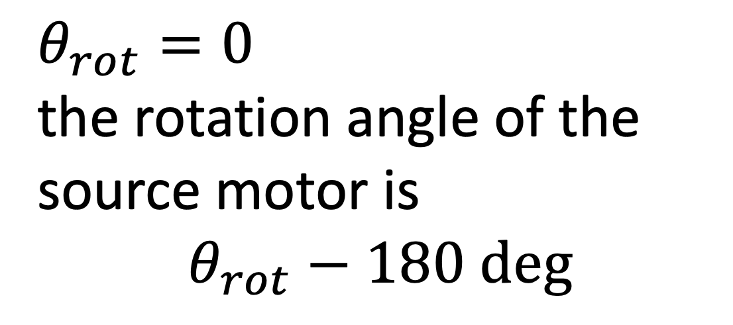
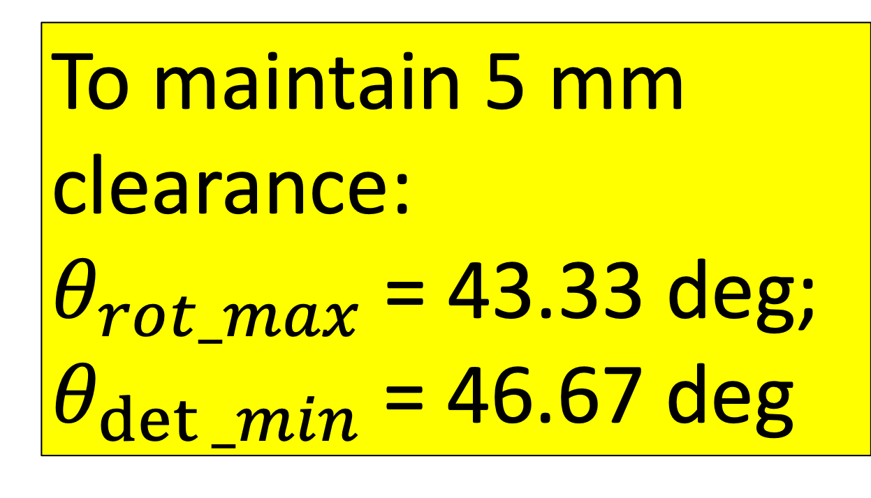
Collimator clearances and rotation: OPPI
To maintain 5 mm clearance:
$θ_{rot_max}$= 43.33 deg;
$θ_{det⁡_min}$= 46.67 deg
$θ_{rot}=0$ the rotation angle of the source motor is $$θ_{rot}−180 deg$$
18.87 mm
16.03 mm
1 mm
Calculated using maxRotation() function within ~/CAGE/sims/source_placement.py
7 mm
8.6 mm
16 mm
22 mm
5.0 mm
6 mm to top of nylon screw
6.5 mm
Legend
Source center
Rotation axis
Important clearance dimensions
Scale: 1 mm real life = 1 cm in drawing
10 mm
scale
https://elog.legend-exp.org/UWScanner/200221_144719/IMG_8271.jpg

Slide 3

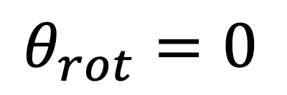
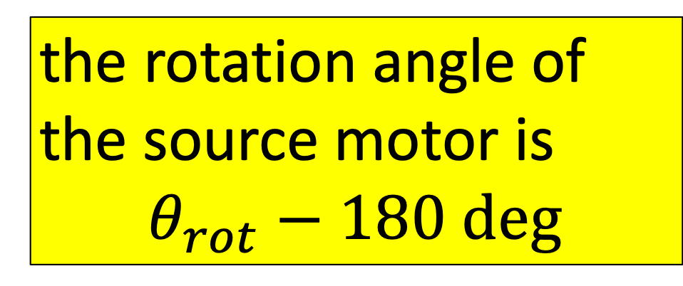
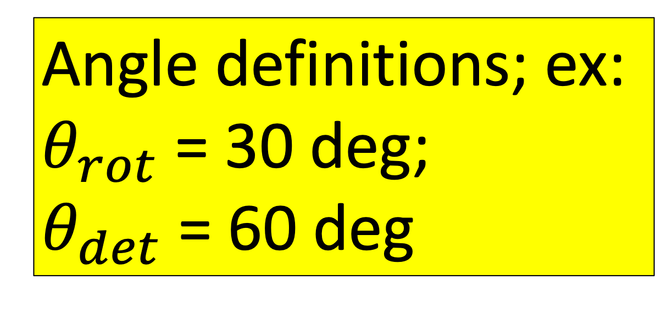

Angle definitions
Angle definitions; ex:
$θ_{rot}$= 30 deg;
$θ_{det}$= 60 deg
Source motor direction
the rotation angle of the source motor is $$θ_{rot}−180 deg$$
18.87 mm
16.03 mm
1 mm
$θ_{rot}=0$
7 mm
8.6 mm
22 mm
7.98 mm
$$θ_{rot}$$
6 mm
$$θ_{det}$$
Legend
Source center
Rotation axis
Important clearance dimensions
Scale: 1 mm real life = 1 cm in drawing
10 mm
scale
https://elog.legend-exp.org/UWScanner/200221_144719/IMG_8271.jpg

Slide 4
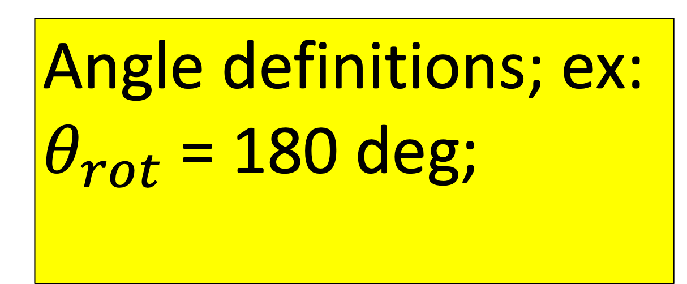
Angle definitions: Parked on limit switch
-- zero source
Angle definitions; ex:
$θ_{rot}$= 180 deg;
Source motor direction
the rotation angle of the source motor is $$θ_{rot}−180 deg$$
18.87 mm
$θ_{rot}=0$
16.03 mm
1 mm
7 mm
8.6 mm
22 mm
6 mm
6.5 mm
Linear motor travel
Legend
Source center
Rotation axis
Important clearance dimensions
Scale: 1 mm real life = 1 cm in drawing
10 mm
scale
https://elog.legend-exp.org/UWScanner/200221_144719/IMG_8271.jpg

Slide 5
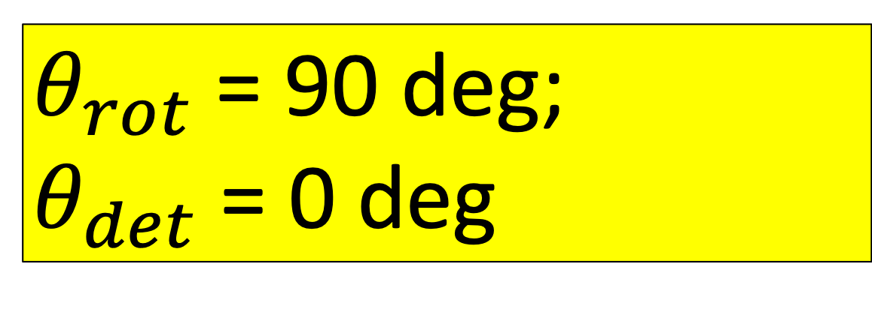
Angle definitions:
--move source -90
Source motor direction
$θ_{rot}$= 90 deg;
$θ_{det}$= 0 deg
the rotation angle of the source motor is $$θ_{rot}−180 deg$$
8.6 mm
18.87 mm
$θ_{rot}=0$
16.03 mm
1 mm
7 mm
22 mm
6.5 mm
Linear motor travel
Legend
Source center
Rotation axis
Important clearance dimensions
Scale: 1 mm real life = 1 cm in drawing
10 mm
scale
https://elog.legend-exp.org/UWScanner/200221_144719/IMG_8271.jpg

Slide 6

Angle definitions:
--move source -150
$θ_{rot}$= 30 deg; (-150 deg source motor)
$θ_{det}$= 60 deg
Source motor direction
the rotation angle of the source motor is $$θ_{rot}−180 deg$$
18.87 mm
16.03 mm
1 mm
$θ_{rot}=0$
7 mm
8.6 mm
22 mm
7.98 mm
$$θ_{rot}$$
6.5 mm
$$θ_{det}$$
Legend
Source center
Rotation axis
Important clearance dimensions
Scale: 1 mm real life = 1 cm in drawing
10 mm
scale
https://elog.legend-exp.org/UWScanner/200221_144719/IMG_8271.jpg

Slide 7
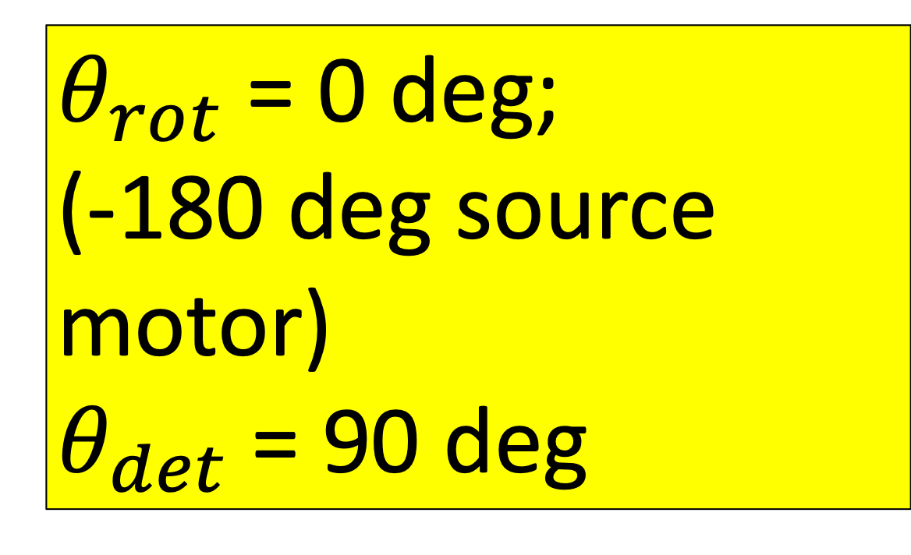
Angle definitions: -180 (centered)
--center source
$θ_{rot}$= 0 deg; (-180 deg source motor)
$θ_{det}$= 90 deg
Source motor direction
the rotation angle of the source motor is $$θ_{rot}−180 deg$$
18.87 mm
16.03 mm
1 mm
$θ_{rot}=0$
8.6 mm
7 mm
Don’t really need to worry about this point– At the lowest point, it’s still ~9 mm above the LMFE
16 mm
22 mm
6 mm to top of nylon screw
6.5 mm
Linear motor travel
Legend
Source center
Rotation axis
Important clearance dimensions
Scale: 1 mm real life = 1 cm in drawing
10 mm
scale
https://elog.legend-exp.org/UWScanner/200221_144719/IMG_8271.jpg

Slide 8

Angle definitions: -205 (max)
--move source -205
$θ_{rot}$= -25 deg; (-205 deg source motor)
$θ_{det}$= -65 deg
Source motor direction
the rotation angle of the source motor is $$θ_{rot}−180 deg$$
18.87 mm
16.03 mm
1 mm
$θ_{rot}=0$
8.6 mm
7 mm
Don’t really need to worry about this point– At the lowest point, it’s still ~9 mm above the LMFE
16 mm
22 mm
6 mm to top of nylon screw
6.5 mm
Linear motor travel
Legend
Source center
Rotation axis
Important clearance dimensions
Scale: 1 mm real life = 1 cm in drawing
10 mm
scale
https://elog.legend-exp.org/UWScanner/200221_144719/IMG_8271.jpg

