Slide 1
Block Chain Based Patient Monitoring System
Theme : Healthcare

Slide 2

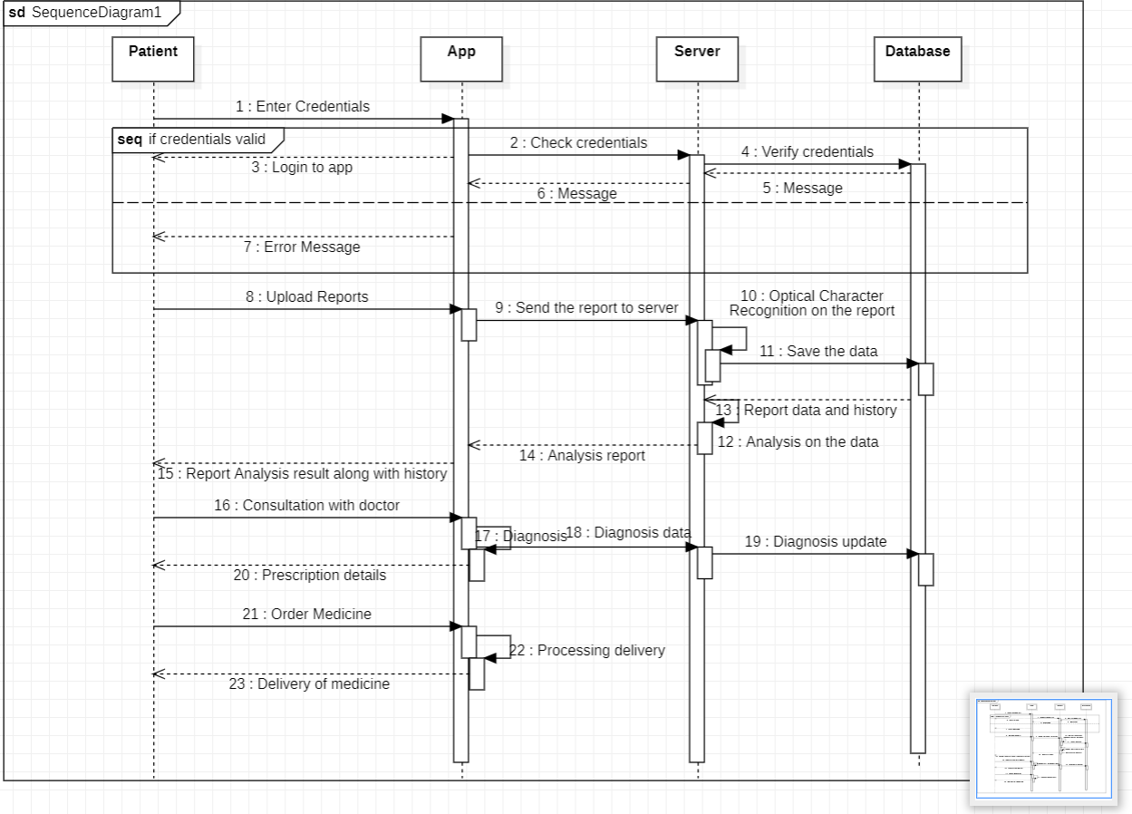
Idea/Approach Details
Description of our idea / Solution / Novelty :
Implement a patient monitoring system where medical data, including vital signs and health records, is stored on a blockchain. The decentralized nature of the blockchain ensures high-level security, making it difficult for unauthorized parties to access or tamper with sensitive health information.
Empower patients with control over their medical data.
Fraud Prevention in Clinical Trials: Blockchain's transparency can aid in preventing data manipulation or fraud in clinical trials. Researchers can track and verify the authenticity of trial data, ensuring the accuracy of research outcomes.
Streamline administrative processes like insurance claims and billing by using blockchain for accurate and auditable record-keeping. This reduces paperwork, errors, and processing time.
Add process flow chart or simulated image of prototype or any relevant image related to your idea
Technology stack / Hardware used :
The UI will be designed using Django templates and css.
There will be a Django Server for the analysis and managements of the records.
SQLITE3 database will be used to store all the records related to patients.

Slide 3
Idea/Approach Details
Description of Use Cases :
To cut the time short for common medical services such as reviewing of lab reports.
Can store all your medical records and connect them.
Discuss all the inferences from the medical report with the help of OCR(Optical Character Recognition).
Have a consultation with an expert without in-person visit.
Users can check availability of hospitals near them and choose their doctors based on their profile and interact with them through private chats.

Slide 4
Idea/Approach Details
Dependencies / Show stopper
User Experience
This entire idea is going be implemented as a web application
We will create a user friendly application with a login based on the type of user they are.
Each user will view a different part of the platform.
There will be various sections / tabs for the user to switch between all the functionalities.
The patient can also connect the medical records of the entire family to treat hereditary diseases easily.
The system should include appropriate security measures, so that only authorized people have access to the patient record.
The system involves direct contact with medical professionals so the availability of the professionals may be a dependency.
Integration of the system with already existing Health Monitoring Apps.

