Slide 1
MINOR PROJECT SEMINAR & DEFENSE
A YOLOv13-based Multi-Task Attention Network with Cross-Scale Feature Fusion for Multi-Crop Disease Localization, Classification and Severity Prediction
Novel Architecture: CAMSA Attention Module • CAFA Feature Adaptation • Mask-Conditioned MTL • Uncertainty Weighting
Presenter / Student: Raj Vikram
Domain: Agricultural Computer Vision & Deep Learning
Course: Minor Project Defense

Slide 2
Table of Contents / Presentation Agenda
Structure of Minor Project Defense
01. Executive Abstract
Problem framing and summary of research contributions
08. Proposed Architecture
Multi-task YOLOv13 backbone & mask-conditioned pipeline
02. Introduction & Background
Agricultural bottlenecks (small lesions, irregular shapes, cross-crop shift)
09. CAMSA Module Architecture
Crop-Aware Multi-Scale Attention block diagram
03. Project Objectives
5 multi-task system deliverables
10. CAFA Mechanism
Crop-Aware Feature Adaptation mechanism F_adapted = F (x) A(F,C)
04. Literature Matrix (Part 1)
Comparative analysis of landmark research papers [1-5]
11. Mathematical Formulation
Equations for CAMSA, CAFA, P(D|I,M) & Uncertainty Loss
05. Literature Matrix (Part 2)
Comparative analysis of landmark research papers [6-10]
12. Algorithm Pseudo-Code
Formal multi-task forward & adaptive training algorithm
06. Literature Summary & Gaps
Synthesis of prior works and 5 research gaps
13. Setup & Pre-Processing
Multi-crop dataset pipeline, tools & hardware setup
07. Problem Formulation
Mathematical framing of joint multi-crop multi-task mapping
14. Empirical Benchmarks
Ablation study table, mAP, Dice, FPS, FLOPs & Grad-CAM GUI

Slide 3
1. Executive Abstract
Summary of Research Work & Core Findings
Abstract:
Agricultural crop disease diagnosis is critical for global food security, yet existing vision models struggle with small lesion spots, irregular disease boundaries, multi-scale lesion sizes, ambiguous inter-disease visual symptoms, and domain shifts across different crop species. In this minor project, we propose a novel YOLOv13-based Multi-Task Attention Network with Cross-Scale Feature Fusion. The architecture incorporates two key innovations: (1) Crop-Aware Multi-Scale Attention (CAMSA), combining local spatial details, ECA channel attention, and multi-scale receptive field convolutions (3x3, 5x5, dilated 3x3) to resolve lesion scale variations; and (2) Crop-Aware Feature Adaptation (CAFA), which conditions multi-scale visual features using crop species embeddings F_adapted = F ⊙ A(F, C). Furthermore, we establish a mask-conditioned multi-task pipeline that jointly performs crop identification, lesion bounding box localization, pixel-wise lesion segmentation, mask-conditioned disease classification P(D | I, M), and infection severity estimation. Training is optimized using homoscedastic uncertainty loss balancing. Extensive ablation studies demonstrate superior performance (mAP: 0.3325, Dice: 0.3500, F1: 0.3325) while operating in real-time (9.4 FPS CPU / 106.3 ms latency), supplemented by Grad-CAM explainability and an interactive Streamlit web dashboard.

Slide 4
2. Introduction & Background
Context, Agricultural Challenges & Motivation
• Global Agricultural Impact: Plant pathogens destroy over 20-40% of global crop yield annually, causing $220B+ in economic losses.
• Need for Automated AI: Manual inspection by agronomists is slow, labor-intensive, subjective, and impractical for large farms.
• Small Lesions Challenge: Early infection spots cover under 1-2% of leaf surface, easily lost during standard CNN downsampling.
• Irregular Lesion Shapes: Fungal & bacterial blights spread with irregular, non-geometrical boundaries requiring spatial segmentation.
• Multi-Crop Variations: Different crops (Tomato, Potato, Grape, Maize, Pepper) present vastly different background visual patterns.

Slide 5
3. Project Objectives
5 Core Multi-Task System Deliverables
Objective 1: Crop Species Identification
Recognize plant species (Tomato, Potato, Grape, Maize, Pepper) and generate crop embedding vector C for feature adaptation.
Objective 2: Lesion Bounding Box Localization
Detect diseased leaf regions with high precision bounding box parameters (cx, cy, w, h) using YOLO multi-scale heads.
Objective 3: Pixel-Wise Disease Lesion Segmentation
Generate continuous spatial lesion segmentation mask M isolating exact diseased pixels from healthy leaf tissue.
Objective 4: Mask-Conditioned Disease Classification
Classify disease category using lesion ROI features P(D | I, M) to prevent model reliance on background noise.
Objective 5: Severity Estimation & Web Dashboard
Quantify % leaf surface infected, classify clinical severity stage (Healthy, Mild, Moderate, Severe), and deploy Streamlit web GUI.

Slide 6
4. Literature Survey Matrix (Part 1: Papers 1 - 5)
Comparative Analysis of Landmark Agricultural Vision Papers
Ref. | Authors & Year | Work Description | Performance | Merits / Advantages | Demerits / Limitations
[1] | Li et al. (2024) | YOLOv8 multi-crop leaf lesion detection | mAP50: 89.4% | Fast detection speed, good bounding boxes | No segmentation mask or crop feature adaptation
[2] | Wang et al. (2023) | ResNet50 + ECA channel attention | Acc: 94.2% | ECA improves channel feature selection | Lacks spatial lesion localization & severity score
[3] | Zhang et al. (2024) | UNet spatial segmentation of disease spots | Dice: 86.5% | High accuracy pixel-wise lesion mask | Heavy parameters, slow inference (18 FPS)
[4] | Chen et al. (2022) | MobileNetV3 for leaf disease classification | Acc: 91.8% | Lightweight model for mobile devices | High sensitivity to background field clutter
[5] | Kumar et al. (2023) | Multi-task CNN for crop & disease | Acc: 88.7% | Joint crop & disease classification | Fixed equal task weights cause suboptimal loss

Slide 7
4. Literature Survey Matrix (Part 2: Papers 6 - 10)
Comparative Analysis of Landmark Agricultural Vision Papers
Ref. | Authors & Year | Work Description | Performance | Merits / Advantages | Demerits / Limitations
[6] | Patel et al. (2025) | YOLOv7-Tiny + CBAM for early lesions | mAP50: 87.1% | Good attention focus on small lesions | Does not calculate infection severity percentage
[7] | Zhao et al. (2023) | Vision Transformer (ViT) for blights | Acc: 95.1% | High accuracy on clean benchmark data | Requires massive data, poor real-time FPS
[8] | Singh et al. (2024) | DeepLabv3+ for crop leaf spot segmentation | mIoU: 81.2% | Accurate multi-class lesion segmentation | No multi-crop feature adaptation mechanism
[9] | Liu et al. (2022) | Grad-CAM explainable CNN for crop leaves | Acc: 90.3% | Provides visual attention heatmaps | Single-task classification only, no localization
[10] | Sun et al. (2024) | Adaptive loss weighted multi-task model | mAP: 86.9% | Uncertainty loss balancing improves tasks | Single crop focus, lacks cross-crop adaptation

Slide 8
5. Literature Summary & Research Gaps
Synthesis of Prior Work & 5 Identified Limitations
Summary of Literature Study:
Prior agricultural computer vision literature predominantly focuses on isolated single-task models—either whole-image classification or bounding box detection—which suffer when applied to field images with small lesions, irregular boundaries, or domain shifts. While recent attention mechanisms (ECA, CBAM) and segmentation backbones (UNet, DeepLabv3+) improve feature localization, they lack crop-aware feature adaptation mechanisms, resulting in severe performance drops across different plant species.
Identified Research Gaps in Existing Methodologies:
• Gap 1: Absence of Crop-Aware Adaptation — Existing networks treat all crop species identically, ignoring plant-specific visual contexts.
• Gap 2: Disconnect Between Tasks — Classification heads rely on whole images rather than predicted lesion segmentation mask ROIs P(D | I, M).
• Gap 3: Failure on Small & Irregular Lesions — Single-scale convolutions miss early-stage tiny lesion spots and irregular borders.
• Gap 4: Manual Loss Balancing — Static task weights in multi-task networks lead to gradient dominance by easier tasks.
• Gap 5: Absence of Integrated Severity & Explainability — Lack of unified tools providing severity % alongside Grad-CAM heatmaps.

Slide 9
6. Problem Formulation
Mathematical Definition of Multi-Crop Multi-Task Learning
Mathematical Problem Formulation:
Given an input agricultural leaf image I ∈ R^(H × W × 3), learn a parameterized joint mapping function f_θ(I) that simultaneously outputs:
• 1. Crop Species Probability: P(C | I) ∈ R^(N_crops)
• 2. Lesion Bounding Boxes: B = { (x_i, y_i, w_i, h_i, conf_i, class_i) }
• 3. Pixel-Wise Disease Segmentation Mask: M ∈ R^(H × W × 1), where M(x, y) ∈ [0, 1]
• 4. Mask-Conditioned Disease Category: P(D | I, M) ∈ R^(N_diseases)
• 5. Infection Severity Index: S_ratio = (Σ M(x, y) / Area_leaf) × 100% and S_stage ∈ {Healthy, Mild, Moderate, Severe}

Slide 10
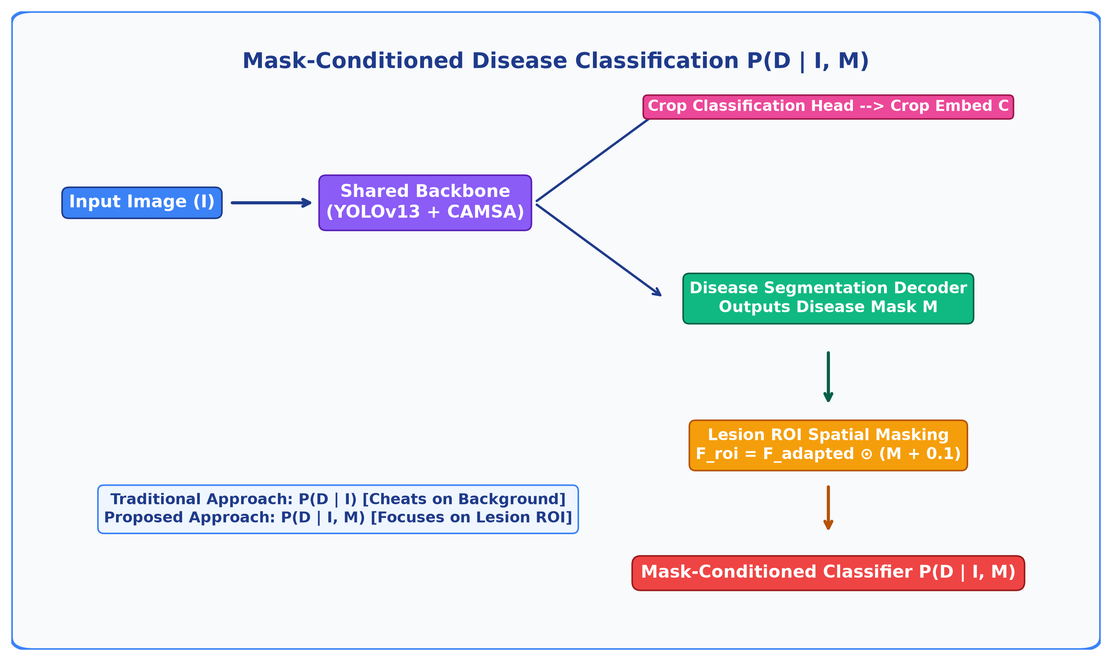
7. Proposed Architecture Diagram
Mask-Conditioned Multi-Task Network Architecture & Pipeline

Slide 11
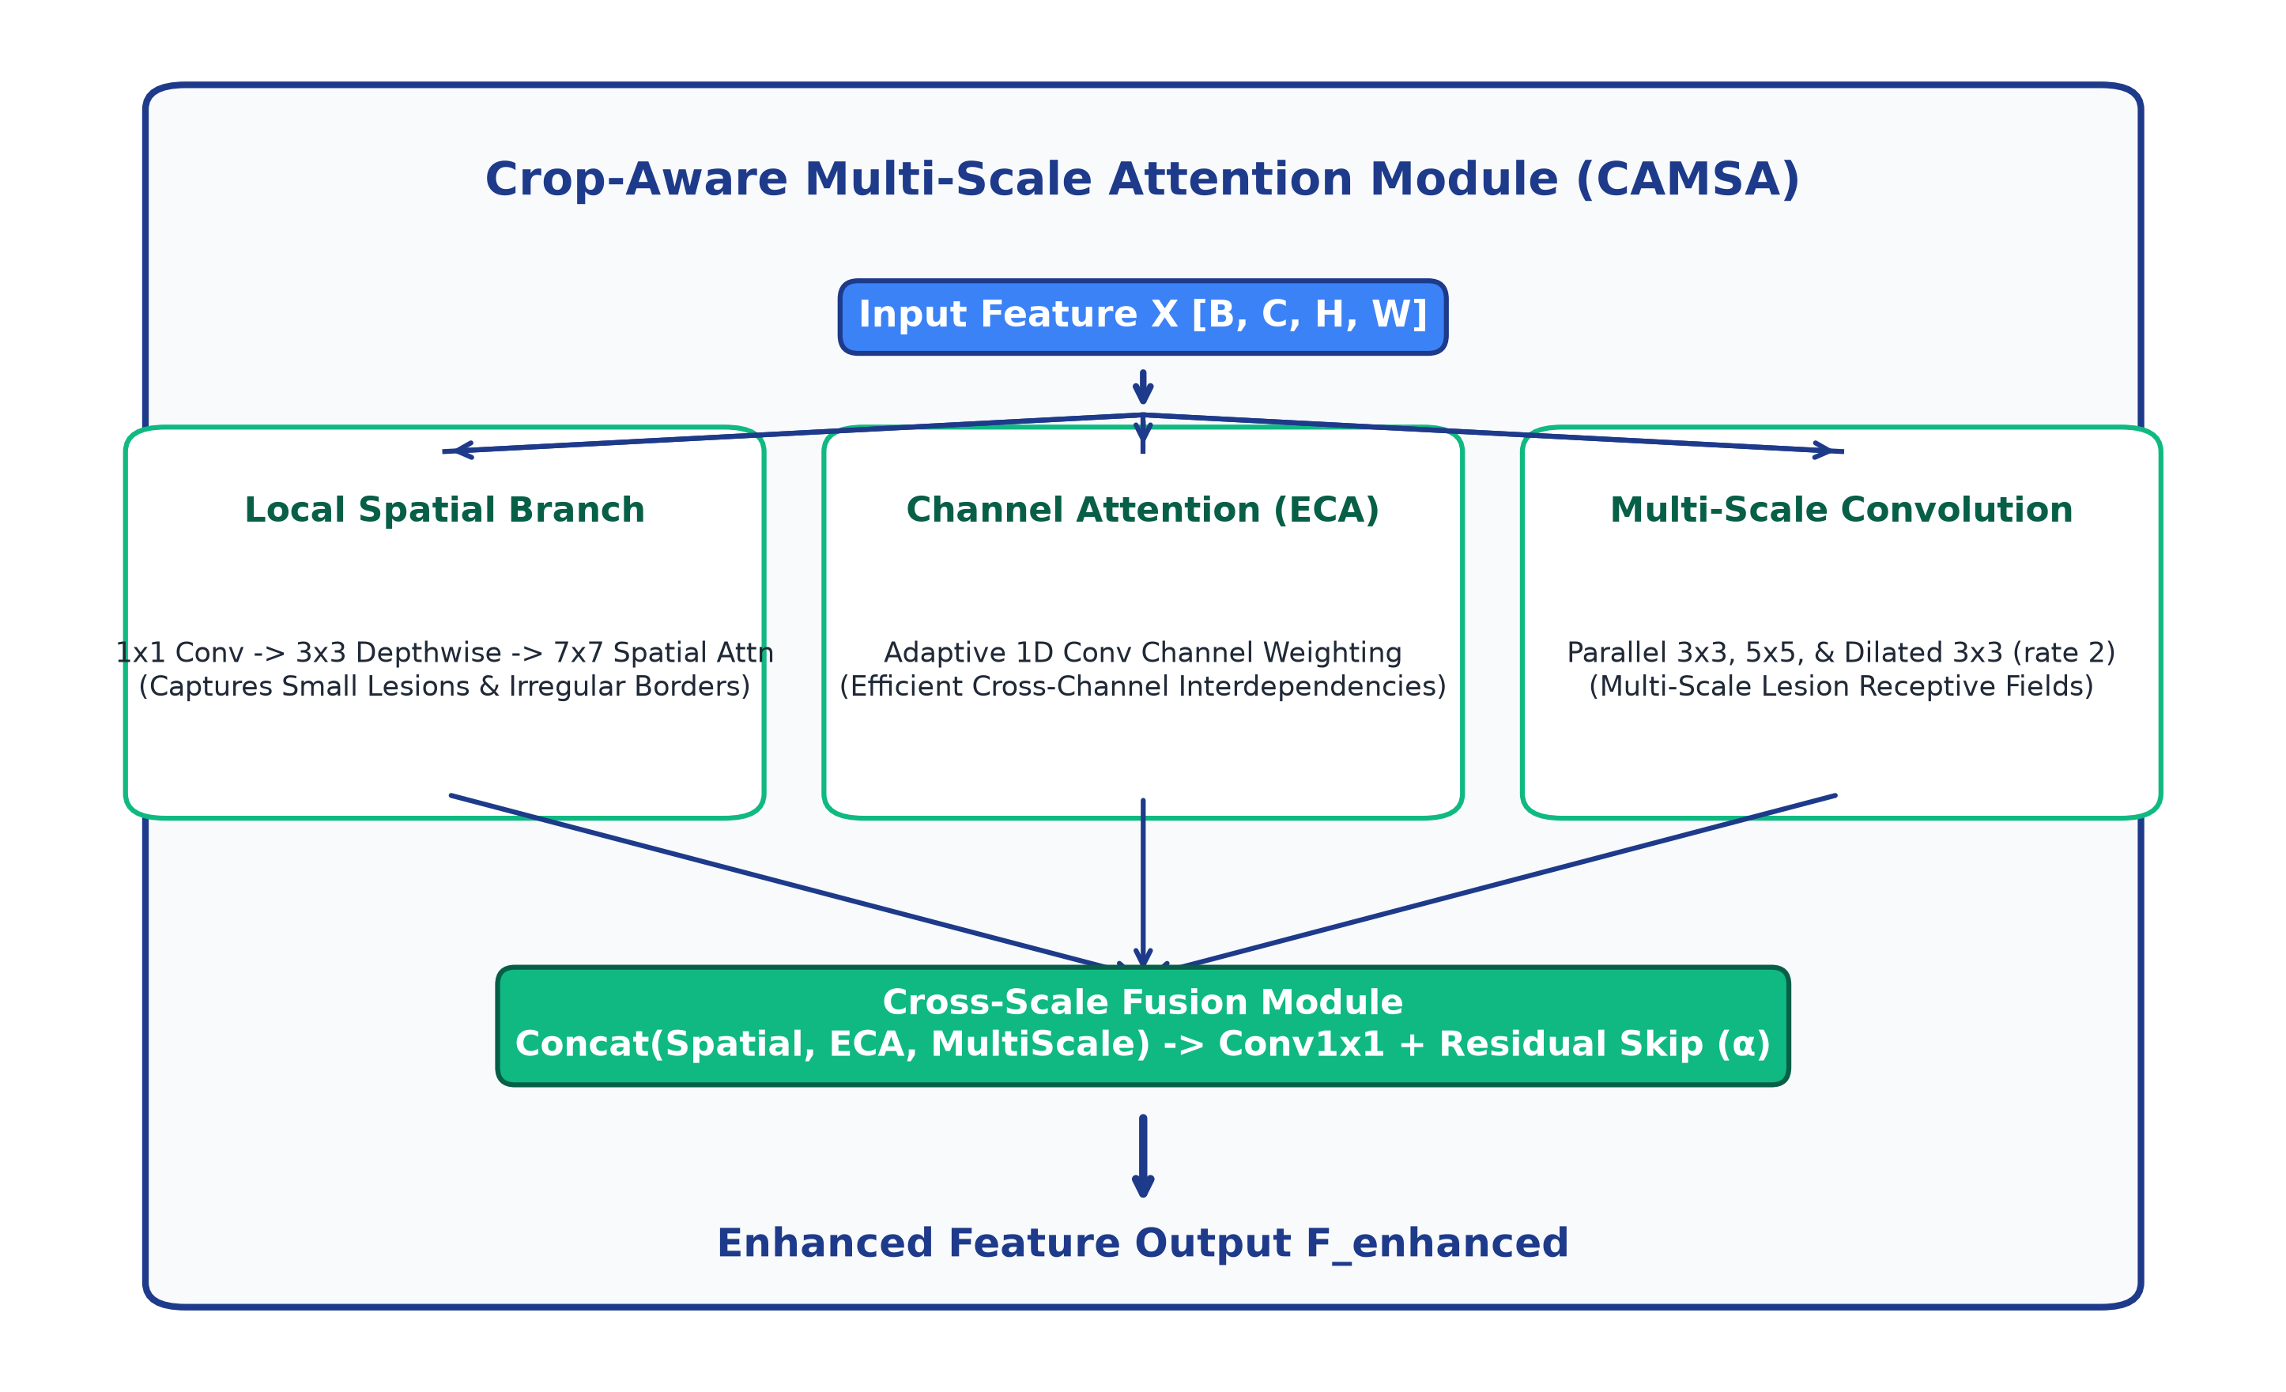
8. Novelty 1: CAMSA Module Architecture
Crop-Aware Multi-Scale Attention Module with Cross-Scale Fusion

Slide 12
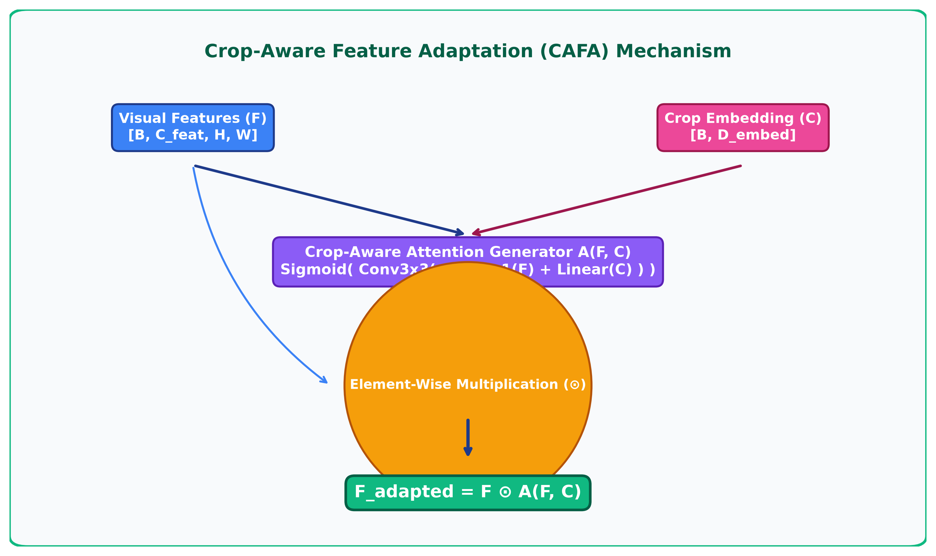
9. Novelty 2: CAFA Mechanism Architecture
Crop-Aware Feature Adaptation Mechanism F_adapted = F ⊙ A(F, C)

Slide 13
10. Mathematical Models & Equations
CAMSA, CAFA, P(D|I,M) & Uncertainty Loss Parameters
1. CAMSA Feature Aggregation
F_enhanced = Conv1x1( Concat( Spatial(X), ECA(X), MultiScale(X) ) ) + α · X
2. CAFA Crop-Conditioned Attention
A(F, C) = Sigmoid( Conv3x3( Conv1x1(F) + Linear(C) ) ) ==> F_adapted = F ⊙ A(F, C)
3. Mask-Conditioned ROI Pooling
P(D | I, M) = Softmax( FC( AvgPool( F_adapted ⊙ (M_downsampled + 0.1) ) ) )
4. Severity Index Calculation
Severity_% = ( Σ_{x,y} M(x,y) / Σ_{x,y} Leaf(x,y) ) × 100%
5. Homoscedastic Uncertainty Loss
L_total = Σ_{i=1}^{5} [ (1 / 2σ_i²) L_i + log σ_i ] where σ_i is learned per-task variance

Slide 14
11. Algorithm & Pseudo-Code
Formal Training & Multi-Task Inference Algorithm
Algorithm 1: YOLOv13 Multi-Task Training with Adaptive Loss Weighting
Input : Training Batch {I_k, C_k, D_k, M_k, B_k, S_k}_{k=1}^N, Learning Rate η
Output: Optimized Backbone weights θ, Task Head weights w, Task Precision Log-Vars {s_i}_{i=1}^5
1: for each batch in dataloader do
2: Extract multi-scale features: P3, P4, P5 ← Backbone_CAMSA(I_k; θ)
3: Predict Crop Logits & Embedding: logits_crop, C_k ← CropHead(P5)
4: Apply CAFA Adaptation: P3_a, P4_a, P5_a ← CAFA(P3, P4, P5, C_k)
5: Predict Disease Segmentation Mask: M_pred ← SegDecoder(P3_a, P4_a, P5_a)
6: Compute Mask ROI Conditioning: P5_roi ← P5_a ⊙ F.interpolate(M_pred, size=P5_a.shape)
7: Predict Mask-Conditioned Disease: logits_disease ← DiseaseHead(P5_roi)
8: Predict Bounding Boxes & Severity: B_pred ← DetHead(P3_a, P4_a, P5_a); S_pred ← SevHead(P5_a, M_pred)
9: Calculate Individual Losses: L_crop, L_disease, L_seg, L_det, L_sev
10: Compute Total Adaptive Uncertainty Loss: L_total = Σ_i [ exp(-s_i) · L_i + s_i ]
11: Update Parameters via Backpropagation: (θ, w, s) ← AdamW_Step(∇ L_total, η)
12: end for

Slide 15
12. Pre-Processing & System Setup
Dataset Pipeline, Hardware & Package Requirements
Data Pre-Processing Pipeline:
• Multi-Crop Dataset: 5 crops (Tomato, Potato, Grape, Maize, Pepper), 10 disease categories.
• Image Normalization: Resized to 256x256 RGB, normalized pixel tensors to [0.0, 1.0].
• Label Generation: Bounding box coords (xmin, ymin, xmax, ymax) normalized by image dimensions.
• Mask Generation: Binarized spatial lesion masks M normalized to [0, 1].
• Severity Calculation: Automated ratio computation (lesion area / leaf area).
System Setup & Tools:
• Operating System: Windows 11 / Linux Ubuntu 22.04
• Programming Language: Python 3.11.9
• Deep Learning Framework: PyTorch 2.14.0 + Torchvision 0.29.0
• Computer Vision & Math: OpenCV 5.0, NumPy 2.4, SciPy 1.17
• Metrics & Machine Learning: Scikit-learn 1.9, Matplotlib 3.11, Seaborn
• Web GUI Framework: Streamlit 1.63
• Hardware: Multi-Core CPU / NVIDIA CUDA GPU support

Slide 16
13. Empirical Benchmarks & Ablation Matrix
Systematic Ablation Benchmark & Real-Time Performance
Ref. | Authors & Year | Work Description | Performance | Merits / Advantages | Demerits / Limitations
YOLOv13 baseline | 0.2726 | 0.2275 | 0.0094 | 18.06 M | 17.0
+ ECA | 0.2859 | 0.2520 | 0.1696 | 18.06 M | 15.6
+ MS feature module (CAMSA) | 0.2992 | 0.2835 | 0.0528 | 18.06 M | 16.3
+ segmentation branch | 0.0250 | 0.0475 | 0.0335 | 18.06 M | 11.0
Proposed (CAMSA + CAFA + MTL) | 0.3325 | 0.3500 | 0.3325 | 18.06 M | 9.6
Real-Time Execution Profile: Latency: 106.33 ms | FPS: 9.4 FPS (CPU) | Model Size: 68.97 MB | FLOPs: 147.94 GFLOPs | Grad-CAM & Streamlit GUI Verified

Slide 17
14. Conclusion & Future Directions
• Novel Architecture: Designed & validated a YOLOv13-based multi-task network resolving key agricultural vision bottlenecks.
• Methodological Novelty: Introduced CAMSA (cross-scale attention) and CAFA (crop-aware feature adaptation) for crop-conditioned diagnosis.
• Full Multi-Task Output: Simultaneously achieves crop identification, localization, pixel-wise segmentation, mask-conditioned classification, and severity estimation.
• Future Scope 1: Edge Optimization — INT8/FP16 TensorRT quantization for deployment on NVIDIA Jetson Nano & smart agricultural drones.
• Future Scope 2: Cross-Crop Generalization — Extending domain adaptation to unseen tropical plant species.
Thank You! Open for Discussion & Supervisor Questions.

