Slide 1
Hash
Zang.wei

Slide 2
Agenda
Hash Function
Hash Conflict
Consistent Hash
SimHash
Bloom Filter

Slide 3
Hash Function
Division
H(key) = key %M
Truncation
Key: 4873152 = 812 [select digits from specific column]
Folding
Key: 4873152 = 48+731+52=831
Hash Strings
Sting ‘hashing’ = 104+97+115+104+105+110+103 = 738

Slide 4
Hash Conflict
Linear probe
Slot = (home+i)%M (i=1,2,…,k, k<=M-1)
Home is index to which the key originally mapped by the hash function
Slot = (home+i*c)%M
Quadratic probe
Slot = (home + i^2)%M
Double hashing
Slot = (home + i*Hp(key))%M
Hp(key) = 1 + key %P
Separate chaining
Linked list is used to store the individual keys that map to the same entry

Slide 5
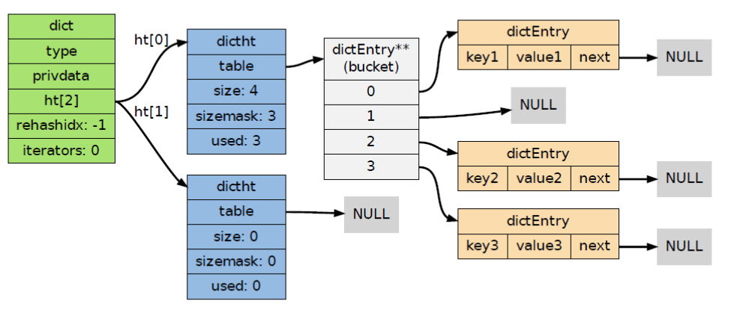
Hash Conflict
Rehashing
Enlarge the hash table size and then rebuild the whole hash table.
Example, dictionary hash table in Redis

Slide 6
Consistent Hashing
Scenario
For load balance, the machine number chosen to cache object o will be:
hash(o) mod n
When we add or remove machine from machine group. The new location will be calculated again.
Hash(o) mod (n+1) → add a machine
Hash(o) mod (n-1) → remove a machine.
Consistent hashing
It can guarantee that when a cache machine is removed, only the objects cached in it will be rehashed; when a new cache machine is added, only a fairly few objects will be rehashed

Slide 7
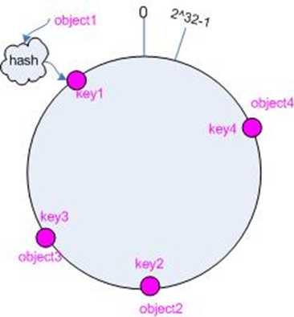
Consistent Hashing
Map object into hash space

Slide 8
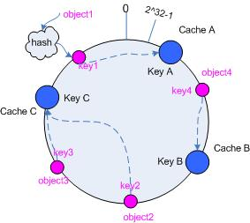
Consistent Hashing
Map cache into hash space

Slide 9
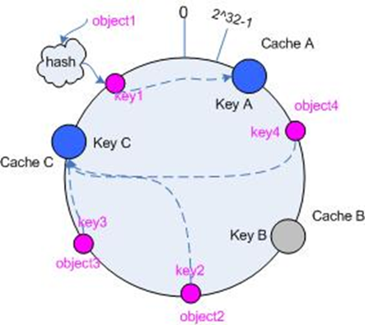
Consistent Hashing
Remove cache

Slide 10
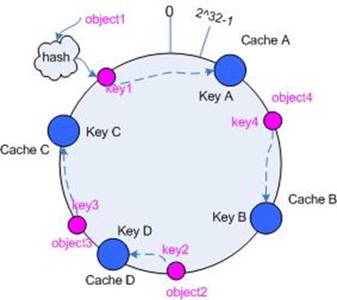
Consistent Hashing
Add cache

Slide 11
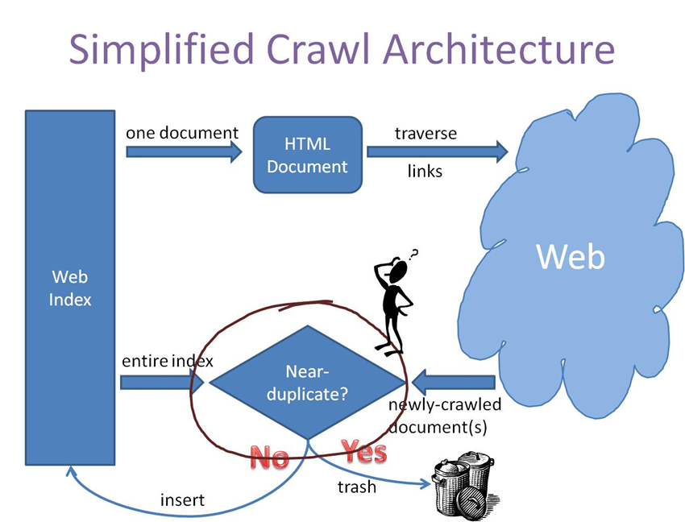
SimHash
How to detect near-duplicate for web pages?

Slide 12
SimHash
Solutions:
1. Just compare two texts through word by word.
2. Split words, extract character vector, then compare.
3. Hash, generate fingerprint. (Md5)
Md5 is not good, why?
Similar pages generate different hash codes

Slide 13
SimHash
Similar pages -> similar hash codes
P1: the cat sat on the mat
P2: the cat sat on a mat
P3: we all scream for ice cream
> p1.simhash => 851459198 00110010110000000011110001111110 > p2.simhash => 847263864 00110010100000000011100001111000 > p3.simhash => 984968088 00111010101101010110101110011000
Hamming Distance(p1,p2)=4，(p1,p3)=16, (p2,p3)=12.

Slide 14
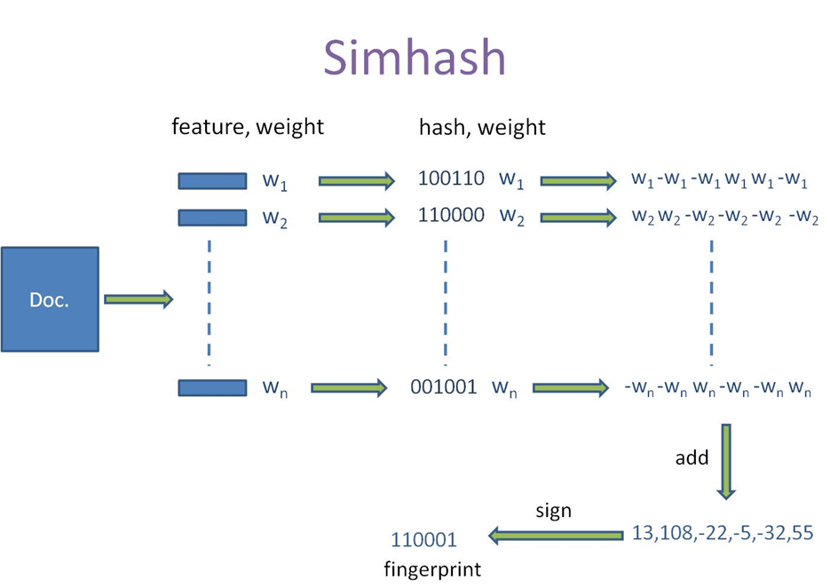
SimHash

Slide 15
SimHash
Split strings into words
the cat sat on the mat → {"th", "he", "e ", " c", "ca", "at", "t ", " s", "sa", " o", "on", "n ", " t", " m", "ma"}
”th”.weight = 5, “he”.weight = 3
Hash word
"th".hash = 100110 , "he".hash = 110000
Add weight
”th” = 5 -5 -5 5 5 -5, “he” = 3 3 -3 -3 -3 -3
Combine
”th”+”he” = 8 -2 -8 2 2 -8
Dimensionality reduction
8 -2 -8 2 2 -8 = 1 0 0 1 1 0

Slide 16
Bloom Filter
How to test whether an element is a member of a set?
List
Tree
Hash
Bitmap
Bloom filter
a space-efficient probabilistic data structure that is used to test whether an element is a member of a set.

Slide 17
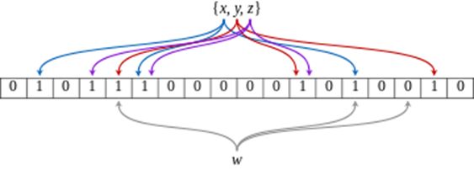
Bloom Filter
Bitmap + hash functions

Slide 18


Bloom Filter
How to use it?
Given n is the number of inserted elements, p is the probability of false positive
Then m can be calculated, which is the number of bits in the array
Then k is the number of hash function can also be got.
Hash function
In depended hash function
Different parameters hash function

Slide 19
Bloom Filter
Good Feature
False positive matches are possible
but false negatives are not
Easy to insert and test
Bad Feature
Delete no…
How to solve it?

Slide 20
Thanks

