Slide 1
Mantrap: =air lock, physical security measure, 确保一个人一个人过
SSL(Secure Sockets Layer、別名：TLS) vs SSH(Secure Shell)
SSL involves 電子証明書, SSH 只是确保通信被加密
L2TP: Layer 2 Tunneling Protocol is a tunneling protocol used to support virtual private networks (VPNs) or as part of the delivery of services by ISPs. It does NOT provide any encryption or confidentiality by itself.
经常与IPSec（Internet Protocol Security）连用，IPSec负责通信加密
Escrow key 托管key,这个不知道是什么东西 (在key recovery process中，previous key必须可以被找回)
OCSP（Online Certificate Status Protocol）：for obtaining the revocation status of an X.509 digital certificate
CRL(certificate revocation list)

Slide 2
Steganography：隐写术
Biometrics：一种authentication技术，比如扫描视网膜（retina）
Logical Address = IP Address
IPv4 = 32-bit， IPv6 = 128-bit
WPA（Wi-Fi Protected Access）
Hardening （a.k.a a process of making an operating system secure from attack） = remove nonessential services 或者 remove unneeded protocols
OSO = open systems connection model

Slide 3
SMTP = simple mail transfer protocol, port 25
NAT = network address translation, 与子网掩码并用，看下图
ISP = internet service provider
NIC = network interface card 网卡
ARP = address resolution protocol, to get MAC address
NAT = Network Address Translation

Slide 4
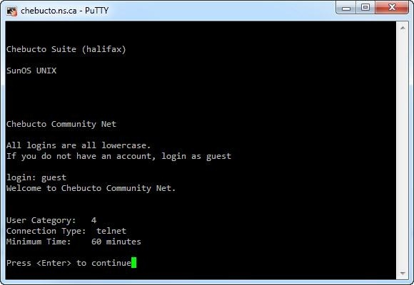
To sum it up in simple terms,
Telnet is used to communicate with other computers and machines in a text-based manner.
A telnet session looks something like this:

Slide 5
IPSec: Internet Protocol Security, is a network protocol suite that authenticates and encrypts the packets of data sent over a network. Works in Level3 - Network layer
Authentication Header (AH)
Encapsulating Security Payload (ESP)
PII: personally identifiable information
some tips for using google:
site:www.panasonic.com ais
搜索制定www上的keyword
link:www.panasonic.com
搜索含有指向制定www的webpage
一些常用调查网络的命令
ping xxx
nslookup xxx
traceroute www.panasonic.co.jp
Simple Network Management Protocol (SNMP)

Slide 6
ICMP=Internet control message protocol
LDAP = lightweight directory access protocol
ports:
SMTP = 25
DNS zone transfer = 53 TCP
HTTP = 80
HTTPS = 443
NetBIOS = 139
SNMP = UDP161,162
找network gateway
netstat -nr
network statistics, 蛮有用的命令，可用来找routingTable

Slide 7
Footprinting
用Google以及JobBoard等，获得公司信息
Scanning
ping，traceroute等，获取IP等网络信息
Enumeration
获取网络内信息，包括Username，pwd，device信息等
System Hacking
Password Cracking

Slide 8
Windows特有的SAM, NTLM, LM, Kerberos
NTLM (NT LAN manager) authentication，一种登陆认证机制，hash用户密码
SAM=security accounts manager
Kerberos 一种远程登录认证机制，用issureTicket的方法
NTLM比较老，已经没有支持
LM是一种Hash算法，比较老
Trinity Rescue Kit （TRK）是一种系统修复工具，可用来用Privilege Escalation
Syskey is a utility that encrypts the hashed password information in a SAM database in a Windows system using a 128-bit RC4 encryption key that, by default, is stored in the Windows registry.
Covert Channel: a backdoor

Slide 9
ターゲットの特定のためのCmd：
ping
traceroute
nslookup
whois
host
スキャンCmd：
namp
盗聴のため：
wireshark
直接攻撃：
Cain&Abel
Fiddler
ssh
crunch
THC-Hydra
metasploit
痕跡消す：
ログ消す
timestamp改竄
backdoor
nectar
cryptcat

Slide 10
Hub: 用Broadcast方式传信息（因为是无线，所以广播信息，正确的接受方only反信）
Switch:比Hub智能，能够记录每个port有谁，不用Broadcast，
可以正确将信息送到正确的port
Router:最智能，最少能够完成两个功能 DHCP和NAT
NAT – Network Address Translation – is the way that the router translates the IP addresses of packets that cross the internet/local network boundary. When computer “A” sends a packet out, the IP address that it’s “from” is that of computer “A” – 192.168.1.2 in the example above. When the router passes that on to the internet, it replaces the local IP address with the internet IP address assigned by the ISP. It also keeps track, so that if a response comes back from somewhere on the internet, the router knows to do the translation in reverse – replace the internet IP address with the local IP address for machine “A” and then send that response packet on to machine “A”.
A side effect of NAT is that machines on the internet cannot initiate communications to local machines – they can only respond to communications initiated by those local machines.

Slide 11
all kinds of DoS attacks:
smurf
将source地址spoof成targetMachine的IP，并送ICMP echo request
ICMP flood
hping3 -l -flood -a IPAddress
ping flood
teardrop
attacker send custom-crafted fragmented packets
fraggle
类似smurf，不同点是送UDP echo request
land
送request，将source地址 spoof成target machine的地址

Slide 12
egress filtering: 过滤从外部来的packet
ingress filtering：过滤从内部向外的packet
proxy：收集UserRequest在forward给外部各个Server，这样可确保外部无法直接访问内部，保护User
Reverse Proxy：设置在某个Server之前，收集所有访问Request再forward给这个Server，目的是保护这个Server

Slide 13
ToDo: aircrack-ng用法

