Slide 1
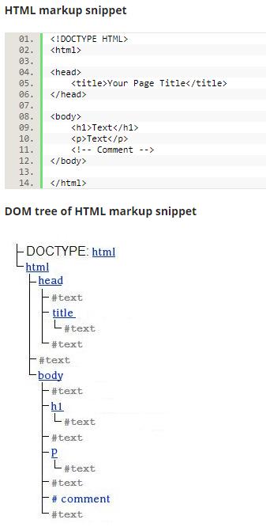
HTML5 Interview Questions:
HTML5 can be divided into 2 parts: Designing/Graphis (CSS, image files) and User Interaction (JavaScript, AJAX, JQuery)
HTML DOM (Document Object Model): When a web page is loaded, the browser creates a Document Object Model of the page. Javascript can dynamically access/update a webpage content by using DOM. See reference on right.
Server-Sent Events (SSE): a server-to-client streaming of event data mechanism, e.g., real-time notifications or updates, like Facebook, Twitter.
WebSocket API: a bi-directional communication channel; efficient, uses less CPU power

