Slide 1
Reason why WEP (wired equivalent privacy, use 64bit or 128bit key) is not secure: the first bytes of the output keystream are “strongly non-random”, if you gather enough packets and you can easily discover the entire WEP key.
WPA (WiFi protected access): RC4 with TKIP (temporal key integrity protocol)
Initialization vector (IV) is larger and an encrypted hash
Every packet gets a unique encryption key
WPA2
AES replace RC4
CCMP (counter mode with cipher block chaining message authentication code protocol) replace TKIP

Slide 2
Wi-Fi Protected Access (WPA) and Wi-Fi Protected Access II(WPA2) are two security protocols and security certification programs developed by the Wi-Fi Alliance to secure wireless computer networks.
IEEE 802.11 a/b/g/n -> HIPERLAN/1, HIPERLAN/2, Bluetooth, (don’t what n is …)
To enhance WiFi security, IEEE802.11i/D3.0(WPA) and D9.0(WPA2) -> layer2 based security method
TRIP – Temporal key integrity protocol
Keys are rotated frequently
Packet counter prevents packet replay
MIC – Message integrity code
Encryption method: Counter-mode with CBC-MAC protocol (CCMP)
256-bit Pre-shared key (PSK) from WiFi password + Service Set Identifier + SSID Length -> PMK – Pairwise master key
PC
WiFi
www
Mobiles
Threat model,
The man in the middle
Hacker

Slide 3
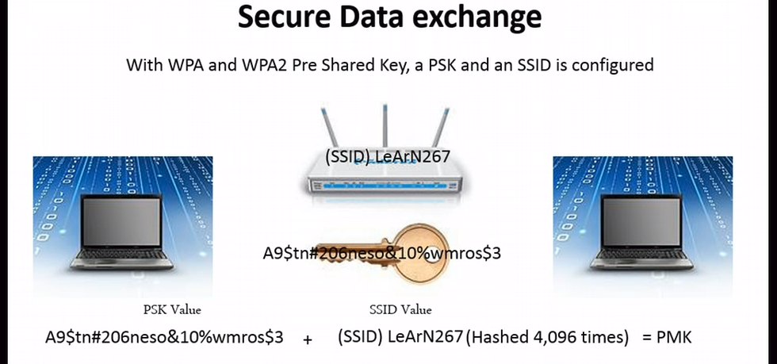
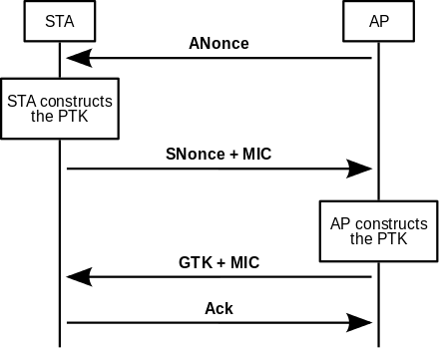
也就是WiFi密码
这种情况下每个人的PMK都是一样的
The PMK is designed to last the entire session and should be exposed as little as possible; therefore, keys to encrypt the traffic need to be derived. A four-way handshake is used to establish another key called the Pairwise Transient Key (PTK). The PTK is generated by concatenating the following attributes: PMK, AP nonce (ANonce), STA nonce (SNonce), AP MAC address, and STA MAC address. The product is then put through a pseudo-random function.
The actual messages exchanged during the handshake are depicted in the figure and explained below (all messages are sent as EAPOL-Key frames):
The AP sends a nonce-value to the STA (ANonce). The client now has all the attributes to construct the PTK.
The STA sends its own nonce-value (SNonce) to the AP together with a Message Integrity Code (MIC), including authentication, which is really a Message Authentication and Integrity Code (MAIC).
The AP constructs and sends the GTK and a sequence number together with another MIC. This sequence number will be used in the next multicast or broadcast frame, so that the receiving STA can perform basic replay detection.
The STA sends a confirmation to the AP.

