Slide 1

Solana Blockchain Outline Figure for Product Manager (Draft)
by 256hax

Slide 2
Yield Farming

Slide 3












Yield Farming Customer Journey Outline
RAY, Governance Token
Domestic
Exchange
DeFi
Exchange
Liquidity
Earn
Specials
Trading
(Orderbooks)
Liquidity
Pools
Staking
Send ETH
Mint
Special NFTs
Overseas
Exchange
AcceleRaytor
Earn Tokens
+
Swap
(AMM)
Farms
IDO
DropZone
Send SOL
Earn
Governance Token
Lottery
Wallet
Exchange
SOL to RAY Token
Add Liquidity
(Get LP Token)
Earn Tokens
Get Specials

Slide 4
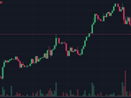


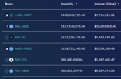
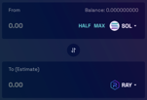
Listing Token on Market - Outline Figure (Draft)
Web3 Team
Orderbooks
Web3 Team
Market
Application
(Dexlab)
Serum Market
Trading
(Dexlab?)
Submit?
Submit?
List?
Trade
Token
User
Create
Token
AMM (Raydium)
Product
Manager
Pools
Swap
Add to Pool?
List?
Exchange
User
Reference: Create and List a Solana Token in a UI with Zero Development in 5 Minutes

Slide 5
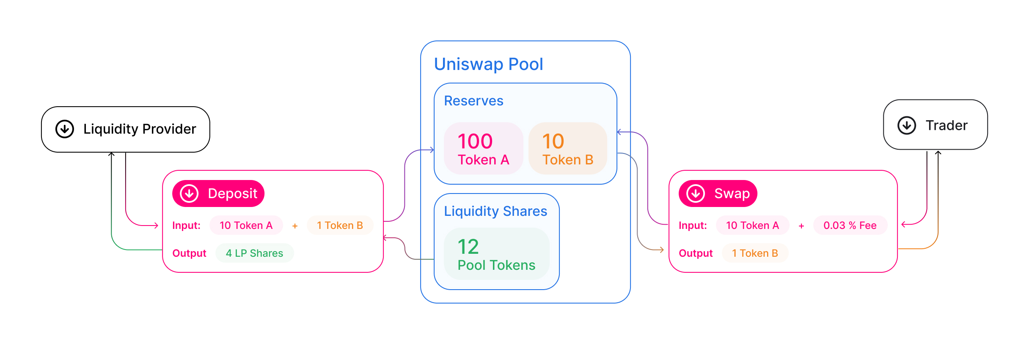
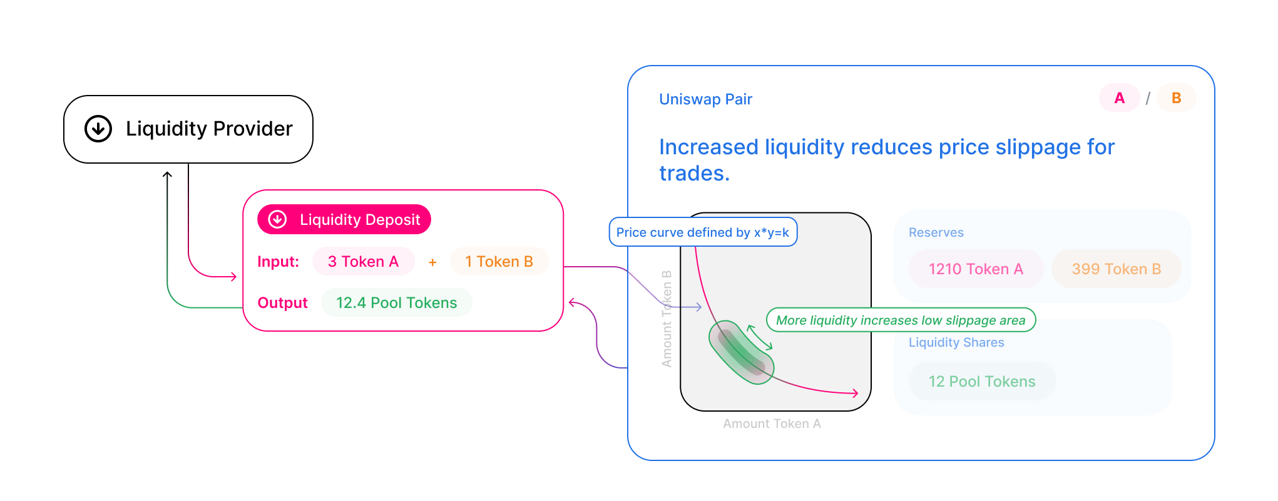
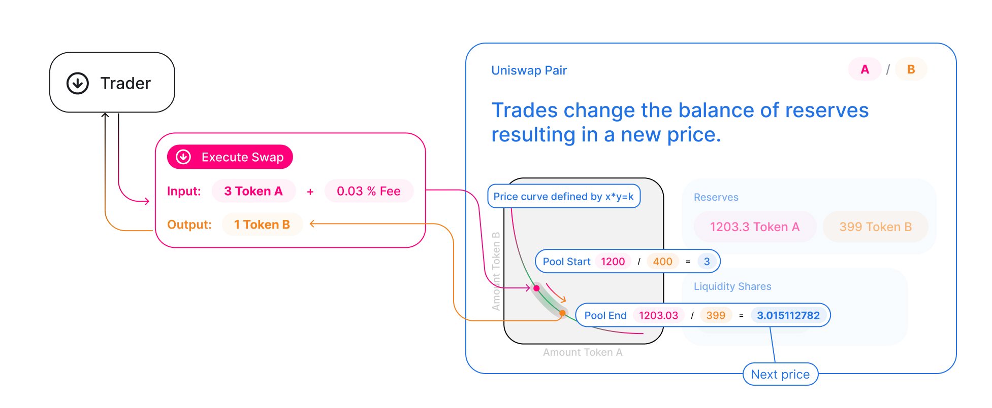
Quote: How Uniswap V2 works
Source: https://docs.uniswap.org/protocol/V2/concepts/protocol-overview/how-uniswap-works
"Anyone can become a liquidity provider (LP) for a pool by depositing an equivalent value of each underlying token in return for pool tokens. These tokens track pro-rata LP shares of the total reserves, and can be redeemed for the underlying assets at any time."
"Pairs act as automated market makers, standing ready to accept one token for the other as long as the “constant product” formula is preserved. This formula, most simply expressed as x * y = k, states that trades must not change the product (k) of a pair’s reserve balances (x and y). Because k remains unchanged from the reference frame of a trade, it is often referred to as the invariant. This formula has the desirable property that larger trades (relative to reserves) execute at exponentially worse rates than smaller ones.
In practice, Uniswap applies a 0.30% fee to trades, which is added to reserves. As a result, each trade actually increases k. This functions as a payout to LPs, which is realized when they burn their pool tokens to withdraw their portion of total reserves. In the future, this fee may be reduced to 0.25%, with the remaining 0.05% withheld as a protocol-wide charge."
"Because the relative price of the two pair assets can only be changed through trading, divergences between the Uniswap price and external prices create arbitrage opportunities. This mechanism ensures that Uniswap prices always trend toward the market-clearing price."

Slide 6

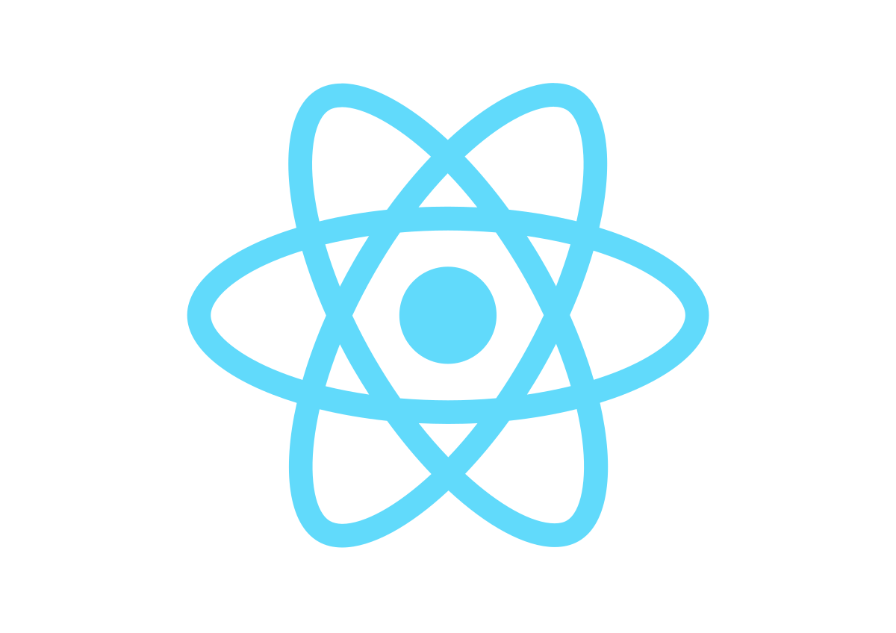



Production System Architecture (Draft)
UI/UX Improvement
ex) The Graph
Web Analytics
ex) Google Analytics
Read
Security Check
ex) Certik
Read
Read
Write
Mint
Wallet
ex) Phantom
Send/Recieve
Frontend
ex) JS (Solana/Anchor Web3), React, Vue
Solana Cluster
(Blockchain)
ex) Solana Mainnet Beta
User
Read
Read/Write
Market / Report
ex) Serum DEX, CoinMarketCap, DefiLlama
Backend
ex) Ruby on Rails, PHP, Python
Write
IPFS Storage
ex) NFT.Storage, Pinata Cloud
Deploy Solana Programs
Deploy Files
Develop
ex) Solana CLI, Rust, Anchor
Wallet
ex) Solana CLI
System
Device
Developer
Action

Slide 7
Accounts

Slide 8
Accounts – Execution Programs/Transactions Process (Draft)
Assign
STEP 1, 2 (Deploy, Re-Deploy Program)
Deploy Program
Execute Program
System Program Account
Overview: God of User's Account
Address: 1111...1111
Executable: Yes
User Account (Developer)
Overview: Developer via Mac
Address: HXtB...setg
Assigned Program: System Program
Executable: No
Program Account
Overview: Execute Program
Address: 5BzF...Y2dC
Executable: Yes
Executable Data: : HMto...KKxp
Upgradeable: Yes
Upgrade Authority: HXtB...setg
Program Executable Data Account
Overview: Program Data
Address: HMto...KKxp
Data (Bytes): 357501
Upgradeable: Yes
Upgrade Authority: HXtB...setg
User Account (Consumer)
Overview: Consumer via Phantom
Address: 2SN6...HRwn
Assigned Program: System Program
Executable: No
Program Sub Account?
Overview: Data Management
Address: Hd7E...tXFg
Allocated Data Size: 16 byte(S)
Assigned Program Id: 5BzF...Y2dC
Executable: No
Assign
Transactions
Management Data?
STEP 3, 4 (Create Account, then Add/Update Data)
Step with Signature(Devnet) | 1. First Deploy Program: 2EJNKDAdHi8foaLirDrEjKrubBkMs27gQHYHCaFzehsVrUqqwELUXnbZa4fc2WJpPVdZqazvYVAkqs6Fhfd9cxUv 2. Re-Deploy(upgrade program): 2MzxcwxR8z7AVbobkpdfnefpmNPBTXnheK7RQmvuTy5xCBq9pZutygnyuoSZqj4u7Fg7hX2bP4H8gHX3rfE18CQH 3. Create Instruction Data(16bytes) Account with adding data(1234): 3ZK8pACVU5eKh5MegD7HXBLQQqQBk3NVTnFL7myNjVjWzb99WDP19ejz7cfXMcJdGieCLakqZ5Coe28cpMcNeQQV 4. Update data(4321): 2rAdweWojqqnnEGrrHGfHgaGFRSThS6cp2hJ6ZJvBwZacy4Z8R6cgn3iKQAnDK1rZdnarKETAL65MfsFGQ6V3LgH
Example Programs | https://github.com/256hax/solana-anchor-react-minimal-example/tree/main/2.crud
Public Key (Address) | User Account (via Mac): % solana address -k ~/.config/solana/id.json Program Account: % solana address -k target/deploy/<Program Name>-keypair.json

Slide 9
Accounts – Sending Token Process (Draft)
User Account (Developer)
Overview: Developer via Mac
Address: HXtB...setg
Account
Token
Relation
STEP 1 (Create Token)
Token
Address: 6cWx...pteX
Supply: 100.000000000
Mint Authority: HXtB...setg
Owner: TokenkegQ...Q5DA
User Token Account (Developer)
Address: FHx9...1Cm7
Mint: 6cWx...pteX
Owner: HXtB...setg
STEP 2 (Create Token Account)
STEP 3 (Mint 100 Tokens)
User Account (Consumer)
Overview: Consumer via Phantom
Address: 2SN6...HRwn
Token Program Account
Overview: Management Token? Escrow?
Address: TokenkegQ...Q5DA
Assigned Program: BPF Loader 2
User Account (Consumer)
Overview: Consumer via Phantom
Address: GV2U...VkcJ
User Token Account (Consumer)
Address: 772U...8ZkK
Mint: 6cWx...pteX
Owner: 2SN6...HRwn
Send?
1 Token
Recieve?
1 Token
User Token Account (Consumer)
Address: 9Ej4...xVoK
Mint: 6cWx...pteX
Owner: 2SN6...HRwn
STEP 4 (Send Token)
Step with Signature(Devnet) | 1. Create Token: 2c67zVpfkUdJP2ZziC1nBmGsEPC3NoK6fisxDJKpZCuZERajyycchWunkSspjvdcxMnMSzxjvfoo7dKkNeDKbs6p 2. Create Token Account and Association): 28pZaLUia6BDcPARLcyDsVZhc3ADVsS9kxNeMxmKwEij1UhraYc4xV6cF85m4sJye1KofW9BjynVXGj83SF4uvQA 3. Mint 100 Tokens: 5U8bH6paBugh96HjTy1haUbCZijpVUK4MoPXqdCVZGNjP2kz5WQk3aGr4By5VPEtSfagpVZ91rTeWpj4tsNQRBs2 (Send 10 Tokens from Developer to Consumer: omit) 4. Send 1 Token from Consumer to Consumer: 3RQ52gXVRkphwJFJehcLawDyi2isZ4A6JkKonW8QnA9N28pUkAqZ8Yevi8R656drk8JzAXvWCDToiBQxMrkCsVif

Slide 10
IDO Pool

Slide 11
User Account (Developer)
User Token Account (Developer)
USDC IDO Pool
User Token Account (Developer)
USDC
User Token Account (Consumer)
USDC
User Account (Consumer)
WIP
User Token Account (Developer)
Watermelon
User Token Account (Developer)
Watermelon IDO Pool
User Token Account (Consumer)
Watermelon

