Slide 1
KARMA
CMV1A
Jet Frieling
Sebastiano Mirabella
Marcel Stoepker
Pim van Zomeren
Razvan Preda

Slide 2
INDEX
Problem definition
Concept
Culture
Mechanics
Iteration process
Prototype process
Conclusion
Questions

Slide 3
PROBLEM DEFINITION
Understanding cultural differences
Empathizing with different cultures
Decision making – right or wrong?
Learning about specifics for each culture
Breaking Stereotypes
Defining target audience

Slide 4
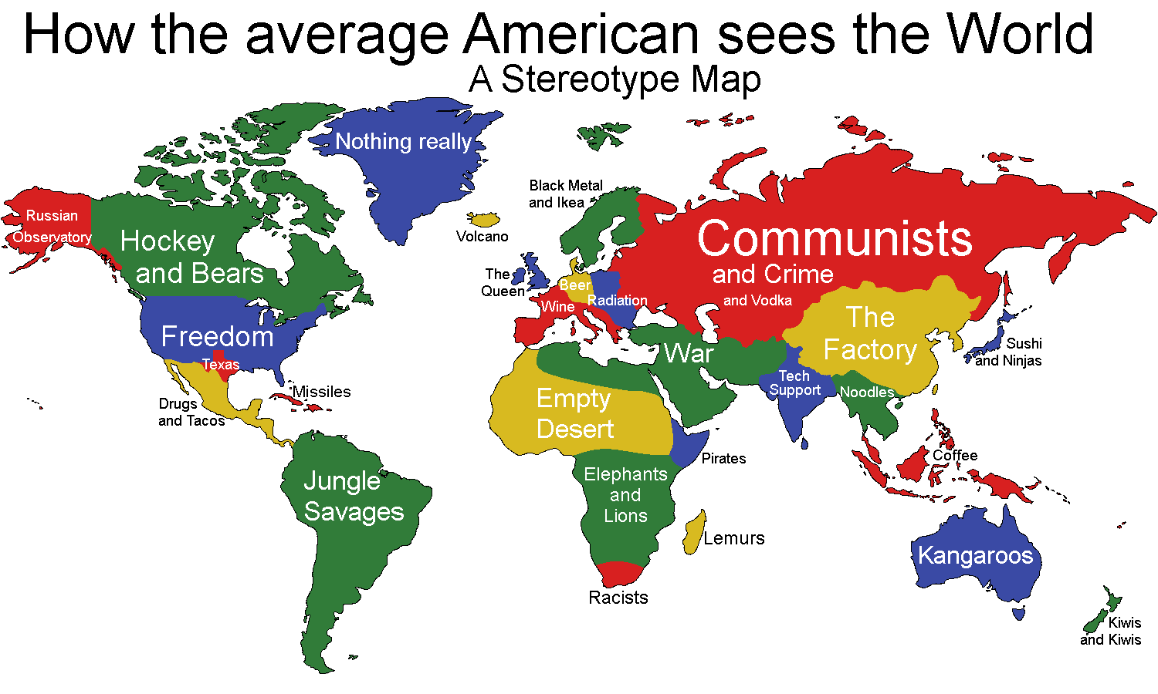

Slide 5
CONCEPT
Open world system
Constantly expanding environment
Main objective: survive for 1 day
Help people from other cultures
Decision based outcomes
Start as a faceless character with no recollection of memory

Slide 6
CULTURE
Concept of power distance
Individualism vs. Collectivism
Respecting personal space
Femininity vs. Masculinity
Norms and values

Slide 7
MECHANICS
Leveling system
Tips & info at the start of each level
Level completion reward
Character details
NPC interaction
Quests
Achievements

Slide 8
ITERATION PROCESS
Main idea: a faceless character in an open world
Both genders
Which cultures we use
Implementing levelling , tips and tricks
Different cities

Slide 9



INSPIRATION

Slide 10
PROTOTYPE PROCCESS
Paper prototype
One city
Pawns as characters
Dialogue cards

Slide 11
CONCLUSION
Main purpose – cultural awareness
Focused on the freedom of choice
Rewarding
Engage players to think

Slide 12
QUESTIONS
?
?
?
?
?
?
?
?
?

