Slide 1
Jodel Alert
Software Engineering – Design
2DV603

Slide 2
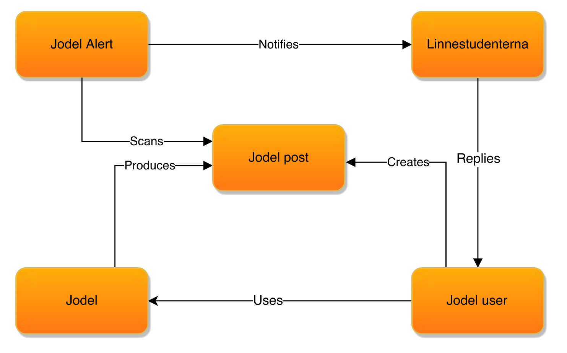
Participating Objects

