Slide 1
Jodel Alert
Software Engineering – Design
2DV603

Slide 2
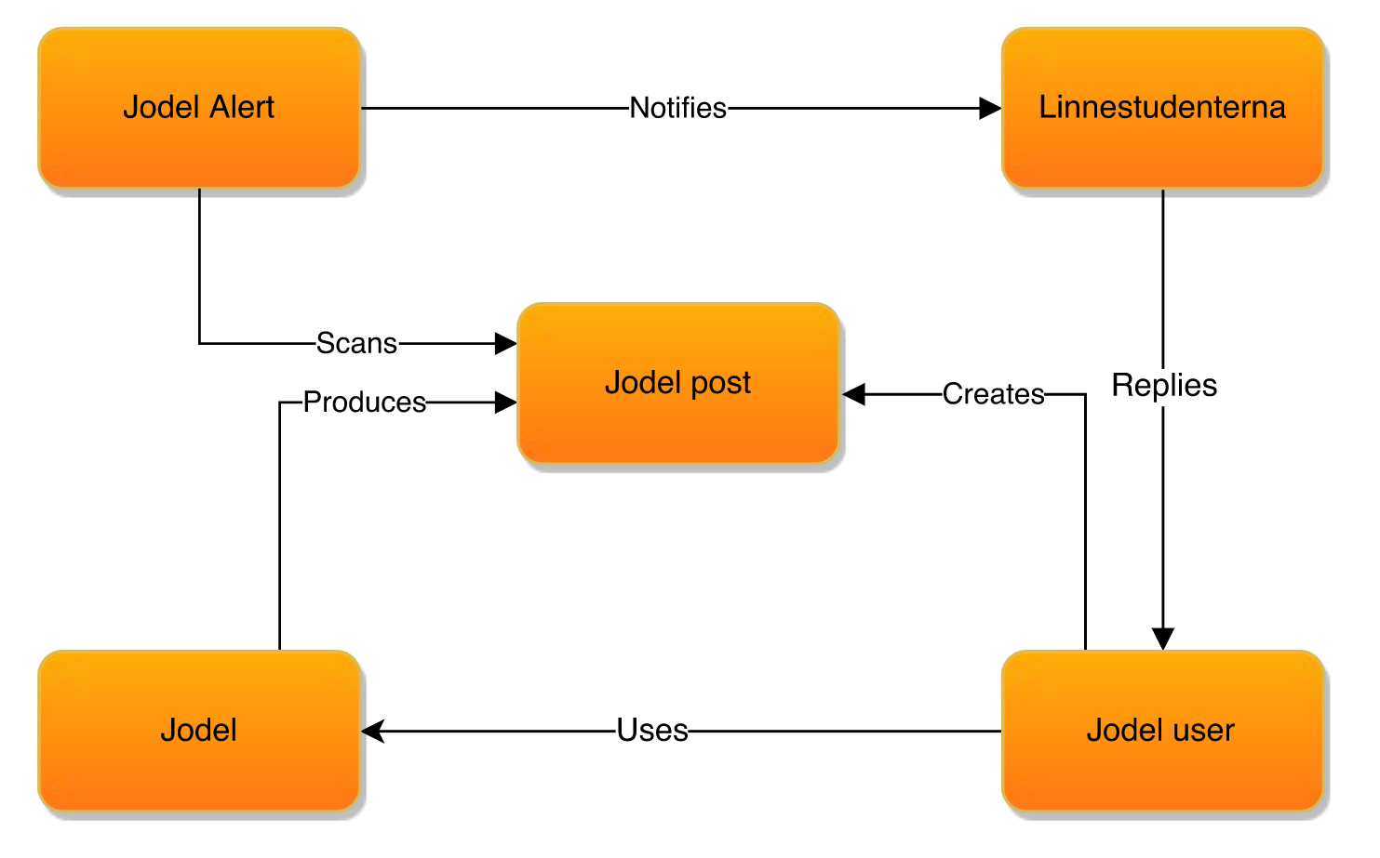
Participating Objects

Slide 3
Jodel
An anonymous social application that targets students and campus life

Slide 4
Jodel Alert
Linnéstudenterna wants to tap into the feed and get an alert when someone posts about accomodation, exams, cheating and students getting mistreated from the university etc (keywords)
Jodel Alert will send Linnéstudenterna an email when such post is found
Today Linnéstudenterna searches the feed manually when given time
Other companies can also benefit from this, in order to see what is trending for that company or what is said in general public by common man about that company

Slide 5
Jodel API
"PostId"
"Message"
"CreatedAt"
"UpdatedAt"
"PinCount"
"HexColor"
"IsNotificationEnabled"
"PostOwn"
"Distance"
"ChildCount"
"VoteCount"
"CommentsCount"
"LocationName"
"UserHandle"
"ImageUrl"

Slide 6
