Slide 1
Jodel Alert
Software Engineering – Design
2DV603

Slide 2
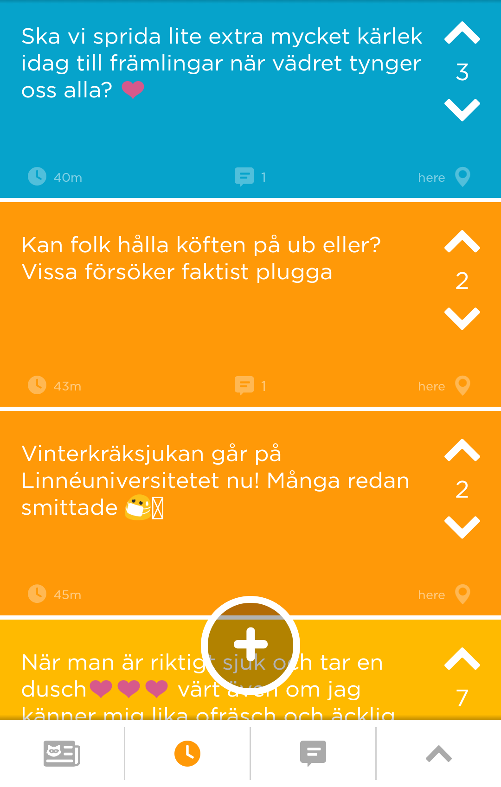
Jodel
An anonymous social application that targets students and campus life

Slide 3
Jodel Alert
Linnéstudenterna wants to tap into the feed and get an alert when someone posts about accomodation, exams, cheating and students getting mistreated from the university etc (keywords)
Jodel Alert will send Linnéstudenterna an email when such post is found
Today Linnéstudenterna searches the feed manually when given time
Other companies can also benefit from this, in order to see what is trending for that company or what is said in general public by common man about that company

Slide 4
Scenario 1
A Jodel user will make a post on the Jodel app. Once this post is submitted the Jodel Alert app will receive an access token to be able to scan the post for any specified keywords from a matching database. If a keyword is found, the Jodel Alert app will send an email to the administrator which contains the keyword used and the content of the post in which it was used. If any errors occur they will be logged and an email will be sent to the list of emails in the database.

Slide 5
Scenario 2
If the administrator of the Jodel Alert app would like to add/remove keywords, they can access the database manually and perform the changes there. The same goes for adding or removing the list of email addresses that will receive notification when a matching keyword is found.

Slide 6
Functional requirements
1. When a keyword is used in a Jodel post, Linnestudenterna will receive a mail
2. The application will request Jodel posts.
3. Keywords should be able to be removed
4. Keywords should be able to be added
5. Keywords should be able to be changed
6. Added keywords saved between sessions (i.e saved on local host if you restart the app)
7. Recipient email should be able to be removed
8. Recipient email should be able to be added
9. Recipient email should be able to be changed

Slide 7
Non functional requirements
1. App will continuously scan Jodel traffic every 15 minutes.
2. When a keyword has been found, email should be sent within 2 seconds

Slide 8
Requirement 1 finding keywords – Use Cases

Slide 9
Use Case Diagram

Slide 10
Jodel API
"PostId"
"Message"
"CreatedAt"
"UpdatedAt"
"PinCount"
"HexColor"
"IsNotificationEnabled"
"PostOwn"
"Distance"
"ChildCount"
"VoteCount"
"CommentsCount"
"LocationName"
"UserHandle"
"ImageUrl"

Slide 11
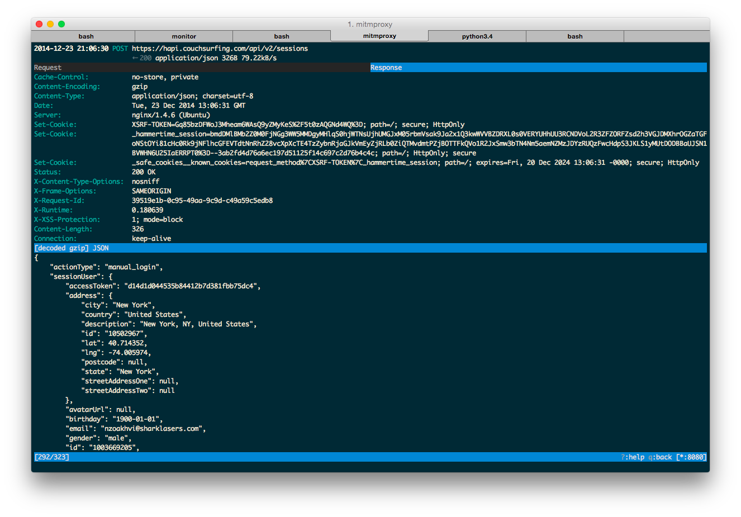

Slide 12
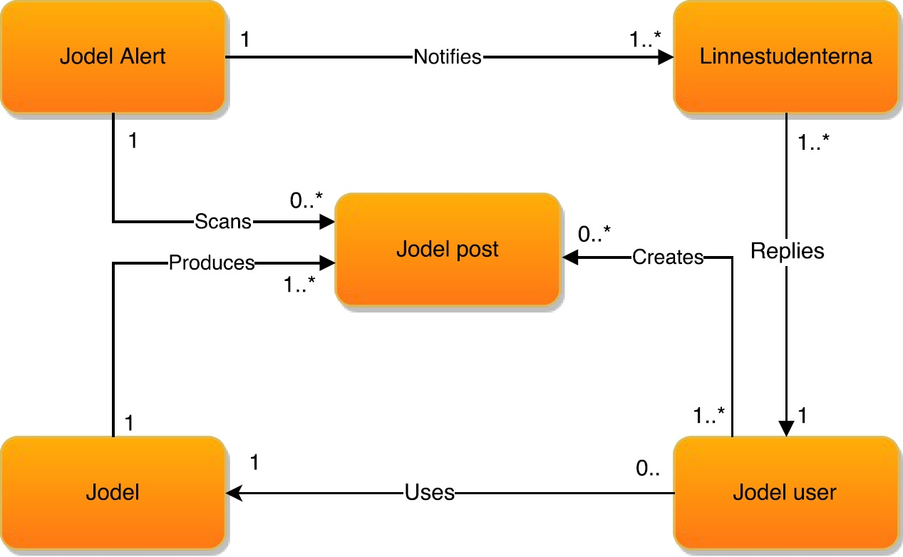
Participating Objects

