Slide 1
WRITING AN ABSTRACT

Slide 2

ABSTRACT
What is an abstract?
Why do we write an abstract?
Where are abstracts used?
How do I write an abstract?
Writing your abstract
5?
Example
mistakes

Slide 3

WHAT IS AN ABSTRACT?
The word abstract comes from the Latin word abstractum: a condensed form of a longer piece of writing.
An abstract is a very brief overview of your ENTIRE study/research. It must be very straight forward and understandable
It is important to be descriptive, but concise--say only what is essential, using no more words than necessary to convey meaning.

Slide 4
WHY DO WE WRITE AN ABSTRACT?
Important parts of academic assignments
  Reports
  research papers
The last item that you write, yet the first thing people will read
  Quick overview of the whole content of the paper.
Leave writing the abstract to the end
  Have a clearer picture of all your findings and conclusions.
  Do not attempt to write the abstract until you have finished the main body

Slide 5
WHERE ARE ABSTRACTS USED?
An increasing number of published journals, proceedings, reports, etc.
This makes the information available to many more people

Slide 6
HOW DO I WRITE AN ABSTRACT?
An abstract should briefly describe:
The topic of the project/ main objective of the study (WHAT)
Problem statement/background (WHY)
Methodology used (methods to achieve your objectives).(HOW)
Present the end product of your system whether it achieves the project objectives or not.(WHAT)
Present the main conclusion and the main benefit of your project – the significant. (WHAT)

Slide 7
The general body of the ABSTRACT
It tells the reader WHAT you did -overall about the system that you’d developed - the purpose of the research (introduction-OBJECTIVE)
WHY you did it, problems faced by the conventional system – (Problem statement)
HOW you did it -your approaches, techniques – (methodology)
WHAT you had found (justify whether you have achieved your objectives), the principal findings (systems),
and WHAT is the significant. -and what are the findings (discussion and conclusion).

Slide 8
5? - FOR PSM 1
WHAT is the background of the project? (what did you do?)
WHY you did it? …the problem to be solved?
HOW you did it? … the method to be used.
WHERE do you want to apply the method?
WHAT is the expected result?

Slide 9
5WS
WHAT is the background of the project?
WHY you did it? …the problem to be solved?
HOW you did it? … the method to be used.
WHAT did you get?
WHAT does it mean? What is the significance?

Slide 10
Common MISTAKES in an ABSTRACT
Too long. It maybe because of repeated sentences. Do not try to put everything in the abstract. Remember that abstract gives the first expression to readers. Long sentences will make readers hard to understand your work and lost of interest.
2. Too much detail. Abstracts that are too long often have unnecessary details. The abstract is not the place for detailed explanations of methodology or for details about the context of your study problem.
3. Too short. On the other hand, shorter is not necessarily better. If your word limit is 200 but you only write 95 words, you probably have not written in sufficient detail. Many students do not give sufficient information about their findings.
4. Failure to include important information. You need to be careful to cover the points listed above. Students often do not cover all of them because they spend too long explaining, for example, the methodology and then do not have enough space to present their conclusion.

Slide 11


ABSTRACT (PSM1)
Virtual communication encompasses a broad spectrum of concepts and technologies that are central to our daily lives such as e-mail, instant messaging and Internet telephony. However, in this busy era, most of working parents are spending more time on workplace than at home with their children. Thus, this situation may lead to communication gap between parent and children. Therefore, virtual communication through mother goose application is developed to allow parents virtually communicate with children by singing rhymes and painting. In addition, children can show picture they had colored or draw to parent. Prototyping-based methodology is used as the methodology to develop this application. This application was developed in Window platform, from the testing had been done it had success to connect with other party which are see each other while having two activities with laptop. This application is expected to help parent and children to have wonderful time through their communication as well as sharing their special and belonging moments.
What?
Why?
How?
Where to apply?
What is the expected result?

Slide 12


ABSTRACT (PSM2)
What?
Model 1
The online UTHM House Rental Assistant Management System is a system which act as a housing agency in UTHM. The purpose of developing this system is to solve the problem of the UTHM students in searching for suitable odd-campus house. This system accepts registration on house owner intended to rent out their house. House information will be gathered and display to student based on the searching criteria. To ensure the benefits of the system goes only to UTHM’s students, they will need to register in order to view the detailed house information. Through the system, students can place their booking on a particular house while owner will contact interested student according to the list. The development of this system will assist students to make a wiser decision and university authority to have a better knowledge about the students’ whereabouts.
Why?
How?
WHAT did you get
What is Significant?

Slide 13
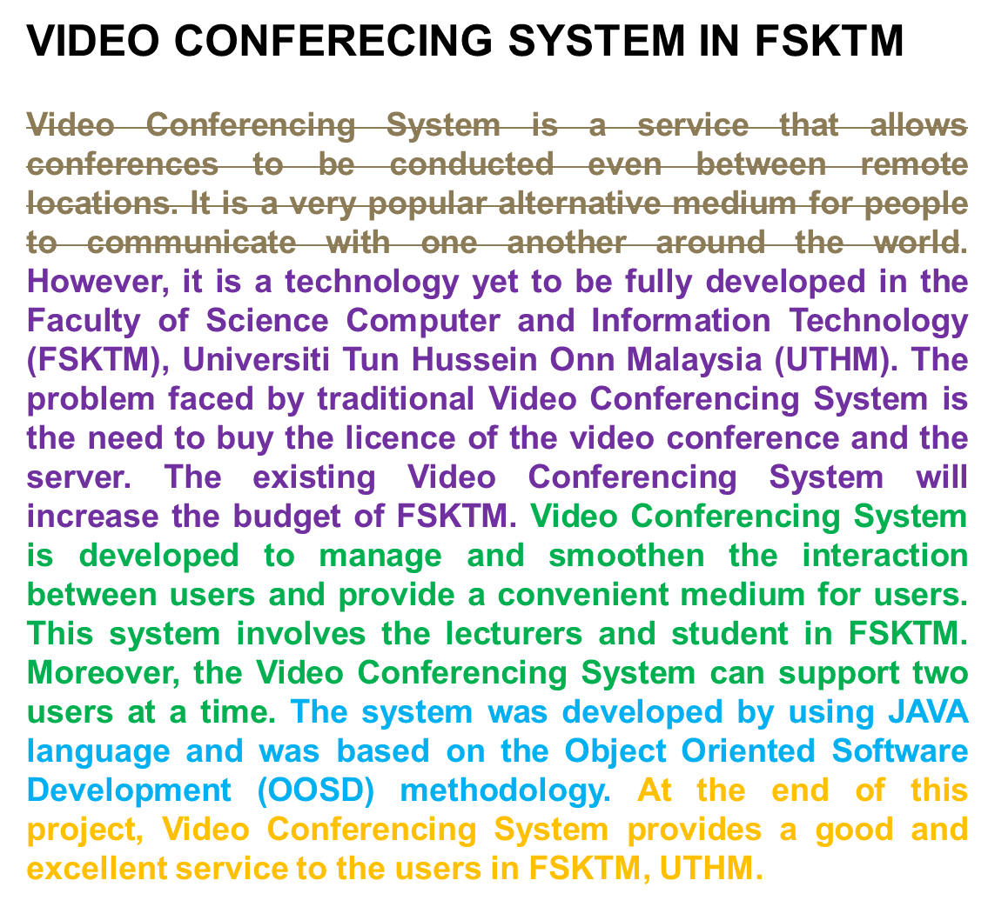

WHAT did you get
Why?
What?
How?
What is Significant?

Slide 14
      APLIKASI PENENTUAN GRED BUAH KELAPA SAWIT MENGGUNAKAN TEKNIK LOGIK KABUR
What?
Aplikasi Penentuan Gred Buah Kelapa Sawit menggunakan Teknik Logik Kabur adalah satu aplikasi yang dibangunkan untuk melaksanakan kerja-kerja pengiraan penggredan buah kelapa sawit. Pada masa sekarang penggredan buah kelapa sawit adalah dilakukan secara manual dengan menggunakan tenaga kerja manusia. Kaedah ini adalah sangat subjektif dan tidak konsisten kerana setiap pegawai penggred mempunyai teknik tersendiri dan mungkin berbeza-beza di antara satu sama lain. Dengan melihat kepada kelemahan tersebut maka Aplikasi Penentuan Gred Buah Kelapa Sawit menggunakan Teknik Logik Kabur dibangunkan. Teknik Logik Kabur adalah satu superset logik konvensional yang digunakan untuk mengendalikan konsep kebenaran separa. Nilai yang dipertimbangkan di dalam logik kabur adalah antara 0 hingga 1. Metodologi yang digunakan bagi membangunkan aplikasi ini adalah metodologi Reka Bentuk Kawalan Logik Kabur. Aplikasi ini dibangunkan dengan menggunakan perisian pengarangan Macromedia Dreamweaver 8, Xampp dan juga sistem pengoperasian Windows 7. Diharapkan aplikasi ini berjaya dibangunkan dan dapat memberikan maklumat tentang sawit kepada para pengguna.
Why?
How?
WHAT did you get
What is Significant?

Slide 15
Weather Forecasting For Batu Pahat Using Artificial Neural Network
Why?
Nowadays, weather forecasting plays a vital role in human activities. Complexity of data gathering in meteorology department and high technical costs leads inaccurate for weather forecasting. In order to minimize the problem, an application that using Artificial Neural Network (ANN) has been developed to forecast weather conditions using Matlab compiler. This application will help people to define the weather conditions daily well and made early preparation to encounter uncertainty. This application is perform in Multilayer Perceptron (MLP) using back-propagation (BP) algorithm. The time series data namely mean evaporation and wind speed are undergoing training and testing based on actual data that obtained from Malaysian Meteorological Department. The result will show in graph plotting for training and testing process. Predictive accuracy for each step of stimulation will measure using Mean Square Error (MSE) graph in this application. Therefore, this application will able to assists Malaysian Meteorological Department to forecast weather so our government and people have sufficient time to prepare and solve.
What?
How?
WHAT did you get
What is Significant?

