Slide 1
Topic 14-2: Construct a Room Impulse Response (RIR) using Ray Tracing (RT) Simulation Methods
Group Members:
Kashan Sardar, 70284, kashan.sardar@tu-ilmenau.de
Tabish Khan, 70396, tabish.khan@tu-ilmenau.de
Dated: 28 Feb 2025

Slide 2
Introduction
Importance of Room Acoustics – Essential for VR, architectural acoustics, and spatial audio rendering, influencing reverberation, absorption, and reflections.
Objective – Implement a Room Impulse Response (RIR) simulation using Ray Tracing (RT) to model sound propagation and reflections.
Simulation Focus – Analyze the impact of room size and acoustic treatments on sound behavior, including frequency-dependent absorption and higher-order reflections.
Methodology – Use Ray Tracing to simulate sound propagation, reflection, and absorption within different room environments.
Insights & Applications – Provides understanding of reverberation effects, helping in audio system design, VR spatialization, and acoustic treatment planning.

Slide 3
Project Description
Objective – Develop a room acoustics simulation tool to compute Room Impulse Response (RIR) using Ray Tracing (RT) methods.
Room Configurations – Simulate four different room sizes, including variations in acoustic treatment (furnished, empty, treated, untreated).
Sound Propagation Modeling – Analyze reverberation and absorption effects with a single sound source and receiver setup.
Frequency Considerations – Incorporate octave band frequencies for accurate material absorption coefficients.
Higher-Order Reflections – Improve simulation accuracy by handling multiple sound reflections within the environment.

Slide 4


Methodology
Technologies Used
Programming Language: Python, C#
3D Modeling and Visualization: Unity (for visualization)
Ray Tracing Engine: Custom-built ray-tracing algorithm using vector mathematics
Material Absorption Data: Based on octave band frequency-dependent coefficients
Data Analysis: Python

Slide 5
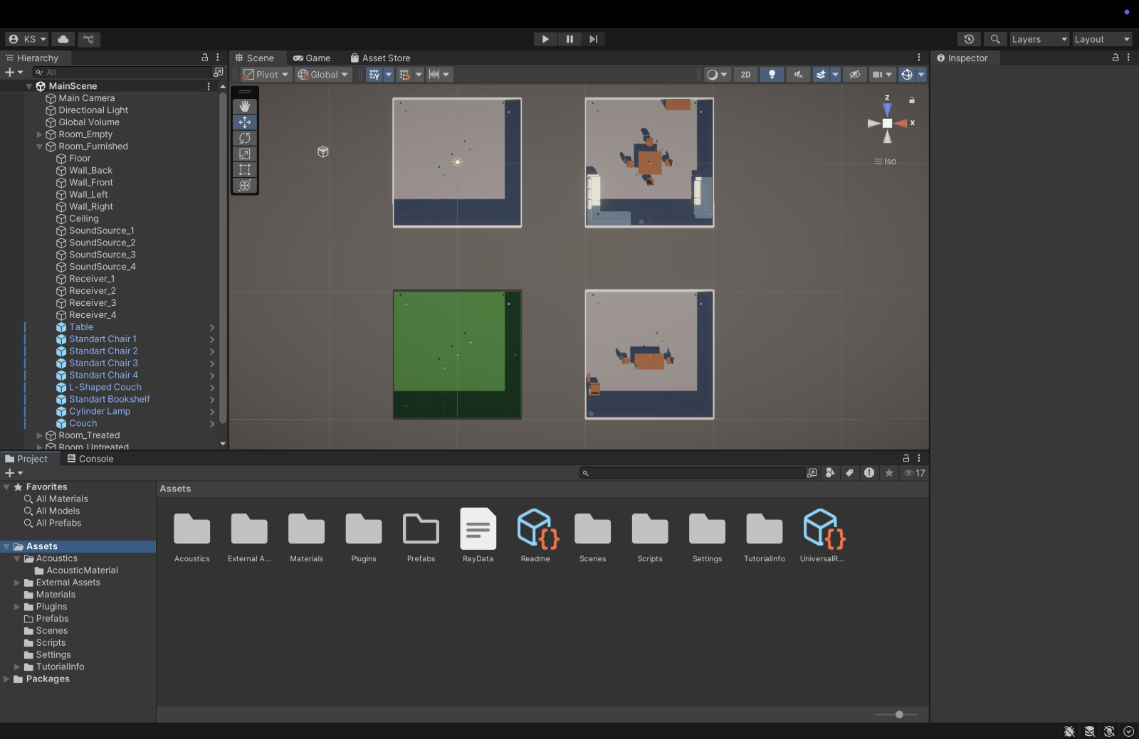
Methodology
Room Modeling
Define four room geometries of different sizes.
Surface materials with varying absorption coefficients based on octave band frequencies.

Slide 6
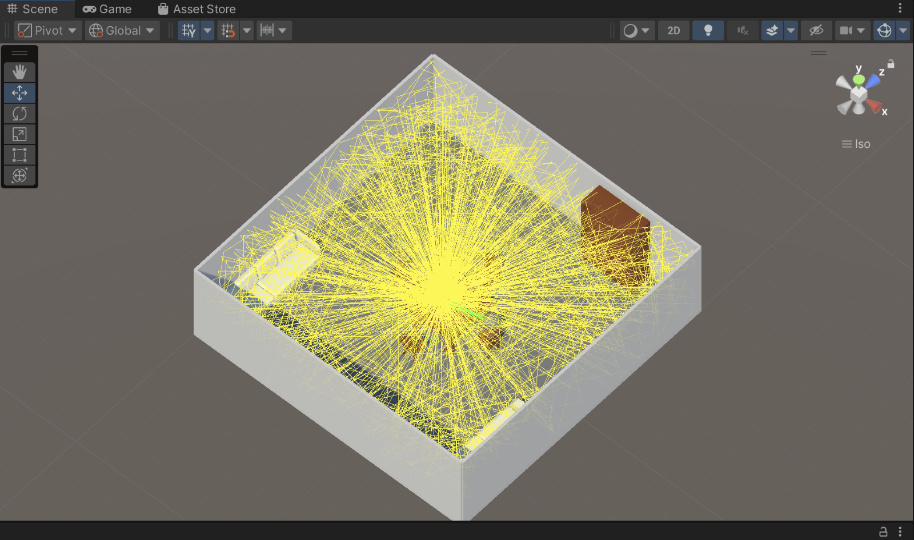
Methodology
Ray Tracing Implementation
Stochastic Ray Tracing (SRT)
Random sampling of ray paths to model energy dispersion and simulate reverberation accurately.

Slide 7
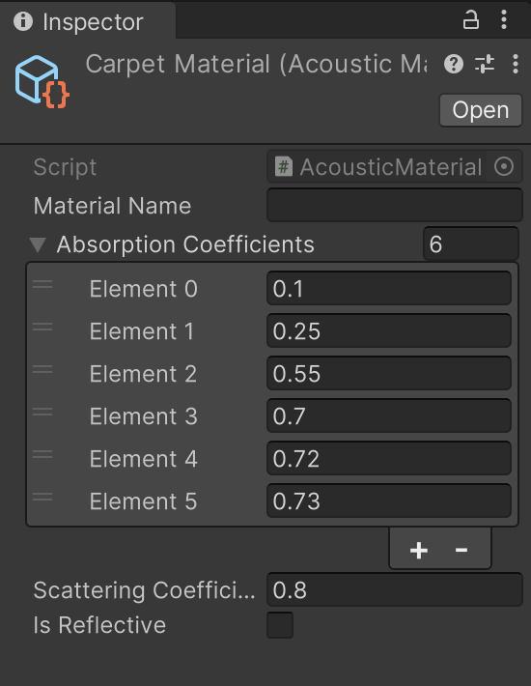
Methodology
Frequency-Dependent Absorption
Assign absorption coefficients to different room surfaces using octave band frequencies.
Compute the sound energy loss for each frequency band at each reflection.

Slide 8
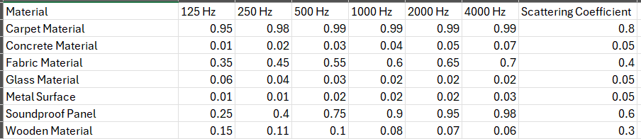
Methodology
Frequency-Dependent Absorption
Assign absorption coefficients to different room surfaces using octave band frequencies.
Compute the sound energy loss for each frequency band at each reflection.

Slide 9
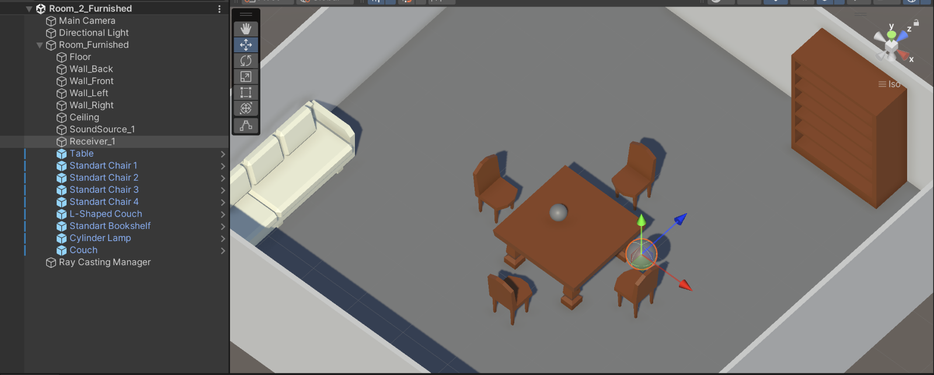
Methodology
Source and Receiver Placement
Place a sound source within the room.
Assign a receiver position to analyze received impulse responses.
Measure variations in reverberation time (RT60) and direct-to-reverberant ratio.

Slide 10
Methodology
Data Processing and Analysis
Generate Impulse Response (IR) waveforms for each receiver location.
Compute key acoustic parameters:
Reverberation time (RT60)
Early decay time (EDT)
Direct-to-reverberant energy ratio
Compare results across different room conditions.

Slide 11
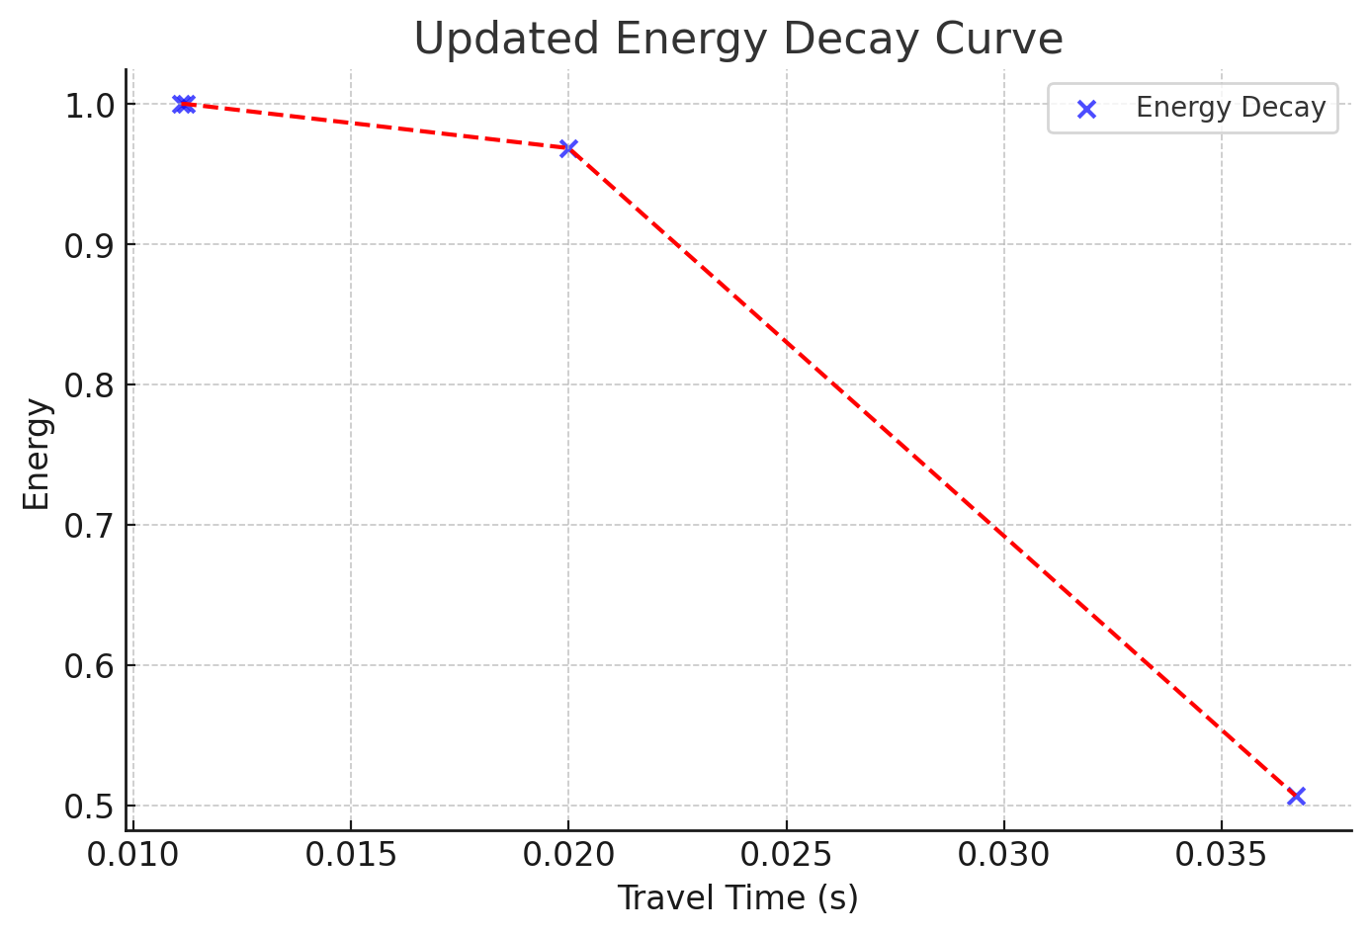
Methodology

Slide 12
Results and Discussion
Room Impulse Response Analysis
The simulated RIR waveforms illustrate how sound reflections vary across room conditions.
Furnished rooms exhibit higher absorption and reduced reverberation.
Empty rooms lead to longer reverberation times (RT60) due to minimal absorption.

Slide 13
Results and Discussion
Frequency-Dependent Absorption Effects
Low frequencies absorb less, causing longer reverberation tails.
High frequencies absorb faster, reducing reflections.
Absorption varies across octave bands, shaping room acoustics.

Slide 14
Results and Discussion
Higher-Order Reflection Analysis
Implementing higher-order reflections improves realism but increases computational complexity.
Efficient ray-tracing methods reduce processing time while maintaining accuracy.

Slide 15
Conclusion and Future Work
This project implemented Room Impulse Response (RIR) simulation using Ray Tracing (RT) to analyze room acoustics.
Results show the impact of room size, materials, and frequency-dependent absorption on sound propagation. Future work includes real-time auralization with Unity + Steam Audio.

Slide 16
References
D. Schröder, Physically Based Real-Time Auralization of Interactive Virtual Environments, RWTH Aachen University, 2011. [Online]. Available: https://publications.rwth-aachen.de/record/50580/files/3875.pdf
Steam Audio Documentation, “Steam Audio: A 3D Spatial Audio Solution for Games and VR,” Valve Corporation, 2024. [Online]. Available: https://valvesoftware.github.io/steam-audio/

Slide 17

Thank You For Your Attention!
This Photo by Unknown Author is licensed under CC BY-SA

