Slide 1
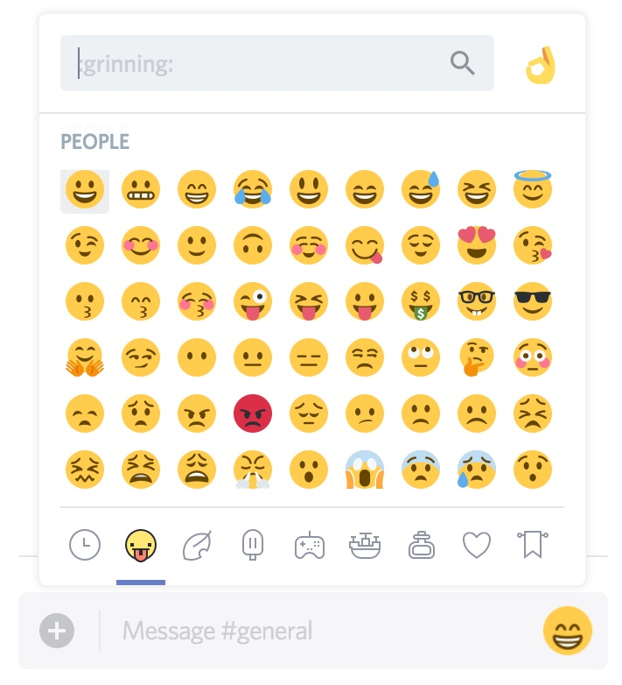

Test data
WaKa#6616
Ene SS Rawa#0855 (2022-07-01 07:01:05)
Good question @WaKa#6616. @danielo#2815 or @katerinabc#6667 can tell you more. This question applies to all @Community Health - Contributors
Other_user#0145 (2022-07-02 08:01:02)
Who are the team leads for the community health project?
2
1
Other_user#0145
danielo#2815 (2022-07-02 08:25:39)
Hi @Other_user#0145, the leads are @katerinabc#6667 and @danielo#2815
katerinabc#6667 (2022-07-02 15:44:32)
That is correct
1
danielo#2815
1
Other_user#0145 (2022-07-02 09:05:34)
Thank you @danielo#2815
danielo#2815 (2022-07-02 17:24:49)
@WaKa#6616 can I call you?
2
Legend:
Chan: Community-health general
Reply
Thread
Emoji
Mention
WaKa#6616 (2022-07-03 20:24:49)
Let's continue this conversation in the thread, I'm available any time tomorrow
1
WaKa#6616
danielo#2815 (2022-07-03 20:26:39)
What about 5pm UTC? @katerinabc#6667 can you join @WaKa#6616 and me? @Other_user#0145 is interested in contributing to the dev work.
1

