Slide 1



Pizza online
Team “Stichtite”

Slide 2
Team members
Valentin Radev
  Username: Vali0
Yasen Mihajlov
  Username: Yasen
Petar Tseperski
  Username: p.tsepeski
Ivan Kolchagov
  Username: kolchagov

Slide 3
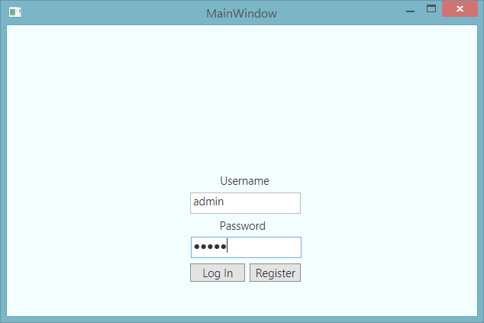
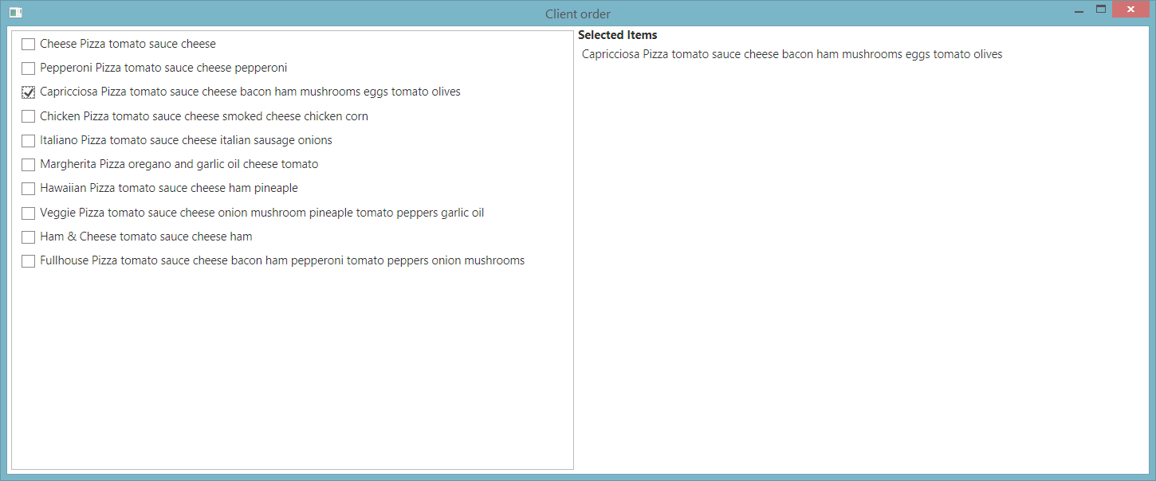
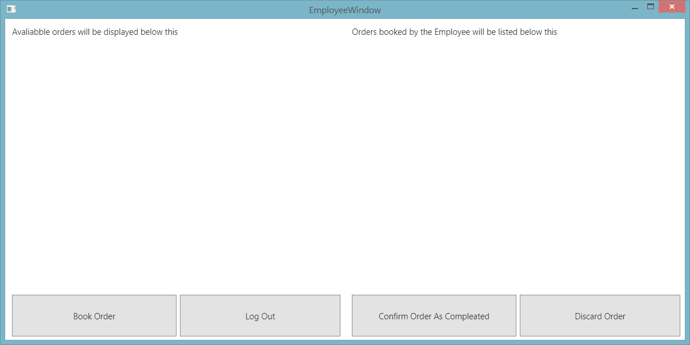
Program overview
Main functions:
Login form
User form
Employee form
Admin form
File handling (CSV)
...

Slide 4
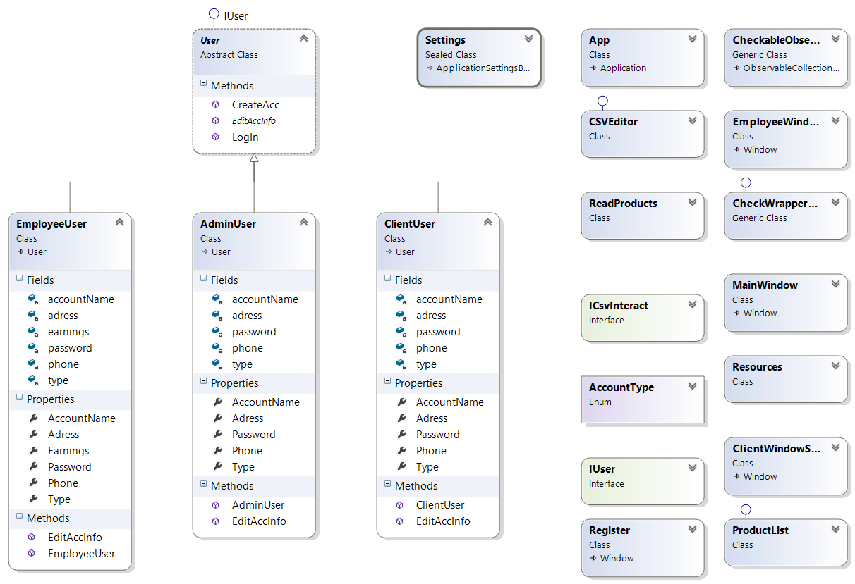
Class Structure

Slide 5

SVN repository:
Selected GoogleCode
https://code.google.com/p/telerik-spring-oop-teamwork-stichtite/
Submission log:
https://code.google.com/p/telerik-spring-oop-teamwork-stichtite/source/list

Slide 6

Questions?

