Slide 1
Big Data Analytics for Energy Use in Public School Power Systems
CASE STUDY · 53 PUBLIC SCHOOLS · WESTERN CAPE, SOUTH AFRICA
Smart-meter data, MongoDB, PySpark and Tableau
Paper id: 204
Emma Daae · Hlib Grygoriev · Marvin Lambertus · Vimala Nunavath
Kristiania University of Applied Sciences, Oslo · University of South-Eastern Norway
Notes:
[Emma, 0:30] Good morning. I'm Emma, and together with Hlib and Marvin I'll present our paper, Big Data Analytics for Energy Usage Assessment in Public School Power Systems, a case study of 53 public schools in the Western Cape, South Africa, co-authored with Vimala Nunavath from the University of South-Eastern Norway.

Slide 2
Why schools, and why South Africa?
MOTIVATION
01
02
03
A strained grid
Tight budgets
A research gap
Regular load-shedding makes every kilowatt-hour count.
Public schools pay for electricity out of constrained operating budgets.
Most studies use billing data, or look at homes and universities. Few apply big-data tools to schools.
Energy use in Western Cape public schools
2 / 13
Notes:
[Emma, 0:50] A school gets one electricity bill a month. It says how much energy was used, but not when or why, so nobody can tell whether it went to teaching or to equipment left on overnight. Smart meters that record every half hour can answer that. Why South Africa? The grid is under pressure, public schools run on tight budgets, and few studies apply big-data tools to school smart-meter data. So we built an end-to-end framework and applied it to real half-hourly data from 53 schools.

Slide 3
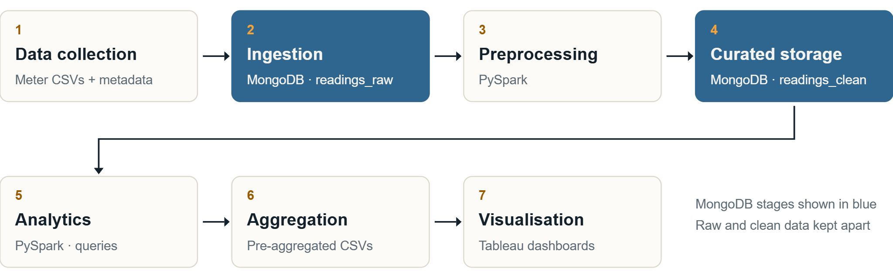
Seven stages from meter file to dashboard
METHOD
Energy use in Western Cape public schools
3 / 13
Notes:
[Emma, 0:55] This is our architecture, in seven stages. We load the raw meter files and a school metadata sheet unchanged into MongoDB as readings_raw. PySpark cleans the data and engineers features, and the result goes back to MongoDB as a separate collection, readings_clean, so the originals stay untouched. PySpark then runs the analytical queries and exports small pre-aggregated CSV files, and Tableau turns those into dashboards. MongoDB stores, PySpark processes, Tableau shows, and the same pipeline could scale to many more schools. Now Hlib will take you through the data.

Slide 4
53 schools, one year, five cleaning steps
DATA AND CLEANING
53
849,696
2.51 GWh
43 / 53
public schools, readings every 30 min
half-hour readings in 2023
total electricity, 2023
schools with a recorded intervention
Schools per funding quintile
Limitations
Q1 18 · Q2 15 · Q3 17 · Q4 3 · Q5 0
No Quintile 5 schools; only 3 in Quintile 4.
Five cleaning steps in PySpark
Missing values
Outliers
Inconsistent data
Types and time
Features
School median fill
Cap at 99.9th percentile
S46 fields rebuilt
Local time, numeric kWh
Hour, weekend, season
Energy use in Western Cape public schools
4 / 13
Notes:
[Hlib, 1:05] Thanks, Emma. The dataset was released by Stellenbosch University in 2024: 53 public schools, with readings every 30 minutes. We focus on 2023, which gives 849,696 readings and 2.51 gigawatt-hours in total. The sample has 18, 15, 17 and 3 schools in Quintiles 1 to 4 and none in Quintile 5, and 43 of the 53 have a recorded intervention. We cleaned the data in five PySpark steps: gaps filled with each school's median, outliers capped at the 99.9th percentile rather than deleted, S46's duplicated season fields rebuilt, timestamps set to Johannesburg time, and features such as hour, weekend flag and season added.

Slide 5
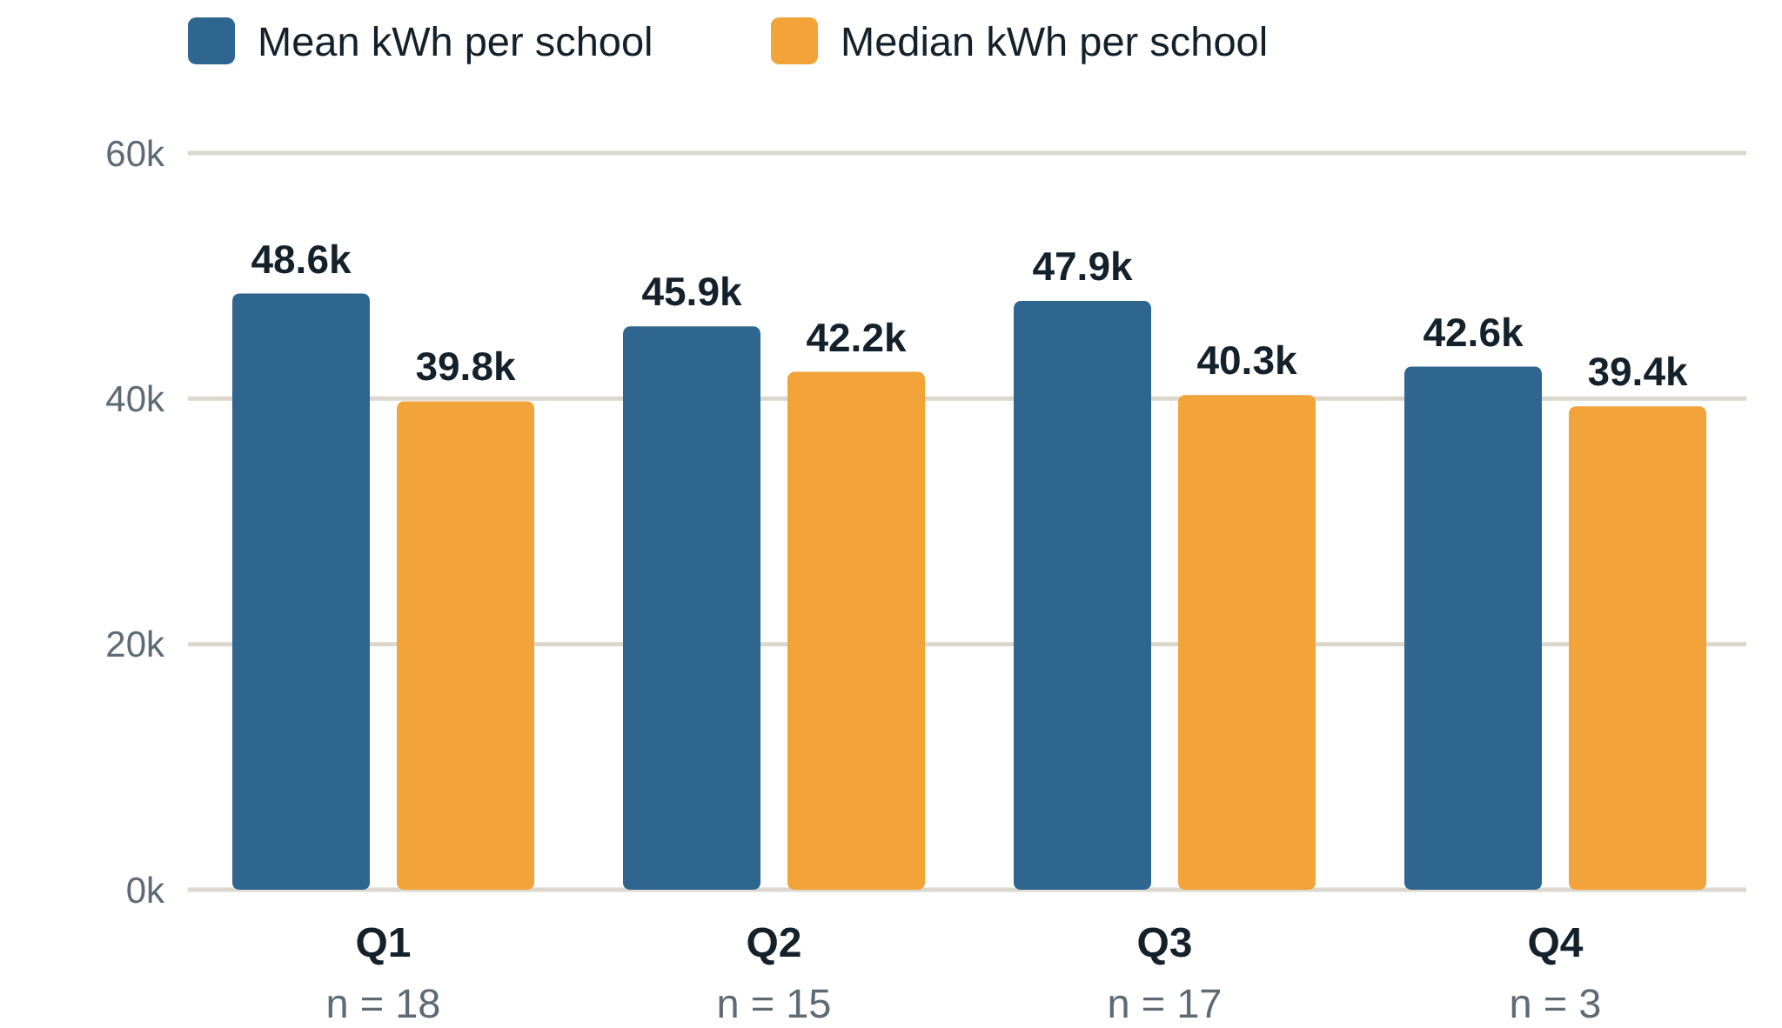
Quintile doesn't predict consumption
RESULTS · CONSUMPTION
Per school, every quintile sits between 42,600 and 48,600 kWh a year.
Q1 has the largest total (874.1 MWh) because it has the most schools.
Medians below means: a few heavy users pull averages up.
Descriptive only: no significance test, and Q4 has 3 schools.
Energy use in Western Cape public schools
5 / 13
Notes:
[Hlib, 0:45] Our first question: does funding quintile predict consumption? Quintile 1 uses the most in total, about 874 megawatt-hours, simply because it has the most schools. Per school, the mean is very similar, from about 42,600 kilowatt-hours in Quintile 4 to about 48,600 in Quintile 1, and the medians sit below the means, so a few heavy users pull the averages up. Quintile alone is not a strong predictor. This is descriptive, with no significance test, and Quintile 4 has only three schools.

Slide 6
Per-learner use tells a different story
RESULTS · CONSUMPTION
Secondary schools use the most per school on average, but school size changes the picture.
S24 · Secondary, Q3
S41 · Primary, Q1
S25 · Primary, Q2
101.3
95.2
36.2
kWh per learner
kWh per learner
kWh per learner
178,043 kWh in 2023
1,758 learners
74,094 kWh, less than half of S24
Only 778 learners
68,502 kWh in 2023
1,894 learners, the most in the dataset
Energy use in Western Cape public schools
6 / 13
Notes:
[Hlib, 0:50] Secondary schools use the most per school, about 61,600 kilowatt-hours a year against about 41,800 for primary. But that ignores school size, so we also looked at use per learner. S24 uses about 178,000 kilowatt-hours, or 101 per learner. S41, a primary school with only 778 learners, uses less than half that in total, but 95 per learner. S25 has the most learners and only about 36. Per-learner figures are a better way to spot schools that need attention. Marvin will now take you through when the energy is used.

Slide 7
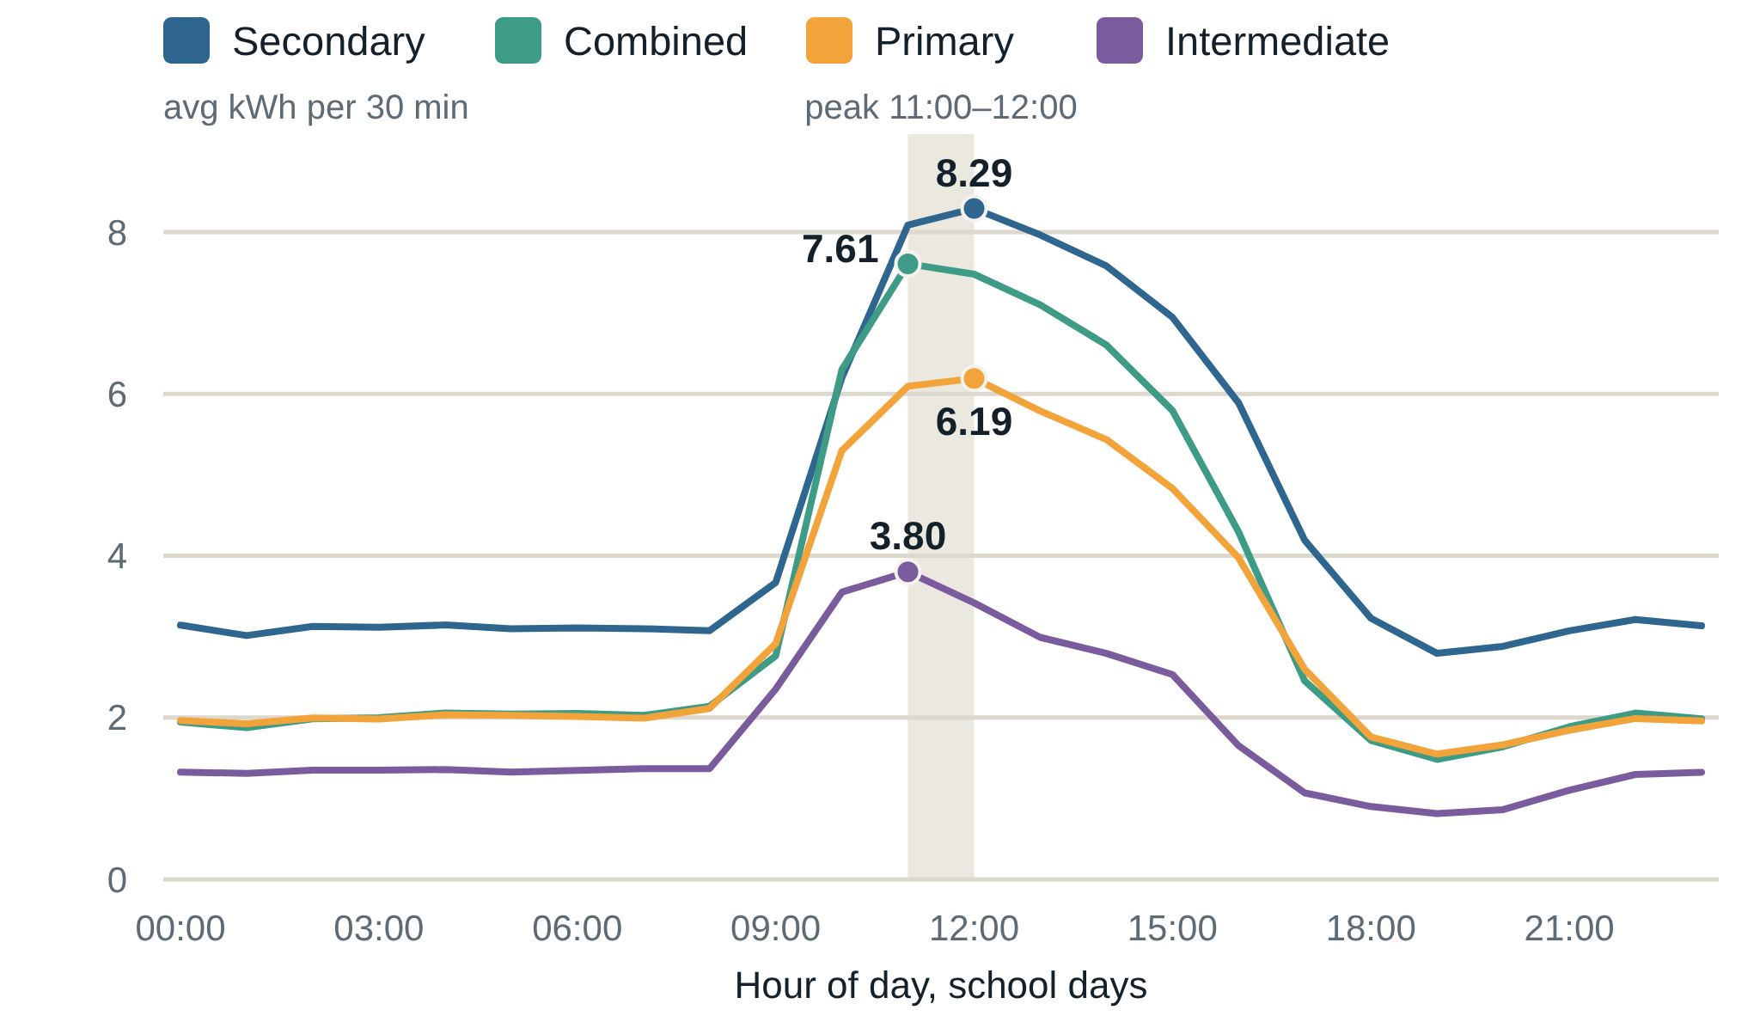
A typical school day peaks around midday
RESULTS · LOAD PROFILE
Secondary
Combined
8.29
7.61
kWh per 30 min
at 12:00
kWh per 30 min
at 11:00
Primary
Intermediate
6.19
3.80
kWh per 30 min
at 12:00
kWh per 30 min
at 11:00
Energy use in Western Cape public schools
7 / 13
Notes:
[Marvin, 0:45] Thanks, Hlib. This is an average school day. Consumption is flat overnight, ramps up sharply between nine and eleven, stays high through teaching hours and declines after about two. On school days the peak comes between 11:00 and 12:00 for every school type: secondary schools highest at about 8.3 kilowatt-hours per half hour, then combined at 7.6, primary at 6.2 and intermediate at 3.8. Energy follows occupancy, which gives us a baseline for weekends and nights.

Slide 8
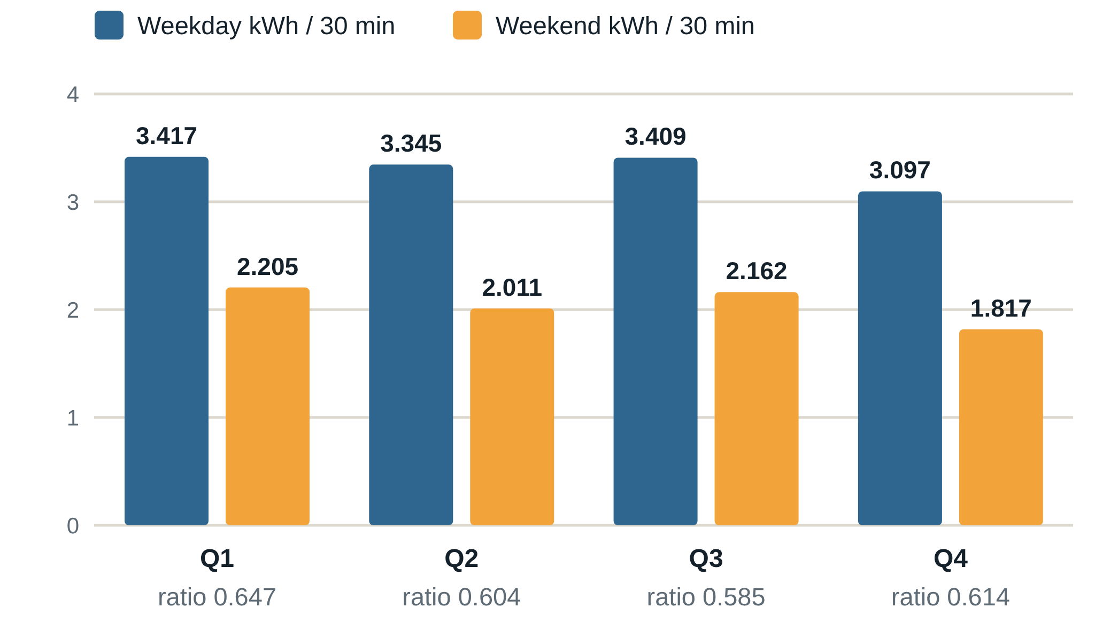
Weekends keep over half the weekday load
RESULTS · LOAD PROFILE
59–65%
of weekday demand remains at weekends, in every quintile.
Likely continuous loads: security lighting, network gear, refrigeration, idle HVAC.
Cheap targets: circuit timers and better scheduling.
Energy use in Western Cape public schools
8 / 13
Notes:
[Marvin, 0:45] Now weekends. You'd expect a school with no classes to use very little, but weekend demand is 59 to 65 percent of weekday demand in every quintile, from 59 in Quintile 3 to 65 in Quintile 1. So more than half of the weekday load is still there when nobody is teaching: likely security lighting, network equipment, refrigeration and idle HVAC. Those are good targets for cheap fixes like circuit timers and better scheduling.

Slide 9
The extremes: winter peaks and a night that never ends
RESULTS · PEAKS AND BASELOAD
≈36 kWh
12–14%
≈9.3 kWh
Highest half-hour readings
of annual use falls 01:00–04:30
S24 every half hour, all night
About 71 kW average power
Secondary schools S43, S48, S47
Mostly in winter, 10:00–14:00
A persistent overnight baseload
Similar across all quintiles
Around 19 kW, continuously
Strong candidate for an energy audit
Energy use in Western Cape public schools
9 / 13
Notes:
[Marvin, 0:50] At the extremes, the highest half-hour reading was about 36 kilowatt-hours at S43, around 71 kilowatts. Peaks came mainly from secondary schools, S43, S48 and S47, mostly in winter between 10:00 and 14:00, which we link to heating and lighting. At the other end, 01:00 to 04:30 accounts for 12 to 14 percent of annual use, similar across quintiles. One school stands out: S24 draws about 9.3 kilowatt-hours every half hour overnight, around 19 kilowatts, which makes it a strong candidate for an energy audit.

Slide 10
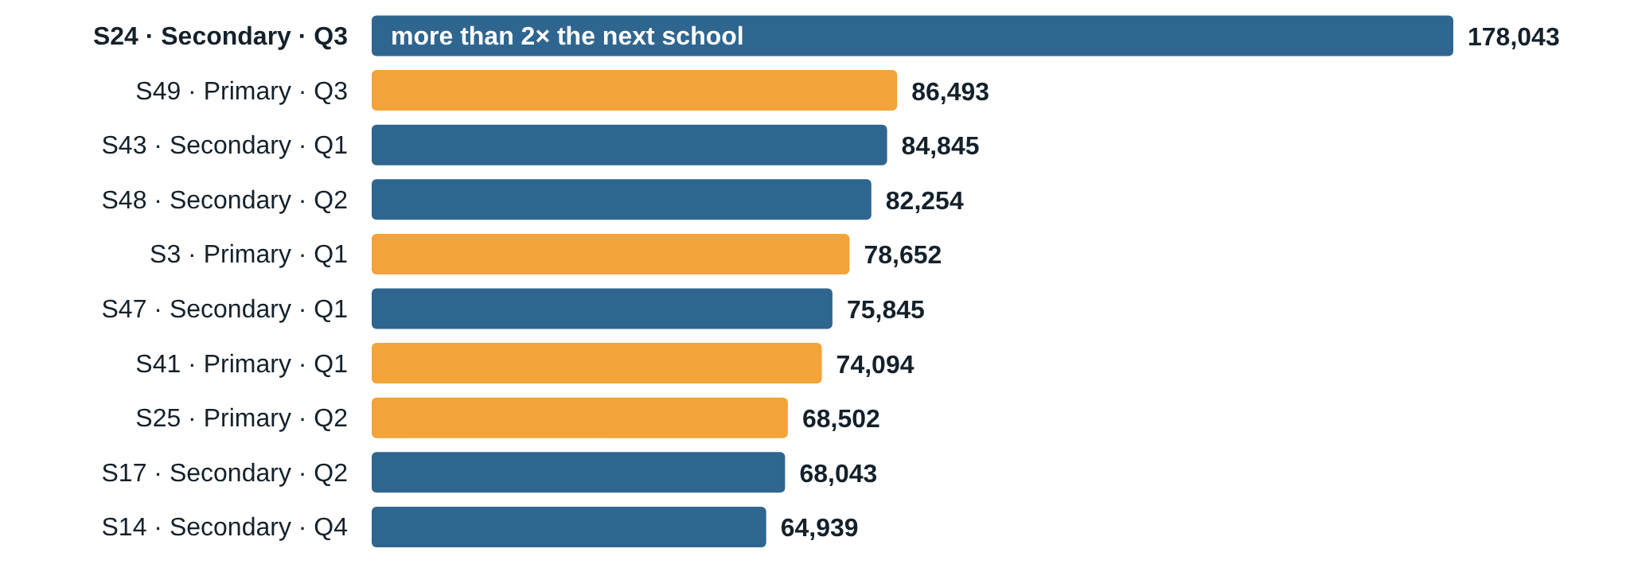
Ten schools use about a third of all electricity
RESULTS · TOP CONSUMERS
Energy use in Western Cape public schools
10 / 13
Notes:
[Marvin, 0:45] The ten highest-consuming schools use about a third of all electricity, around 34 percent, so consumption is very concentrated. Six are secondary schools and four are primary. S24 is at the top with about 178,000 kilowatt-hours, more than twice the second-ranked school, S49, at about 86,500, even though their learner numbers are similar. Targeting a small number of schools could deliver a large share of the possible savings.

Slide 11
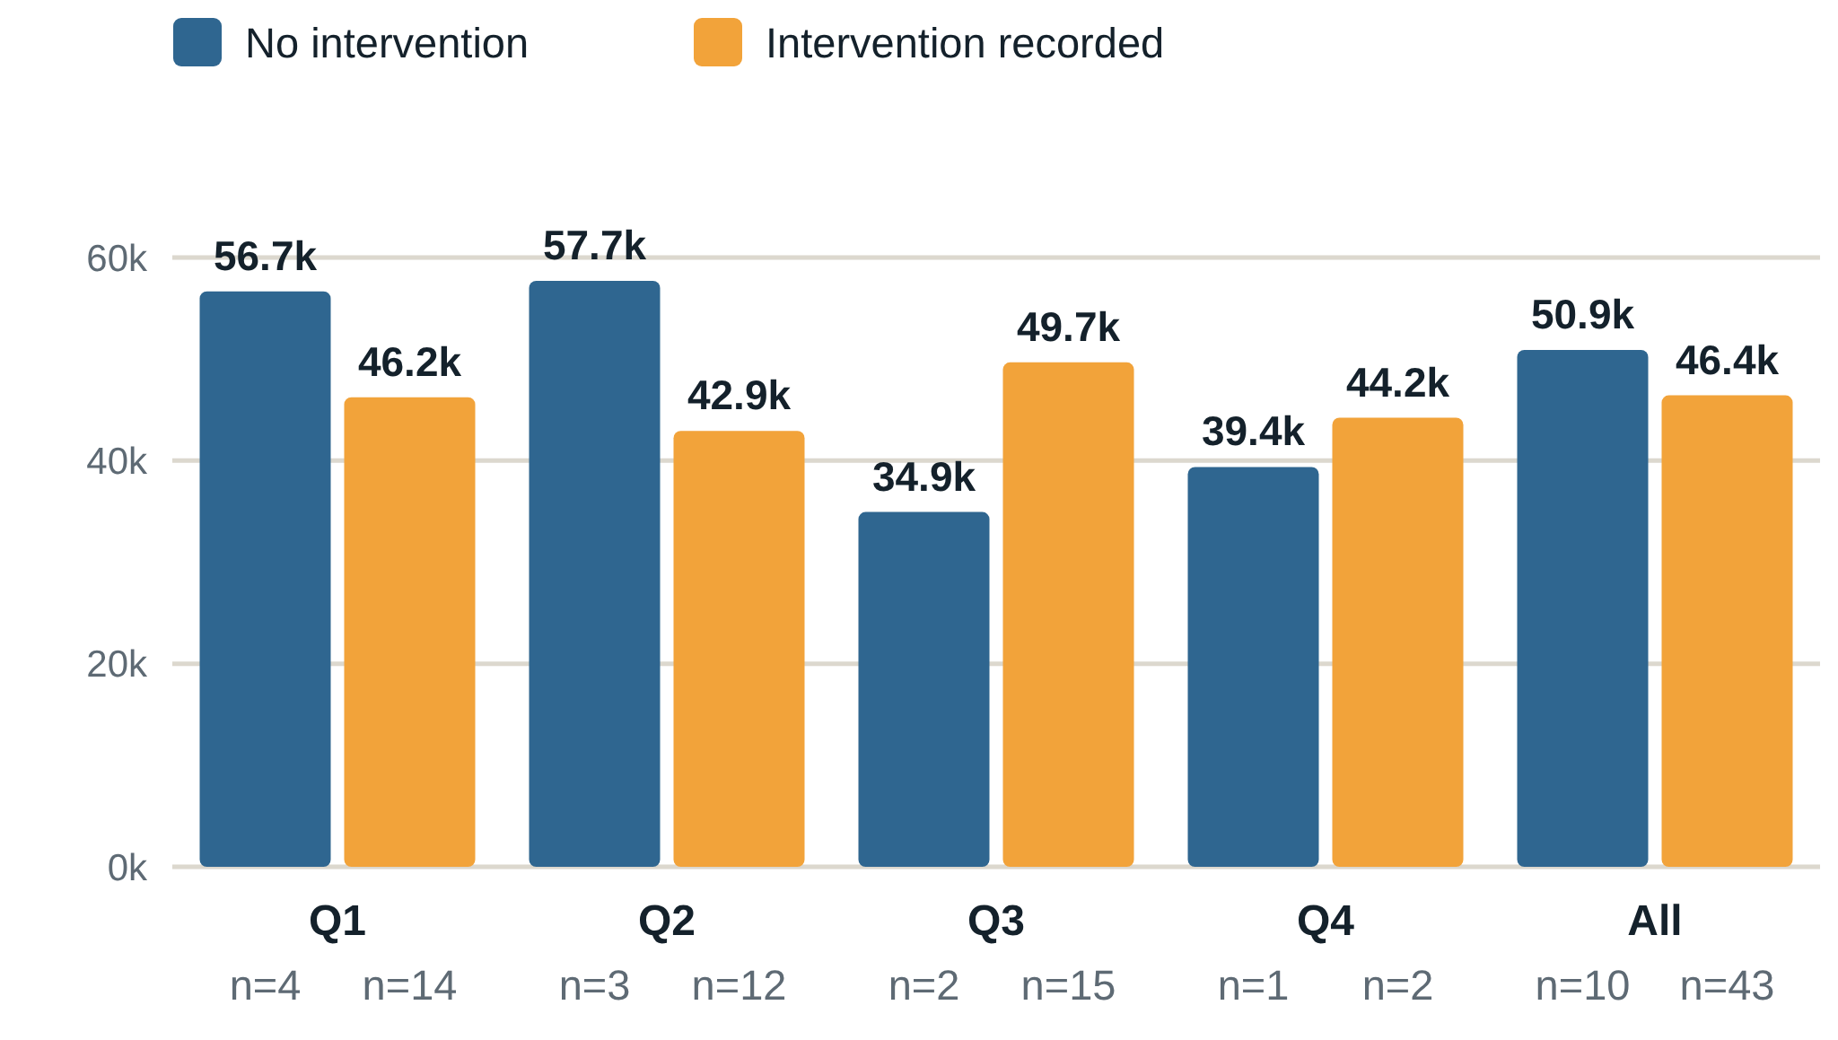
Intervened schools use less, with caveats
RESULTS · INTERVENTIONS
≈4,500 kWh
less per year on average with an intervention (46,424 vs 50,906)
Clear in Q1 and Q2
Reversed in Q3, largely due to S24
Without S24, the Q3 intervened mean falls from 49,681 to ≈40,500 kWh
Q4 too small to read
Association, not causation: no data on intervention type, timing or prior use.
Energy use in Western Cape public schools
11 / 13
Notes:
[Marvin, 0:45] Finally, interventions. Schools with a recorded intervention used about 4,500 kilowatt-hours less per year on average: 46,424 against 50,906. The gap is clear in Quintiles 1 and 2. In Quintile 3 it reverses, largely because of S24; without it, that group's average falls from about 49,700 to about 40,500. Quintile 4 is too small to read. This is an association, not proof. We don't know what the interventions were or when they happened, so a before-and-after comparison is future work.

Slide 12
What we found, and what comes next
CONCLUSIONS
Findings
Limitations
Next steps
Weekends: 59–65% of weekday use
Overnight: 12–14% of annual use
Winter midday peaks in secondary schools
Ten schools use about a third of the total; S24 stands out
No detail on intervention type or timing
Only 3 Q4 schools, no Q5
No floor-area data, so no kWh per m²
Add building, occupancy and infrastructure data
Collect detailed intervention records
Stream with Kafka and Spark Structured Streaming
Energy use in Western Cape public schools
12 / 13
Notes:
[Marvin, 0:55] To conclude. We built a MongoDB, PySpark and Tableau framework and applied it to about 850,000 half-hourly readings from 53 schools. We found high weekend and overnight use, winter midday peaks in secondary schools, consumption concentrated in a few schools, and S24 as an audit candidate. Limitations: missing intervention details, few Quintile 4 schools, no Quintile 5, and no floor-area data. Next steps: building and occupancy data, intervention records, and streaming with Kafka and Spark Structured Streaming. A scalable big-data pipeline can turn raw smart-meter data into concrete evidence for school energy management.

Slide 13
Thank you.
Questions?
Emma Daae · Hlib Grygoriev · Marvin Lambertus · Vimala Nunavath
Notes:
[All, 0:20] Thank you for listening. We're happy to take your questions.

