Slide 1
Auto Check PRUExpert Email Domain
Done by: Jia Qi

Slide 2
What does it do?
Start up a form for the user to select the countries they want to be filtered.
Filter through the selected countries one by one
Search and highlight the correct email domain addresses for each selected countries to red text.
- This is done to check whether the email address entered by the participants are correct based on the parameter list
It takes about 5 minutes or so for the process to check through the selected countries
While the process is running, it is not recommended to touch the mouse or keyboard as it may mess up the process.
If Philippines has been selected, it will prompt and remind the user to check through the email addresses with gmail and yahoo’s ‘pluk’

Slide 3
Pros
With just an input of the initial form that starts up upon initialization, the bot will be able to check through selected countries only.
You are able to do something else in real life while this process is running and doing its job
It makes 0 mistakes during the process. It will never fail you when checking the email domains.
Fully customizable selection of countries (this was not a feature from before)
Able to fill dummy data to prevent possible crashes [WIP]
Able to select countries that are not yet filtered

Slide 4
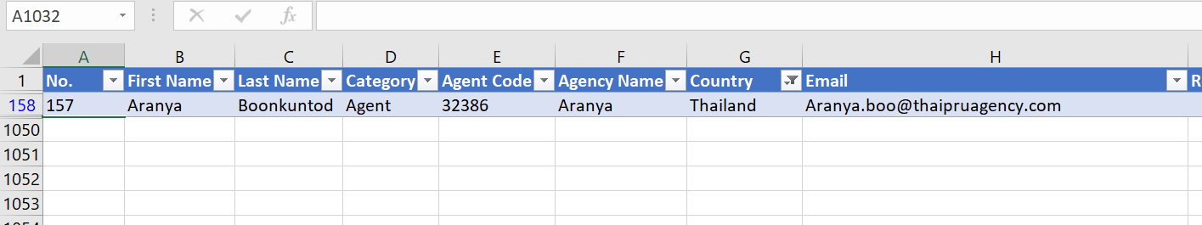
Cons
Program will crash in 2 scenarios (I have tried my best to fix it and have workarounds for it)
Scenario 1
The selected country only have one row of data. And it does not proceed to click on the filter button after searching for the first email domain search.
Example:
In this example, Thailand only has one email address. After filtering for the first search result, the program will stop working.

Slide 5
Cons
Program will crash in 2 scenarios (I have tried my best to fix it and have workarounds for it)
Scenario 1
The selected country only have one row of data. And it does not proceed to click on the filter button after searching for the first email domain search.
Example:
Solution: A simple fix can be done by entering dummy data for all the countries before the program starts

Slide 6
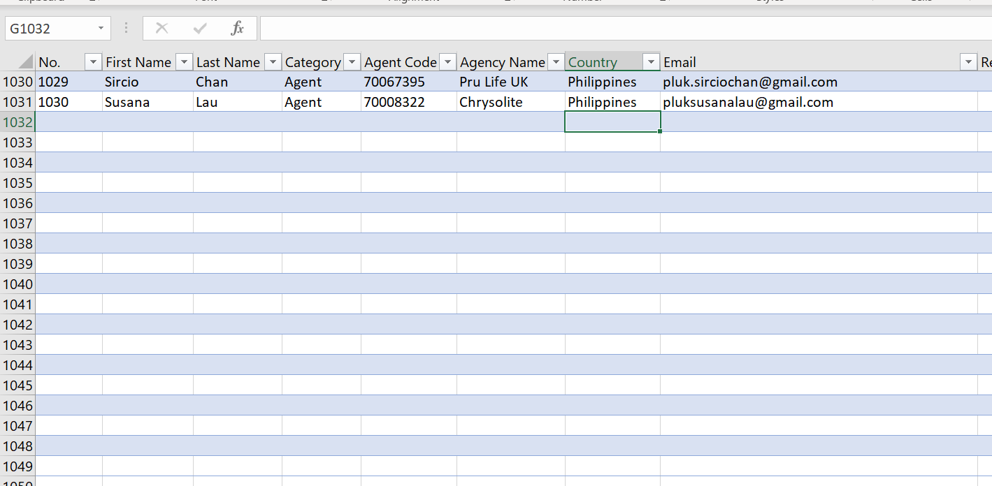
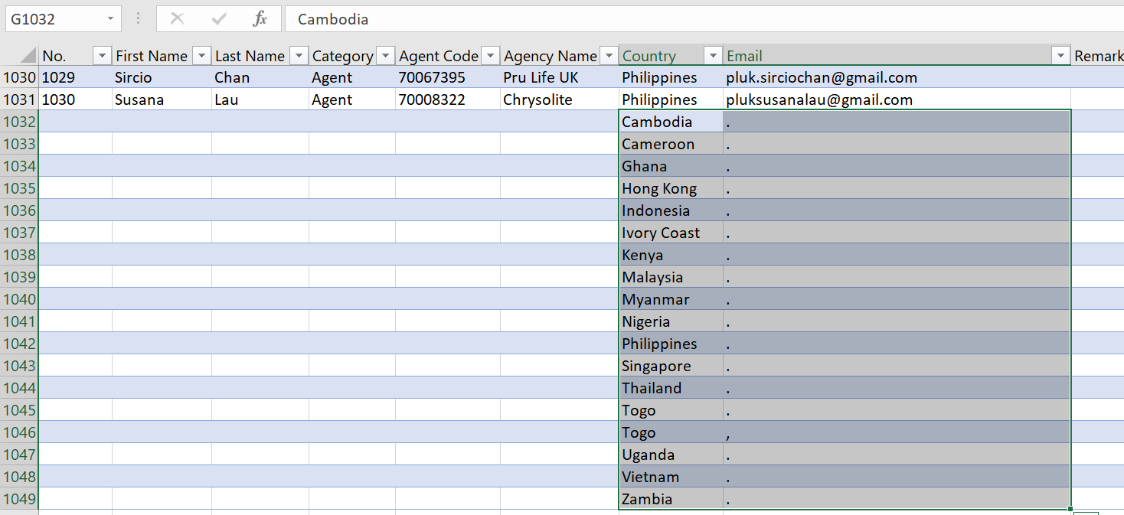

Cons
Solution
Input the dummy data from the file “dummy_data.txt” at the last line of the data
Copy the text in the file
Paste the text at the last line of the table like so:

Slide 7
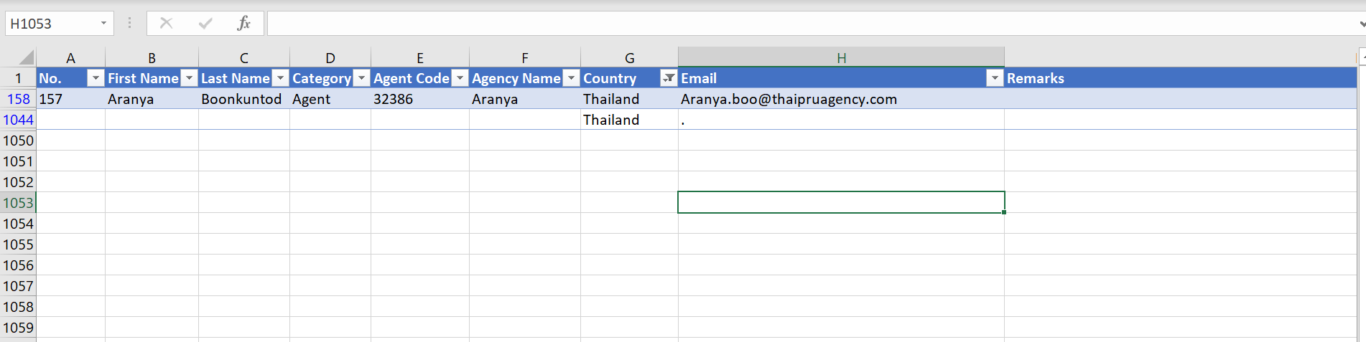
Two records on Thailand
Now the process won’t crash!

Slide 8
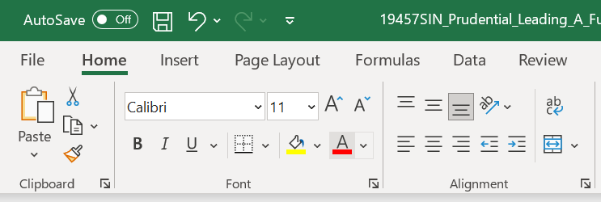
Cons
Scenario 2
Do not change the ‘select colour’ button. This may sound confusing.. But I’ll do my best to explain
In MSExcel, if you changed colour using the font colour picker, it will change the name of the button
For example, the name of the button if you did not change the colour is “default red colour font”. But if you picked another colour, the name of the button will change.
Let’s say you picked the colour blue, the name of the button will change to “blue colour font”

Slide 9
Cons
Even if you change the color back to red, this will not fix it. The button will instead be renamed to “red colour font” and not “default red colour font”
A simple fix would be to re-open the file but have the colour be red before closing. This will then change the name of the button to “default red colour font” again when you re-open excel.
UIPath is very specific on the names of the buttons it clicks on and this is one prime example of the limitations of UIPath.

Slide 10
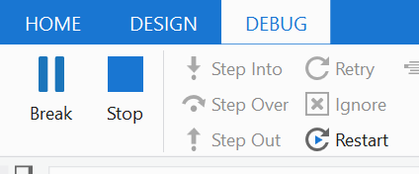
Cons
The process will not be able to stop once it has started. There is no ‘fail-safe’ button to stop the process. The only solution is to try your best to reach for the stop button once it is running
While the process is running, you cannot touch the mouse or keyboard as it may mess up the process.
The speed of the process is dependent on your CPU and Memory.
It may be slightly slower than doing it normally, but it has an accuracy of 100% when checking for email domains.
It is not able to check for exception in certain cases. May have to check manually if there are any.

Slide 11
Demo

