Slide 1
Extreme Presentation™ Example Page Layouts
Rev. 2.0
Andrew V. Abela, Ph.D.
www.ExtremePresentation.com
a.v.abela@gmail.com

Slide 2
SmartArt Enabled Layouts

Slide 3
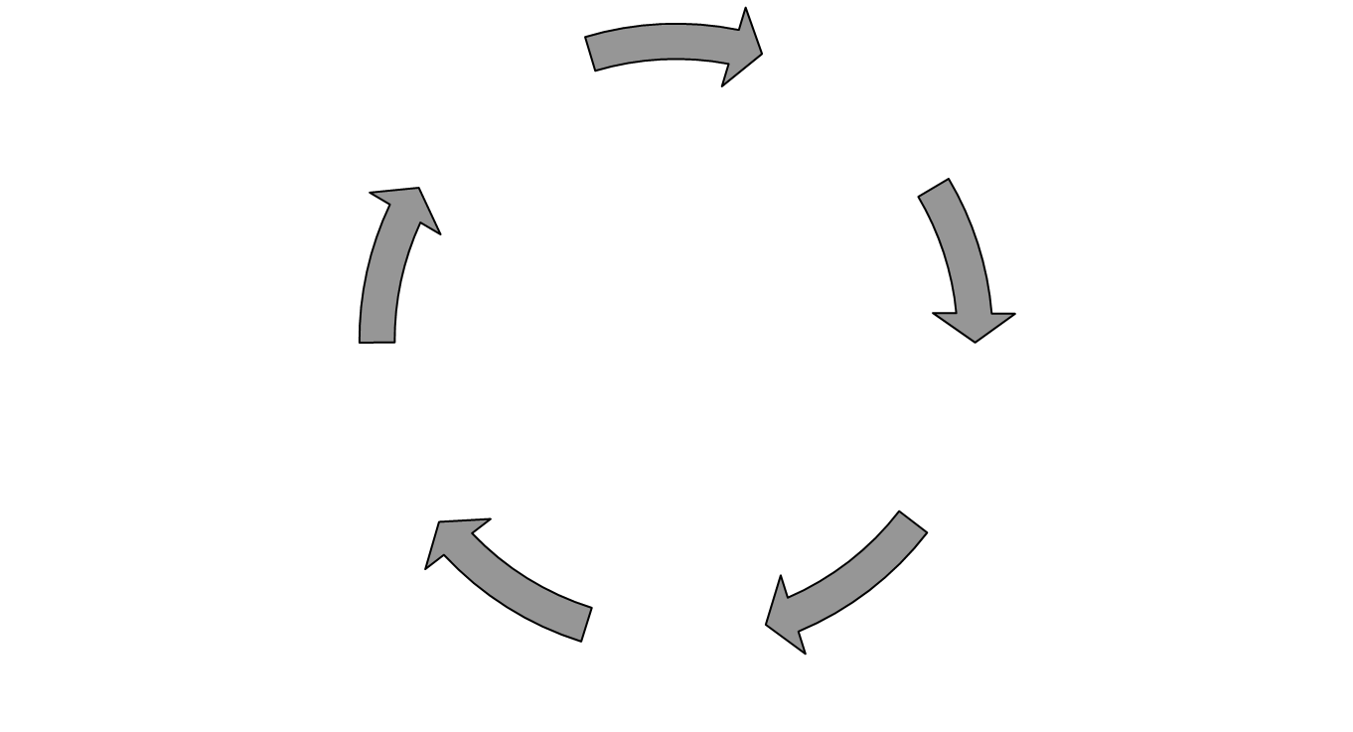
{Cyclical Process}
{Optional Subtitle}
Source: {text}

Slide 4

{Growth Opportunity}
{Optional Subtitle}
Source: {text}

