Slide 1
Thermodynamic modeling and asphaltene deposition simulator results for Tahiti
Anju Kurup, Walter Chapman
Rice University
May 23, 2011

Slide 2
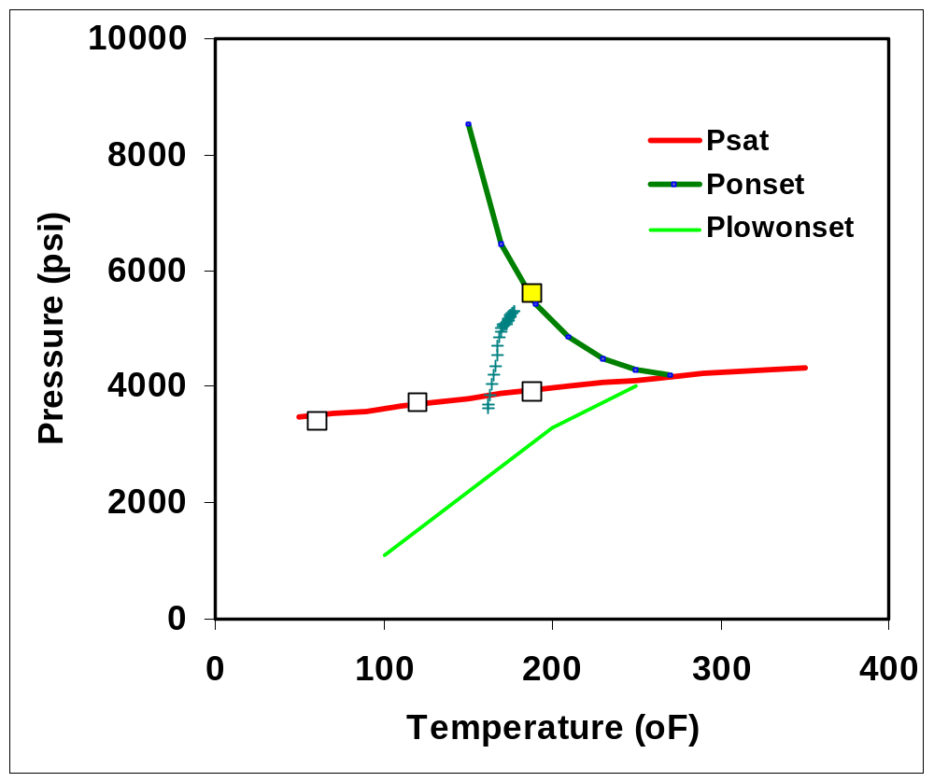
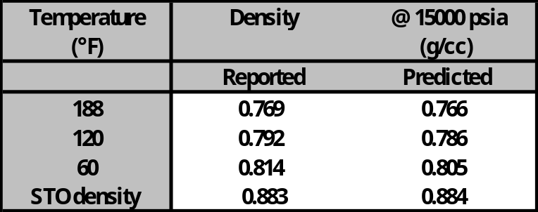
Asphaltene precipitation envelope with PC SAFT
Density predictions with PC SAFT vs measured
PC SAFT parameter estimation performed using the previously established protocol.
The thermodynamic model was benchmarked against the data available – Psat , Ponset
Yellow data point – Measured asphaltene onset
White data points – Measured saturation pressures
According to this thermodynamic model, all the P-T operating points (green data points) fall in the asphaltene precipitation envelope indicating potential to asphaltene precipitation and deposition along the entire length of the pipe.

Slide 3
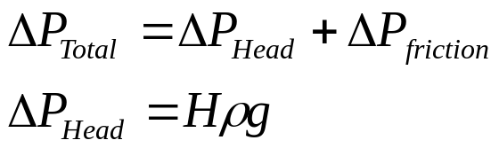
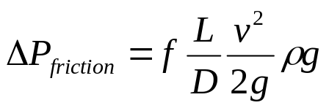
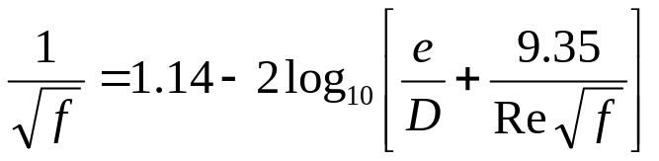
Calculation of deposit thickness
Pressure drop along the pipe length
Darcy- Weisbach formula
Colebrook-White equation
e= roughness, 0.045 mm for steel pipe
For a pipe with no deposit calculated DelP_{friction} using the above formula. DelP_{friction} subtracted from total DelP gives the DelP_{head} which remains the same with time.
For a period of one month, calculated the deposit thickness that results in frictional pressure loss measured (DelP_{total} – DelP_{head}) assuming a uniform deposit along the entire pipe length.
These calculations give a value of ~0.3 inch of deposit for a period of ~ one month.

Slide 4
Estimation of kinetic parameters required in the model
Reference: Anisimov et al., J. Phys. Chem, 1995
Study of Asphaltene aggregation in hydrocarbon solutions
Time required to form particles (~5 micron) ~ 1 hr.
Hence, Kp and Ka were initially estimated as 1/1hr = 3E-4 /sec

Slide 5
Estimation of Kd
Reference: Xie and Karan, Energy & Fuels, 2005.
Study of kinetics of asphaltene adsorption on metal surface.
Quartz crystal microbalance study of asphaltene adsorption on gold.
Asphaltene adsorption of ~ 2 mg/cm2 in 700 min.
Kd calculated as ~ 4E-4 /sec

Slide 6
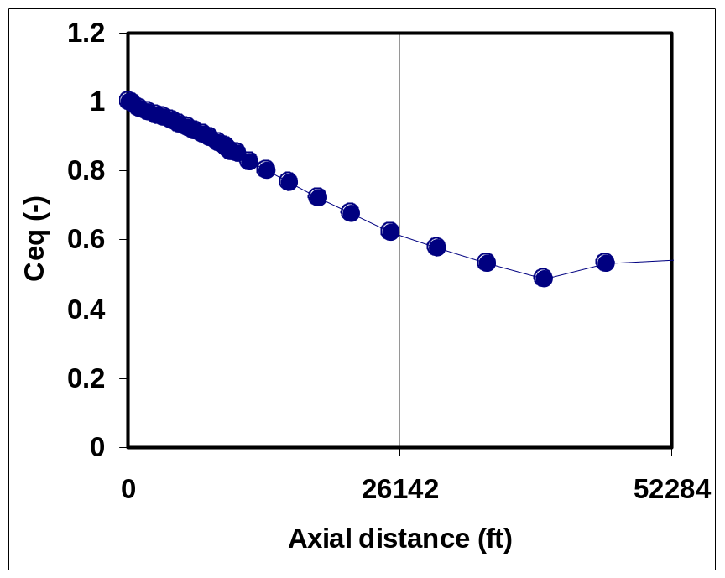
Equilibrium concentration of asphaltene along the axial distance of pipe from thermodynamic model (PC SAFT)
Ceq – Asphaltene solubility in the oil along the axial distance of the pipe was calculated using the thermodynamic model for the P-T values provided.
It is seen that Ceq reaches a minimum closer to the exit of the pipe (near the bubble point). Hence according to this thermodynamic model, asphaltene precipitation and consequent deposition possibility is maximum closer to the exit of the pipe.

Slide 7
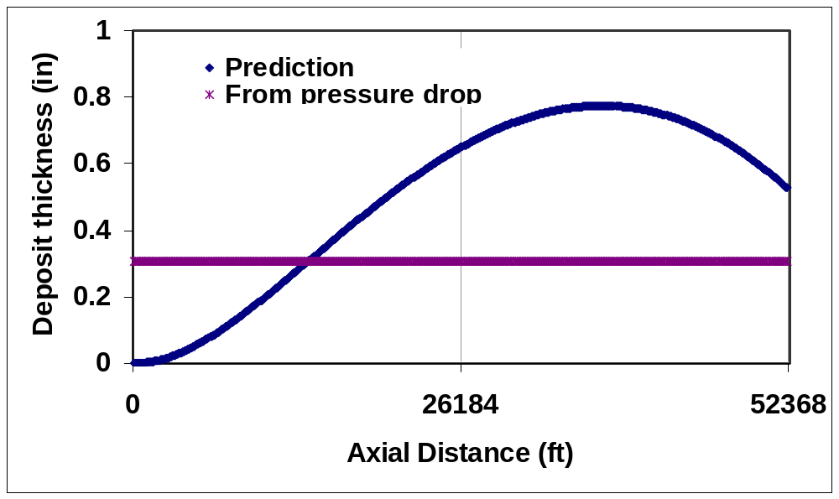
Deposit thickness prediction with the simulator
Kp, Ka = 3E-4, Kd = 4E-4 /sec
Average deposit thickness predicted = 0.5 in
DelP_{friction} in the presence of the deposit was calculated using the formula described in slide 2. Pipe was discretized into several sections and the reduced radius of the pipe due to the deposit was used to calculate the DelP_{friction}. From this the pressure loss due to friction for the entire pipe was calculated and is 1590 psi. The DelP_{friction} measured during a period of one month was 833 psi. The deposit thickness is over predicted with the current kinetic parameters.

Slide 8
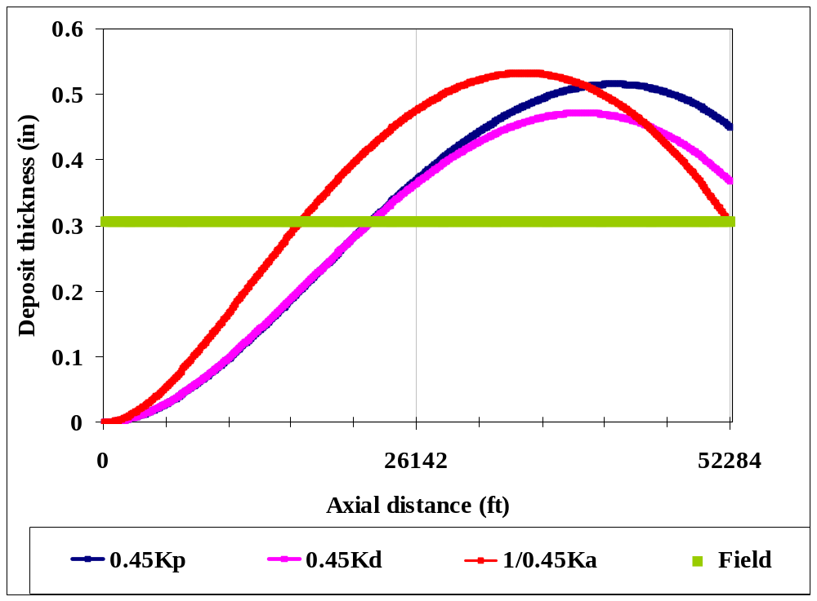
Deposit thickness prediction with the simulator
ΔP_{fric} =
931psi
ΔP_{fric} =
874psi
ΔP_{fric} =
999psi
ΔP_{fric} =
834psi
Slight variation of the kinetic parameters (0.5 times) give average thickness matching that reported. Frictional pressure loss for each of the profiles are calculated and compared to the field reported values.
Simulator predictions with these sets of kinetic parameters show deposit peak towards the exit of the pipe as expected from the thermodynamic model.

Slide 9
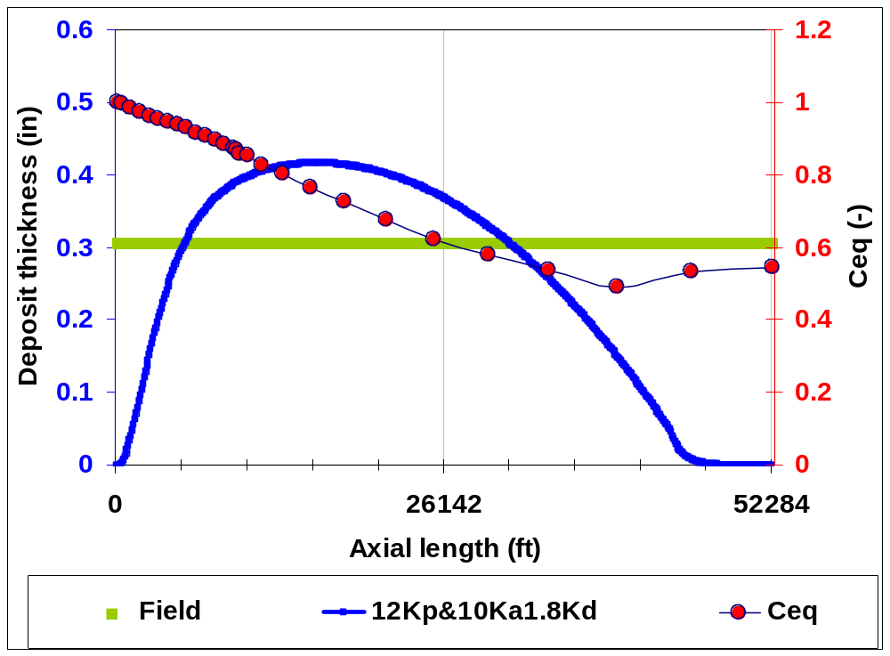
Deposit thickness prediction with the simulator
Precipitation and aggregation kinetic parameters when increased by an order of magnitude changes the shape of the deposition profile and the location of the deposition peak.
DelP_{fric} = 787 psi

Slide 10
Summary
According to the thermodynamic model, all the P-T operating points fall within the precipitation envelope and hence the deposition should be present over the entire length of the pipe. However, presence of highly turbulent conditions can reduce the spread of the deposit. These effects are difficult to quantify and are not being considered in the current simulator. Also change in elevation or presence of low spots along the pipe can act as regions where asphaltenes can sediment and form deposit. These factors are also not considered in the present simulator.
Plot of Ceq vs axial length shows that Ceq is minimum closer to the pipe exit, which indicates that the maximum asphaltene precipitation driving force is towards the exit of the pipe.
Simulator predictions with precipitation and aggregation kinetic parameters ~ 1E-4 show deposition profile in lieu with thermodynamic prediction that the deposit peak should be towards exit of pipe.
However, simulator predictions with precipitation and aggregation kinetic parameters ~ 1E-3 changes the shape of the deposition profile and the peak of the profile shifts towards the entrance of the pipe.
Hence, either capillary deposition experiment or kinetic experiments are required for the estimation of kinetic parameters for this oil in order to make a better prediction of the deposit location.

Slide 11
Transient simulator
Current deposition simulator is a steady state simulator. The effect of increasing deposit thickness on the flow velocity is not considered. Presence of deposit in the pipe causes flow constriction which increases the velocity of fluid flowing past. This in turn can affect the deposition flux of asphaltenes.
Presence of deposit also increases the frictional pressure loss which affects the pressure temperature operating curves along the axial length which again can affect the deposition flux profile.
Hence, modifications are made to the present simulator to convert it into a transient simulator.
In this transient simulator discretization in both time and axial co-ordinate is performed and the resultant equations are then integrated taking into account the presence of deposit in each of the axial grid points.

Slide 12
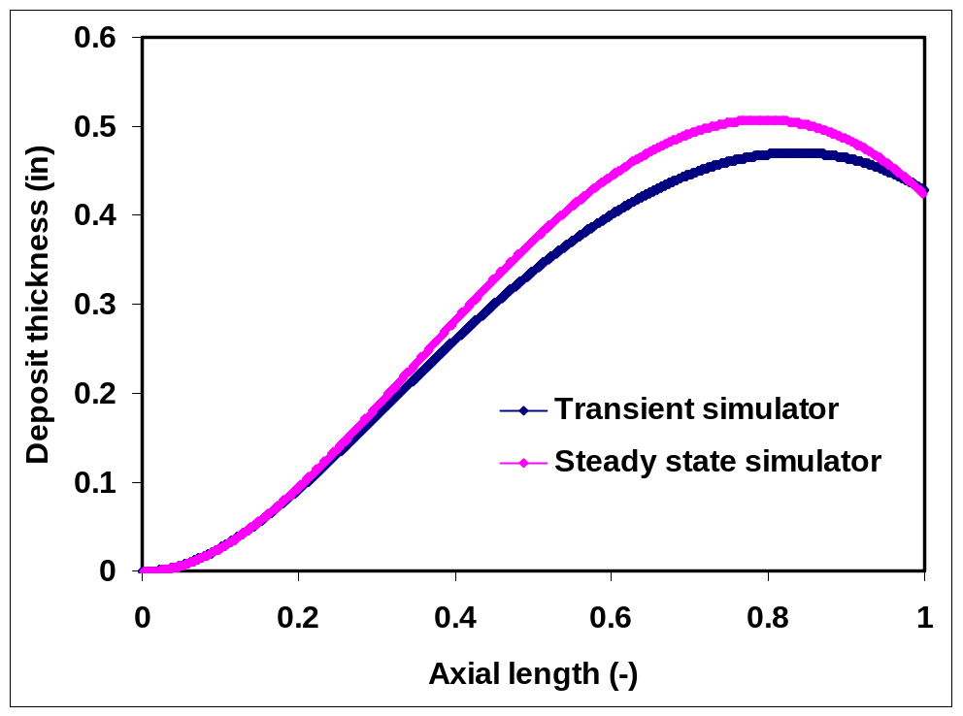
Comparison of transient simulator predictions against the steady state simulator predictions
Transient simulator is run for a period of one month. Steady state simulator results are multiplied by time period of one month.
Presence of deposit causes the velocity to increase which decreases the Damkohler numbers causing the deposit thickness to decrease. At higher velocities the time available for precipitation and consequent deposition decreases resulting in lower deposition thickness (0.47 inch against 0.52 inch with steady state simulator).
Sensitivity of time discretization shows that for insufficient grid points the transient simulator matches with the steady state simulator results.

Slide 13
Transient simulator
A fully coupled transient simulator can also be developed that takes into consideration the change in the pressure profile by calculating the frictional pressure loss at every axial grid point and then calculating the new asphaltene solubility at these grid points.
However, it is observed that the pressure loss due to head dominates the frictional pressure loss and hence incorporating this aspect may show only slight difference in the predictions. Nevertheless this modification to the transient simulator can also be incorporated.

