Slide 1

Kaizen: Thoughts on UI testing
Leveraging UI resource verification
05.21.2010
Jo Gel Santiago
GS LCM Tokyo

Slide 2
<agenda>
introduction
resource UI verification
  single file verification
  cross-release file comparison
  cross-language file comparison
use cases
tools & utilities
  new tools demo

Slide 3

INTRODUCTION
revisiting UI testing
G11N testing
resource containers in CTX products
resource UI verification

Slide 4
<intro>
UI testing
  process of testing software product with user interface
  types of interfaces: GUI/CLI/speech/vision/multi-modal
  consistency, usability, visibility, accessibility & compatibility
  typically, in accordance to spec, design, use cases, guidelines
  UI objects: windows, dialogs, controls, containers, texts
Approach
  display and iterate on every UI objects
  run scenarios on UI related operations & user-interactions
  software automation
    window frameworks: WinForms/MFC, Java AWT/Swing/SWT, Adobe Flash/Flex

Slide 5
<g11n.test>
today‘s focus
coverage
  regression testcase
    G11N related testcase selection (those considered with G11N risk)
    G11N testcases: input methods, code pages, printing…
    UI walkthrough
    resource UI verification
  automation tools
    GUIzard, UI monkey, ResourceValidator
    UIFramework/TestComplete + Scripts
    Unit test tools
references
    GTP, G11N criteria, feature specs, use cases, design docs
    guidelines(?), UI map/state diagram(?), checklist
    CPR, SR

Slide 6
<ui.ver::bg>
windows resource files
  Windows PE: w32 & .Net binaries
  win32: 21 types - RT_STRING, RT_MESSAGETABLE, RT_DIALOG…
  .Net: 19 types - String, Stream, Char…
other formats
  java resource bundles (properties files)
  dbm hash file (.dir & .pag pair)
  ini file (performance counter strings)
  xml formatted files (.cxmi, .resx, .xml)
  adm files (group policy strings)
  ms(pit) file (error strings, action texts, titles, descriptions, properties)
  text file (eula, license, .net text resource)
  swf file (Adobe Flex), .mo file (Python), & so on
  nib/xiv file (Mac apps)

Slide 7
<ui.ver::def>
“token check” on LCM terminology
static verification of UI resource file
  static – does not require a working system-under-test
  verification – check for consistency and other possible issues
  comparison – diff with other versions, or localized counterparts
  UI binaries - win32 PE files, .Net dlls, plain texts, hash files
  UI objects - strings/messages, version info, templates (menu/dialog)
  G11N interests - localizable objects
why run?
  UI objects cannot be totally covered in the actual testing path
    branching conditions
    object dependency
  lack of documentation and reference information
    complete UI maps and relations
  build & integration errors
    encoding, code integration issues and other regression issues

Slide 8
<ui.ver::tools>
Windows Resource
  Resource Hacker
  Asmex
  .Net reflector
  ResourceValidator
  smrdump/resdump
  enumres/rescmp/resport
Others
  Resource Exporters/Dumpers
    Java Properties Extractor (batch file script)
    DBM Resource Dumper (DBM to txt)
  Compare Tools
    Diff Tools: WinMerge, Differencer, DiffDaff, P4Diff
    CommandLine: fc, comp, xyzzydiff, diff(Unix)
today‘s demo

Slide 9

TYPES OF VERIFICATION
single resource UI file check
cross-release file comparison
cross-language file comparison

Slide 10
<ui.ver::sfv>
single file verification
  verification of a single resource UI binary file
possible issues:
  garbled strings (encoding)
  incomplete/un-localized strings
  hard-coded strings (in dialog/menu templates)
  duplicate keys and/or values
  build related errors
    incorrect file build path
    code mis-integration
  version inconsistency
    fixed version info vs translated version info
    unexpected localized version info
  information leak
    confidential info ← (possibly?!)

Slide 11
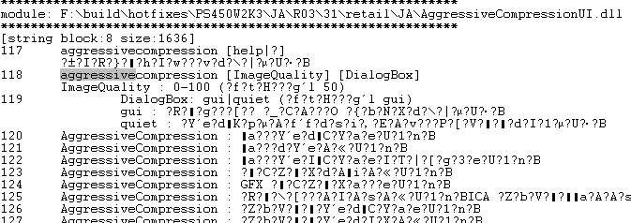
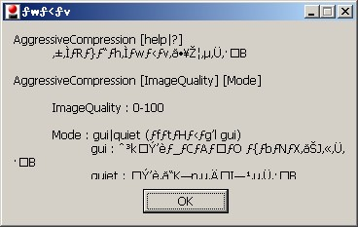
<sfv::issues>
garbled strings:
  commonly caused by incorrect encoding / missing fonts
Garbled Japanese characters (aggressivecompressionUI.dll)
actual UI dialog at runtime (aggressivecompression.exe)

Slide 12
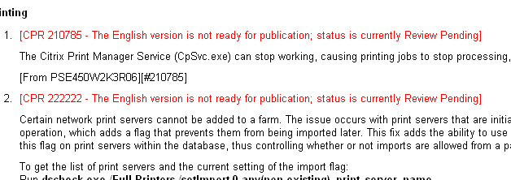
<sfv::issues>
incomplete strings:
  task markers like <TBD>, <ForConfirmation>, <RequiresApproval>
  usually used in readme localization, linguists may be doing the same on UI resource files
  dependent to the developer’s workstyle
task markers used in readme.

Slide 13
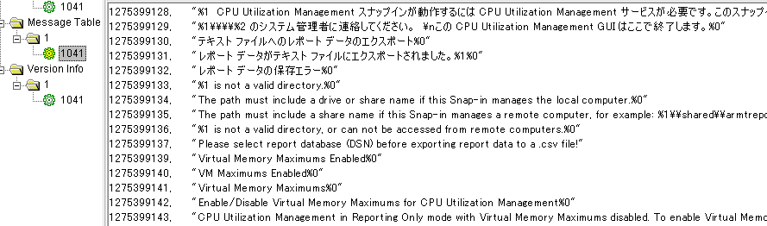
<sfv::issues>
unlocalized strings:
  some text entries in localized modules are still in English
  causes: mis-integration, unsubmitted changelists, build issue
un-localized message table entries in ctxcpumsg.dll

Slide 14
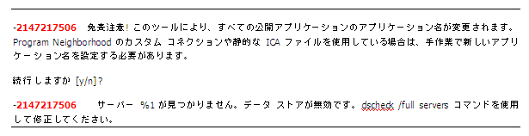

<sfv::issues>
duplicate entries:
  duplicate key
  duplicate value
duplicate resource key issue
(imamsgsui.dll, Ohio HRP02 B05)
possible implications:
  runtime exception: key already exists in the table
  unintended resource string is returned
what happens if the 1st entry was returned instead of the 2nd line.

Slide 15
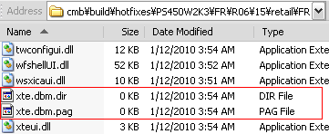
<sfv::issues>
build-related errors:
  corrupted or empty files
  incorrect file-path during build/packaging
    incomplete rademsgui.dll from Mako was pulled into Ohio HRP06 build
    path to EN resource files was specified in the later build of RU HRP05
Empty resource file issue on Ohio HRP06 FR build 15

Slide 16
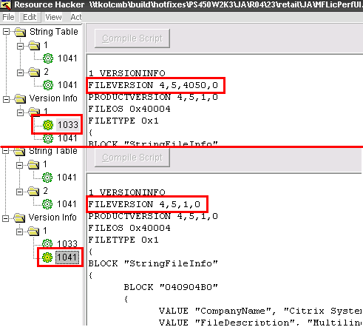
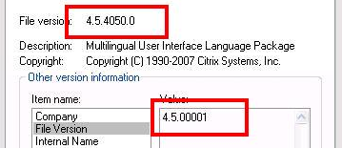
<sfv::issues>
version inconsistency:
  file version number differs in fixed and translated version block
  unexpected localization of version info
    Citrix file’s version info only contains one block with one language
    No(?) guideline for version info properties localization
unintended localization of version info in MFLicPerfUI.dll
file version number inconsistency in fixed and translated block.

Slide 17
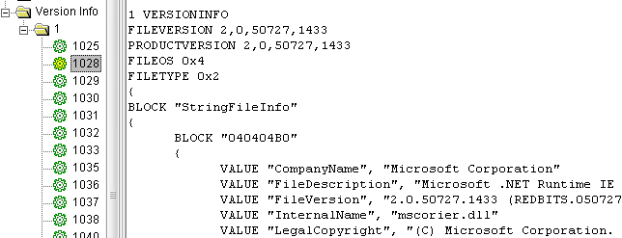
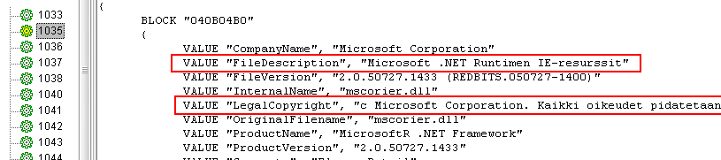
<sfv::fyi>
example: localized version info :
  version info properties are localizable objects
  some companies do version info localization
localized file version info properties

Slide 18
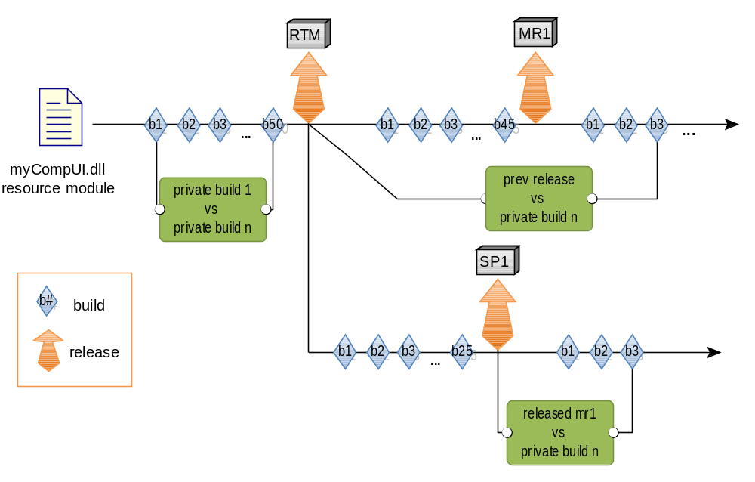
<ui.verification::crfc>
cross-release file comparison
  comparing the UI elements of multiple versions of the same UI module

Slide 19
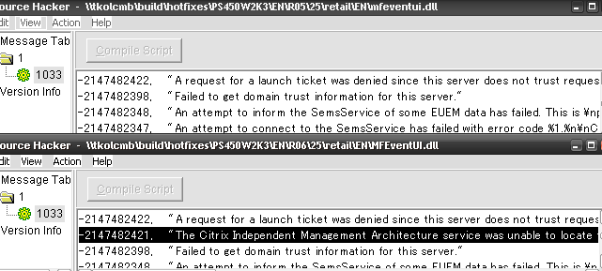
<crfc::issues>
newly added entries:
  new entries - may be intended or unintended
  intended entries should be documented like in CPRs
  unintended changes caused by mass code integration & build errors
newly added message table string entry in resource UI dll.
documented in CPR and FS.

Slide 20
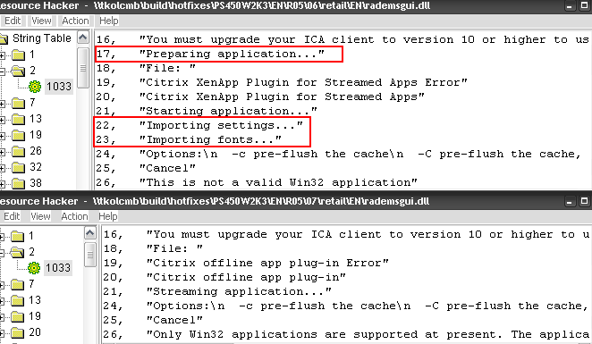
<crfc::issues>
deleted or removed entries:
  deleted entries - may be intended (but are not usual)
  commonly caused incorrect build path
missing string entries in the later builds of rademsgui.dll (Ohio HRP05 )
possible implications:
  null value causing runtime exception leading to application crash

Slide 21
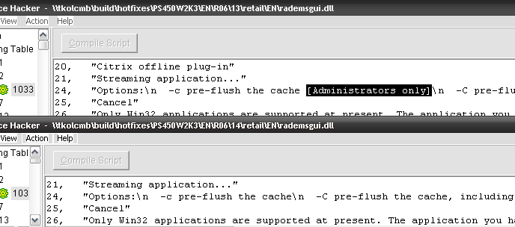
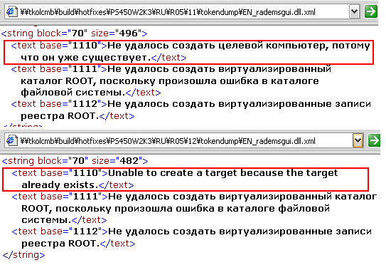
<crfc::issues>
reverted/modified entries:
  modified entries - may be intended or unintended
  intended entries should be documented like in CPRs
  unintended changes caused by mass code integration & build errors
reversion to English texts
(HRP05 RU rademsgui.dll)
some words removed from the previous version.

Slide 22

<crfc::issues>
key alignment:
  new entries are inserted into existing table & succeeding entries are mapped with different keys.
  rare case but could happen
versioning issue:
  new released versions should have higher file version number
  in some cases, file version is not bumped
    file installation failing due to old version number
MSI make use of file version number and are placed in the table during package creation.
File version is NOT determined at installation runtime.

Slide 23
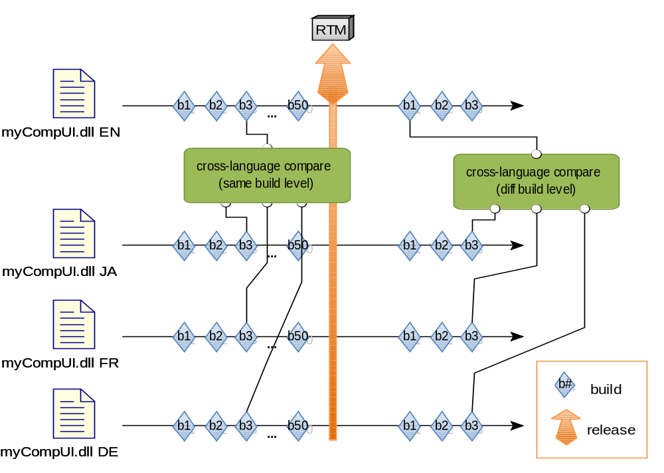
<ui.verification::clfc>
cross-language file comparison
  comparing the UI elements of the base and localized versions of the UI module
  tier-1 languages: JA, FR,ES,DE

Slide 24
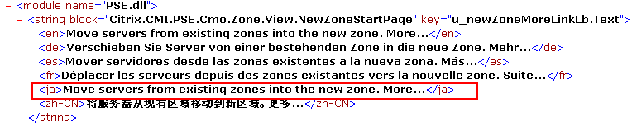
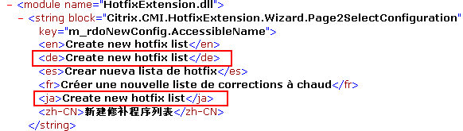
<clfc::issues>
un-localized entries:
  English strings as reference, un-localized entries can be easily detected
unlocalized JA strings in Parra XA Mgmt Console (PSE.dll)
unlocalized JA & DE strings in Parra XA Mgmt Console (PSE.dll)

Slide 25
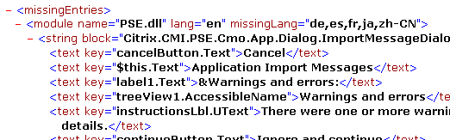
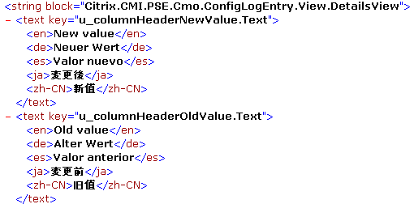
<clfc::issues>
missing entries:
  entries found in English language which are not in the localized module
  missing string entry or missing whole block (class resource)
rescmp output result indicating the listed entries are missing on the localized modules.
merged output files where FR resources are missing.

Slide 26
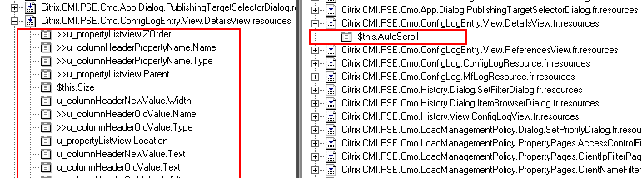
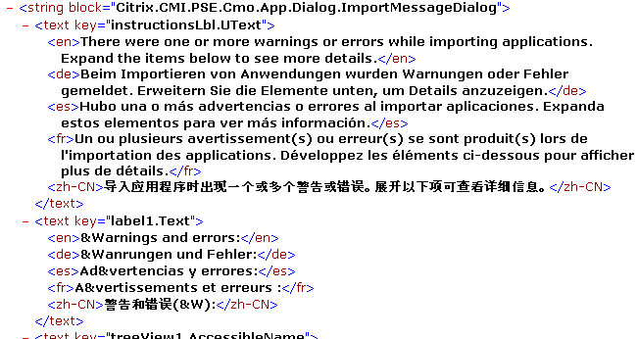
<clfc::issues>
missing entries (block):
comparison of EN and FR resources entries using Asmex
merged output files where JA resources are missing.

Slide 27
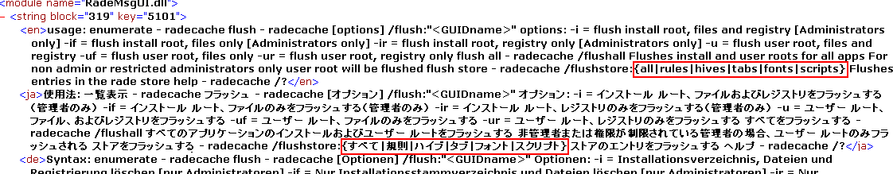
<clfc::issues>
translation issues
  context-issues
    the translated strings are contextually incorrect.
    word meaning depends on the actual usage context
      → e.g. close: 閉じる (shut) 、近い (near) 、親しい (intimate) …
    sometimes the English string itself maybe contextually incorrect.
  over-translation
    translation of texts which should not be translated
    units, perf counters, proper nouns, commands/options, SQL etc.
    implications: functional regressions
switch parameters translated to Japanese texts.

Slide 28
<clfc::issues>
formatting tags/specifiers
  serve as parameter placeholder in a formatted texts
  also indicates formatting flags and options
  examples: %d, %4.2f , {0}, {1:E}
tag related issues
  tag order
    tag order may differ in the localized texts according to grammar
      English: {0} over {1} is the answer.
      Japanese: 正解は{1}分の{0}です。
  missing tags
    tags may be un/intentionally removed from the translated context
      English: Total is ${0} and {1} cents.
      Japanese: 合計は￥{0}です。
purely rely on the linguists’ expertise on the subject matter

Slide 29
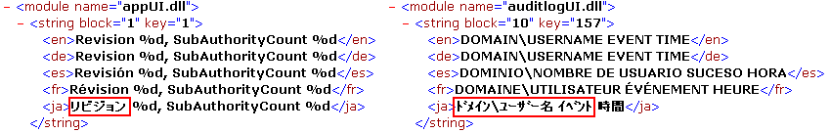
<clfc::issues>
relative glyph sizes
  some languages have glyphs (Japanese, Hangul )
    full-width (全角, zenkaku), half-width (半角, hankaku)
    latin and numeric characters can be represented in full-width forms
    context is similar but representation differs: 1-byte vs 2-bytes
    implications: functional regressions, possible truncations
  full-width characters translation issue
    latin characters: e.g. “Test” can be written as “Ｔｅｓｔ”
    numeric data: date: “2010” → “２０１０” number: {2} → {２}
  full-width or half-width Katakana
    Japanese Katakana characters can be in full-width or half-width
katakana in full-width form
katakana in half-width form

Slide 30
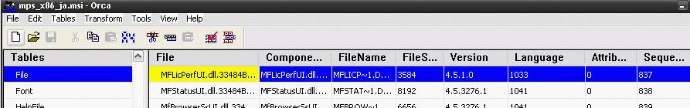
<clfc::issues>
versioning issue:
  files of the same build/release level should have consistent versioning
  base and localized modules in the same release should have the same version number
MSI make use of file version number and are placed in the table during package creation.
File version is NOT determined at installation runtime.
File version are retrieved by MSI packager using the language value

Slide 31

USEFUL SCENARIOS
leveraging resource UI verification in
hardware dependencies/limitation
software design & configurations

Slide 32
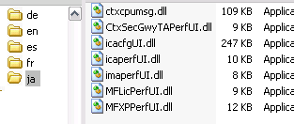
< important.cases >
hardware dependencies:
  installation of specific binaries have hardware-related dependencies
  related testcases not executable if components are not installed
  e.g.: XA ctxcpu components only installed in host with 2+ CPUs
ctxcpumsg.dll resource UI
ctxcpu component record with its install condition in mps.msi table.

Slide 33
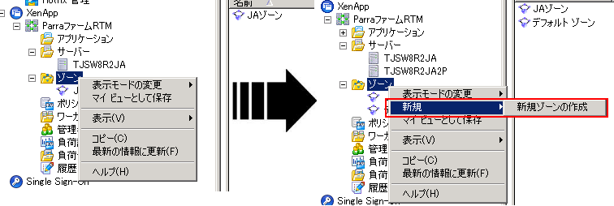
< important.cases >
context menus:
  menus are disabled, hidden (visible=false), unavailable (object=null)
  conditions have to be satisfied to branch into a new UI test path
  e.g.: XA “create new zone” context menu which requires 2+ server objects in the farm to make it available.
case of 1-server farm
case of 2-server farm

Slide 34
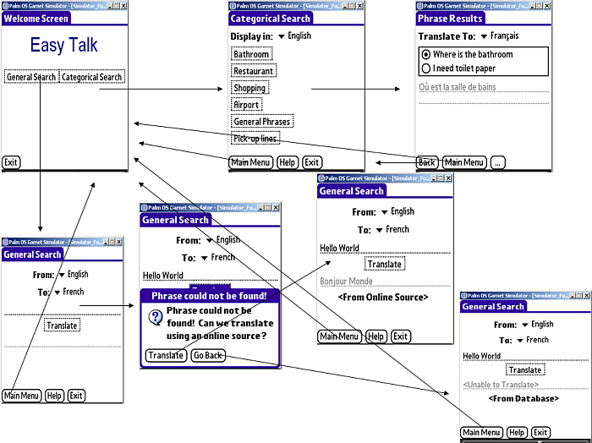
< important.cases >
complex UI structure:
  UI objects (window/dialog/controls) are in tree-like structure
  UI visibility/accessibility may be dependent to certain state/conditions
  complete UI map and relationship (required conditions) becomes a need
    GTP, UML diagrams may serve as a reference
UI map example

Slide 35
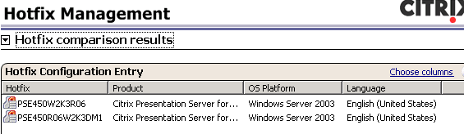
< important.cases >
object/state dependencies:
  functionalities not accessible without an external object
    object like product hotfixes, generated log files
  runnable tasks may be dependent to system or object state
    e.g. database purge function only available at db.size > 1GB
    citrix components: radecache flush, dscheck
DSC(AMC) Hotfix Mgmt functionalities cannot be tested without hotfixes.

Slide 36

A DIFFERENT PERSPECTIVE
leveraging resource UI verification in
testcase coverage assessment
testing “untestable” UI
regression tracing

Slide 37
< diff.perspectives >
test-coverage assessment:
  how many UI objects are covered in the created testcases?
  complete UI map/list is not available
  deduction of features/scenarios where UI resources are used
using deduction
  descriptive names of UI resource filenames, classes, types and keys
  context of the string values
  UI objects like dialog and menu templates
examples:
  filename: HDXFlashEventMessages.dll ← related to HDX Media Flash feature
  type: RT_MESSAGETABLE ← generally used for event messages
  class: Citrix.CMI.PSE.Cmo.Zone.View.NewZoneStartPage ← related to New Zone creation
  key: u_newZoneMoreLinkLb.Text ← string is used as Text property of a control
  text value ← may provide the actual context

Slide 38
< diff.perspectives >
locating “untestable” UI objects :
  test path is unreachable due to some reasons
  cannot be verified at runtime
tracing build regressions:
  code-level reversion in-between builds
    automatic / mass code integrations
  build system configuration changes
    system changes: switching to new build system – CIBA → HFDB
    build developer inputs: incorrect file or branch paths
build systems are NOT perfect!
Resource UI verification (on every build) will help prevent UI related regressions in getting into the final product.

Slide 39

TOOLS & UTILITIES
useful tools & utilities
Resource Hacker
Asmex
new tools

Slide 40
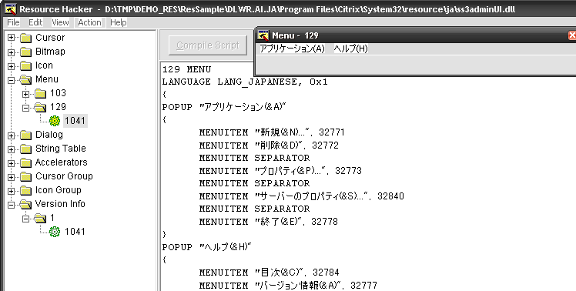
< tools&utilities >
Resource Hacker:
  free GUI-based Win32 resource editor
  good support for viewing visual resources – dialog, menu, icons, etc…
  difficulty in displaying Russian texts
  cannot read some modules: e.g. HDXFlashEventMessages.dll
very useful in checking visual UI resources like menu and dialog templates as well as icons & images.

Slide 41
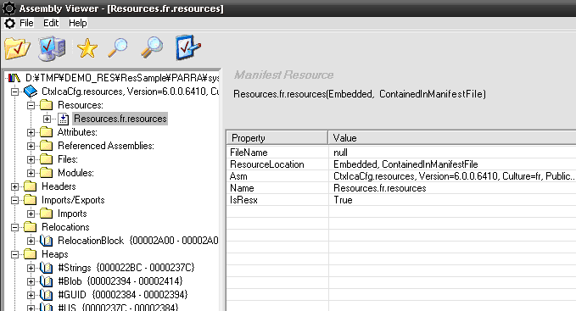
< tools&utilities >
Asmex:
  open-source .Net assembly explorer
  primarily used for examining classes/modules
  good GUI for viewing internal structure including embedded resources

Slide 42
< tools&utilities >
Other tools:
ResourceValidator
  cross-language compare tool for consistency check between base language (EN) & localized satellite resource files
  only supports: W32 MessageTable & .Net String resources
  no cross-release comparison
  requires external dll & config file
.Net Reflector
  commercial utility for .Net assembly analysis & decompile
  has a free version with limited functionality
smrdump (GS LCM)
  command-line app for dumping Win32 MessageTable and String resources into console
resdump (GS LCM)
  command-line app for dumping .Net String resources into console

Slide 43
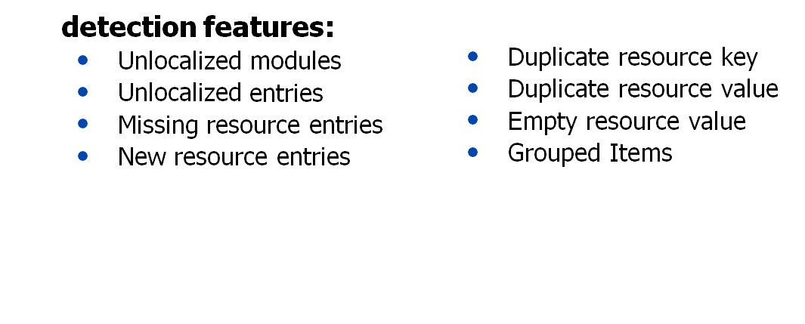
< tools&utilities >
enumres
  console app for exporting all string resources to xml file (per file basis)
  supports: Win32 RT_MessageTable, RT_String & .Net String resources
  tbd: Win32 resource types - version, dialog, menu, accelerators
rescmp
  console app to compare/check issues on dumped XML files by enumres
  supports both cross-release/build & cross-language file comparison
  produces merged XML files (for side-by-side comparison of entries) and an output XML file for the possible issues found

Slide 44

DEMO
exporting resources with enumres
comparing resources with rescmp
dumping dialog templates to bitmap

Slide 45
< enumres:usage >
[Usage]
dump single module:
>enumres.exe filePath [outputDirectory]
dump all modules in a directory:
>enumres.exe dirPaths(dir1[;dir2]) [filters(dll;exe;...)] [outDir/XML]
[Examples]
>enumres.exe "%programfiles%\citrix\system32\aui.dll"
output file → "%programfiles%\citrix\system32\tokendump\aui.dll.xml"
>enumres.exe "%programfiles%\citrix\system32\aui.dll" "c:\temp"
output file → c:\temp\aui.dll.xml“
>enumres.exe "%programfiles%\citrix\system32"
output dir→ "%programfiles%\citrix\tokendump"
>enumres.exe "%programfiles%\citrix\system32" dll;exe;vrs “c:\temp”
output file → c:\temp\
including subfolders
sub-folder structure is maintained.

Slide 46
< demo:enumres >
Ex 1: dump a single module
>enumres D:\TMP\DEMO_RES\EnumRes\Case1\MFErrorUI.dll
output: D:\TMP\DEMO_RES\EnumRes\Case1\tokendump\MFErrorUI.dll.xml
Ex 2: dump a whole resource directory
>enumres D:\TMP\DEMO_RES\ResSample\PARRA\xa.mgmt
output: D:\TMP\DEMO_RES\ResSample\PARRA\tokendump
Ex 3: with ext file filter and output directory
>enumres ”%DEMO%\ResSample\hrp05” exe;dll;vrs “%DEMO%\ResDumps\hrp05”
Ex 4: dump a whole installation directory
>enumres D:\TMP\DEMO_RES\ResSample\DLWR.AI.JA\Program Files\Citrix dll;exe;vrs D:\TMP\DEMO_RES\Dlwr_ProgFiles_Citrix_Dump
output: D:\TMP\DEMO_RES\Dlwr_ProgFiles_Citrix_Dump

Slide 47
< rescmp:usage >
[Usage]
>rescmp.exe /c|d <refLang=dir1;dir2> [<lang2=dir1;dir2>] [<lang3=dir1;dir2>] [addtl switches]
cross-language comparison:
>rescmp.exe /c "en=%cd%\xa.mgmt" /s /x "Comment" /o "%cd%\Out" /n "out.xml"
>rescmp.exe /c "en=%cd%\xa.mgmt\en" “de=%cd%\xa.mgmt\de” “fr=%cd%\xa.mgmt\fr”
cross-release comparison:
>rescmp.exe /d “rtm=%cd%\ohio” “hrp1=%cd%\hrp1” /x "RTM vs HRP1 Diff”
>rescmp.exe /d “b1=%cd%\b1” “b2=%cd%\b2” “b3=%cd%\b3” /x “HRP1 B1,B2,B3 Diff”
additional switches:
/r -recursive sub directory scan
/s -satellite resources structure
/x <comment> -user comments
/o <pathToOutputDir> -output directory
/n <xmlFileName> -output filename
/a <lang=code> -alternative language code e.g. es=1034
/g <suffixString> -key suffix string e.g. "items" for item grouping
/m <file1=file2> -filename mapping e.g. "CVhdMount.exe=CVhdMountUI.dll"

Slide 48
< demo:rescmp >
1st parameter serve as the reference version
CROSS-RELEASE:
Ex 1: 2-version comparison (HRP05 Build 25 – HRP06 Build 14)
> rescmp /d “hrp5b25=D:\TMP\DEMO_RES\ResDumps\PSJ450W2K3R05\25\JA"
“hrp6b14=D:\TMP\DEMO_RES\ResDumps\PSJ450W2K3R06\14\JA"
/x “JA HRP05 B25 – HRP06 B14 Diff"
/o “D:\TMP\DEMO_RES\ResCompare\JAHRP05B25-HRP06B14Diff”
/n “hrp06b13b14diff.xml”
Ex 2: multiple versions (HRP06 Builds 4, 13, 14, 25)
> rescmp /d "b04=D:\TMP\DEMO_RES\ResDumps\PSE450W2K3R06\04\EN"
"b13=D:\TMP\DEMO_RES\ResDumps\PSE450W2K3R06\13\EN"
"b14=D:\TMP\DEMO_RES\ResDumps\PSE450W2K3R06\14\EN"
"b25=D:\TMP\DEMO_RES\ResDumps\PSE450W2K3R06\25\EN"
/x "HRP06 EN Bld 04, 13, 14, 25 Diff"
/o “D:\TMP\DEMO_RES\ResCompare\HRP06B04B13B1B254Diff”
/n “hrp06b04b13b14b25diff.xml”
use in tracing which build the regressing code is included

Slide 49
< demo:rescmp >
1st lang parameter serve as the reference or base language files
CROSS-LANGUAGE:
Ex 1: 2-language comparison
>rescmp /c en=D:\TMP\DEMO_RES\ZZResDumps\hrp05\PSE450W2K3R05\25\EN
ja=D:\TMP\DEMO_RES\ZZResDumps\hrp05\PSJ450W2K3R05\25\JA
/x "HRP05 B25 EN-JA Compare"
/o D:\TMP\DEMO_RES\ResCompare\HRP05B25EN-JAComp
/n HRP05B25EN-JAComp.xml
Ex 2: satellite resource structured folder (EN files at root)
>rescmp /c en=D:\TMP\DEMO_RES\ZZResDumps\Parra\xa.mgmt /s
/x "Parra XAMgmtConsole Cross-Language Check"
/o D:\TMP\DEMO_RES\ResCompare\ParraXAMgmtComp
/n ParraXAMgmtComp.xml
Ex 3: satellite resource structured folder (EN files in subfolder)
>rescmp /c en=D:\TMP\DEMO_RES\ZZResDumps\Parra\sys32.resource /s
/x "Parra System32 Resources Cross-Language Check"
/o D:\TMP\DEMO_RES\ResCompare\ParraSys32Comp
/n ParraSys32Comp.xml

Slide 50
< demo:rescmp >
Ex 4: with alternative culture
>rescmp /c en=D:\TMP\DEMO_RES\ZZResDumps\Parra\sys32.resource /s
/x "Parra System32 Resources Cross-Language Check"
/a en=2057 es=2058 es=1034
Ex 5: with mapped files
>rescmp /c en=D:\TMP\DEMO_RES\ZZResDumps\PVS /s
/o D:\TMP\DEMO_RES\ZZResCompare\PVS
/m CVhdMount.exe=CVhdMountUI.dll [file2.exe=file2UI.dll]
Ex 6: with grouped items
>rescmp /c en=D:\TMP\DEMO_RES\ZZResDumps\Parra\sys32.resource /s
/x "Parra System32 Resources Cross-Language Check"
/g options;items
Spanish (Trad Sort): 1034, English-UK=2057, Spanish-Mexico=2058
Only applicable to .Net string resources:
example keys: comboBox1.Items, comboBox1.Items1, comboBox1.Items2

Slide 51
< demo:others >
resport (prototype)
  dump dialog templates to bitmap image
  usage: resport <pathToResWithDlgTempEntries>
Java Properties Extractor (JDK required)
  search for jar files and extract embedded properties
  encode file to native and dump to text file
  use fc or comp to find modified contents
  usage: xtprop.bat <pathToSearchJarFiles>
DBM Hash file exporter (batch file + perl script)
  load dbm file pair & export string resource to text file
  usage: dmpAllDbm <pathToSearchForDbmFilePairs> [csv]
Embedded MST Update Dumper (VBScript + msidb.exe)
  extract embedded MST from an MSI file
  apply MST and dump the transform view table to text file
  usage: dmpmst.vbs CTX_Licensing.msi

Slide 52

FUTURE PLANS
Enhancements/Refinements
Integration with Auto scripts
- Tools on non-Win resources

Slide 53
< enhancements >
enumres
  - additional Win32 resource type support (exporting the text parts )
    RT_VERSION: all file version properties
    RT_DIALOG: dialog captions and dialog items’ text label
    RT_MENU: text labels of each menu and menuitems
    RT_ACCELERATORS: accelerator key characters
- minimize false positives
rescmp
  - additional pattern detection & comparison
    formatting tag order check and compare
    command-line switch pattern
resport
- port functionality to enumres

Slide 54

DISCUSSION
- Comments
- Requests
- Suggestions
- Questions

