Slide 1

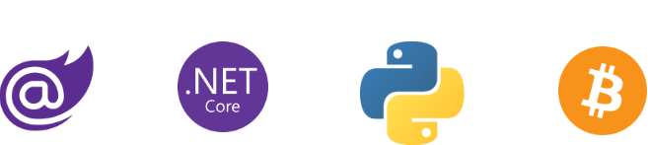
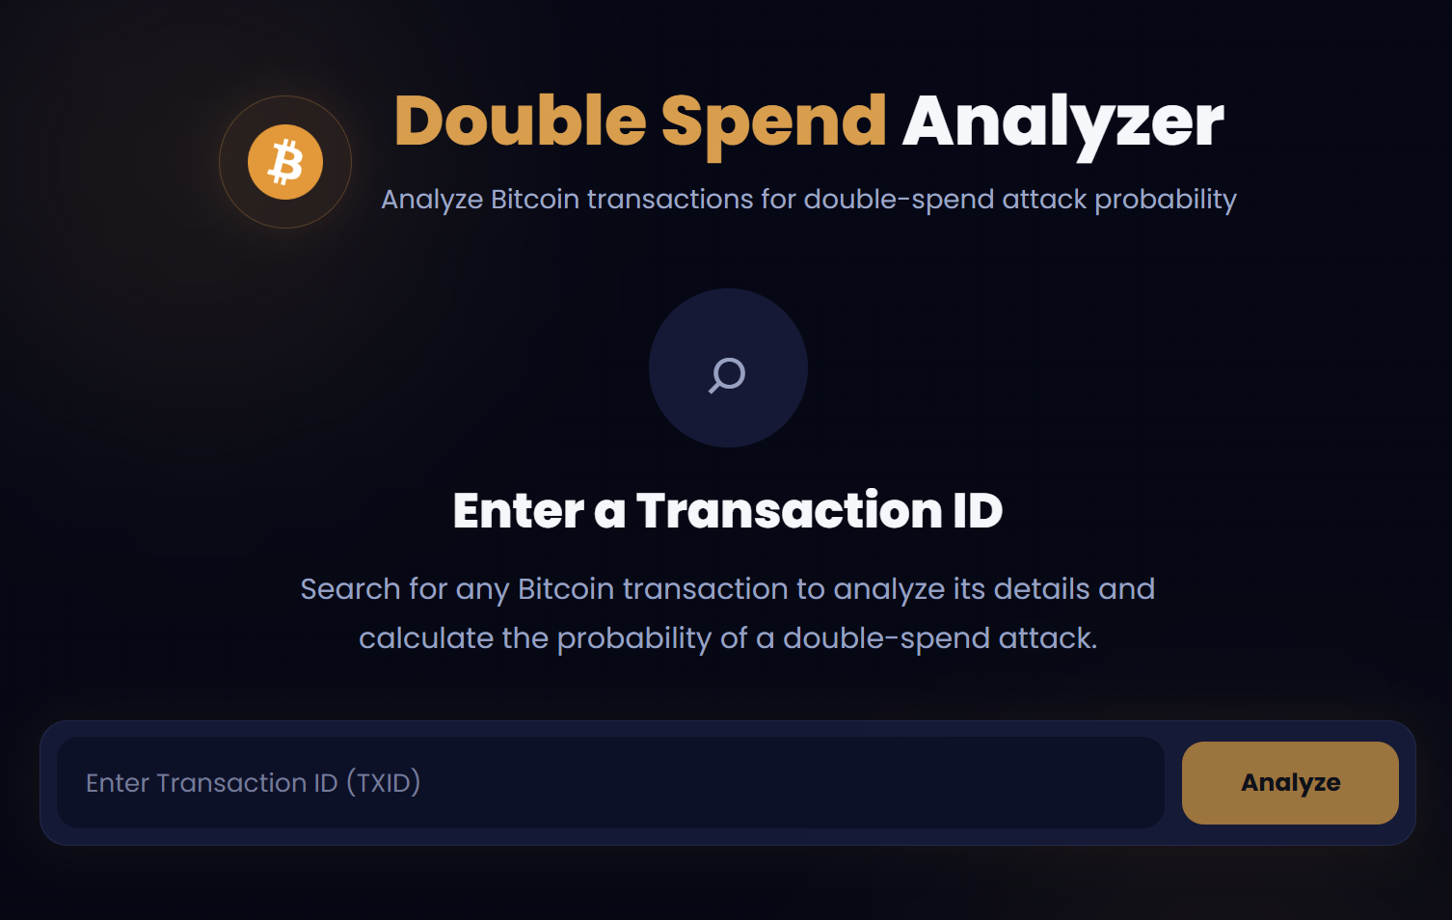
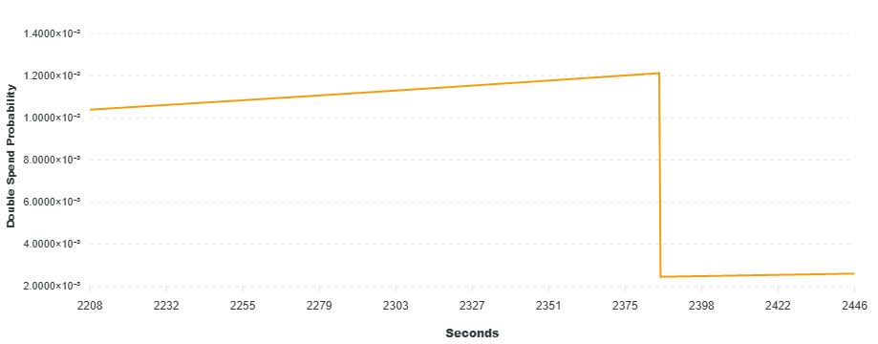
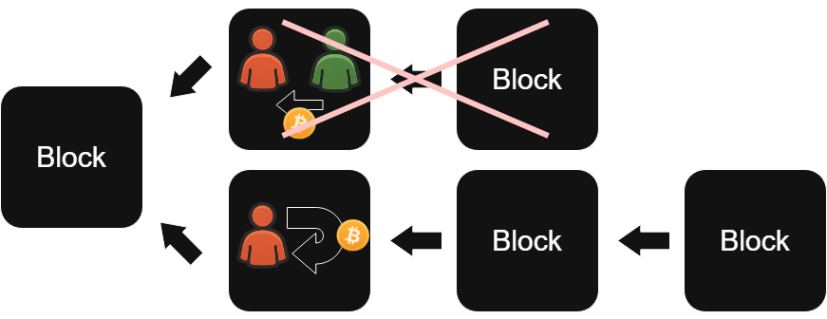
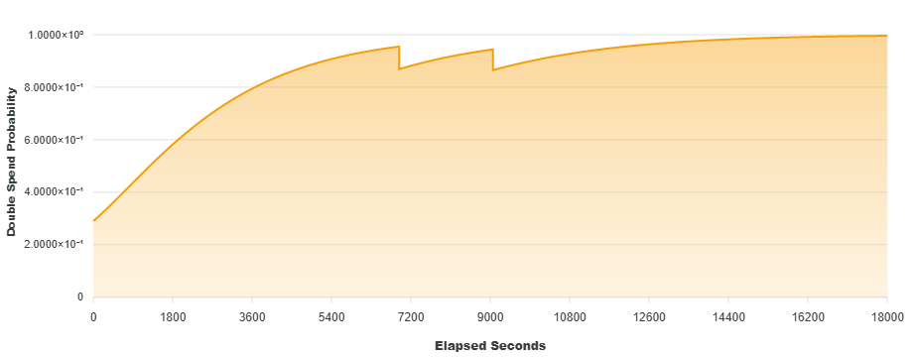
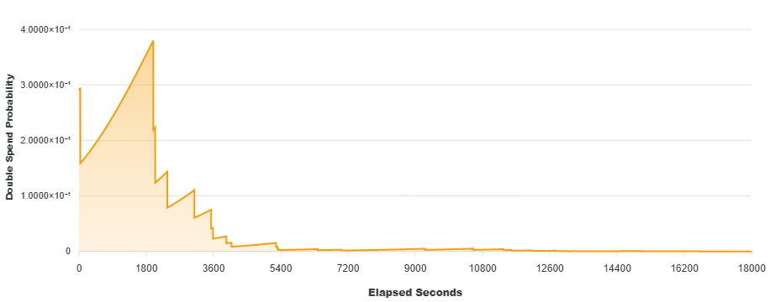
Bitcoin Double Spend Website
Department of Computer Science & Engineering
Spring 2026
What is Double Spend?
Double Spend Graphs
Double spending is a threat to the integrity of the Bitcoin blockchain in which an attacker attempts to spend the same Bitcoin in two different transactions.
The attacker first sends Bitcoin to another user, then creates a second conflicting transaction that sends those same funds back to themselves.
If the second transaction is confirmed instead of the first, the attacker keeps the Bitcoin, and the original recipient loses the payment and goods.
Real-Time Analysis
Features
Summary
Txid Lookup: A user can search any transaction on the Bitcoin blockchain by its transaction ID (Txid)
Detailed Insights: View transaction age, inputs, outputs, and total BTC spent.
Live Risk Metrics: Assess double spend probability in real-time. Adjust the alpha value to simulate risks from varying attacker hash power.
Interactive Visuals: Track and analyze risk trends over time.
The Bitcoin Double Spend Website is a blockchain analysis tool designed to assess and visualize the real-time risk of double spend attacks. By monitoring transactions directly from the peer-to-peer network, the system educates users on the mechanics of blockchain security and transaction finality.
Data Acquisition: Runs a full Bitcoin Core Node on the UAA network to gain direct access to the global mempool and blockchain history.
Risk Analysis Engine: A Python-based service that interfaces with the node to calculate real-time double spend probabilities based on a given transaction’s age and number of confirmations on the network.
Backend API: An ASP.NET Core API that orchestrates communication between the analytical engine and the user interface.
Frontend & Visualization: A responsive Blazor web application featuring transaction summaries, interactive graphs to visualize transaction risks, and network trends.
5 hr: Abnormal Confirmations
Project Outcomes
Education: Users gain a clearer understanding of what double spend attacks are and what the risks are associated with it.
Accessibility: Traditional blockchain explorers don’t commonly provide risk data, limiting how easily users can learn and understand transaction risks. Our platform improves access to these insights through a more user-friendly and informative interface.
Usability: Provides an intuitive interface that is easy to use and conveys information efficiently.
5 hr: Normal Confirmations
References
“Bitcoin: A Peer-to-Peer Electronic Cash System,” 2008. [Online]. Available: https://bitcoin.org/bitcoin.pdf
“An analysis of acceptance policies for blockchain transactions,” IACR Cryptology ePrint Archive, Rep. 2018/040, Jan. 2018. [Online]. Available: https://eprint.iacr.org/2018/040

