Slide 1

Double Spend Website

Slide 2
Overview
Double Spend Background
Requirements
Design
Testing

Slide 3
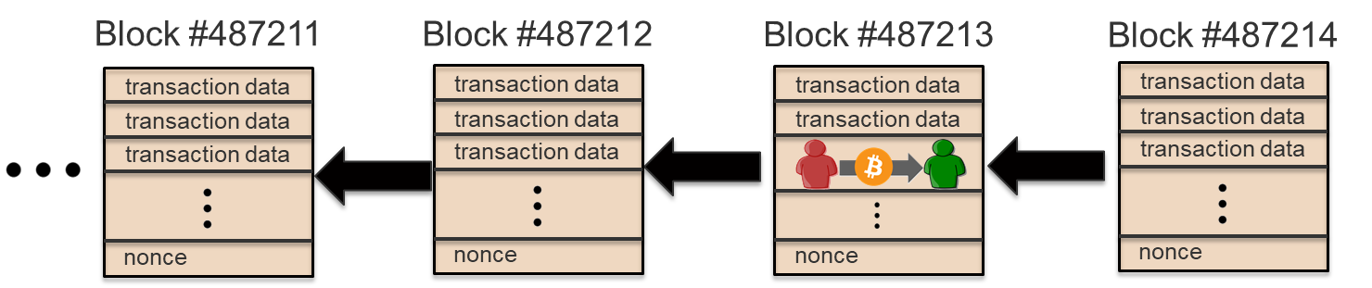
Bitcoin Blockchain
Transactions are grouped in blocks
Each block links to the previous block

Slide 4

Bitcoin Miners
Miners are computers solving a puzzle
Miners confirm transaction by including them in a new block
Winners publish a new block of the puzzle and receive $$$
New block found every ~10 minutes
Following a Consensus
  Work on the longest chain
  Post block as soon as its found

Slide 5





Slide 6





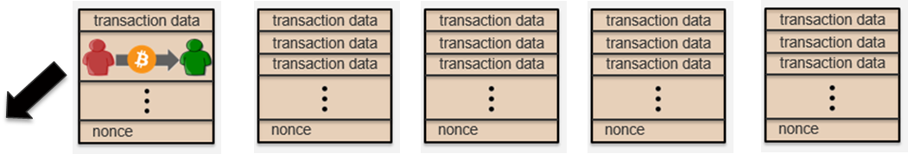
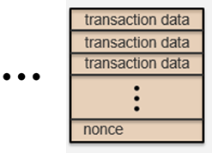
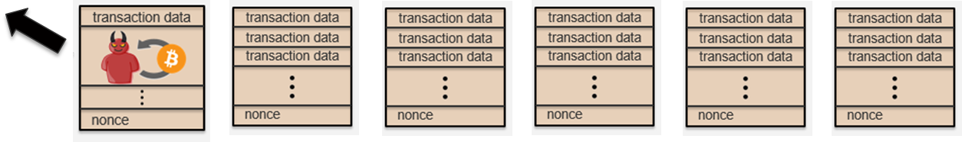

Slide 11


Slide 12


Slide 13


Slide 15
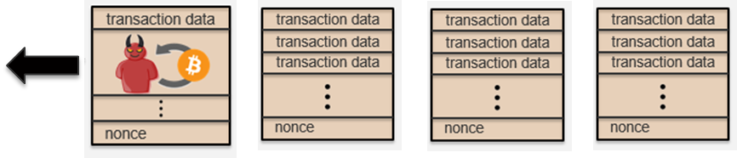

Slide 17
What is a Double Spend?
Double spend is a blockchain attack where the attacker spends the same Bitcoin more than once.
Attacker creates a new chain in private and attempts to gain acceptance from the network.
A successful double spend is a fundamental threat to cryptocurrency.

Slide 18
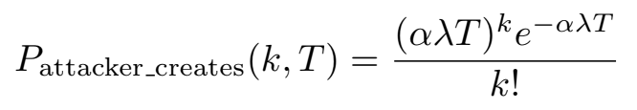
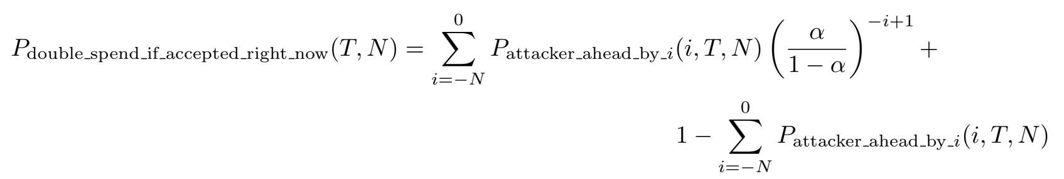
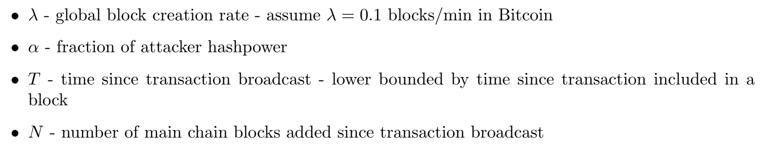
Double Spend Equations

Slide 19
Requirements
Base Functional Requirement:
A user can search any transaction on the Bitcoin blockchain and view its double spend risk in real time.
Additional Requirements:
Users can view details of a transaction (inputs, outputs, fees etc.)
View graphical interfaces that display risk information
Ability to explore blocks (if time allows)

Slide 20
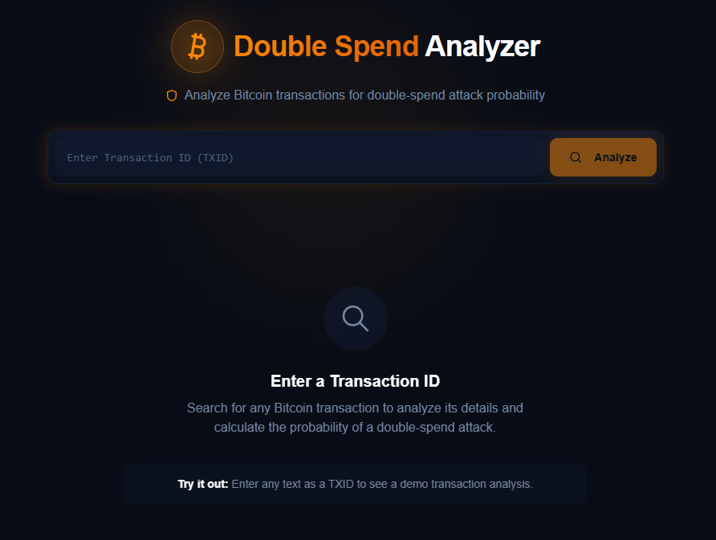
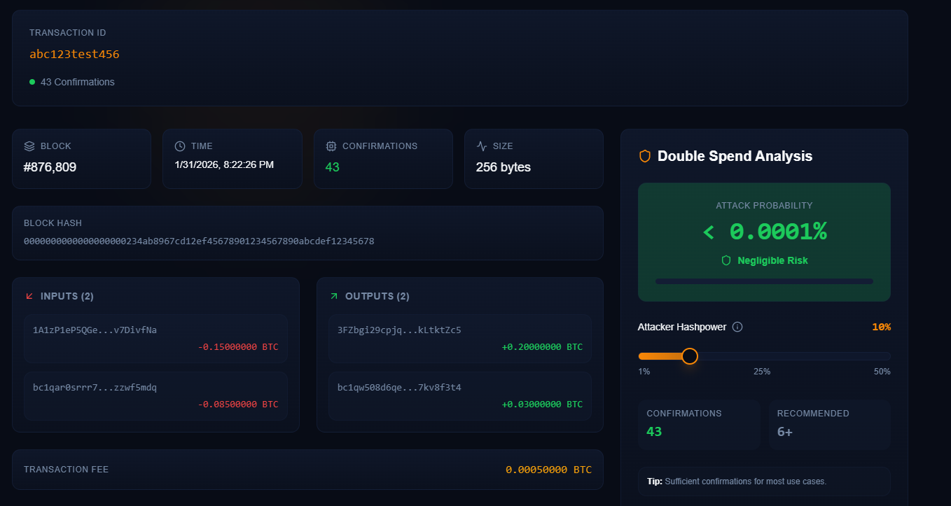
UI Concept

Slide 21
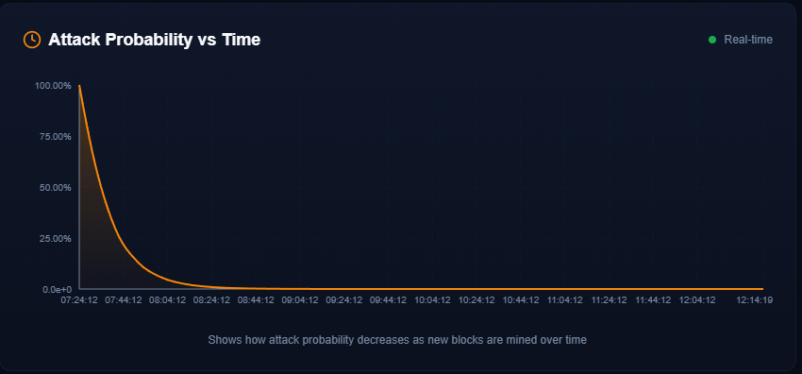
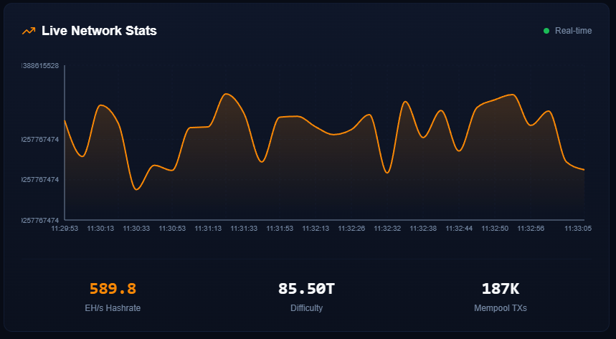
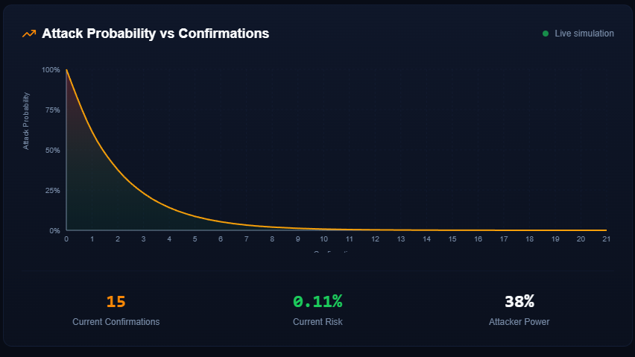
UI Concept - Cont.

Slide 22
UI Concept - Cont.
Main Components:
Home page with double-spend information
Search for transaction with ID and see basic stats along with double spend
Expandable double spend window for more detailed analysis
Block/transaction explorer

Slide 23
Design
4 main components:
  Blazor Web Interface
  ASP.NET Core API
  Python Worker
    FastAPI
    Math
  Bitcoin Node
No plans for database
  Make new calls for new transactions
Will likely utilize server caching or client memory caching

Slide 24
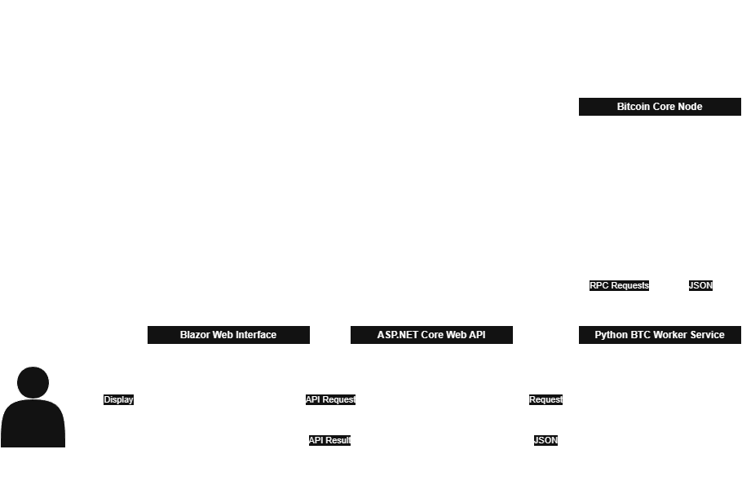
High Level Architecture

Slide 25
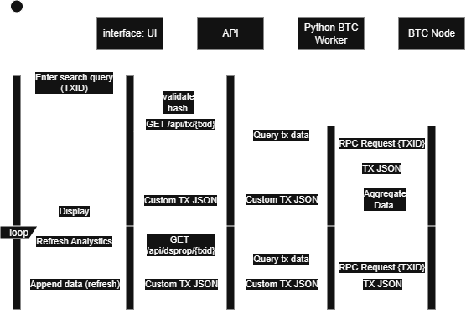
Sequence Diagram

Slide 26
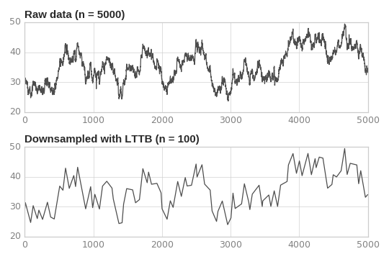
Double-spend graph challenges
Imagine a 10 year old transaction
10 years * 365 days * 24 hours * 60 minutes * 60 seconds = ~315m points
Use Level of Detail (LOD) Time-Series Rendering
  Dynamically reduce data points based on viewing distance, screen resolution, or zoom level
  Largest Triangle Three Buckets (LTTP)
    Reduce number of data points
    Keep graph shape

Slide 27
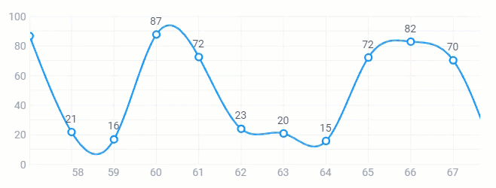
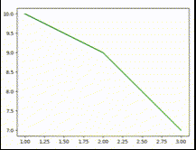
Double-spend graph challenges - Cont.
Dynamic Refreshing Data
Client wants dynamic refreshing graph in MS
Option A (easy MVP): short polling
  Client side timer; request updated curve every X seconds
Option B (harder): streaming pipeline
  Server pushes data as its computed
  Checks for changes constantly such as time or # of confirmations

Slide 28
Graph Goals
By default, render full history with downsampled LOD data
  One time per transaction for each time interval
Included different time intervals such as full history, 1 year, 1 month, 1 day, etc.
Only render dynamically when zoomed at the end
  Real time updates imperceivable at scale
  MVP: Refresh relatively live such as 1HZ or 2HZ
  End Goal: Refresh very quickly, no pausing

Slide 29
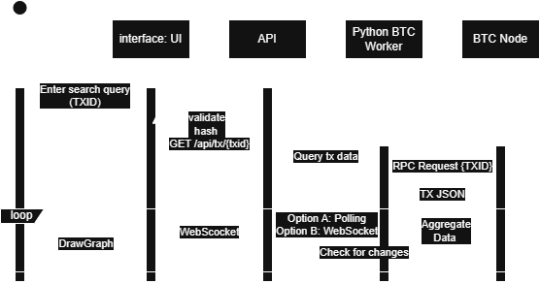
Slightly Updated Sequence Diagram

Slide 30
Testing
Backend
  Postman
Frontend & Backend
  End-to-end (E2E)

Slide 31
Questions??

Slide 32
References
CSCE A375 Cryptocurrency Slides
https://docs.webix.com/desktop__dynamic_chart.html
https://www.geeksforgeeks.org/python/dynamically-updating-plot-in-matplotlib
https://pypi.org/project/lttb/

