Slide 1
Azure Fundamentals Overview – 4 Costs
Milliman TechForum
2021-03-22

Slide 2
Introductions
Presenter 1
Title
Presenter 2
Title
Presenter 3
Title
Presenter 4
Title
Presenter 6
Title

Slide 3
Customer Specific intro Topics
Insert Slides Covering:
Customer specific learning management system links.
Survey information
Guidance on study group format

Slide 4
Azure Fundamentals Certification and the AZ-900 Exam

Slide 5
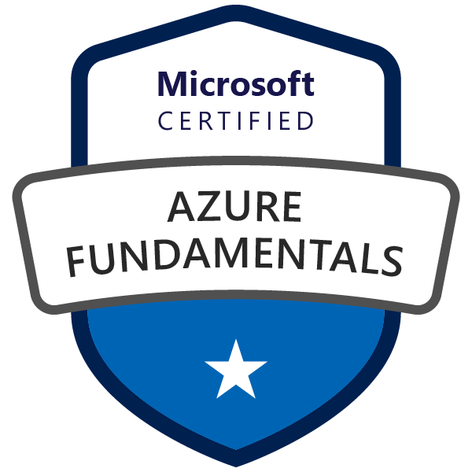
Microsoft Certified – Azure Fundamentals
Goal: Prove that you understand cloud concepts, core Azure Services, Azure pricing and support, the fundamentals of cloud security, privacy, compliance and trust.
Value: The knowledge gained by acquiring this certification will provide a valuable foundation for working with the platform and continuing on to more advanced role based Azure certifications.

Slide 6

Azure Role-based Certifications
Fundamentals
Associate
Expert
Azure Administrator Associate
Exam AZ-103
Azure DevOps Engineer Expert
Azure Developer Associate
Exams AZ-400
Exam AZ-203
Azure Security Engineer Associate
Azure Fundamentals
Exam AZ-500
Exam AZ-900
Azure Solutions Architect Expert
Azure AI Engineer Associate
Exams AZ-300 + AZ-301
Exam AI-100
Azure Data Engineer Associate
Exam DP-200
More roles to come ...
Azure Certification Exams: aka.ms/ExamsAzure

Slide 7
Exam Blueprint ( AZ-900 )
Study areas | Weights
Understanding cloud concepts | 15-20%
Understanding core Azure services | 30-35%
Understand security, privacy, compliance, and trust | 30-35%
Understand Azure pricing and support | 25-30%
Percentages indicate the relative weight of each area on the exam.
The higher the percentage, the more questions you are likely to see in that area.
Absolutely an accurate representation of what questions will show up.

Slide 8
Understand Azure pricing and support (25-30%)
Understand Azure subscriptions
describe an Azure subscription
understand the uses and options with Azure subscriptions
Understand planning and management of costs
understand options for purchasing Azure products and services
understand options around Azure Free account
understand the factors affecting costs such as resource types, services, locations, ingress and egress traffic
understand Zones for billing purposes
understand the Pricing calculator
understand the Total Cost of Ownership (TCO) calculator
understand best practices for minimizing Azure costs such as performing cost analysis, creating spending limits and quotas, and using tags to identify cost owners; use Azure reservations; use Azure Advisor recommendations
describe Azure Cost Management
Understand the support options available with Azure
understand support plans that are available such as Dev, Standard, Professional Direct and Premier
understand how to open a support ticket
understand available support channels outside of support plan channels
describe the Knowledge Center
Describe Azure Service Level Agreements (SLAs)
describe a Service Level Agreement (SLA)
determine SLA for a particular Azure product or service
Understand service lifecycle in Azure
understand Public and Private Preview features
understand how to access Preview features
understand the term General Availability (GA)
monitor feature updates

Slide 9
Azure Fundamentals Learning Path - Prework
Predict costs and optimize spending for Azure

Slide 10
Predict costs and optimize spending for Azure

Slide 11
Purchasing Azure products and services
Three main customer types on which the available purchasing options for Azure products and services are contingent are:
Enterprise. Enterprise customers sign an Enterprise Agreement with Azure that commits them to spending a negotiated amount on Azure services, which they typically pay annually.
Web direct. Web direct customers sign up for Azure through the Azure website.
Cloud solution providers (CSPs) typically are Microsoft partner companies that a customer hires to build solutions on top of Azure. Payment and billing for Azure usage occurs through the customer's CSP.
Products and services in Azure are arranged by category, such as compute and networking, which have various resources that you can provision.

Slide 12
Usage Metering
Usage meters are implemented behind the scenes for each resource to track resource utilization for billing.
A single VM for example may have the following usage meters associated w/ it:
Compute Hours
IP Address Hours
Data Transfer In
Data Transfer Out
Standard Managed Disk
Standard Managed Disk Operations
Standard IO-Disk
Standard IO-Block Blob Read
Standard IO-Block Blob Write
Standard IO-Block Blob Delete

Slide 13
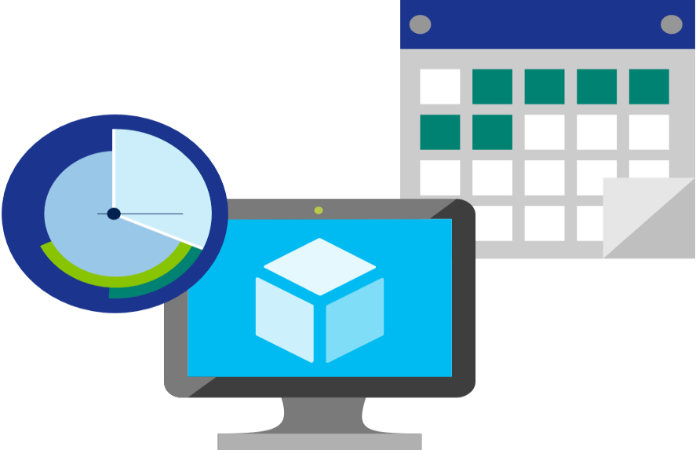
Factors affecting costs
Three factors affect costs:
Resource Type: Costs are resource-specific, so the usage that a meter tracks and the number of meters associated with a resource depend on the resource type.
Purchasing Option: Azure usage rates and billing periods can differ between Enterprise, Web Direct, and CSP customers.
Location: The Azure infrastructure is globally distributed, and usage costs might vary between locations that offer particular Azure products, services, and resources.

Slide 14

Zones for Billing Purposes
Bandwidth refers to data moving in and out of Azure datacenters. Some inbound data transfers are free, such as data going into Azure datacenters. For outbound data transfers—such as data going out of Azure datacenters—pricing is based on Zones.
A zone is a geographical grouping of Azure Regions for billing purposes. Zones are:
Zone 1. Includes West US, East US, West Europe, and others.
Zone 2 . Includes Australia Central, Japan West, Central India, and others.
Zone 3. Includes Brazil South only.
DE Zone 1. Includes Germany Central and Germany Northeast.

Slide 15
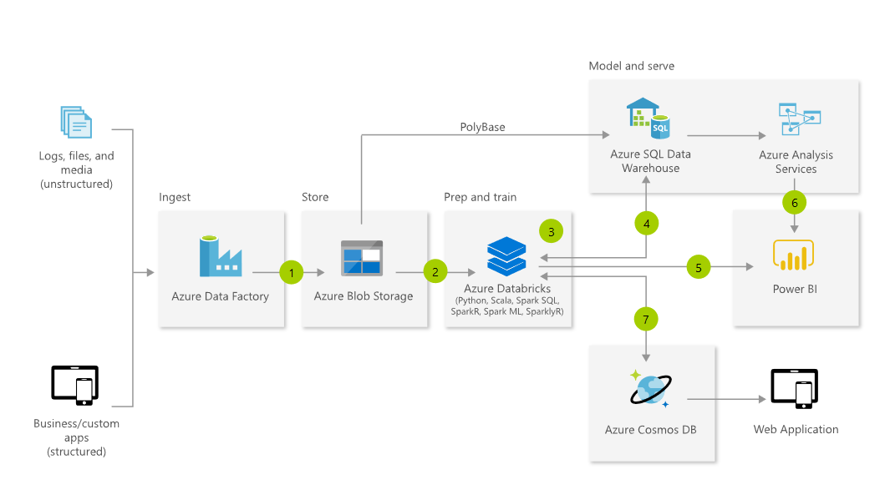
Pricing Calculator
https://azure.microsoft.com/en-us/pricing/calculator

Slide 16
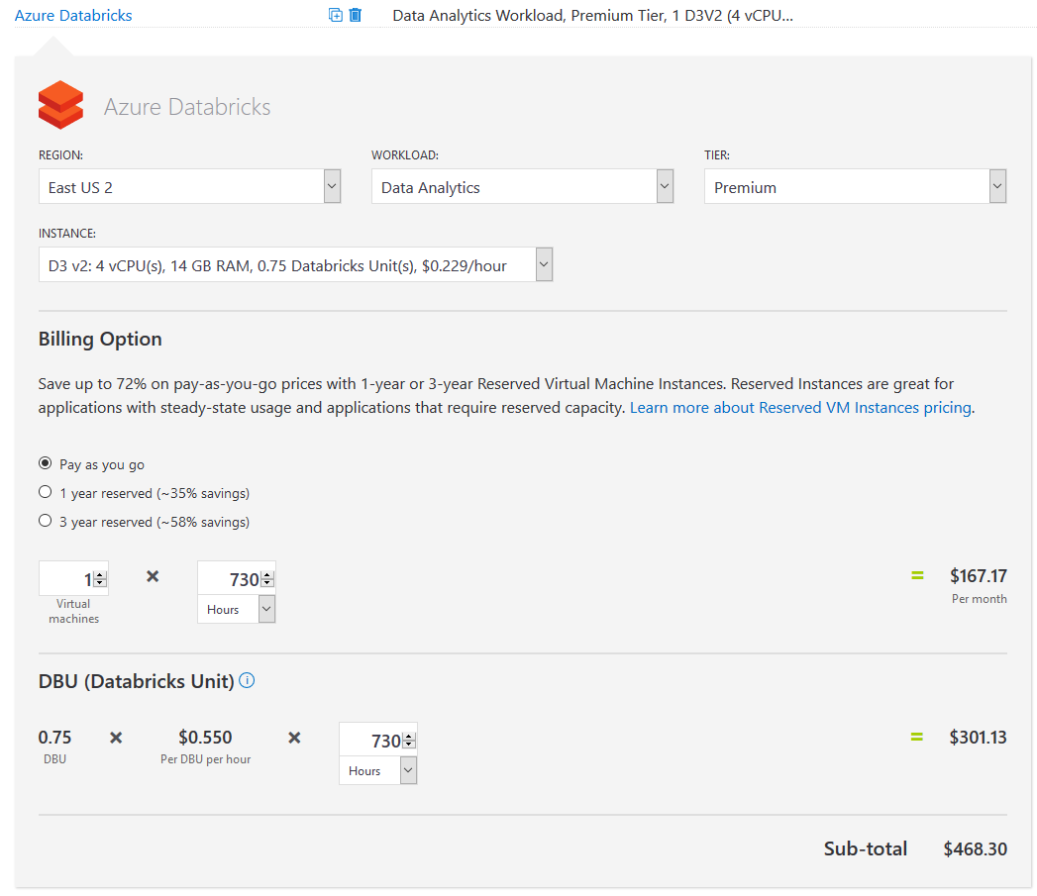
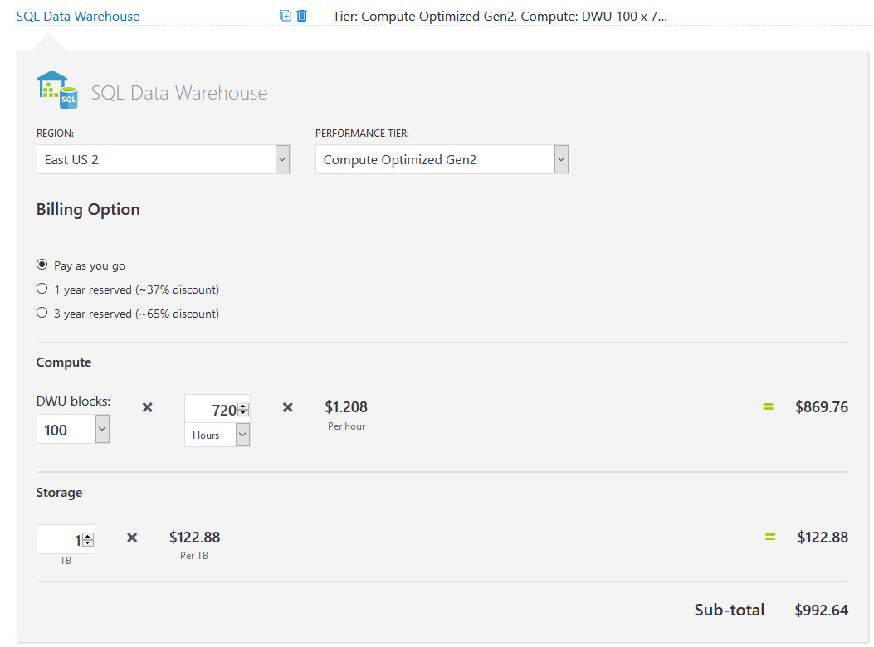
Pricing Calculator Cont.
https://azure.microsoft.com/en-us/pricing/calculator

Slide 17
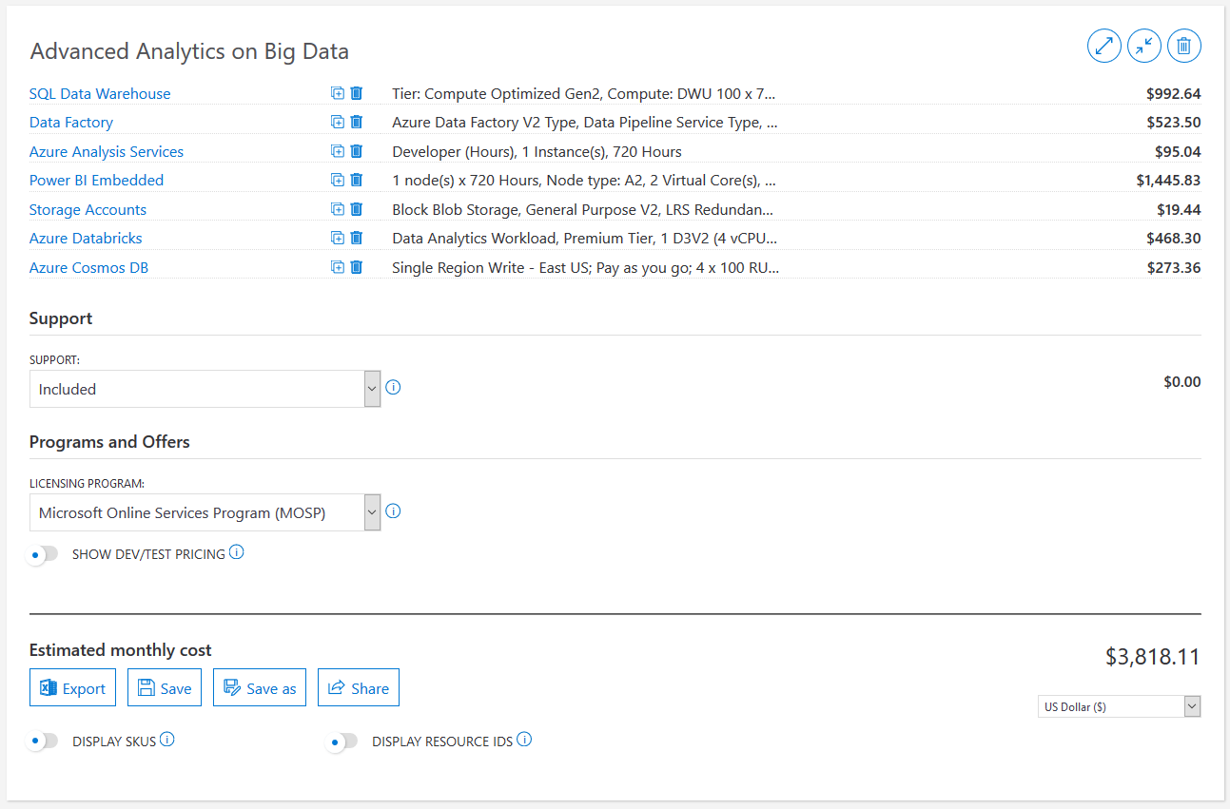
Pricing Calculator Cont.
https://azure.microsoft.com/en-us/pricing/calculator

Slide 18
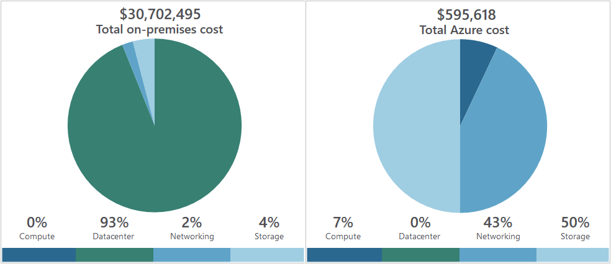
Total cost of ownership (TCO) calculator
https://azure.microsoft.com/en-us/pricing/tco/calculator/
A tool that you use to estimate cost savings you can realize by migrating to Azure
A report compares the costs of on-premises infrastructures with the costs of using Azure products and services to host infrastructure in the cloud

Slide 19
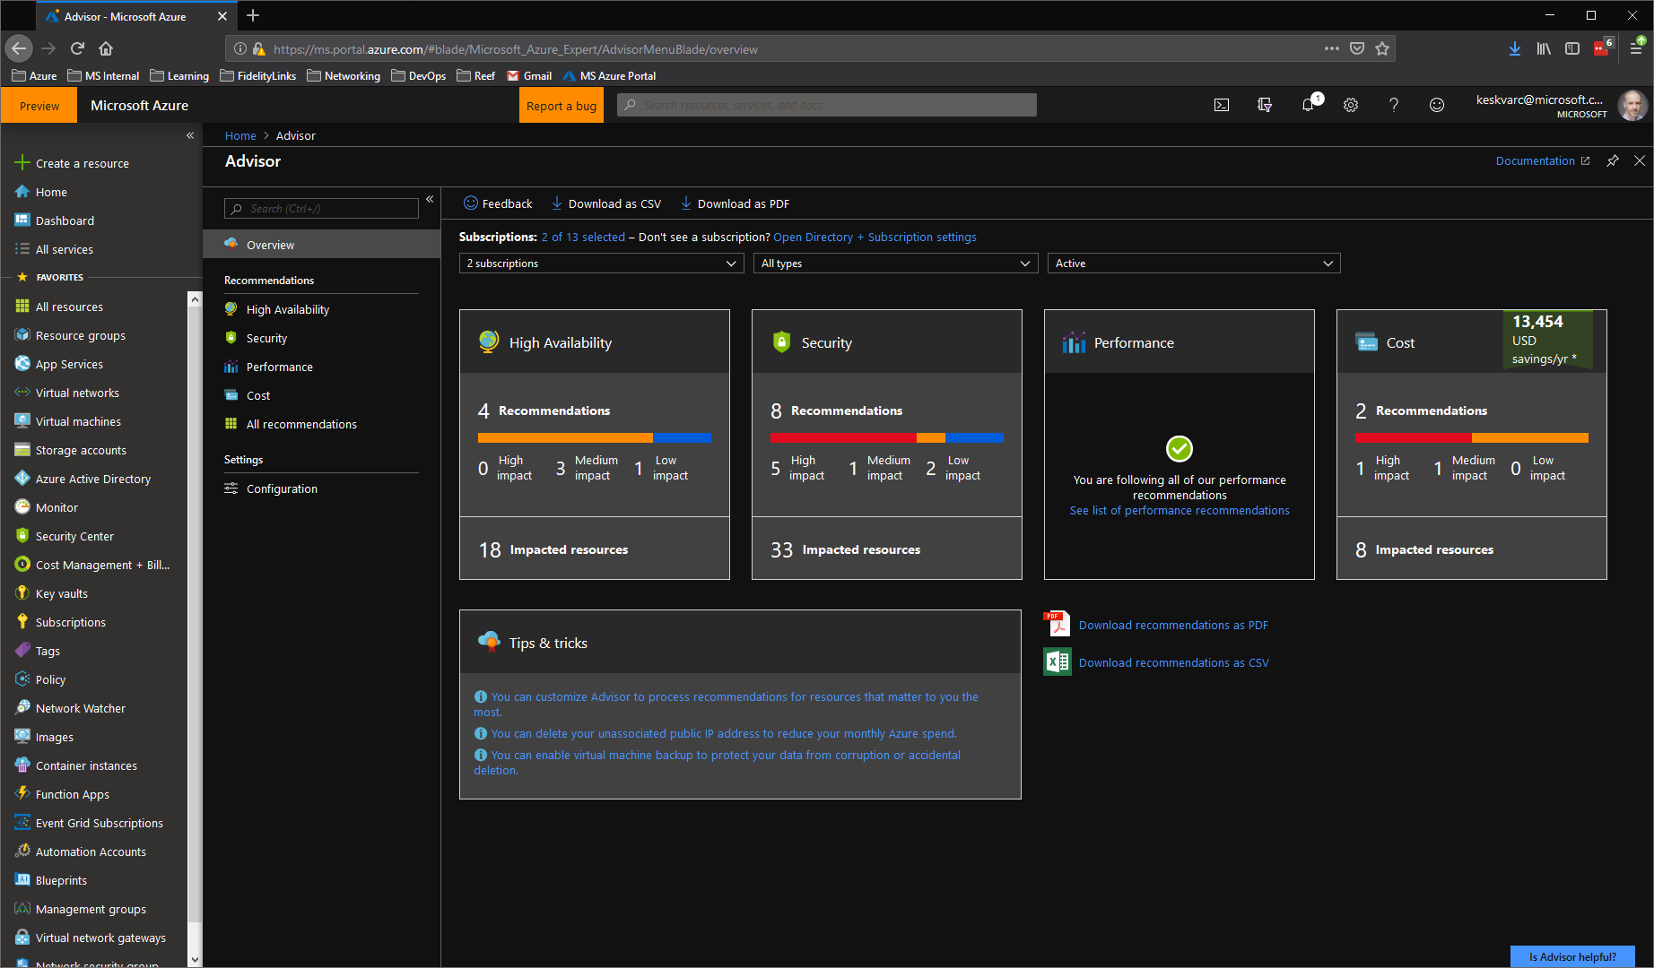
Azure Advisor

Slide 20
Azure Advisor – Available Cost Saving Recommendations
Optimize virtual machine spend by resizing or shutting down underutilized instances
Reduce costs by eliminating unprovisioned ExpressRoute circuits
Reduce costs by deleting or reconfiguring idle virtual network gateways
Buy reserved virtual machine instances to save money over pay-as-you-go costs
Delete unassociated public IP addresses to save money

Slide 21
Minimizing costs
The following best practice guidelines can help minimize your Azure costs:
Perform cost analyses. Use the Azure Pricing and TCO calculators
Monitor usage with Azure Advisor. Implement recommendations
Use Azure Reservations. To get a discount, reserve products and resources by paying in advance. Prepay for 1 or 3 years, and achieve up to 72% savings over pay-as-you-go costs
Choose low-cost locations and regions. If possible, use low-cost locations
Apply tags to identify cost owners. Identify usage owners with tags

Slide 22
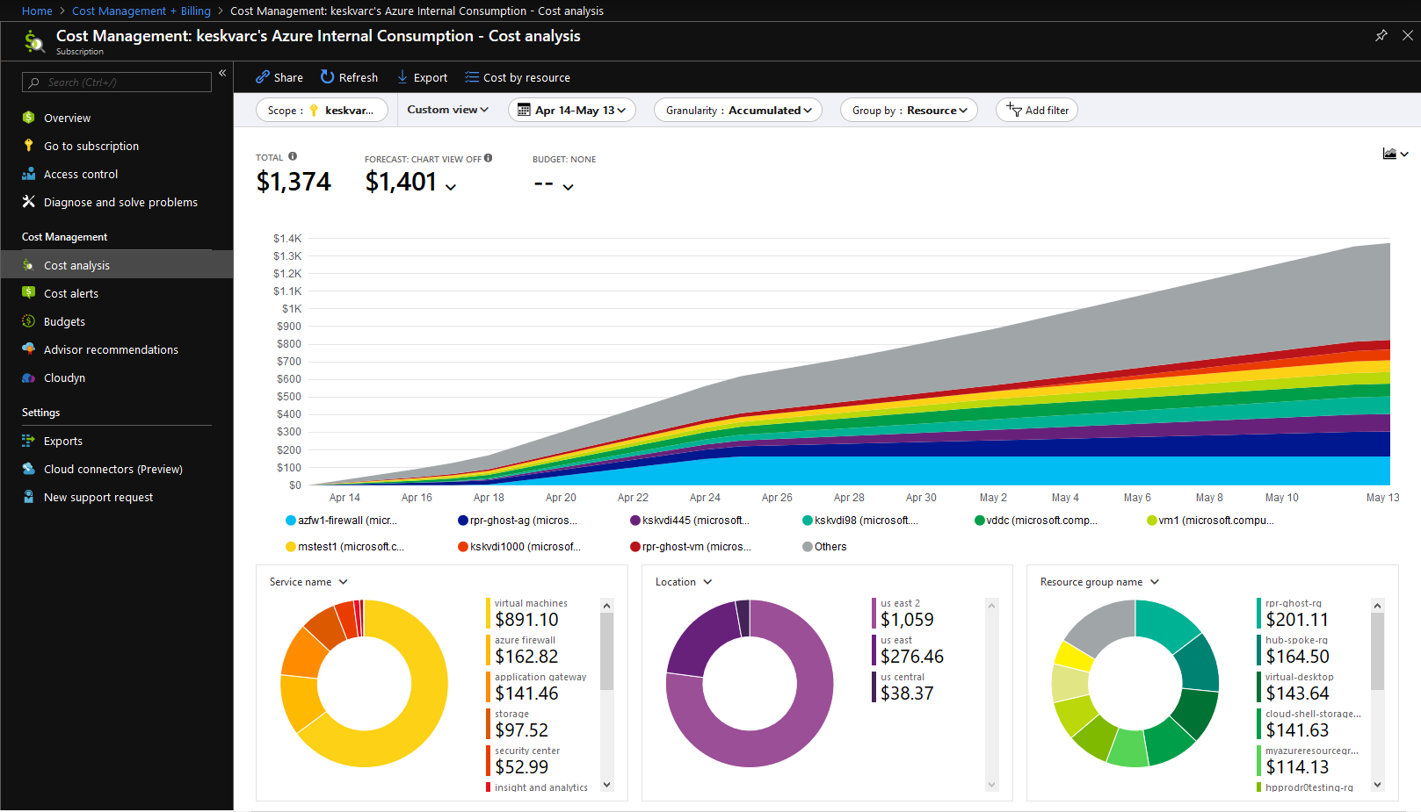
Azure Cost Management
Azure Cost Management is an Azure product that provides a set of tools for monitoring, allocating, and optimizing Azure costs
Reporting. Generate reports
Data enrichment. Improve accountability by categorizing resources with tags
Budgets. Monitor resource demand trends, consumption rates, and cost patterns
Alerting. Get alerts based on your cost and usage budgets
Recommendations. Receive recommendations to eliminate idle resources and to optimize provisioned Azure resources

Slide 23
Review Question 1
Q: You plan to deploy a solution in which you will leverage a series of virtual machines and Azure SQL DB across two separate regions. You need to chose the best tool for evaluating cost. Which tool would you use?
a.) Azure Advisor
b.) Azure TCO Calculator
c.) Azure Pricing Calculator
d.) Azure Cost Management

Slide 24
Review Question 1
Q: You plan to deploy a solution in which you will leverage a series of virtual machines and Azure SQL DB across two separate regions. You need to chose the best tool for evaluating cost. Which tool would you use?
a.) Azure Advisor
b.) Azure TCO Calculator
c.) Azure Pricing Calculator
d.) Azure Cost Management

Slide 25
Review Question 2
Q: How long can you use a free subscription before it expires?
a.) 40 days
b.) 1 Year
c.) 6 months
d.) 2 Years

Slide 26
Review Question 2
Q: How long can you use a free subscription before it expires?
a.) 40 days
b.) 1 Year
c.) 6 months
d.) 2 Years

Slide 27
Review Question 3
Q: Azure Advisor is capable of making cost optimization recommendations for which of the following:
a.) Resizing or shutting down underutilized instances
b.) Eliminating unprovisioned ExpressRoute circuits
c.) Deleting or reconfiguring idle virtual network gateways
d.) Use reserved instances to save money over pay-as-you-go costs
e.) Remove unassociated public IP addresses
f.) Remove subscriptions with no resources deployed.

Slide 28
Review Question 3
Q: Azure Advisor is capable of making cost optimization recommendations for which of the following:
a.) Resizing or shutting down underutilized instances
b.) Eliminating unprovisioned ExpressRoute circuits
c.) Deleting or reconfiguring idle virtual network gateways
d.) Use reserved instances to save money over pay-as-you-go costs
e.) Remove unassociated public IP addresses
f.) Remove subscriptions with no resources deployed.

Slide 29
Review Question 4
Q: True or False: A Zone is a geographical grouping of regions that is used to determine billing based on peak usage periods.

Slide 30
Review Question 4
Q: True or False: A Zone is a geographical grouping of regions that is used to determine billing based on peak usage periods.
A: False: Zones are used to calculate data transfer charges within Azure. Depending on the zone of the region data transfer rates will vary.

Slide 31
Review Question 5
Q: Which of the following functionality is available free of charge with Azure Cost Management?
a.) Reporting on Azure Costs
b.) Reporting on AWS Costs
c.) Creating and managing Azure budgets
d.) Alerting on Azure Costs
e.) Alerting on GCP costs

Slide 32
Review Question 5
Q: Which of the following functionality is available free of charge with Azure Cost Management?
a.) Reporting on Azure Costs
b.) Reporting on AWS Costs
c.) Creating and managing Azure budgets
d.) Alerting on Azure Costs
e.) Alerting on GCP costs

Slide 33
Review Question 6
Q: Which of the following impacts cost within Azure:
a.) Resource Type
b.) Purchasing Option
d.) Availability Zone a resource is deployed to
c.) Location
d.) Service Category

Slide 34
Review Question 6
Q: Which of the following impacts cost within Azure:
a.) Resource Type
b.) Purchasing Option
d.) Availability Zone a resource is deployed to
c.) Location
d.) Service Category

Slide 35
Wrap Up – Blueprint Review

Slide 36
Skills Measured – Understand Cloud Concepts (15-20%)
Describe the benefits and considerations of using cloud services
understand terms such as High Availability, Scalability, Elasticity, Agility, Fault Tolerance, and Disaster Recovery
understand the principles of economies of scale
understand the differences between Capital Expenditure (CapEx) and Operational Expenditure (OpEx)
understand the consumption-based model
Describe the differences between Infrastructure-as-a-Service (IaaS), Platform-as-a-Service (PaaS) and Software-as-a-Service (SaaS)
describe Infrastructure-as-a-Service (IaaS)
describe Platform-as-a-Service (PaaS)
describe Software-as-a-Service (SaaS)
compare and contrast the three different service types
Describe the differences between Public, Private and Hybrid cloud models
describe Public cloud
describe Private cloud
describe Hybrid cloud
compare and contrast the three different cloud models

Slide 37
Skills Measured – Understand Core Azure Services (30-35%)
Understand the core Azure architectural components
describe Regions
describe Availability Zones
describe Resource Groups
describe Azure Resource manager
describe the benefits and usage of core Azure architectural components
Describe some of the core products available in Azure
describe products available for Compute such as Virtual Machines, Virtual Machine Scale Sets, App Service and Functions
describe products available for Networking such as Virtual Network, Load Balancer, VPN Gateway, Application Gateway and Content Delivery Network
describe products available for Storage such as Blob Storage, Disk Storage, File Storage, and Archive Storage
describe products available for Databases such as CosmosDB, Azure SQL Database, Azure Database Migration service, and Azure SQL Data Warehouse
describe the Azure Marketplace and its usage scenarios
Describe some of the solutions available on Azure
describe Internet of Things (IoT) and products that are available for IoT on Azure such as IoT Fundamentals, IoT Hub and IoT Central
describe Big Data and Analytics and products that are available for Big Data and Analytics such as SQL Data Warehouse, HDInsight and Data Lake Analytics
describe Artificial Intelligence (AI) and products that are available for AI such as Azure Machine Learning Service and Studio
describe Serverless computing and Azure products that are available for serverless computing such as Azure Functions, Logic Apps and App grid
describe the benefits and outcomes of using Azure solutions
Understand Azure management tools
understand Azure tools such as Azure CLI, PowerShell, and the Azure Portal
understand Azure Advisor

Slide 38
Understand security, privacy, compliance, and trust (30-35%)
Understand securing network connectivity in Azure
describe Azure Firewall
describe Azure DDoS Protection
describe Network Security Group (NSG)
choose an appropriate Azure security solution
Describe core Azure Identity services
understand the difference between authentication and authorization
describe Azure Active Directory
describe Azure Multi-Factor Authentication
Describe security tools and features of Azure
describe Azure Security
understand Azure Security center usage scenarios
describe Key Vault
describe Azure Information Protection (AIP)
describe Azure Advanced Threat Protection (ATP)
Describe Azure governance methodologies
describe Azure Policies
describe Initiatives
describe Role-Based Access Control (RBAC)
describe Locks
describe Azure Advisor security assistance
Understand monitoring and reporting options in Azure
describe Azure Monitor
describe Azure Service Health
understand the use cases and benefits of Azure Monitor and Azure Service Health
Understand privacy, compliance and data protection standards in Azure
understand industry compliance terms such as GDPR, ISO and NIST
understand the Microsoft Privacy Statement
describe the Trust center
describe the Service Trust Portal
describe Compliance Manager
determine if Azure is compliant for a business need
understand Azure Government services
understand Azure Germany services

Slide 39
Understand Azure pricing and support (25-30%)
Understand Azure subscriptions
describe an Azure subscription
understand the uses and options with Azure subscriptions
Understand planning and management of costs
understand options for purchasing Azure products and services
understand options around Azure Free account
understand the factors affecting costs such as resource types, services, locations, ingress and egress traffic
understand Zones for billing purposes
understand the Pricing calculator
understand the Total Cost of Ownership (TCO) calculator
understand best practices for minimizing Azure costs such as performing cost analysis, creating spending limits and quotas, and using tags to identify cost owners; use Azure reservations; use Azure Advisor recommendations
describe Azure Cost Management
Understand the support options available with Azure
understand support plans that are available such as Dev, Standard, Professional Direct and Premier
understand how to open a support ticket
understand available support channels outside of support plan channels
describe the Knowledge Center
Describe Azure Service Level Agreements (SLAs)
describe a Service Level Agreement (SLA)
determine SLA for a particular Azure product or service
Understand service lifecycle in Azure
understand Public and Private Preview features
understand how to access Preview features
understand the term General Availability (GA)
monitor feature updates

Slide 40
Certification Exam Resources
All Azure Certification Exams
AZ-900 Exam Blueprint
Azure Fundamentals Learning Path
Pearson VUE – Microsoft
MeasureUp Practice Test for AZ-900
Certification Exam policies and FAQ
Exam Format and Question Types
Azure Free Account (Home Only)

Slide 41

Custom Logo Here
Bullets here to educate audience on state of adoption at customer
Links to internal resources for onboarding
CSA contact information for solution migration questions, etc.

Slide 42
Open Q&A

