Slide 1
Border testing result between 2020-2022

Slide 2
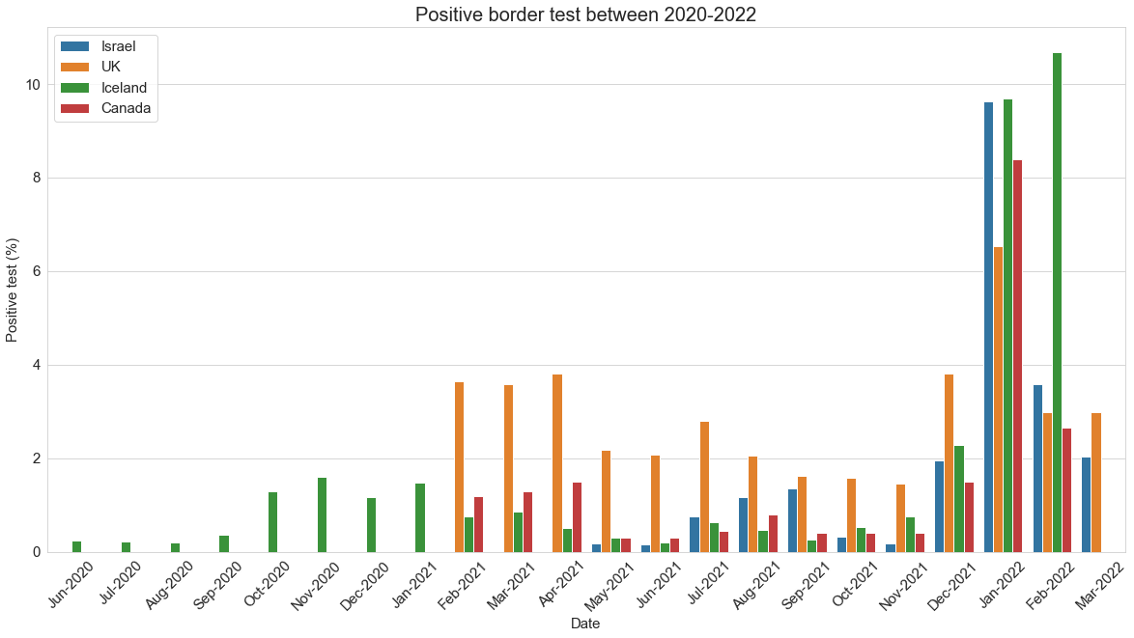
Border testing results

Slide 3
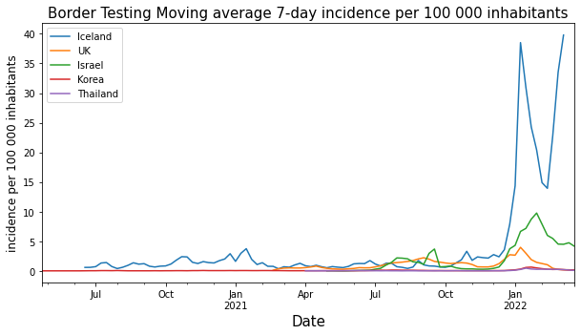

Slide 4
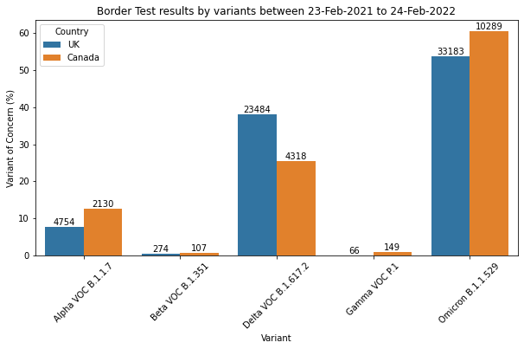
Border positive test variants

Slide 5
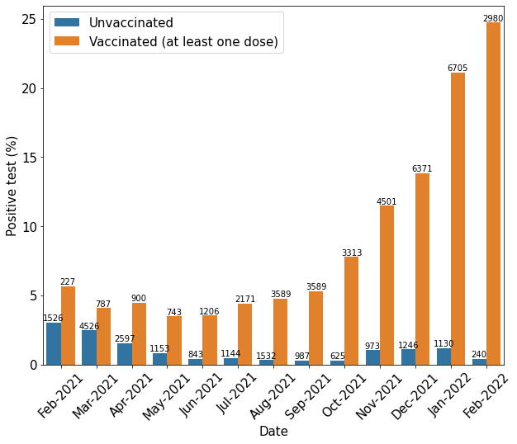
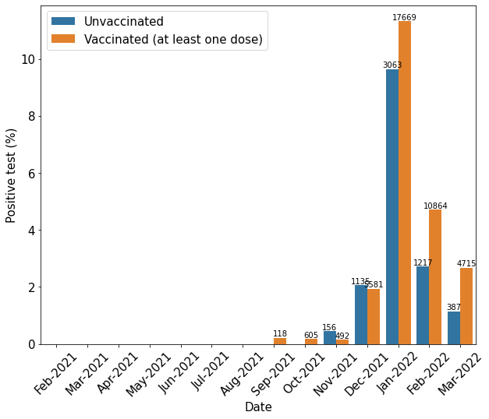
Vaccinated vs. Non-vaccinated
UK
Israel

Slide 6
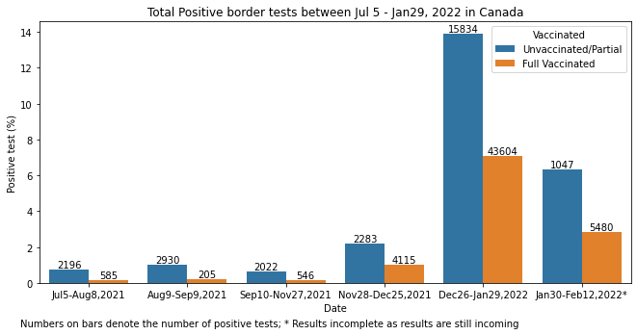
Vaccinated vs. Non-vaccinated

Slide 7
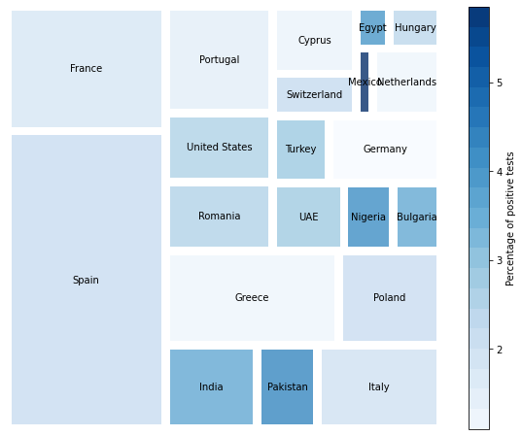
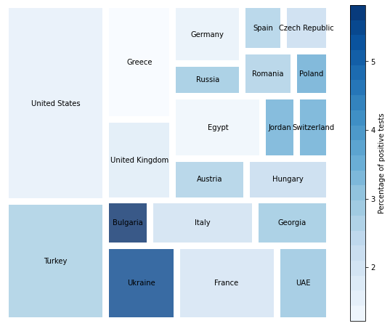
Country of departure
UK
Israel

Slide 8
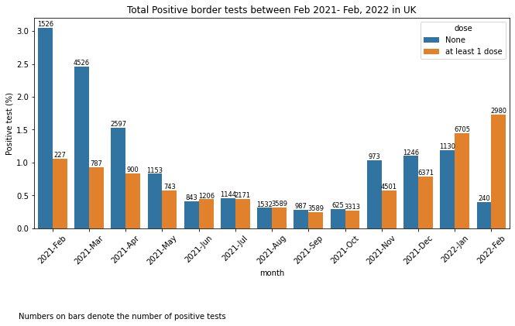
Vaccination Status | Positive | Total
None | 18,522 | 2,409,026
Partially Vaccinated | 2,542 | 67,200
Unknown Dose Vaccinated | 0 | 6,602,690
Full | 34,540 | 395,385

Slide 10
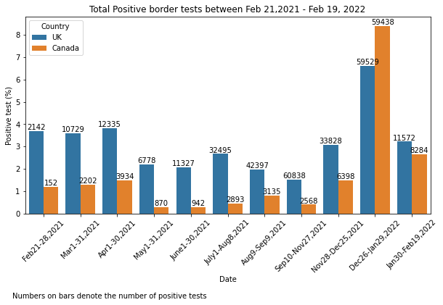
UK vs. Canada border testing statistics
Canada border rule: PCR test within 72 hours (since Jan 2021)

Slide 11
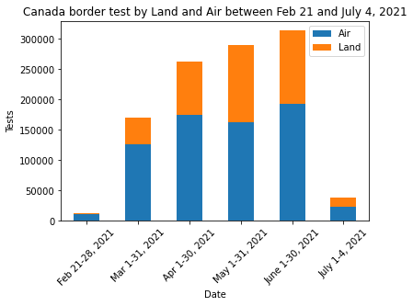
Other statistics

Slide 12
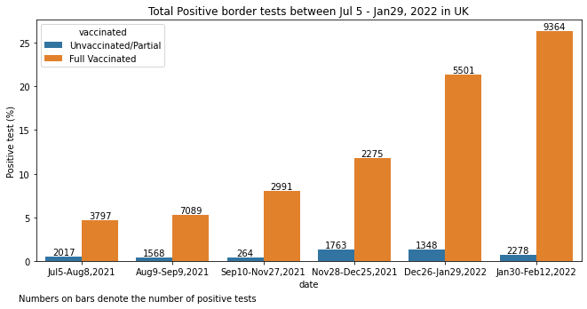

Slide 13
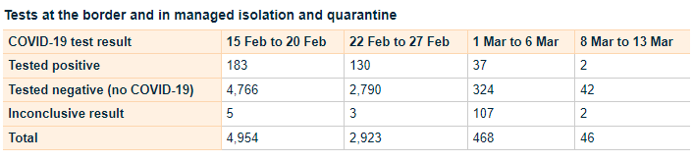
Israel:
Number of daily positive cases by country from 01-05-2021 – 15-03-2022
Vaccination status of travelers
https://datadashboard.health.gov.il/COVID-19/general?utm_source=go.gov.il&utm_medium=referral
New Zealand (only the last 4 weeks)

Slide 14
New Zealand (Last 4 weeks)

Slide 15
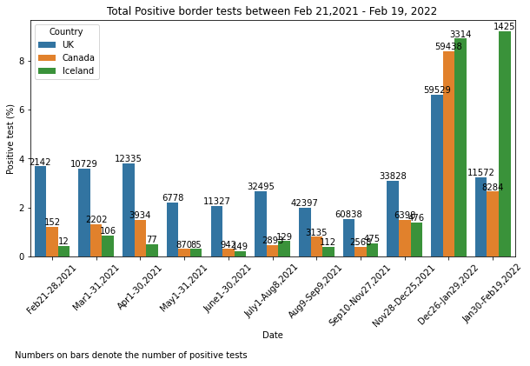

Slide 16
Jan- 2020
Jan - 2021
Jan - 2022
Feb
Mar
Apr
May
Jun
Jul
Aug
Sep
Oct
Nov
Dec
Feb
Mar
Apr
May
Jun
Jul
Aug
Sep
Oct
Nov
Dec
Feb
Mar
New travel corridors- Self-isolation exempted if visited these territory 14 days before arrival in the UK (10th July)
Travelers must provide journey and contact details 48 hours before entering UK (8th June)
Travelers to England must provide negative pre departure COVID (18th Jan)
Managed isolation hotels for travellers from countries with travel ban (15th Feb)
Fully vaccinated travellers from amber list country require only day 2 post-arrival test (19th Jul)
FCO advises against all but essential travel worldwide (17th)
New traffic light system: Red, Amber, Green (17th May)
Change to traffic light system- Red list only (4th Oct)
Fully vaccinated needs only LFD instead of PCR (22nd Oct)
Fully vaccinated needs only LFD instead of PCR (22nd Oct)

Slide 17
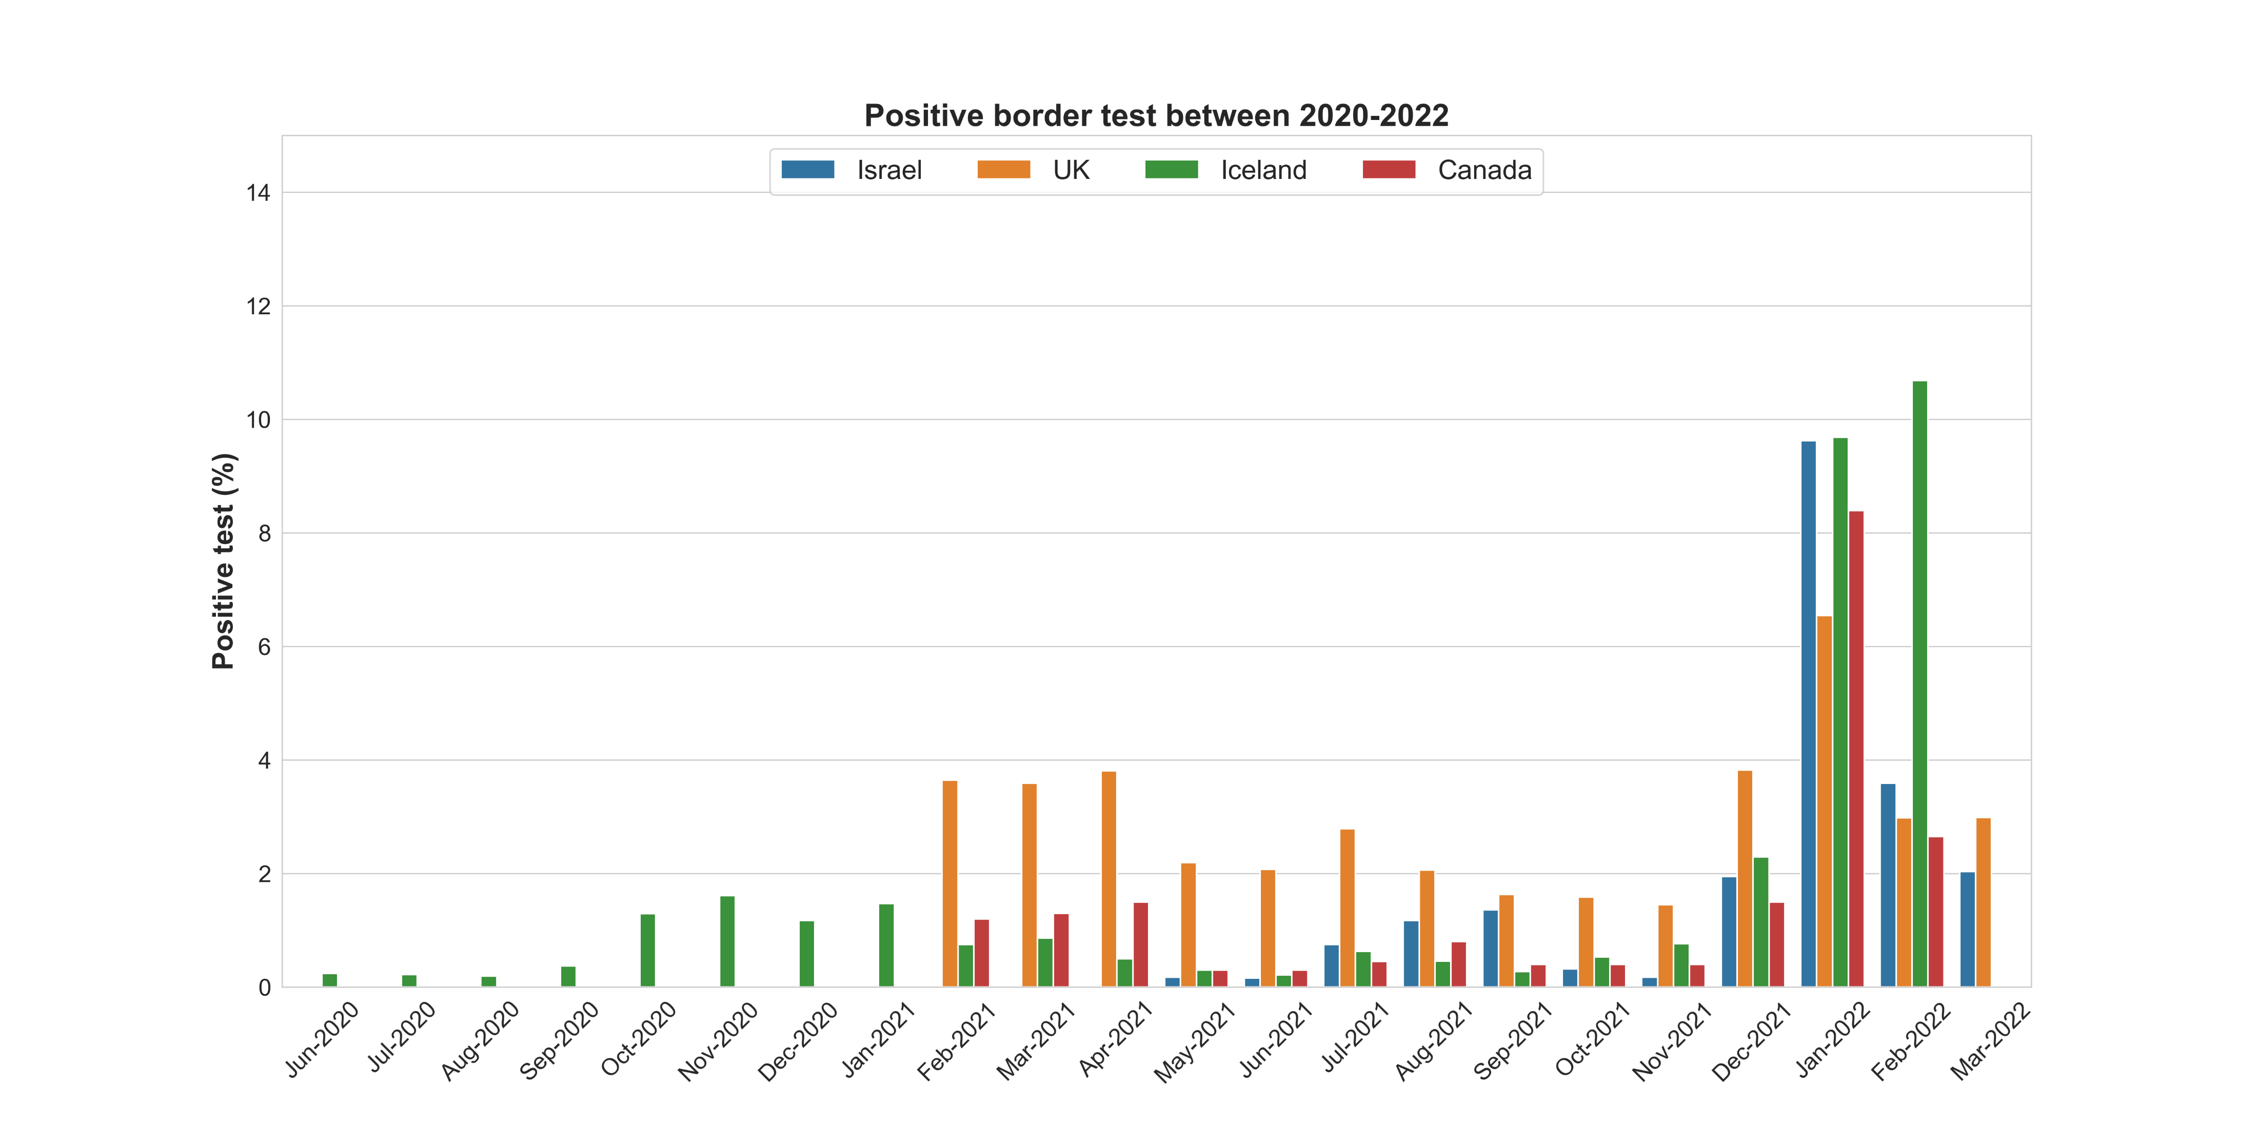
Iceland and UK lifts restriction for all travellers
Introduction of travel corridors (UK 10th Jul 2020)
Iceland allows tourist with COVID test to avoid quarantine
Travellers to UK and Canada to provide negative test (UK 18th Jan 2021)
Tourists to Iceland avoid quarantine with COVID passport
Red/Amber/Green list (UK 17th May 2021)
Red list vs. Rest of the world (UK 4th Oct 2021)
Fully vaccinated travellers to Canada do not need to quarantine (7th Sep)
Managed isolation hotel for travellers from countries with travel ban

Slide 18
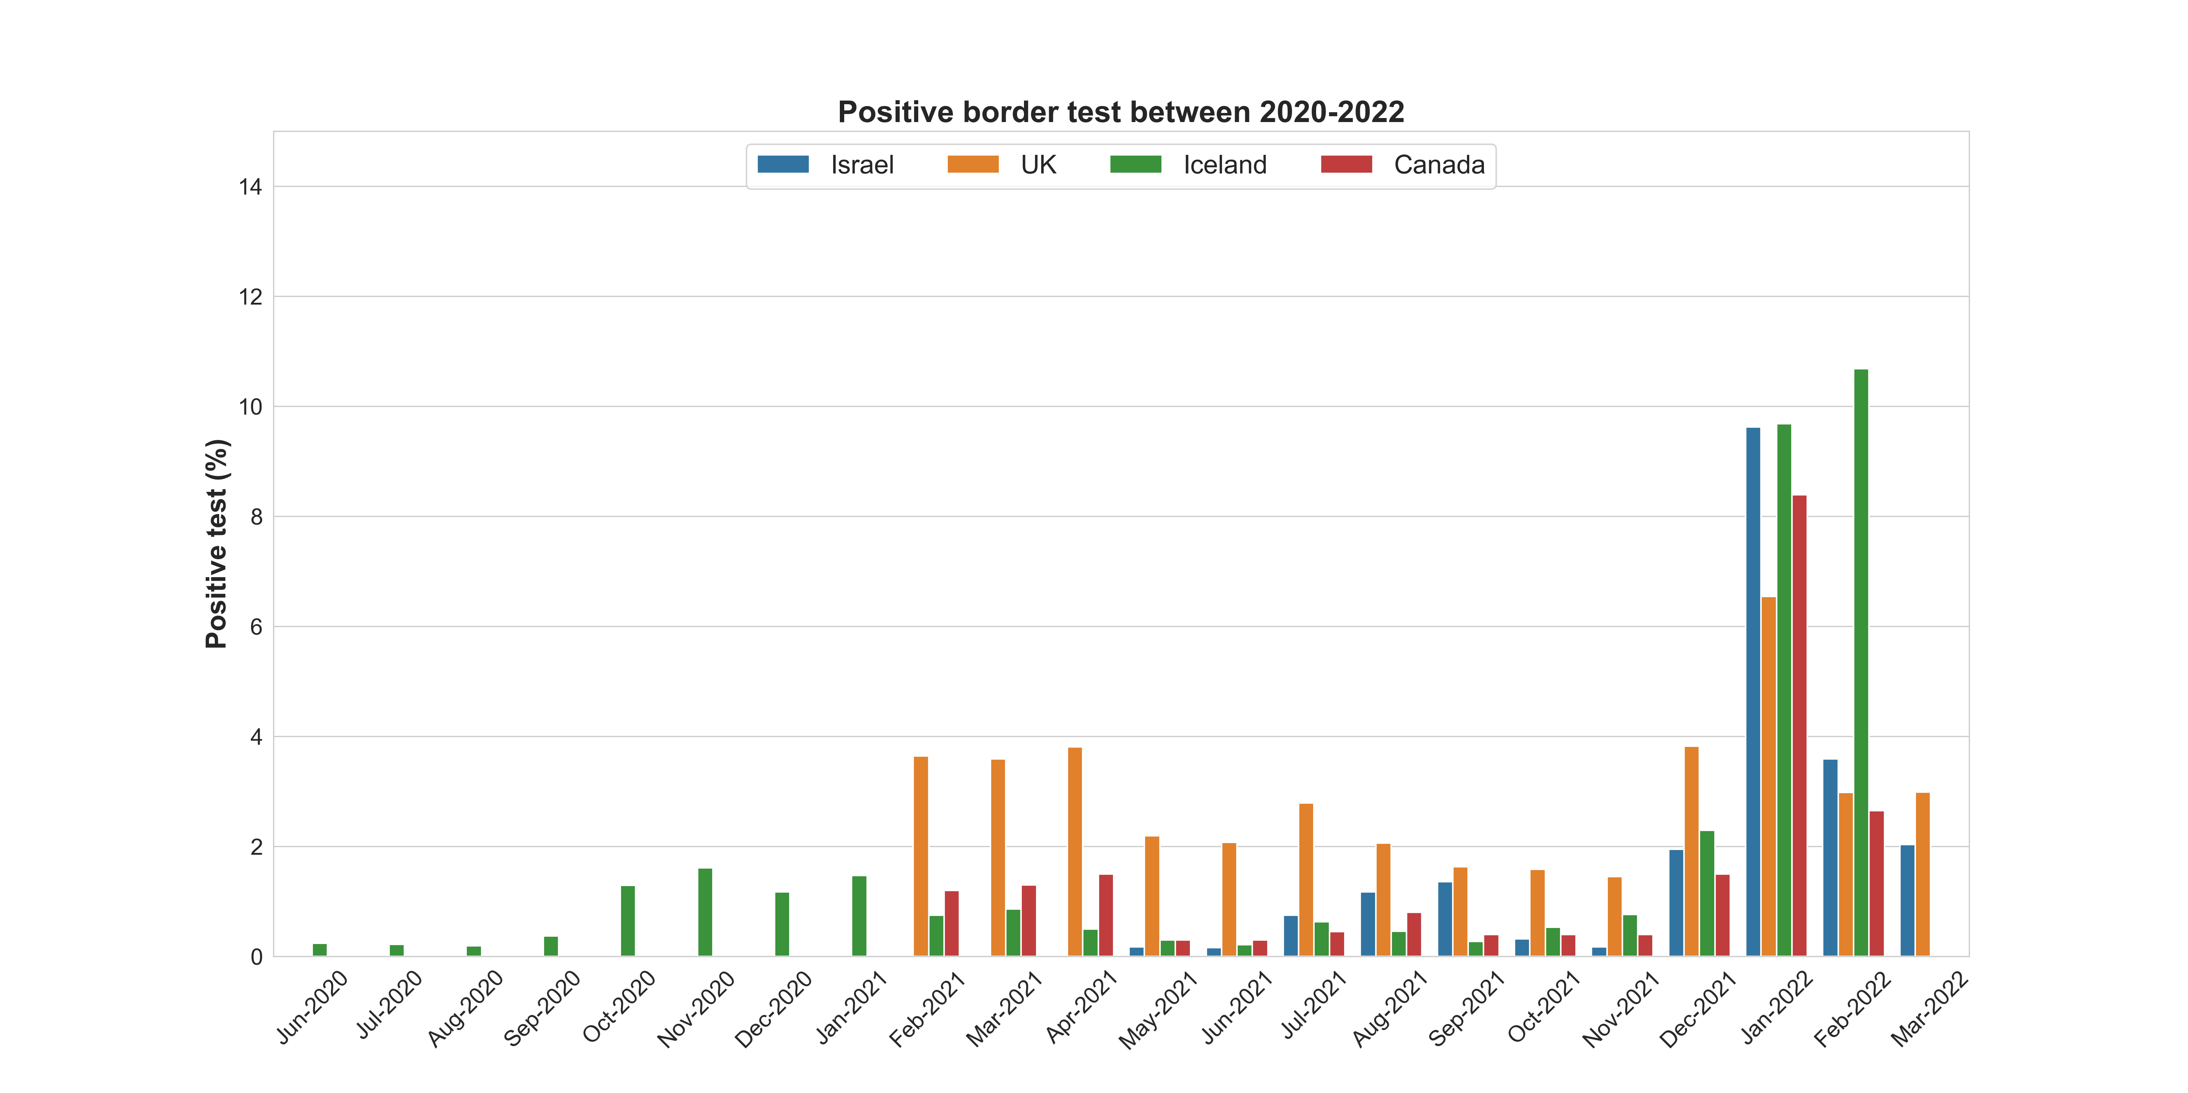
Iceland requires COVID-19 tests on arrival (15th June)
Canada requires COVID-19 tests on arrival (6th Jan)
Iceland waives quarantine for vaccinated tourists ( 25th Jan)
Canada waives quarantine for vaccinated travellers ( 7th Sep)
Iceland removes all requirements (25th Feb)
UK waives PCR requirement (22nd Oct)
UK introduces travel corridors (10th Jul)
UK requires pre-departure COVID-19 test (18th Jan)
Red/Amber/Green list in UK (17th May)
Red list vs. Rest of the world in UK (4th Oct)
UK removes all restrictions (22nd Mar)

Slide 19

Iceland requires COVID-19 tests on arrival (15th June)
Canada requires COVID-19 tests on arrival (6th Jan)
Iceland waives quarantine for vaccinated tourists ( 25th Jan)
Canada waives quarantine for vaccinated travellers ( 7th Sep)
Iceland removes all requirements (25th Feb)
UK waives PCR requirement (22nd Oct)
UK introduces travel corridors (10th Jul)
UK requires pre-departure COVID-19 test (18th Jan)
Red/Amber/Green list in UK (17th May)
Red list vs. Rest of the world in UK (4th Oct)
UK removes all restrictions (22nd Mar)

Slide 20
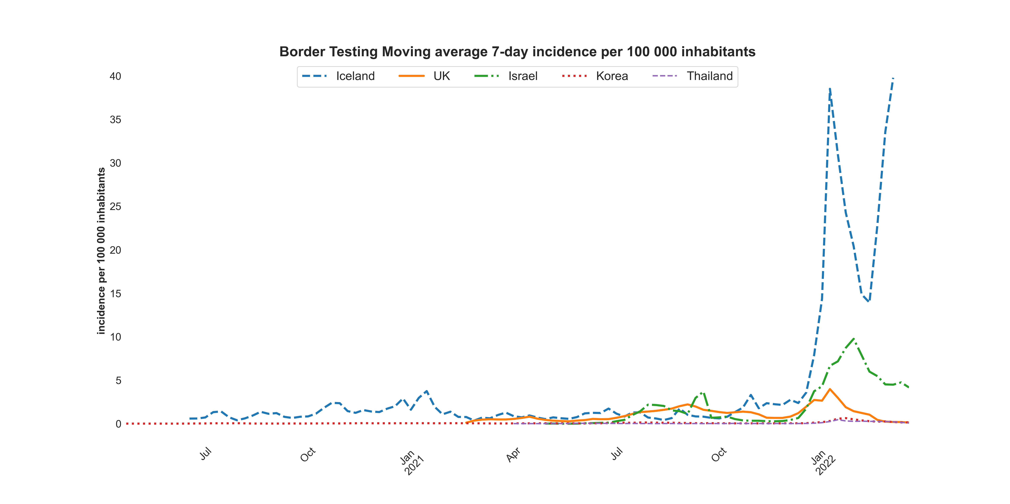
Alpha
Delta
Omicron
Beta
Gamma

