Slide 1
The Battle of the Neighborhoods – Report
Find Location for Opening New VietNAMESE ResTaurant IN Manhatta

Slide 2
Introduction & Business Problem:
In New York city, there are a lot of international cuisines restaurant from around the world like Turkish, Japanese, Chinese restaurants. Vietnamese is one of exotic food and have become popular in United State.
Food street is one of unique features that make Vietnam becomes a attractive travel destination in Asian. Vietnamese food is highly recommended by tourists around the world.
Therefore, it is a good idea to start your own Vietnamese restaurants which serves an exotic food – Vietnamese food in New York city. Target audience: Manhatta area
Problem: Where we should open a restaurant

Slide 3
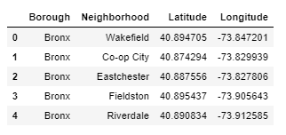
Data
Data 1: Neighborhood has a total of 5 boroughs and 306 neighborhoods. In order to segment the neighborhoods and explore them, we will essentially need a dataset that contains the 5 boroughs and the neighborhoods that exist in each borough as well as the latitude and longitude coordinates of each neighborhood. This dataset exists for free on the web. Link to the dataset is: https://geo.nyu.edu/catalog/nyu_2451_34572

Slide 4
DATA
Data2: New York city geographical coordinates data will be utilized as input for the Foursquare API, that will be leveraged to provision venues information for each neighborhood. We will use the Foursquare API to explore neighborhoods in New York City.
Moreover, Vietnamese restaurant category Id 4bf58dd8d48988d14a941735 is used for retrieving data from Foursquare API.

Slide 5
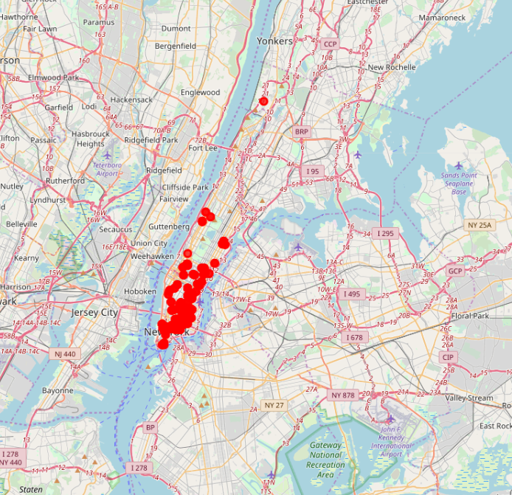
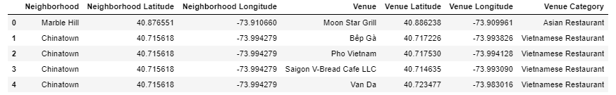
METHODOLOGY
First, I convert addresses into their equivalent latitude and longitude values. Then using Foursquare API to explore neighborhoods in Manhattan, New York. Finally, explore function to get Vietnamese restaurant categories in each neighborhood:

Slide 6
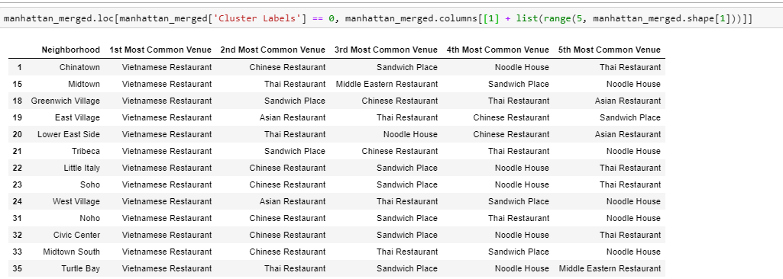
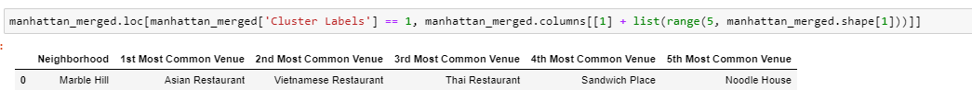
METHODOLOGY
Group the neighborhoods into clusters K-means clustering algorithm
Results:
Cluster 1: Cluster II:

Slide 7
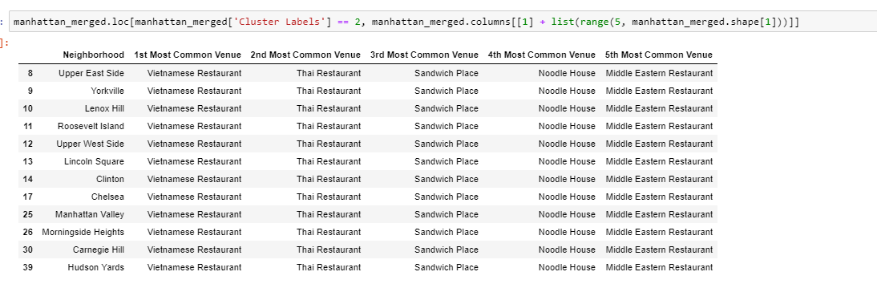
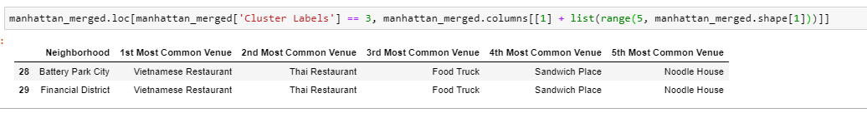
METHODOLOGY
Cluster 3 Cluster 4:

Slide 8
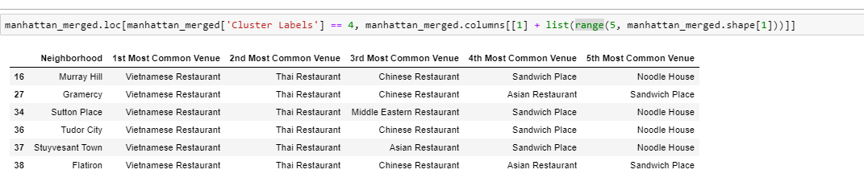
MethoDOLOGY
Cluster 5:

Slide 9
DISCUSSION
In this section, I would be discussing the lack of data. Due to the limit of data, this analysis may be right or wrong. If there are more data available, I believe that the result will be much better.

Slide 10
Conclusion
In conclusion, the best areas for open Vietnamese restaurant is Marble Hill. The result of project may be right or not because of data lacking. There is definitely the room for further improvement. However, we met the object of the project.

