Slide 1

UCS503P • PROJECT PROPOSAL
BharatAssist
Simplifying government for every citizen
An AI-powered Bureaucracy Navigator and Legal Document Simplifier that turns fragmented government information into a guided, citizen-friendly journey.
Lehar Arora · 1024030419 Aastha Mahajan · 1024030424
THAPAR INSTITUTE OF ENGINEERING AND TECHNOLOGY

Slide 2
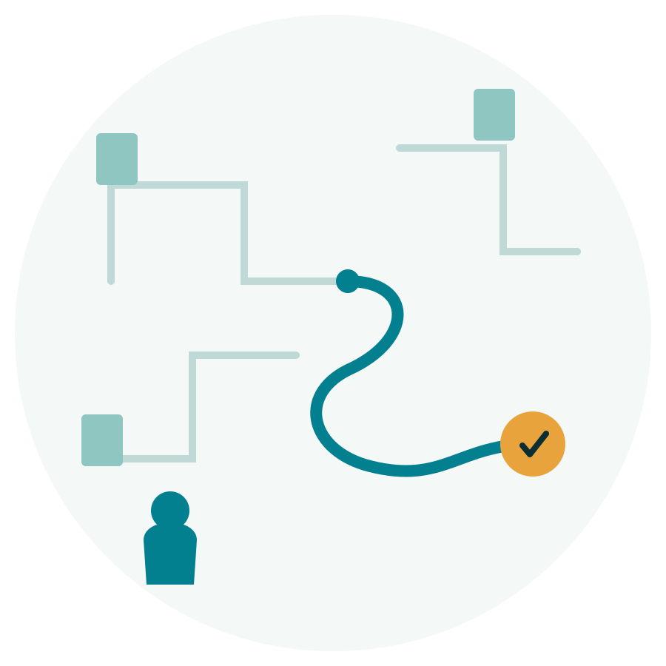




01 · THE WHY
Government is accessible — but not always understandable
The gap isn't only information. It's navigation, language, confidence and time.
Fragmented information
Complex language
Uncertainty
High effort
Citizens move across portals, notices, FAQs and department pages to piece together one procedure.
Legal and government documents are difficult to interpret without prior administrative knowledge.
Eligibility, documents, fees and next steps are often unclear at the moment of action.
The result is longer search time, repeated attempts and avoidable confusion.
THE DESIGN QUESTION
How might we turn bureaucracy from a maze of information into a guided, citizen-friendly journey?
BHARATASSIST
PROJECT OVERVIEW
02

Slide 3
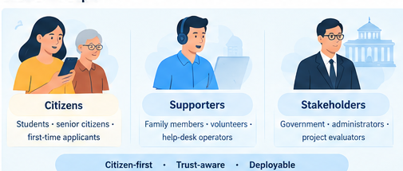



02 · PEOPLE
Designed around the citizen, built for the ecosystem
PRIMARY
SECONDARY
INSTITUTIONAL
Citizens
Supporters
Stakeholders
Students · senior citizens · first-time applicants · people unfamiliar with government processes
Family members · volunteers · help-desk operators · digital-access facilitators
Government information owners · administrators · project evaluators
Need: Clarity, steps, documents, simple language.
Need: Faster, repeatable answers and easier explanations.
Need: Grounded information, maintainability, reliability, privacy and measurable performance.
Citizen-first · Trust-aware · Deployable
BHARATASSIST
PROJECT OVERVIEW
03

Slide 4







03 · USE CASES
One assistant, multiple moments of need
The product is organized around real citizen tasks rather than around technology.
Find a service
Ask a follow-up
Understand a document
"How do I apply?" → eligibility, documents, fees and procedure
"What if I don't have this document?" → context-aware continuation
Upload a complex legal/government document → simpler explanation
Switch language
Speak instead of type
Return later
Interact across 12 Indian languages for broader accessibility
Voice input + audio output for hands-free / low-literacy scenarios
Authenticated users can access persistent conversation history
BHARATASSIST
PROJECT OVERVIEW
04

Slide 5






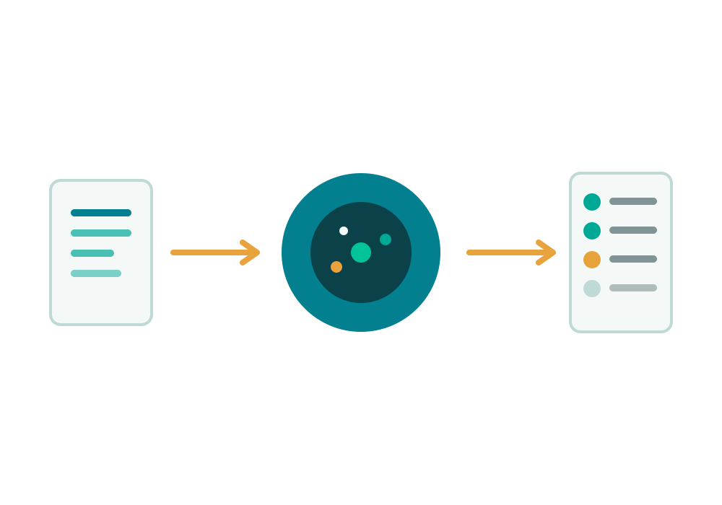
04 · SOLUTION
BharatAssist turns a question into a guided action
A single interface connects service discovery, grounded AI guidance and document understanding.
01
02
03
04
05
Ask / Upload
Understand
Ground
Respond
Act
Citizen enters a query or uploads a document
Input is validated, context is retained and sensitive data is protected
Relevant verified knowledge / document content is retrieved
Gemini generates a clear, contextual explanation
Citizen gets steps, documents, fees and next actions
CORE PROMISE
Less searching. Less jargon. More confidence to complete the task.
BHARATASSIST
PROJECT OVERVIEW
05

Slide 6
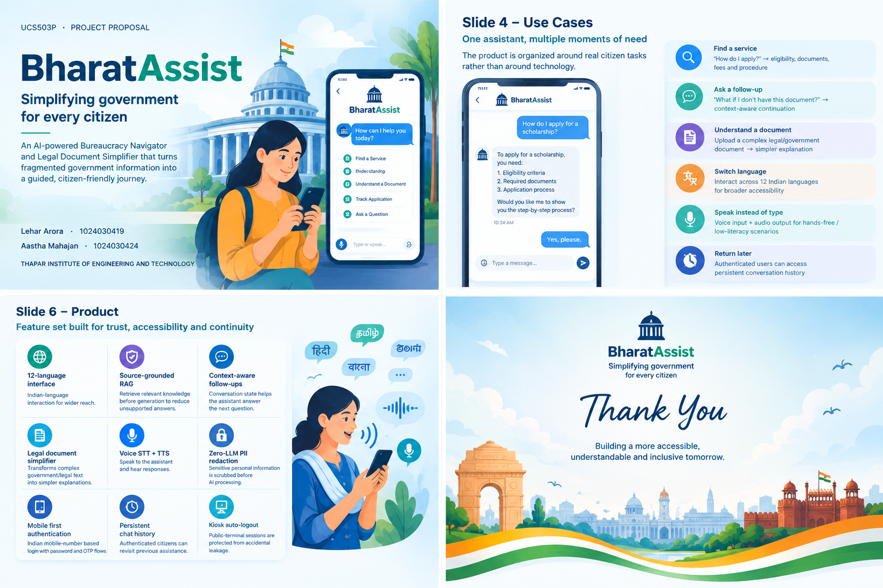




05 · PRODUCT
Feature set built for trust, accessibility and continuity
12-language interface
Source-grounded RAG
Context-aware follow-ups
Indian-language interaction for wider reach.
Retrieve relevant knowledge before generation to reduce unsupported answers.
Conversation state helps the assistant answer the next question.
Legal document simplifier
Voice STT + TTS
Zero-LLM PII redaction
Transforms complex government/legal text into simpler explanations.
Speak to the assistant and hear responses.
Sensitive personal information is scrubbed before AI processing.
Mobile-first authentication
Persistent chat history
Kiosk auto-logout
Indian mobile-number based login with password and OTP flows.
Authenticated citizens can revisit previous assistance.
Public-terminal sessions are protected from accidental leakage.
BHARATASSIST
PROJECT OVERVIEW
06

Slide 7
06 · SYSTEM ARCHITECTURE
A modular pipeline keeps the AI useful — and controllable
CITIZEN LAYER
ENGINEERING CHOICES
Responsive Web UI · Auth · Chat · Document Upload · Voice · Multilingual UI
Flask/Python backend keeps service logic modular and testable.
APPLICATION LAYER
ChromaDB + sentence-transformers provide retrieval grounding.
Flask Backend → Auth Controller → PII Redaction → RAG Retrieval → Gemini Gateway
DATA + AI LAYER
SQLite supports local persistence for users and chat history.
SQLite · ChromaDB · sentence-transformers embeddings · Gemini 2.5 Flash
CONTROL PLANE
Automated tests · CI/CD · session controls · source verification · privacy safeguards
Voice, multilingual UI and responsive design extend accessibility.
BHARATASSIST
PROJECT OVERVIEW
07

Slide 8



07 · TRUST & OUTCOMES
AI is useful only when citizens can rely on it
Grounding
Privacy
Testing
RAG retrieves relevant knowledge before generation.
AI guidance is positioned as guidance; official sources remain the authority.
PII is redacted before the LLM layer.
Kiosk auto-logout and guest/logged-in separation reduce leakage.
33 automated tests cover frontend, APIs, AI assistant, simplifier, voice, auth, security and history.
IRT target ≤ 2 min; RAG grounding confidence threshold 0.35.
≤ 2 min
≥ 4/5
≥ 4/5
≥ 99%
33 / 33
100%
Response time
target (IRT)
Comprehension
score target
User satisfaction
target
Reliability
target
Automated test
pass rate (current)
PII scrubbing
precision (current)
Targets and current results come from the project proposal / current project evaluation.
BHARATASSIST
PROJECT OVERVIEW
08

Slide 9



08 · DIFFERENTIATION
Not just a chatbot — a guided civic workflow
TYPICAL CHAT EXPERIENCE
BHARATASSIST APPROACH
Answers in isolation
Context-aware follow-ups
May generate unsupported text
RAG-grounded responses
One-language assumption
12 Indian languages
Text-only interaction
STT + TTS voice interaction
Privacy added later
PII redaction before LLM
Conversation disappears
Persistent authenticated history
Public-device risk
Kiosk auto-logout
BHARATASSIST
PROJECT OVERVIEW
09

Slide 10


09 · VALUE & ECOSYSTEM
Public value first — sustainability through a platform model
Value Created
Institutional Value
Sustainability Path
Citizens
Organizations / ecosystems
Deployment models
Lower search effort
Standardized guidance
Government / institutional licensing
Faster understanding
Lower repetitive support load
Assisted-service / kiosk deployments
Better confidence
Easier knowledge maintenance
Partnerships with civic-tech orgs
Accessible multilingual interaction
Better digital access
Enterprise knowledge-assistant use
BUSINESS LOGIC Build once as a reusable platform → adapt verified service knowledge by department / geography → measure usage and outcomes.
Ecosystem: Citizens ↔ BharatAssist (AI · RAG · Privacy · UX) ↔ Government / Info Owners ↔ Help-desks & Facilitators ↔ Admins
BHARATASSIST
PROJECT OVERVIEW
10

Slide 11





10 · DELIVERY
From prototype to a deployable civic platform
NOW
NEXT
SCALE
FUTURE
Core assistant + auth + history + multilingual + voice + RAG + privacy + tests
Stabilize login/OTP edge cases · strengthen Document Simplifier backend · refine UX
Admin content workflows · richer service coverage · analytics · cloud deployment
RTI drafting · scheme recommendations · document checklist · application tracking
ITERATION ENGINE
Weekly releases · automated testing · feedback-driven refinement · measurable outcomes
BHARATASSIST
PROJECT OVERVIEW
11

Slide 12





12 · CLOSING
From "What do I do?" to "I know what to do next."
BharatAssist
A citizen-first AI layer for navigating government information with clarity, context and care.
Clear
Grounded
Private
Accessible
Thank you
Lehar Arora · Aastha Mahajan UCS503P · Thapar Institute of Engineering and Technology
BHARATASSIST
THANK YOU
12

