Slide 1
IT3210 OCR Demo
This slide contains text blocks for extraction.
- Topic: C language memory model
- Goal: verify PPTX OCR route

Slide 2
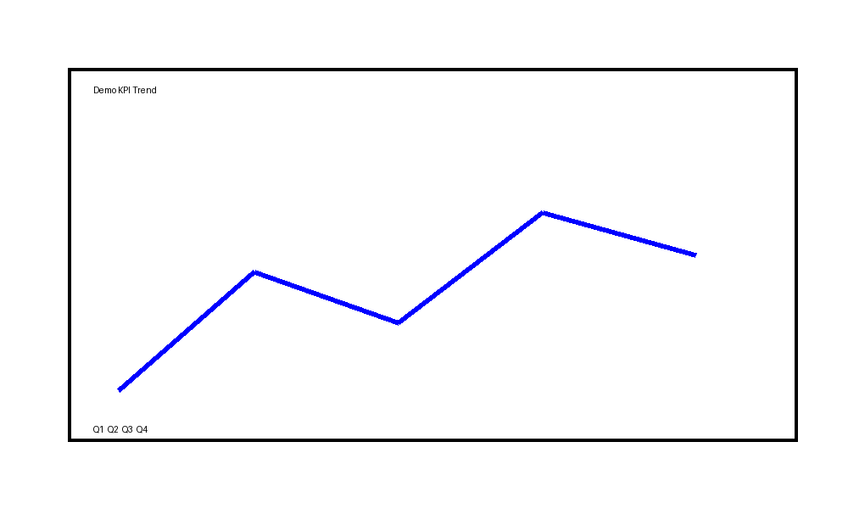
Visual Content Slide
The chart below should trigger vision prompt generation.

