Slide 1
Information Security
Introduction and course plan
Dr. Nguyen Khanh Van
Dept. of Software Engineering
Hanoi University of Technology
August, 2009
Information Security
Van Nguyen -- HUT
Slide #1-<number>

Slide 2
Introduction
This intro (managerial approach): What the system designer/security architect should know
  Components of computer security
  Threats
  Policies and mechanisms
  Assurance
  Operational and Human issues
  The security life cycle
Later (technical approach): the security engineer’s
August, 2009
Information Security
Van Nguyen -- HUT
Slide #1-<number>

Slide 3
Basic Components
Confidentiality
  Keeping data and resources hidden
Integrity
  Data integrity (integrity)
  Origin integrity (authentication)
Availability
  Enabling access to data and resources
August, 2009
Information Security
Van Nguyen -- HUT
Slide #1-<number>
Notes:
Confidentiality: a good example is cryptography, which traditionally is used to protect secret messages. But cryptography is traditionally used to protect data, not resources. Resources are protected by limiting information, for example by using firewalls or address translation mechanisms.
Integrity: a good example here is that of an interrupted database transaction, leaving the database in an inconsistent state (this foreshadows the Clark-Wilson model). Trustworthiness of both data and origin affects integrity, as noted in the book’s example. That integrity is tied to trustworthiness makes it much harder to quantify than confidentiality. Cryptography provides mechanisms for detecting violations of integrity, but not preventing them (e.g., a digital signature can be used to determine if data has changed).
Availability: this is usually defined in terms of “quality of service,” in which authorized users are expected to receive a specific level of service (stated in terms of a metric). Denial of service attacks are attempts to block availability.

Slide 4
Classes of Threats
Disclosure
  Snooping
Deception
  Modification, spoofing, repudiation of origin, denial of receipt
Disruption
  Modification
Usurpation
  Modification, spoofing, delay, denial of service
August, 2009
Information Security
Van Nguyen -- HUT
Slide #1-<number>
Notes:
Snooping : an example is passive wiretapping, where the attacker monitors communications.
Modification: an example is active wiretapping, where the attacker injects something into a communication or modifies parts of the communication. Modification is sometimes called alteration.
Spoofing: delegation is basically authorized spoofing. The difference is that the ones to which authority is delegated does not impersonate the delegator; she simply asserts authority to act as an agent for the delegator.
Delay:
Denial of service: this may not be due to an attack, but due to limits of resources. However, the effect here is critical. If you define security in terms of what users need to access, the inability to access is a security problem regardless of whether the reason is intentional (an attack) or unintentional (not an attack).

Slide 5
Snooping
The unauthorized interception of information, is a form of disclosure.
  Passive: some entity is listening to/reading communications …
  (Passive) wiretapping is a form of snooping in which a network is monitored (wire: the network)
  Confidentiality services counter this threat.
August, 2009
Information Security
Van Nguyen -- HUT
Slide #1-<number>

Slide 6
Modification
Or alteration, an unauthorized change of information, covers three classes of threats.
  Deception: incorrect information is accepted as correct/ wrong decision is made.
  Disruption and usurpation: If the modified data controls the operation of the system
Active wiretapping is a form of modification in which data moving across a network is altered.
  Example: the man-in-the-middle attack
Integrity services counter this threat.
August, 2009
Information Security
Van Nguyen -- HUT
Slide #1-<number>

Slide 7
The man-in-the-middle attack
An intruder reads messages from the sender and sends (possibly modified) versions to the recipient,
  Succeeds if the recipient and sender don’t realize his presence.
August, 2009
Information Security
Van Nguyen -- HUT
Slide #1-<number>

Slide 8
Repudiation of origin
A false denial that an entity sent (or created) something.
  Example: suppose a customer ➔ a letter agreeing to pay for a product ➔ the vendor ships the product and then demands payment ➔ the customer denies having ordered the product and keep the unsolicited shipment without payment.
    The customer has repudiated the origin of the letter. If the vendor cannot prove that the letter came from the customer, the attack succeeds.
  Integrity mechanisms cope with this threat.
August, 2009
Information Security
Van Nguyen -- HUT
Slide #1-<number>

Slide 9
Denial of receipt
A false denial that an entity received some information or message.
  E.g. A customer orders an expensive product and pays in advance: customer pays ➔ vendor ships. The customer then falsly asks the vendor when he will receive the product➔ denial of receipt attack.
    The vendor can defend against this attack only by proving that the customer did, despite his denials, receive the product.
  Integrity and availability mechanisms guard against these attacks.
August, 2009
Information Security
Van Nguyen
Slide #1-<number>

Slide 10
Denial of service
A long-term inhibition of service, so a form of usurpation, although often used with other mechanisms to deceive.
  The attacker prevents a server from providing a service. The denial may occur at
    the source (by preventing the server from obtaining the resources needed to perform its function),
    at the destination (by blocking the communications from the server), or along the intermediate path (by discarding messages from either the client or the server, or both).
  Availability mechanisms counter this threat.
August, 2009
Information Security
Van Nguyen
Slide #1-<number>

Slide 11
Policies and Mechanisms
Policy says what is, and is not, allowed
  This defines “security” for the site/system/etc.
Mechanisms enforce policies
Composition of policies
  If policies conflict, discrepancies may create security vulnerabilities
August, 2009
Information Security
Van Nguyen -- HUT
Slide #1-<number>
Notes:
Policy: may be expressed in
natural language, which is usually imprecise but easy to understand;
mathematics, which is usually precise but hard to understand;
policy languages, which look like some form of programming language and try to balance precision with ease of understanding
Mechanisms: may be
technical, in which controls in the computer enforce the policy; for example, the requirement that a user supply a password to authenticate herself before using the computer
procedural, in which controls outside the system enforce the policy; for example, firing someone for ringing in a disk containing a game program obtained from an untrusted source
The composition problem requires checking for inconsistencies among policies. If, for example, one policy allows students and faculty access to all data, and the other allows only faculty access to all the data, then they must be resolved (e.g., partition the data so that students and faculty can access some data, and only faculty access the other data).

Slide 12
Policies and Mechanisms
Policy: may be expressed in
  natural language, which is usually imprecise but easy to understand;
  mathematics, which is usually precise but hard to understand;
  policy languages, which look like some form of programming language and try to balance precision with ease of understanding
August, 2009
Information Security
Van Nguyen
Slide #1-<number>

Slide 13
Policies and Mechanisms
Mechanisms: may be
  technical, in which controls in the computer enforce the policy, e.g. a user has to supply a password to authenticate herself before using
  procedural, in which controls outside the system enforce the policy; e.g. , firing someone for bringing in a game disk from an untrusted source
The composition problem requires checking for inconsistencies among policies
August, 2009
Information Security
Van Nguyen
Slide #1-<number>
Notes:
The composition problem requires checking for inconsistencies among policies
If, for example, one policy allows students and faculty access to all data, and the other allows only faculty access to all the data, then they must be resolved (e.g., partition the data so that students and faculty can access some data, and only faculty access the other data)

Slide 14
Goals of Security
Prevention
  Prevent attackers from violating security policy
Detection
  Detect attackers’ violation of security policy
Recovery
  Stop attack, assess and repair damage
  Continue to function correctly even if attack succeeds
August, 2009
Information Security
Van Nguyen -- HUT
Slide #1-<number>
Notes:
Prevention is ideal, because then there are no successful attacks.
Detection occurs after someone violates the policy. The mechanism determines that a violation of the policy has occurred (or is underway), and reports it. The system (or system security officer) must then respond appropriately.
Recovery means that the system continues to function correctly, possibly after a period during which it fails to function correctly. If the system functions correctly always, but possibly with degraded services, it is said to be intrusion tolerant. This is very difficult to do correctly; usually, recovery means that the attack is stopped, the system fixed (which may involve shutting down the system for some time, or making it unavailable to all users except the system security officers), and then the system resumes correct operations.

Slide 15
Assurance
Assurance is a measure of how well the system meets its requirements; i.e. how much you can trust the system to do what it is supposed to do.
Assurance techniques:
  Specification
  Design
  Implementation
August, 2009
Information Security
Van Nguyen -- HUT
Slide #1-<number>
Notes:
Assurance is a measure of how well the system meets its requirements; more informally, how much you can trust the system to do what it is supposed to do. It does not say what the system is to do; rather, it only covers how well the system does it.

Slide 16
Specification
Specification
  Arise from Requirements analysis
  Statement of desired functionality: says what the system must do to meet those requirements. Can be
    very formal (mathematical) or informal (natural language)
    high-level or low-level
      E.g. describing what the system as a whole is to do vs. what specific modules of code are to do
August, 2009
Information Security
Van Nguyen
Slide #1-<number>

Slide 17
Design and Implementation
Design: How to meet specification
  Typically, the design is layered by breaking the system into abstractions, and then refining the abstractions (work down to the hardware).
  An analyst must show the design matches the specification.
Implementation
  Actual coding of the modules and software components.
    These must be correct (perform as specified), and their aggregation must satisfy the design.
August, 2009
Information Security
Van Nguyen
Slide #1-<number>
Notes:
The design architects the system to satisfy, or meet, the specifications. Typically, the design is layered by breaking the system into abstractions, and then refining the abstractions as you work your way down to the hardware. An analyst also must show the design matches the specification.
The implementation is the actual coding of the modules and software components. These must be correct (perform as specified), and their aggregation must satisfy the design.
Note the assumptions of correct compilers, hardware, etc.

Slide 18
Operational Issues
Cost-Benefit Analysis
  Is it cheaper to prevent or recover?
Risk Analysis
  Should we protect something?
  How much should we protect this thing?
Laws and Customs
  Are desired security measures illegal?
  Will people do them?
August, 2009
Information Security
Van Nguyen -- HUT
Slide #1-<number>
Notes:
Security does not end when the system is completed. Its operation affects security. A “secure” system can be breached by improper operation (for example, when accounts with no passwords are created). The question is how to assess the effect of operational issues on security.
Cost-Benefit Analysis: this weighs the cost of protecting data and resources with the costs associated with losing the data. Among the considerations are the overlap of mechanisms’ effects (one mechanism may protect multiple services, so its cost is amortized), the non-technical aspects of the mechanism (will it be impossible to enforce), and the ease of use (if a mechanism is too cumbersome, it may cost more to retrofit a decent user interface than the benefits would warrant).
Risk Analysis: what happens if the data and resources are compromised? This tells you what you need to protect and to what level. Cost-benefit analyses help determine the risk here, but there may be other metrics involved (such as customs).
Salary Database: connecting to the Internet or not.
Laws and Customs: these constrain what you can do. Encryption used to be the biggie here, as the text indicates. How much that has changed is anybody’s guess. Customs involve non-legislated things, like the use of urine specimens to determine identity. That is legal, at least in the US in some cases; but it would never be widely accepted as an alternative to a password.

Slide 19
Human Issues
Organizational Problems
  Power and responsibility
    those responsible for security have the power to enforce security (not responsibility without power or vice versa)
  Financial benefits
    Tricky: security is not a direct financial incentive, only appreciated when loss occurs
August, 2009
Information Security
Van Nguyen -- HUT
Slide #1-<number>
Notes:
Organizations: the key here is that those responsible for security have the power to enforce security. Otherwise there is confusion, and the architects need not worry if the system is secure because they won’t be blamed if someone gets in. This arises when system administrators, for example, are responsible for security, but only security officers can make the rules. Preventing this problem (power without responsibility, or vice versa) is tricky and requires capable management. What’s worse is that security is not a direct financial incentive for most companies because it doesn’t bring in revenue. It merely prevents the loss of revenue obtained from other sources.

Slide 20
Human Issues
People problems
  Outsiders and insiders
  Social engineering
August, 2009
Information Security
Van Nguyen -- HUT
Slide #1-<number>
Notes:
People problems are by far the main source of security problems. Outsiders are attackers from without the organization; insiders are people who have authorized access to the system and, possibly, are authorized to access data and resources, but use the data or resources in unauthorized ways. It is speculated that insiders account for 80-90% of all security problems, but the studies generally do not disclose their methodology in detail, so it is hard to know how accurate they are. (Worse, there are many slightly different definitions of the term “insider,” causing the studies to measure slightly different things!) Social engineering, or lying, is quite effective, especially if the people gulled are inexperienced in security (possibly because they are new, or because they are tired).

Slide 21
The security lifecycle
Threats
Policy
Specification
Design
Implementation
Operation
August, 2009
Information Security
Van Nguyen -- HUT
Slide #1-<number>
Notes:
The point to this slide is that each step feeds into the earlier steps. In theory, each of these should only affect the one before it, and the one after it. In practice, each affects all the ones that come before it.
Feedback from operation and maintenance is critical, and often overlooked. It allows one to validate the threats and the legitimacy of the policy.

Slide 22
EXAMPLE
A major corporation decided to improve its security.
  Hired consultants → determined the threats → created a policy → derived specifications that the security mechanisms had to meet → developed a design that would meet the specifications.
During the implementation phase
  discovered [modems to the telephones] → firewall → the design had to be modified to divide systems into two classes: outside or behind the firewall
August, 2009
Information Security
Van Nguyen
Slide #1-<number>

Slide 23
EXAMPLE
When deployed, the operation and maintenance phase revealed several unexpected threats.
  sensitive data sent across the Internet in the clear → crypto is very difficult to use→ fixed implementation
  several "trusted" hosts (allowed to log in without authentication) were physically outside the company’control
    This violated policy, because of commercial reasons → modified the policy element about "trusted hosts”
  Finally, the company detected proprietary material being sent to a competitor over electronic mail.
    This added a threat that the company had earlier discounted. The company did not realize that it needed to worry about insider attacks.
August, 2009
Information Security
Van Nguyen
Slide #1-<number>

Slide 24
Key Points
Policy defines security, and mechanisms enforce security
  Confidentiality
  Integrity
  Availability
Trust and knowing assumptions
Importance of assurance
The human factor
August, 2009
Information Security
Van Nguyen -- HUT
Slide #1-<number>

Slide 25
SECURITY ENGINEER’S
August, 2009
Information Security
Van Nguyen
Slide #1-<number>

Slide 26
Terminologies
Vulnerabilities (weaknesses)
Threats (potential scenario of attack)
Attacks
Controls (security measures)
August, 2009
Information Security
Van Nguyen
Slide #1-<number>

Slide 27
What the security engineer should master
The technical foundation of security such as cryptography and related technologies, access control methods, authentication methods and other security architectures
Knowledge and skills in some major areas, i.e. security topics in
  Computer networks
  Databases and data mining
  Software and programs
  Web and Internet services
  Electronic privacy and e-commerce

Slide 28
Methods of Defense
Prevention
Deterrence
Reflection
Detection
Recovering
August, 2009
Information Security
Van Nguyen
Slide #1-<number>

Slide 29
Controls
Encryption
Software controls
Hardware controls
Policies and procedures
Physical controls
August, 2009
Information Security
Van Nguyen
Slide #1-<number>

Slide 30
Cryptography
Cryptographers work on formal methods in building secure systems of storing and processing information and communicating between its parts, all under the present of adversaries.
  Encryption:
  Entity authentication tools
  Message authentication with digital signatures
  Key management
  and many other cryptographic tools

Slide 31
Access Control Methods
Scenario: Can user X use resource F with right (privilege) R?
  Access Control Matrix
  Discretionary Access Control
  Mandatory Access Control
  Role-based Access Control

Slide 32
Authentication Methods
What entity knows (eg. password)
What entity has (eg. Identity card, smart card)
What entity is (eg. fingerprints, retinal characteristics)
Where entity is (eg. In front of a particular terminal)

Slide 33
Network security
Popular attacks, threats in networks
Some popular strong attacks against Internet protocols
Available secure packages/protocol suite: IPsec, SSL/TLS
Firewall, Intrusion Detection Systems

Slide 34
Security in Software/Programs/Web
Malicious codes: Logic bomb, virus, worms, …
Unintentional common errors: buffer overflow …
Attacks exploiting common mistakes
Web attacks: command injection e.g. SQL injection, cross-site scripting …

Slide 35
Database security
Database Security Levels
Reliability and Integrity
Attacks against database
Access Control

Slide 36
Privacy, DRM and E-payment
Some hot topics related to the many aspects of Internet services and transactions
  Controversies around level of user privacy: can perfect anonymity is allowed?
  How to protect copyright of digital products?
  How can we pay in securely and efficiently when doing e-commerce?

Slide 37
What is This Course About?
Learn to think about security
  Threats, defenses, policies
  Software, human and environment factors
Think as an attacker:
  Learn to identify threats
Think as a security designer:
  Learn how to prevent attacks and/or limit their consequences
  Understand and apply security principles
  Learn tools that can defend against specific attacks, no silver-bullet solution
August, 2009
Information Security
Van Nguyen
Slide #1-<number>

Slide 38
Agenda
A gentle intro to Cryptography
Authentication methods
Access control methods and mechanisms
Software and Program security
August, 2009
Information Security
Van Nguyen
Slide #1-<number>

Slide 39
Course Material
Lecturer’s website
http://sedic.soict.hust.edu.vn/vannk/
http://sedic.soict.hust.edu.vn/vannk/AntoanThongtin/ComputerSecurity.htm
Introduction to Computer Security, Matt Bishop, Addison-Wesley Professional
Security in Computing, Charles P.Pfleeger, Prentice Hall
Cryptography And Network Security: Principles and Practices, William Stallings, Prentice Hall
August, 2009
Information Security
Van Nguyen
Slide #1-<number>

Slide 40
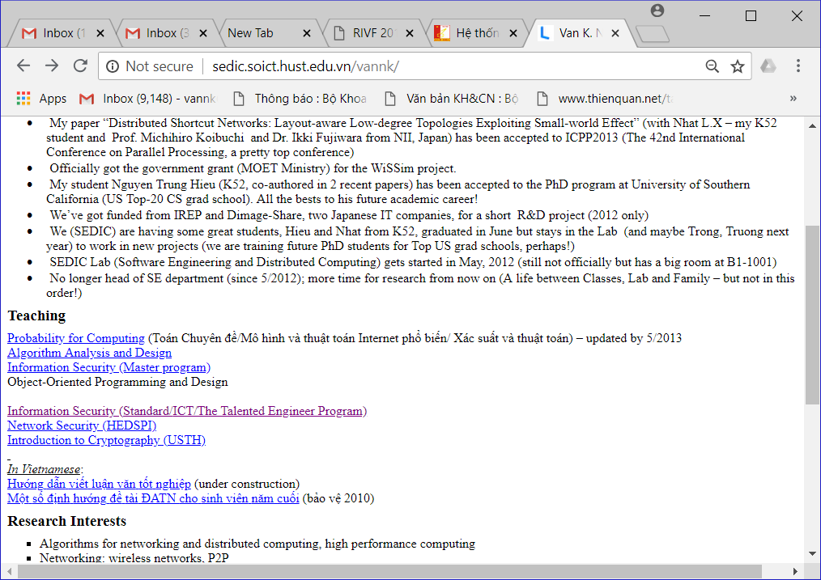
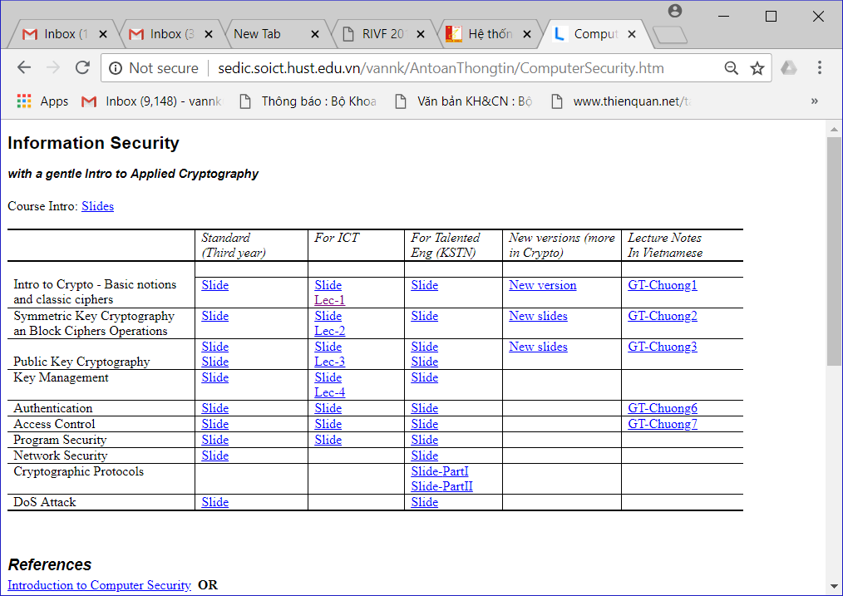
Course Website

Slide 41
Group Project
Objectives
The how-to-dos in:
  Choosing topic
  Doing survey and/or software product
  Producing Write-up report
Evaluation method

