Slide 1
Identity Authentication
Van Nguyen – HUT
Hanoi – 2009
(with material from Bishop’s text “Introduction to Computer Security”)

Slide 2
Authentication
Basics
Passwords
Challenge-Response
Biometrics
Location
Multiple Methods
Sep 2009
Information Security by Van K Nguyen Hanoi University of Technology

Slide 3
Basics
Authentication: binding of identity to subject
  Identity is that of external entity (my identity, Van, etc.)
  Subject is computer entity (process, etc.)
Note:
  message authentication is a different topic and already mentioned in the applications of hash functions
Sep 2009
Information Security by Van K Nguyen Hanoi University of Technology

Slide 4
Establishing Identity
One or more of the following
  What entity knows (eg. password)
  What entity has (eg. Identity card, smart card)
  What entity is (eg. fingerprints, retinal characteristics)
  Where entity is (eg. In front of a particular terminal)
Sep 2009
Information Security by Van K Nguyen Hanoi University of Technology

Slide 5
Authentication System
We need a formal definition, rather abstract view, of an AS
A 5-tuple (A, C, F, L, S)
  A – a set: information that proves identity
  C – a set: information stored on computer and used to validate authentication information
  F: a set of complementation functions; f : A → C
    To compute complement information from identity information
  L: authentication functions that prove identity
  S: functions enabling entity to create, alter information in A or C
Sep 2009
Information Security by Van K Nguyen Hanoi University of Technology

Slide 6
Example
Password system, with passwords stored on line in clear text
  A set of strings making up passwords
  C = A
  F singleton set of identity function { I }
  L single equality test function { eq }
  S function to set/change password
Sep 2009
Information Security by Van K Nguyen Hanoi University of Technology

Slide 7
Passwords
Sequence of characters
  Examples: 10 digits, a string of letters, etc.
  Generated randomly, by user, by computer with user input
Sequence of words
  Examples: pass-phrases
Algorithms
  Examples: challenge-response, one-time passwords
Sep 2009
Information Security by Van K Nguyen Hanoi University of Technology

Slide 8
Storage
Store as cleartext
  If password file compromised, all passwords revealed
Encipher file
  Need to have decipherment, encipherment keys in memory
  Reduces to previous problem ➔ need something else
Solution: Instead store one-way hash of password
  Got the file, attacker must still guess passwords or invert the hash values
Sep 2009
Information Security by Van K Nguyen Hanoi University of Technology

Slide 9
Example: Unix
By definition, a 5-tuple (A, C, F, L, S)
  A – a set: information that proves identity
    A = { strings of 8 chars or less }
  C – a set: information stored on computer and used to validate authentication information
    C = {hash values of password}
  F: a set of complementation functions; f : A → C
    F = { versions of modified DES }
  L: authentication functions that prove identity
    L = { login, su, … }
  S: functions enabling entity to create, alter information in A or C
    S = { passwd, nispasswd, passwd+, … }
Sep 2009
Information Security by Van K Nguyen Hanoi University of Technology

Slide 10
Example: Unix
By definition, a 5-tuple (A, C, F, L, S)
  A – a set: information that proves identity
    A = { strings of 8 chars or less }
  C – a set: information stored on computer and used to validate authentication information
    C = {hash values of password}
  F: a set of complementation functions; f : A → C
    F = { versions of modified DES }
  L: authentication functions that prove identity
    L = { login, su, … }
  S: functions enabling entity to create, alter information in A or C
    S = { passwd, nispasswd, passwd+, … }
Sep 2009
Information Security by Van K Nguyen Hanoi University of Technology

Slide 11
Attacking passwords
Goal: find a ∈ A such that:
  For some f ∈ F, f(a) = c ∈ C
  c is associated with entity
Two ways to determine whether a meets these requirements:
  By trying computing f(a) for a set of a values until succeed
  By trying calling I(a) until succeed (I(a) returns true)
Sep 2009
Information Security by Van K Nguyen Hanoi University of Technology

Slide 12
Preventing Attacks
How to prevent this:
  Hide one of a, f, or c
    Prevents obvious attack from above
    Example: UNIX/Linux shadow password files
      Hides the c’s
  Block access to all l ∈ L or result of l(a)
    Prevents attacker from knowing if guess succeeded
    Example: preventing any logins to an account from a network
      Prevents knowing results of l (or accessing l)
Sep 2009
Information Security by Van K Nguyen Hanoi University of Technology

Slide 13
Dictionary Attacks
Trial-and-error from a list of potential passwords
  Off-line: know f and c’s, and repeatedly try different guesses g ∈ A until the list is done or passwords guessed
    Examples: crack, john-the-ripper
  On-line: have access to functions in L and try guesses g until some l(g) succeeds
    Examples: trying to log in by guessing a password
Sep 2009
Information Security by Van K Nguyen Hanoi University of Technology

Slide 14
Success probability over a time period
Anderson’s formula:
P probability of guessing a password in specified period of time
G number of guesses tested in 1 time unit
T number of time units
N number of possible passwords (|A|)
Then P ≥ TG/N
Sep 2009
Information Security by Van K Nguyen Hanoi University of Technology

Slide 15
Example
Goal
  Passwords drawn from a 96-char alphabet
  Can test 10⁴ guesses per second
  Probability of a success to be 0.5 over a 365 day period
  What is minimum password length?
Solution
  N ≥ TG/P = (365×24×60×60)×10⁴/0.5 = 6.31×10¹¹
  Choose s such that Σ^{s}_{j=0} 96^{j} ≥ N
  So s ≥ 6, meaning passwords must be at least 6 chars long
Sep 2009
Information Security by Van K Nguyen Hanoi University of Technology

Slide 16
On password selection
Random selection
  Any password from A equally likely to be selected
Pronounceable passwords
User selection of passwords
Sep 2009
Information Security by Van K Nguyen Hanoi University of Technology

Slide 17
Pronounceable Passwords
Generate phonemes randomly
  Phoneme is unit of sound, eg. cv, vc, cvc, vcv
  Examples: helgoret, juttelon are; przbqxdfl, zxrptglfn are not
Problem: too few
Solution: key crunching
  Run long key through hash function and convert to printable sequence
  Use this sequence as password
Sep 2009
Information Security by Van K Nguyen Hanoi University of Technology

Slide 18
User Selection
Problem: people pick easy to guess passwords
  Based on account names, user names, computer names, place names
  Dictionary words (also reversed, odd capitalizations, control characters, “elite-speak”, conjugations or declensions, swear words, Torah/Bible/Koran/… words)
  Too short, digits only, letters only
  License plates, acronyms, social security numbers
  Personal characteristics or foibles (pet names, nicknames, job characteristics, etc.
Sep 2009
Information Security by Van K Nguyen Hanoi University of Technology

Slide 19
Picking Good Passwords
“LlMm*2^Ap”
  Names of members of 2 families
“OoHeO/FSK”
  Second letter of each word of length 4 or more in third line of third verse of Star-Spangled Banner, followed by “/”, followed by author’s initials
What’s good here may be bad there
  “DMC/MHmh” bad at Dartmouth (“Dartmouth Medical Center/Mary Hitchcock memorial hospital”), ok here
Why are these now bad passwords? ☹
Sep 2009
Information Security by Van K Nguyen Hanoi University of Technology

Slide 20
Proactive Password Checking
Analyze proposed password for “goodness”
  Always invoked
  Can detect, reject bad passwords for an appropriate definition of “bad”
  Discriminate on per-user, per-site basis
  Needs to do pattern matching on words
  Needs to execute subprograms and use results
    Spell checker, for example
  Easy to set up and integrate into password selection system
Sep 2009
Information Security by Van K Nguyen Hanoi University of Technology

Slide 21
Salting
Goal: slow dictionary attacks
Method: perturb hash function so that:
  Parameter controls which hash function is used
  Parameter differs for each password
  So given n password hashes, and therefore n salts, need to hash guess n
Sep 2009
Information Security by Van K Nguyen Hanoi University of Technology

Slide 22
Examples
Vanilla UNIX method
  Use DES to encipher 0 message with password as key; iterate 25 times
  Perturb E table in DES in one of 4096 ways
    12 bit salt flips entries 1–11 with entries 25–36
Alternate methods
  Use salt as first part of input to hash function
Sep 2009
Information Security by Van K Nguyen Hanoi University of Technology

Slide 23



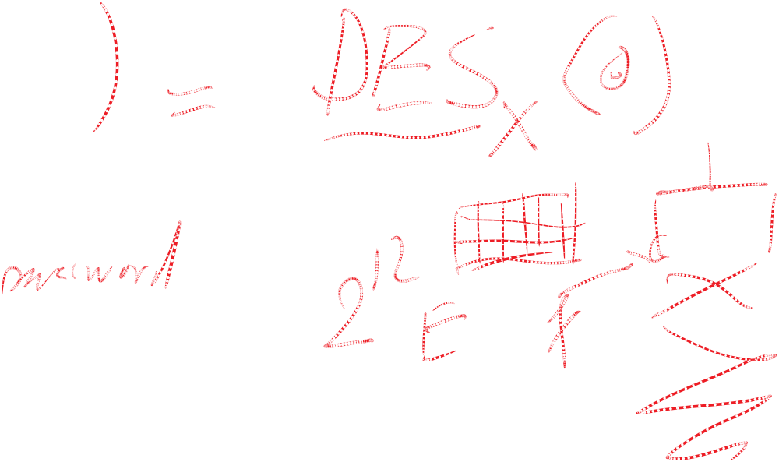



Sep 2009
Information Security by Van K Nguyen Hanoi University of Technology

Slide 24
Unix actually is …
UNIX system standard hash function
  Hashes password into 11 char string using one of 4096 hash functions
As authentication system:
  A = { strings of 8 chars or less }
  C = { 2 char hash id || 11 char hash }
  F = { 4096 versions of modified DES }
  L = { login, su, … }
  S = { passwd, nispasswd, passwd+, … }
Sep 2009
Information Security by Van K Nguyen Hanoi University of Technology

Slide 25
Guessing Through L
Cannot prevent these
  Otherwise, legitimate users cannot log in
Make them slow
  Backoff
  Disconnection
  Disabling
    Be very careful with administrative accounts!
  Jailing
    Allow in, but restrict activities
Sep 2009
Information Security by Van K Nguyen Hanoi University of Technology

Slide 26
Password Aging
Force users to change passwords after some time has expired
  How do you force users not to re-use passwords?
    Record previous passwords
    Block changes for a period of time
  Give users time to think of good passwords
    Don’t force them to change before they can log in
    Warn them of expiration days in advance
Sep 2009
Information Security by Van K Nguyen Hanoi University of Technology

Slide 27
Challenge-Response
User, system share a secret function f (in practice, f is a
known function with unknown parameters, such as a
cryptographic key)
user
request to authenticate
system
user
random message r
(the challenge)
system
user
f(r)
(the response)
system
Sep 2009
Information Security by Van K Nguyen Hanoi University of Technology

Slide 28
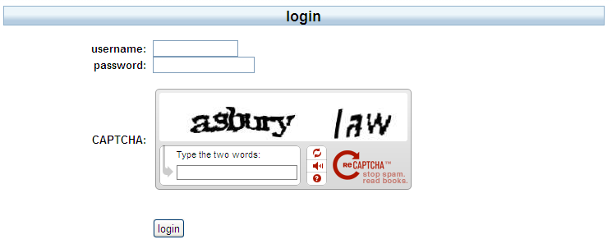
Pass Algorithms
Challenge-response with the function f itself a secret
  Challenge is a random string of characters
  Response is some function of that string
  Usually used in conjunction with fixed, reusable password
Sep 2009
Information Security by Van K Nguyen Hanoi University of Technology

Slide 29
One-Time Passwords
Password that can be used exactly once
  After use, it is immediately invalidated
Challenge-response mechanism
  Challenge is number of authentications; response is password for that particular number
Problems
  Synchronization of user, system
  Generation of good random passwords
  Password distribution problem
Sep 2009
Information Security by Van K Nguyen Hanoi University of Technology

Slide 30
S/Key
One-time password scheme based on idea of Lamport
h one-way hash function (MD5 or SHA-1, for example)
User chooses initial seed k
System calculates:
  h(k) = k₁, h(k₁) = k₂, …, h(k_{n–1}) = k_{n}
Passwords are reverse order:
  p₁ = k_{n}, p₂ = k_{n–1}, …, p_{n–1} = k₂, p_{n} = k₁
Sep 2009
Information Security by Van K Nguyen Hanoi University of Technology

Slide 31
S/Key Protocol
System stores maximum number of authentications n, number
of next authentication i, last correctly supplied password p_{i–1}.
user
{ name }
system
{ i }
system
user
{ p_{i} }
user
system
System computes h(p_{i}) = h(k_{n–i+1}) = k_{n–i+2} = p_{i–1}. If match with
what is stored, system replaces p_{i–1} with p_{i} and increments i.
Sep 2009
Information Security by Van K Nguyen Hanoi University of Technology

Slide 32
Hardware Support
Token-based
  Used to compute response to challenge
    May encipher or hash challenge
    May require PIN from user
Temporally-based
  Every minute (or so) different number shown
    Computer knows what number to expect when
  User enters number and fixed password
Sep 2009
Information Security by Van K Nguyen Hanoi University of Technology

Slide 33
C-R and Dictionary Attacks
Same as for fixed passwords
  Attacker knows challenge r and response f(r); if f encryption function, can try different keys
    May only need to know form of response; attacker can tell if guess correct by looking to see if deciphered object is of right form
    Example: Kerberos Version 4 used DES, but keys had 20 bits of randomness; Purdue attackers guessed keys quickly because deciphered tickets had a fixed set of bits in some locations
Sep 2009
Information Security by Van K Nguyen Hanoi University of Technology

Slide 34
Encrypted Key Exchange
Defeats off-line dictionary attacks
Idea: random challenges enciphered, so attacker cannot verify correct decipherment of challenge
Assume Alice, Bob share secret password s
In what follows, Alice needs to generate a random public key p and a corresponding private key q
Also, k is a randomly generated session key, and R_{A} and R_{B} are random challenges
Sep 2009
Information Security by Van K Nguyen Hanoi University of Technology

Slide 35
EKE Protocol
Alice
Alice || E_{s}(p)
Bob
E_{s}(E_{p}(k))
Alice
Bob
Now Alice, Bob share a randomly generated
secret session key k
Alice
E_{k}(R_{A})
Bob
E_{k}(R_{A}R_{B})
Alice
Bob
E_{k}(R_{B})
Bob
Alice
Sep 2009
Information Security by Van K Nguyen Hanoi University of Technology

Slide 36
Biometrics
Automated measurement of biological, behavioral features that identify a person
  Fingerprints: optical or electrical techniques
    Maps fingerprint into a graph, then compares with database
    Measurements imprecise, so approximate matching algorithms used
  Voices: speaker verification or recognition
    Verification: uses statistical techniques to test hypothesis that speaker is who is claimed (speaker dependent)
    Recognition: checks content of answers (speaker independent)
Sep 2009
Information Security by Van K Nguyen Hanoi University of Technology

Slide 37
Other Characteristics
Can use several other characteristics
  Eyes: patterns in irises unique
    Measure patterns, determine if differences are random; or correlate images using statistical tests
  Faces: image, or specific characteristics like distance from nose to chin
    Lighting, view of face, other noise can hinder this
  Keystroke dynamics: believed to be unique
    Keystroke intervals, pressure, duration of stroke, where key is struck
    Statistical tests used
Sep 2009
Information Security by Van K Nguyen Hanoi University of Technology

Slide 38
Cautions
These can be fooled!
  Assumes biometric device accurate in the environment it is being used in!
  Transmission of data to validator is tamperproof, correct
Sep 2009
Information Security by Van K Nguyen Hanoi University of Technology

Slide 39
Location
If you know where user is, validate identity by seeing if person is where the user is
  Requires special-purpose hardware to locate user
    GPS (global positioning system) device gives location signature of entity
    Host uses LSS (location signature sensor) to get signature for entity
Sep 2009
Information Security by Van K Nguyen Hanoi University of Technology

Slide 40
Multiple Methods
Example: “where you are” also requires entity to have LSS and GPS, so also “what you have”
Can assign different methods to different tasks
  As users perform more and more sensitive tasks, must authenticate in more and more ways (presumably, more stringently) File describes authentication required
    Also includes controls on access (time of day, etc.), resources, and requests to change passwords
  Pluggable Authentication Modules
Sep 2009
Information Security by Van K Nguyen Hanoi University of Technology

Slide 41
PAM
Idea: when program needs to authenticate, it checks central repository for methods to use
Library call: pam_authenticate
  Accesses file with name of program in /etc/pam_d
Modules do authentication checking
  sufficient: succeed if module succeeds
  required: fail if module fails, but all required modules executed before reporting failure
  requisite: like required, but don’t check all modules
  optional: invoke only if all previous modules fail
Sep 2009
Information Security by Van K Nguyen Hanoi University of Technology

Slide 42
Example PAM File
auth sufficient /usr/lib/pam_ftp.so
auth required /usr/lib/pam_unix_auth.so use_first_pass
auth required /usr/lib/pam_listfile.so onerr=succeed \ item=user sense=deny file=/etc/ftpusers
For ftp:
If user “anonymous”, return okay; if not, set PAM_AUTHTOK to password, PAM_RUSER to name, and fail
Now check that password in PAM_AUTHTOK belongs to that of user in PAM_RUSER; if not, fail
Now see if user in PAM_RUSER named in /etc/ftpusers; if so, fail; if error or not found, succeed
Sep 2009
Information Security by Van K Nguyen Hanoi University of Technology

Slide 43
Key Points
Authentication is not cryptography
  You have to consider system components
Passwords are here to stay
  They provide a basis for most forms of authentication
Protocols are important
  They can make masquerading harder
Authentication methods can be combined
  Example: PAM
Sep 2009
Information Security by Van K Nguyen Hanoi University of Technology

Slide 44
Kerberos
A computer network authentication protocol
  which allows nodes communicating over a non-secure network to prove their identity to one another in a secure manner.
Details:
  Self-study materials from Internet
Sep 2009
Information Security by Van K Nguyen Hanoi University of Technology

Slide 45
w
w’
v
v’
u
z
t
Sep 2009
Information Security by Van K Nguyen Hanoi University of Technology

