Slide 1
Why should I collaborate?

Slide 2
Why should I collaborate?
Two (or more!) heads are better than one:
expands the area of research,
brings in fresh ideas/perspectives,
internal “peer-review” allows cross validation of results…

Slide 3
Why should I collaborate?
Two (or more!) heads are better than one:
expands the area of research,
brings in fresh ideas/perspectives,
internal “peer-review” allows cross validation of results…
Can potentially accelerate research:
sharing the workload…
pressure of working to timescales…

Slide 4
Why should I collaborate?
Two (or more!) heads are better than one:
expands the area of research,
there is no way you can be an expert on everything!
internal “peer-review” allows cross validation of results…
Can potentially accelerate research:
sharing the workload…
pressure of working to timescales…
Great way to learn:
new mathematical skills…
different approaches to research, writing etc…

Slide 5
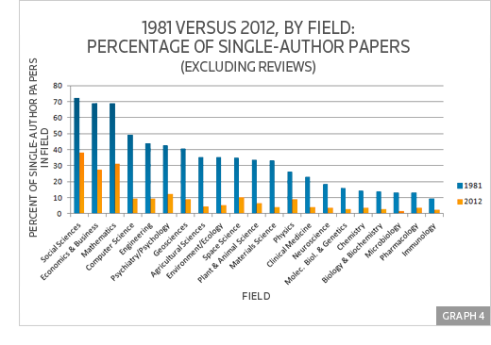
Moreover…
It is the norm in academia, even mathematics…

Slide 6
Moreover…
It is the norm in academia, even mathematics…
In industry, you won’t have much choice…

Slide 7
Moreover…
It is the norm in academia, even mathematics…
In industry, you won’t have much choice…
It is highly attractive to grant funders, hiring committees…

Slide 8
Moreover…
It is the norm in academia, even mathematics…
In industry, you won’t have much choice…
It is highly attractive to grant funders, hiring committees…
It is no barrier to personal fame and glory!

Slide 9
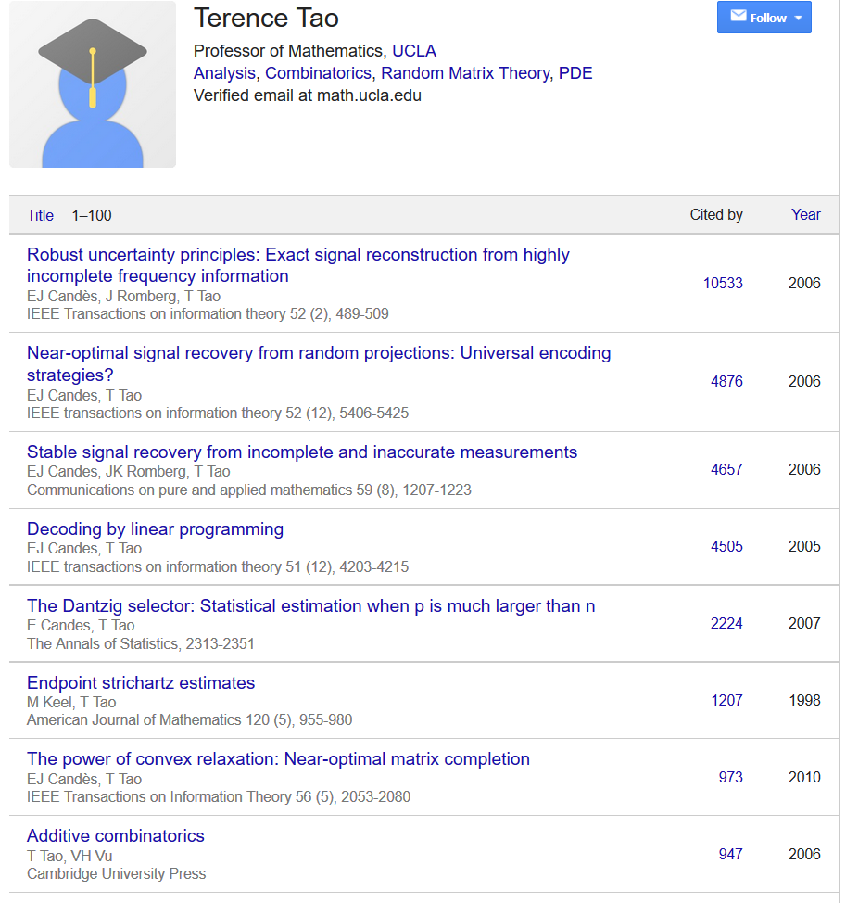
Moreover…
It is the norm in academia, even mathematics…
In industry, you won’t have much choice…
It is highly attractive to grant funders, hiring committees…
It is no barrier to personal fame and glory!

Slide 10
Moreover…
It is the norm in academia, even mathematics…
In industry, you won’t have much choice…
It is highly attractive to grant funders, hiring committees…
It is no barrier to personal fame and glory!
Great way to travel to new places…

Slide 11
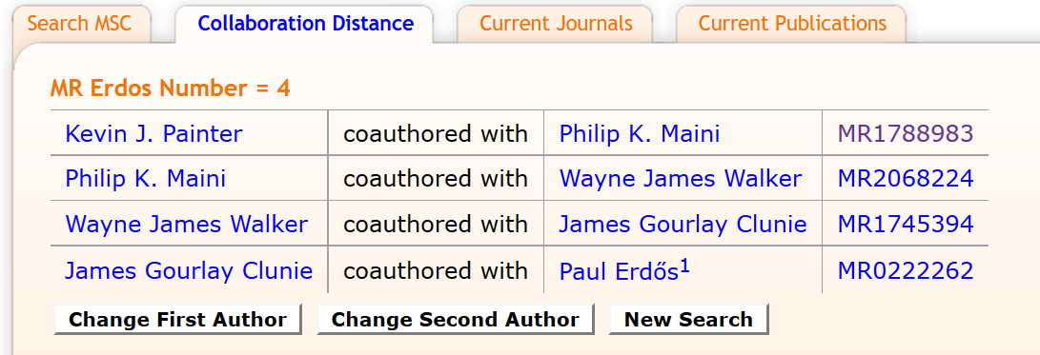
Moreover…
It is the norm in academia, even mathematics…
In industry, you won’t have much choice…
It is highly attractive to grant funders, hiring committees…
It is no barrier to personal fame and glory!
Great way to travel to new places…
You’ll get an Erdös number…

Slide 12
Cons of collaboration…
Can potentially slow things down: waiting for collaborators to complete specific tasks…

Slide 13
Cons of collaboration…
Can potentially slow things down: waiting for collaborators to complete specific tasks…
Potentially “toxic” collaborators who contribute little to the project…

Slide 14
Cons of collaboration…
Can potentially slow things down: waiting for collaborators to complete specific tasks…
Potentially “toxic” collaborators who contribute little to the project…
If industrial partners, issues to do with intellectual property and confidentiality agreements…

Slide 15
Cons of collaboration…
Can potentially slow things down: waiting for collaborators to complete specific tasks…
Potentially “toxic” collaborators who contribute little to the project…
If industrial partners, issues to do with intellectual property and confidentiality agreements…
How much are you willing to share with a collaborator who you do not know personally?

Slide 16
Cons of collaboration…
Can potentially slow things down: waiting for collaborators to complete specific tasks…
Potentially “toxic” collaborators who contribute little to the project…
If industrial partners, issues to do with intellectual property and confidentiality agreements…
How much are you willing to share with a collaborator who you do not know personally?
Large projects become particularly tricky to “manage”.

Slide 17
Cons of collaboration…
Can potentially slow things down: waiting for collaborators to complete specific tasks…
Potentially “toxic” collaborators who contribute little to the project…
If industrial partners, issues to do with intellectual property and confidentiality agreements…
How much are you willing to share with a collaborator who you do not know personally?
Large projects become particularly tricky to “manage”
Tricky issues of authorship…

Slide 18
Authorship
Average number of authors per article is going up.

Slide 19
Authorship
Average number of authors per article is going up.
Author order.
In many areas of mathematics, authors are ordered alphabetically.
In some areas of mathematics, authors are ordered by contribution.
In other disciplines, other (often complicated) rules apply.
Interdisciplinary fields often apply the standard practice of the journal/field of publication.
Sometimes, different conventions apply in different countries.

Slide 20
Authorship
Average number of authors per article is going up.
Author order.
Extreme examples: physics paper in 2015 with > 5000 authors on a 9 page article; +1000 author papers common in areas of physics, biology, chemistry…

Slide 21
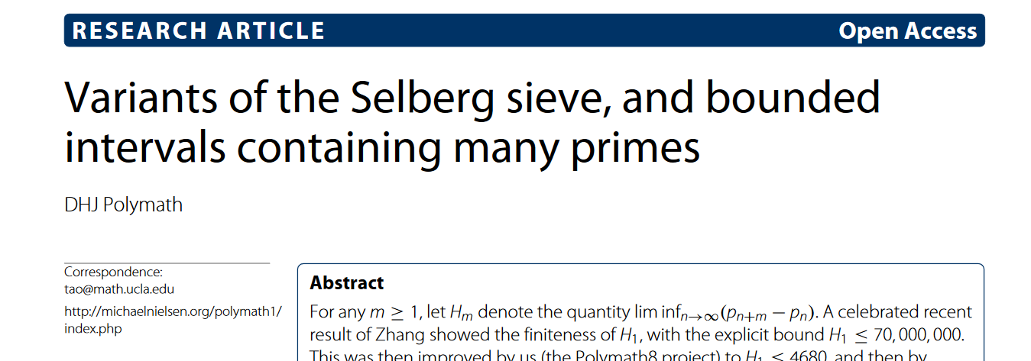
Authorship
Average number of authors per article is going up.
Author order.
Extreme examples: physics paper in 2015 with > 5000 authors on a 9 page article; +1000 author papers common in areas of physics, biology, chemistry…
Mathematics: large collaborations relatively rare but can occur, particularly in interdisciplinary fields. Other examples include the “Polymath project”;

Slide 22
Authorship
Average number of authors per article is going up.
Author order.
Extreme examples: physics paper in 2015 with > 5000 authors on a 9 page article; +1000 author papers common in areas of physics, biology, chemistry…
Mathematics: large collaborations relatively rare but can occur, particularly in interdisciplinary fields. Other examples include the “Polymath project”;
Many journals now ask for “author contribution” descriptions.

Slide 23
Authorship
Average number of authors per article is going up.
Author order.
Extreme examples: physics paper in 2015 with > 5000 authors on a 9 page article; +1000 author papers common in areas of physics, biology, chemistry…
Mathematics: large collaborations relatively rare but can occur, particularly in interdisciplinary fields. Other examples include the “Polymath project”;
Many journals now ask for “author contribution” descriptions.
When should you be an “author”?
Different journals have slightly different guidelines, but typically an author should have made a “substantial contribution” to the work and must “bear accountability” for its contents.

Slide 24
Authorship
Average number of authors per article is going up.
Author order.
Extreme examples: physics paper in 2015 with > 5000 authors on a 9 page article; +1000 author papers common in areas of physics, biology, chemistry…
Mathematics: large collaborations relatively rare but can occur, particularly in interdisciplinary fields. Other examples include the “Polymath project”;
Many journals now ask for “author contribution” descriptions.
When should you be an “author”?
Looking forward…
Lots of collaborative papers is attractive, but hiring committees will also want to see serious evidence of research where you are a major contributor, such as single author papers, papers where you are the “first author” or where you have played an equally important role with coauthors.

Slide 25
Taster projects: lay your ground rules early…
“Self-organisation”: larger groups can be trickier to coordinate

Slide 26
Taster projects: lay your ground rules early…
“Self-organisation”: larger groups can be trickier to coordinate
Communicate! Hold regular meetings outside those with supervisors…

Slide 27
Taster projects: lay your ground rules early…
“Self-organisation”: larger groups can be trickier to coordinate
Communicate! Hold regular meetings outside those with supervisors…
Listen to each other! Often there can be multiple valid ways to tackle a problem…

Slide 28
Taster projects: lay your ground rules early…
“Self-organisation”: larger groups can be trickier to coordinate
Communicate! Hold regular meetings outside those with supervisors…
Listen to each other! Often there can be multiple valid ways to tackle a problem…
In discussions, avoid language such as “stupid, idiotic, etc…”

Slide 29
Taster projects: lay your ground rules early…
“Self-organisation”: larger groups can be trickier to coordinate
Communicate! Hold regular meetings outside those with supervisors…
Listen to each other! Often there can be multiple valid ways to tackle a problem…
In discussions, avoid language such as “stupid, idiotic, etc…”
Make sure you have all agreed on how labour is divided. If new work come up, make sure they are distributed rather than loaded on to individuals.

Slide 30
Taster projects: lay your ground rules early…
“Self-organisation”: larger groups can be trickier to coordinate
Communicate! Hold regular meetings outside those with supervisors…
Listen to each other! Often there can be multiple valid ways to tackle a problem…
In discussions, avoid language such as “stupid, idiotic, etc…”
Make sure you have all agreed on how labour is divided. If new work come up, make sure they are distributed rather than loaded on to individuals
Admit it if you are struggling with your own work…

Slide 31
Taster projects: lay your ground rules early…
“Self-organisation”: larger groups can be trickier to coordinate
Communicate! Hold regular meetings outside those with supervisors…
Listen to each other! Often there can be multiple valid ways to tackle a problem…
In discussions, avoid language such as “stupid, idiotic, etc…”
Make sure you have all agreed on how labour is divided. If new work come up, make sure they are distributed rather than loaded on to individuals
Admit it if you are struggling with your own work…
Agree “the basics” at an early stage: for example, all write in latex rather than using “wysiwyg” software such as Lyx….

