Slide 1


An On-Demand Charging for Connected Target Coverage in WRSNs Using Fuzzy Logic and Q-Learning
HA NOI UNIVERSITY OF SCIENCE AND TECHNOLOGY

Slide 2
Catalogue
1. Introduction
2. Related Works
3. Problem Model
4. Fuzzy Q-Charging Algorithm
5. Performance Evaluation
6. Conclusion

Slide 3
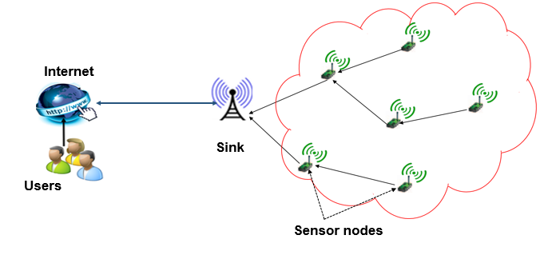
Wireless sensor network - WSN
Figure 1: Architecture of a simple Wireless Sensor Network

Slide 4

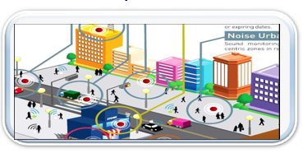
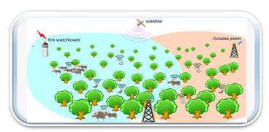
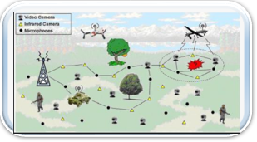
Applications
Figure 2: Smart agriculture
Figure 4: Smart city
Figure 3: Environment Monitoring
Figure 5: Military surveillance

Slide 5

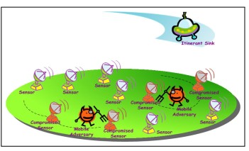

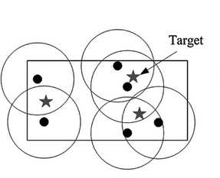
Challenges
The energy of each Sensor Node is limited.
The security of the Network.
Guaranteeing target coverage
Guaranteeing area coverage
Figure 7: Security Figure 8: Energy Figure 9: Target coverage

Slide 6
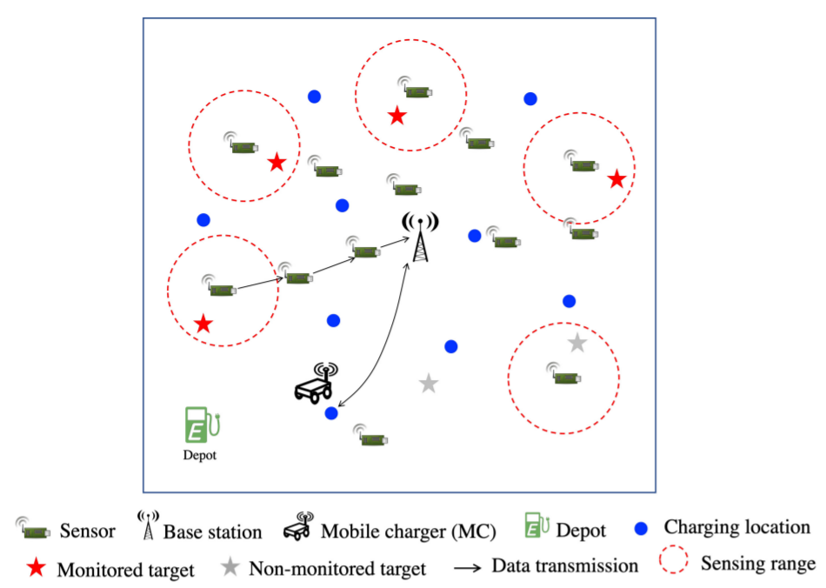
Wireless Rechargeable Sensor Networks
Wireless rechargeable sensor networks, which exploit wireless energy transfer technologies to address the energy constraint problem in traditional wireless sensor networks.
The performance of a on-demand charging algorithm is decided by two important factors:
- The choice of the next optimal charging location.
- The optimal charging time at each charging location.

Slide 7
Catalogue
1. Introduction
2. Related Works
3. Problem Model
4. Fuzzy Q-Charging Algorithm
5. Performance Evaluation
6. Conclusion

Slide 8
Related Works
W. Xu et al. in [1] introduce a multi-chargers approximation model to increase the charging speed.
In [2], C. Lin et al. derive a new energy transfer model, use linear programming to obtain the optimal solution based on fixed charging schedule.
The authors in [17] studied how to optimize the serving order of the charging requests waiting in the queue using the gravitational search algorithm.
In [15], X. Cao et al. use a deep reinforcement learning-based on-demand charging algorithm to maximize total reward.
¹ Xu, W.; Liang, W.; Kan, H.; Xu, Y.; Zhang, X. Minimizing the Longest Charge Delay of Multiple Mobile Chargers for Wireless Rechargeable Sensor Networks by Charging Multiple Sensors Simultaneously. In Proceedings of the 2019 IEEE 39th International Conference on Distributed Computing Systems (ICDCS), Dallas, TX, USA, 7–10 July 2019; pp. 881–890.
² Lin, C.; Zhou, Y.; Ma, F.; Deng, J.; Wang, L.; Wu, G. Minimizing Charging Delay for Directional Charging in Wireless Rechargeable Sensor Networks. In Proceedings of the IEEE INFOCOM 2019-IEEE Conference on Computer Communications, Paris, France, 29 April–2 May 2019; pp. 1819–1827.
³ Kaswan, A.; Tomar, A.; Jana, P.K. An efficient scheduling scheme for mobile charger in on-demand wireless rechargeable sensor networks. J. Netw. Comput. Appl. 2018, 114, 123–134.
⁴ Cao, X.; Xu, W.; Liu, X.; Peng, J.; Liu, T. A Deep Reinforcement Learning-Based On-Demand Charging Algorithm for Wireless Rechargeable Sensor Networks. Ad Hoc Netw. 2020, 110, 102278

Slide 9
Related Works
Common limitations of previous works:
The charging time problem has not been thoroughly considered (Most of them leverage either the fully charging approach).
There is no existing work considering the target coverage and connectivity constraints concurrently.
The charging model of this paper:
Address the target coverage and connectivity constraints in charging schedule optimization.
Uniquely consider the optimization of charging time and charging location simultaneously by using Fuzzy logic and Q-learning in their proposal.

Slide 10
Catalogue
1. Introduction
2. Related Works
3. Problem Model
4. Fuzzy Q-Charging Algorithm
5. Performance Evaluation
6. Conclusion

Slide 11
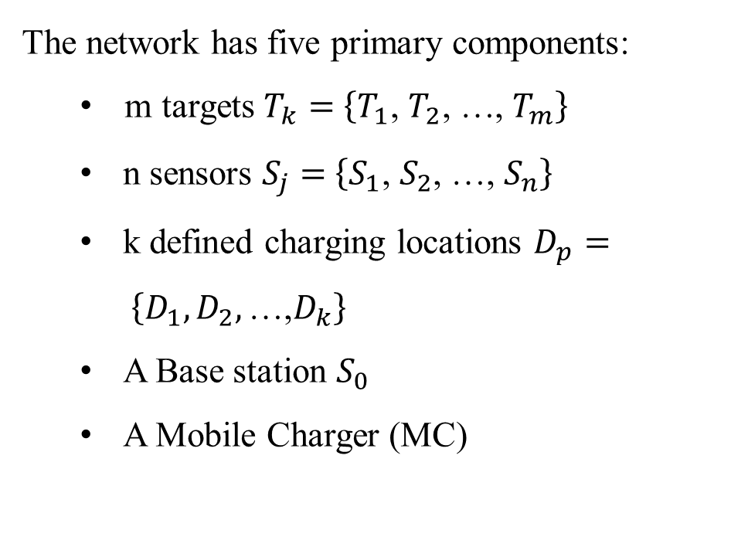
Network Model
The network has five primary components:
m targets $T_{k}$ $=$ $\left\{T_{1}\text{, }T_{2}\text{, …, }T_{m}\right\}$
n sensors $S_{j}$ $=$ $\left\{S_{1}\text{, }S_{2}\text{, …, }S_{n}\right\}$
k defined charging locations $D_{p}= \left\{D_{1}, D_{2},\text{…,} D_{k}\right\}$
A Base station $S_{0}$
A Mobile Charger (MC)
Figure 10: Network model

Slide 12
Catalogue
1. Introduction
2. Related Works
3. Problem Model
4. Fuzzy Q-Charging Algorithm
5. Performance Evaluation
6. Conclusion

Slide 13
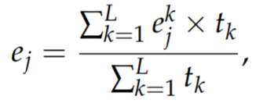
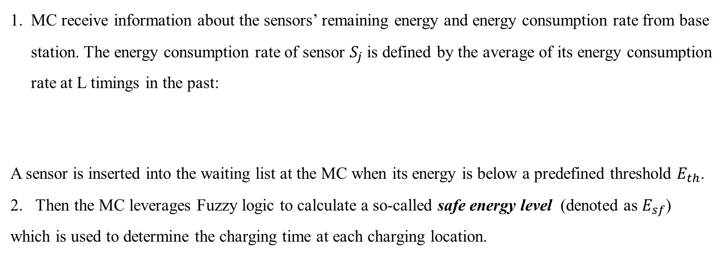
Fuzzy Q-Charging Algorithm
MC receive information about the sensors’ remaining energy and energy consumption rate from base station. The energy consumption rate of sensor $S_{j}$is defined by the average of its energy consumption rate at L timings in the past:
A sensor is inserted into the waiting list at the MC when its energy is below a predefined threshold $E_{th}$.
2. Then the MC leverages Fuzzy logic to calculate a so-called safe energy level (denoted as $E_{sf}$) which is used to determine the charging time at each charging location.

Slide 14
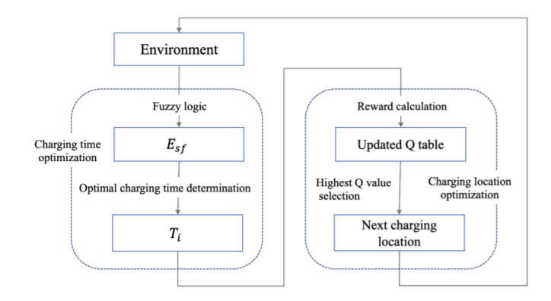
Fuzzy Q-Charging Algorithm
The MC calculates the reward of every charging location and updates the Q-table
MC moves to the next charging location as the one with the highest Q-value and charges for the determined charging time.
* When the energy of the MC goes below a threshold, it returns to the depot to recharge itself.
Figure 13: The flow of Fuzzy Q-Charging Algorithm

Slide 15
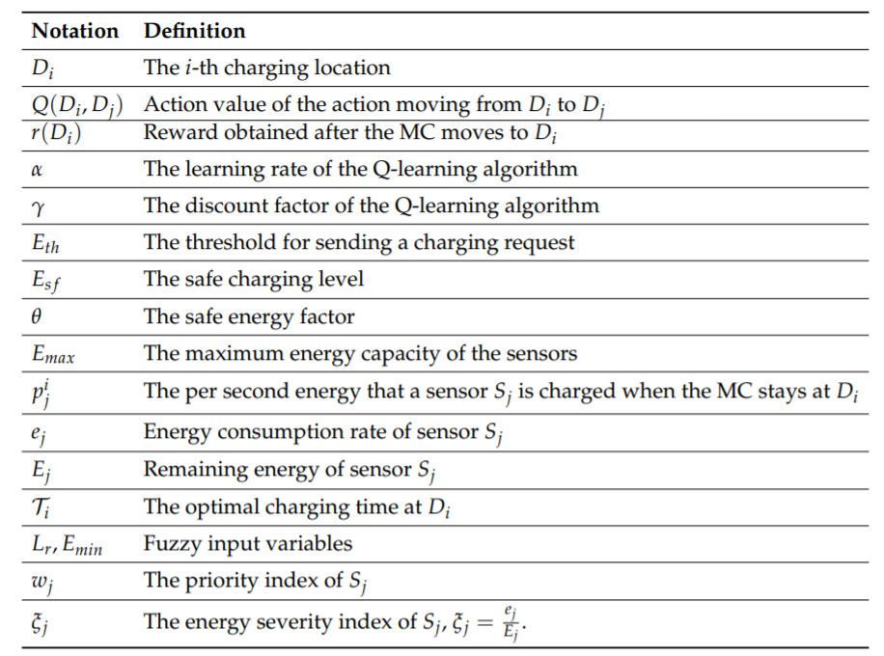
Notations

Slide 16
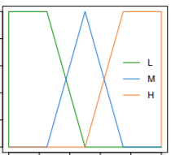
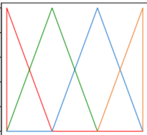
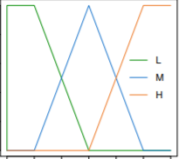

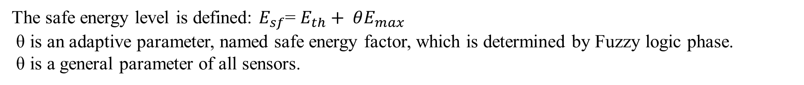

Fuzzy Phase
The safe energy level is defined: $E_{sf}$= $E_{th}+ θE_{max}$
θ is an adaptive parameter, named safe energy factor, which is determined by Fuzzy logic phase.
θ is a general parameter of all sensors.
Minimal Residual Energy
Fuzzification
$$E_{min}$$
𝜃
FIS
9 Rules
The number of charging requests
Fuzzification
Defuzzification
$$L_{r}$$

Slide 17

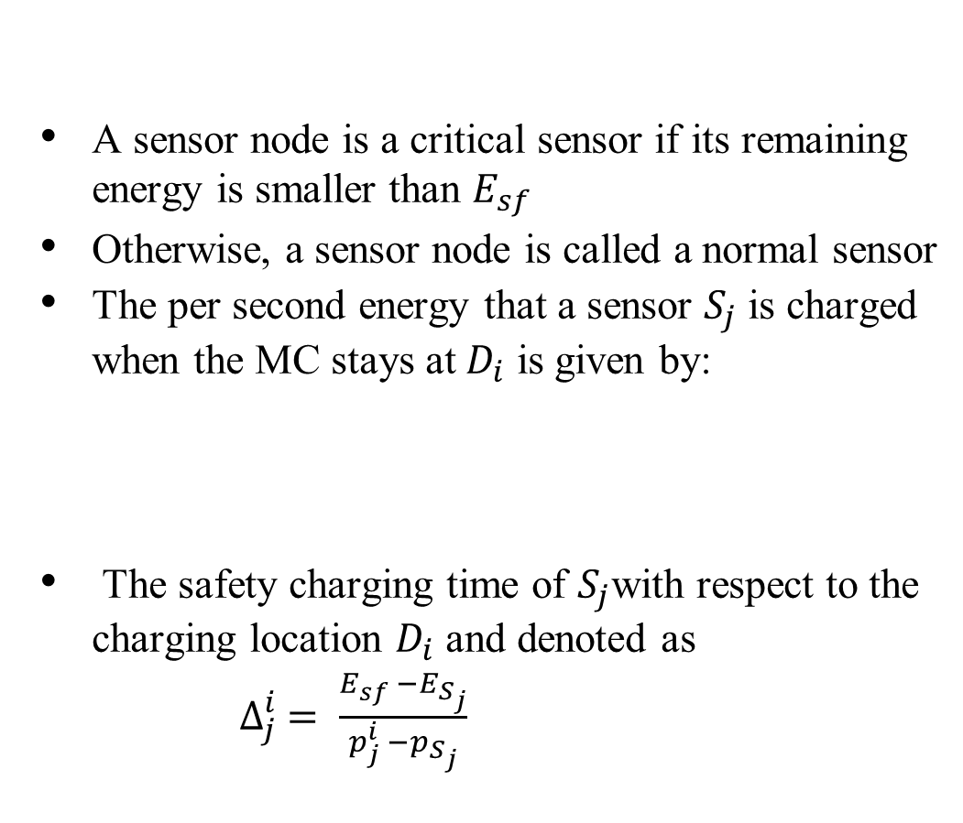

Charging Time Determination
A sensor node is a critical sensor if its remaining energy is smaller than $E_{sf}$
Otherwise, a sensor node is called a normal sensor
The per second energy that a sensor $S_{j}$ is charged when the MC stays at $D_{i}$ is given by:
The safety charging time of $S_{j}$with respect to the charging location $D_{i}$ and denoted as
$∆_{j}^{i} = \frac{E_{sf} −E_{S_{j}}}{p_{j}^{i} −p_{S_{j}}}$
Objective of this phase: the number of sensors reaching a safe energy level is as big as possible when MC stops at $D_{i}$

Slide 18
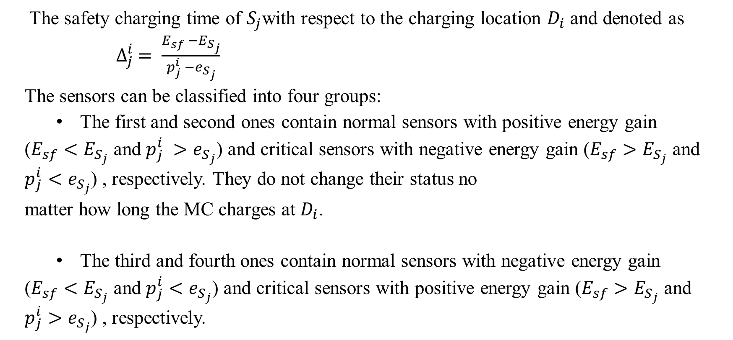
Charging Time Determination
The safety charging time of $S_{j}$with respect to the charging location $D_{i}$ and denoted as
$∆_{j}^{i} = \frac{E_{sf} −E_{S_{j}}}{p_{j}^{i} −e_{S_{j}}}$
The sensors can be classified into four groups:
The first and second ones contain normal sensors with positive energy gain
($E_{sf}<E_{S_{j}}$ and $p_{j}^{i} >e_{S_{j}}$) and critical sensors with negative energy gain ($E_{sf}>E_{S_{j}}$ and $p_{j}^{i}<e_{S_{j}}$) , respectively. They do not change their status no
matter how long the MC charges at $D_{i}$.
The third and fourth ones contain normal sensors with negative energy gain
($E_{sf}<E_{S_{j}}$ and $p_{j}^{i}<e_{S_{j}}$) and critical sensors with positive energy gain ($E_{sf}>E_{S_{j}}$ and $p_{j}^{i}>e_{S_{j}}$) , respectively.

Slide 19
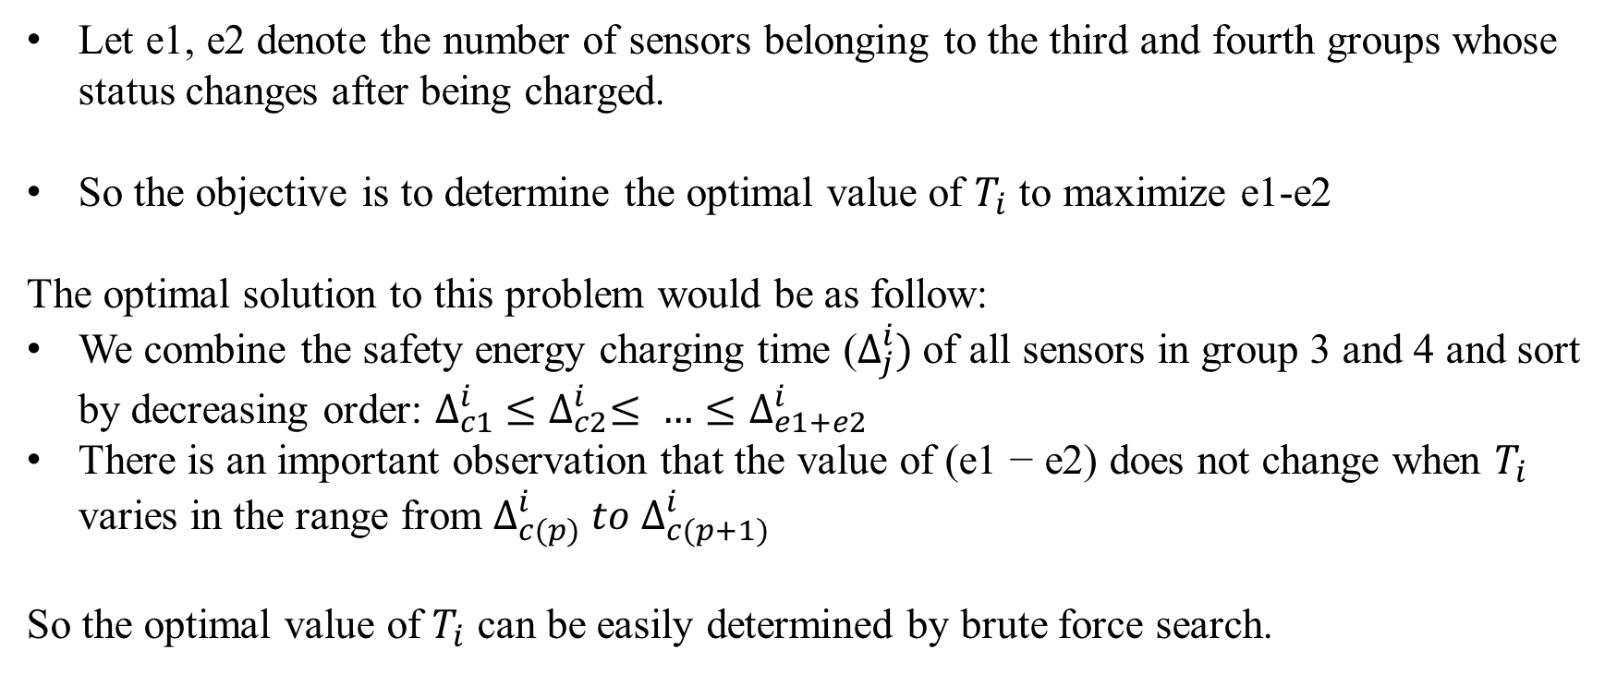
Charging Time Determination
Let e1, e2 denote the number of sensors belonging to the third and fourth groups whose status changes after being charged.
So the objective is to determine the optimal value of $T_{i}$ to maximize e1-e2
The optimal solution to this problem would be as follow:
We combine the safety energy charging time ($∆_{j}^{i})$of all sensors in group 3 and 4 and sort by decreasing order: $∆_{c1}^{i} ≤∆_{c2}^{i}≤ …≤∆_{e1+e2}^{i}$
There is an important observation that the value of (e1 − e2) does not change when $T_{i}$ varies in the range from $∆_{c(p)}^{i} to ∆_{c(p+1)}^{i}$
So the optimal value of $T_{i}$ can be easily determined by brute force search.

Slide 20
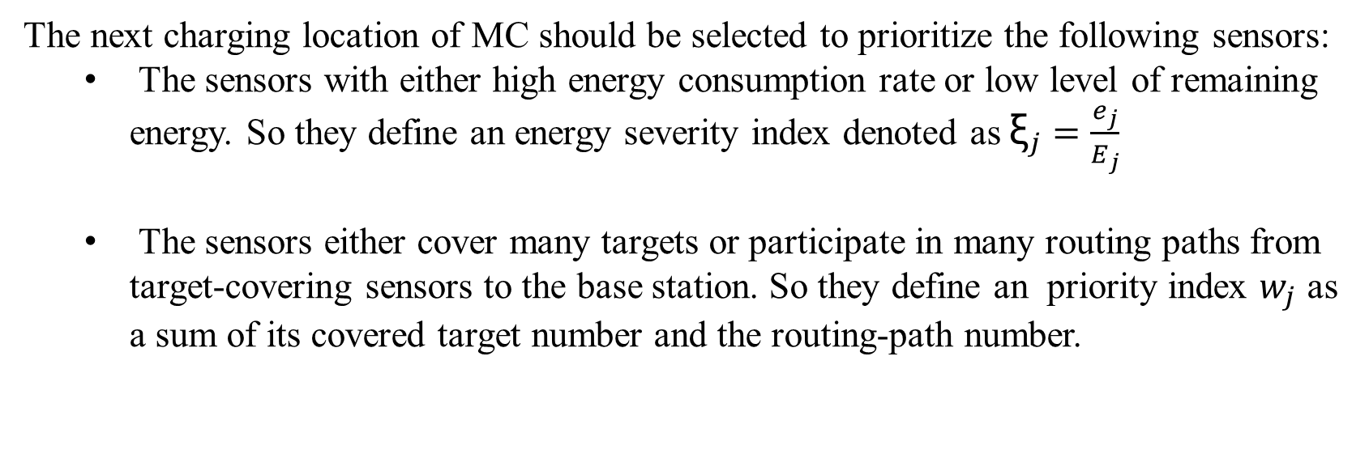
Reward function
The next charging location of MC should be selected to prioritize the following sensors:
The sensors with either high energy consumption rate or low level of remaining energy. So they define an energy severity index denoted as ${\text{ξ}}_{j}=\frac{e_{j}}{E_{j}}$
The sensors either cover many targets or participate in many routing paths from target-covering sensors to the base station. So they define an priority index $w_{j}$ as a sum of its covered target number and the routing-path number.

Slide 21
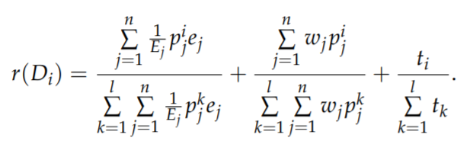
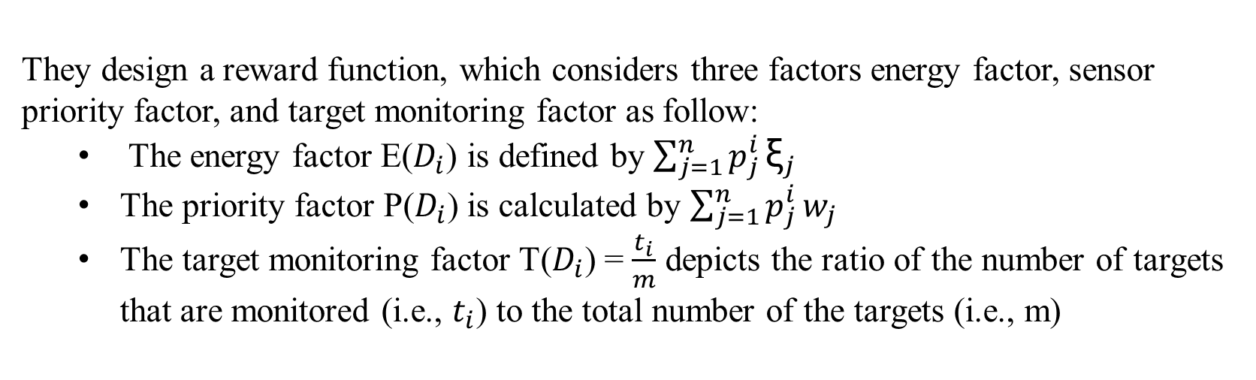
Reward function
They design a reward function, which considers three factors energy factor, sensor priority factor, and target monitoring factor as follow:
The energy factor E($D_{i}$) is defined by $\sum_{j=1}^{n}{p_{j}^{i}}{\text{ξ}}_{j}$
The priority factor P($D_{i}$) is calculated by $\sum_{j=1}^{n}{p_{j}^{i}}w_{j}$
The target monitoring factor T($D_{i}$) = $\frac{t_{i}}{m}$ depicts the ratio of the number of targets that are monitored (i.e., $t_{i}$) to the total number of the targets (i.e., m)
The reward of a charging location $D_{i}$ (denoted by r($D_{i}$)) is the normalized sum of the three factors.

Slide 22
Update Q table
The network is considered the environment
The MC is the agent.
A state is defined by the current charging location of the MC.
An action is a move to the next charging location. Each MC maintains its own Q-table, which is a two dimensional array. Each row represents a state, and each column represents an action.

Slide 23
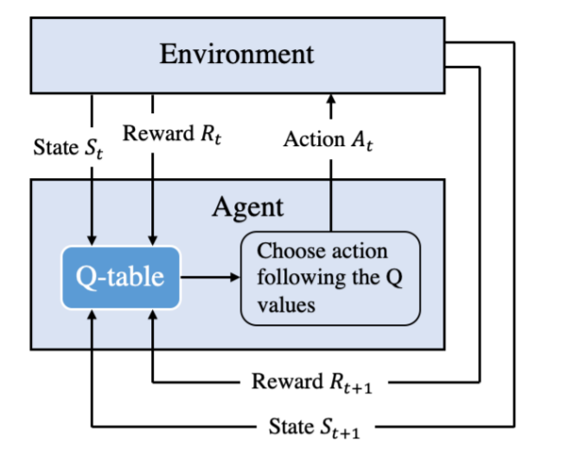
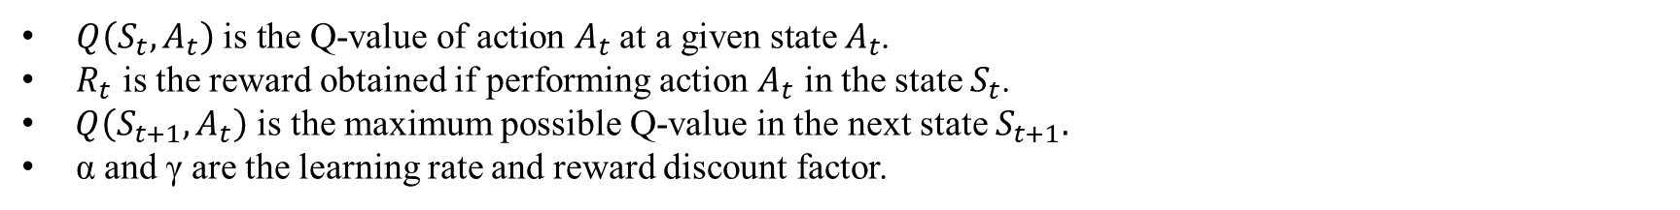
Overview
Q-learning framework consists of four components: an environment, one or more agents, a state space, and an action space.
After performing an action, the agent modifies its policy to attain its goal. The Q-value is updated using the Bellman equation as follows:
Figure 11: Q-Learning overview
$Q\left(S_{t}, A_{t}\right) \text{is} \text{the} \text{Q}\text{−}\text{value} \text{of} \text{action} A_{t} \text{at} \text{a} \text{given} \text{state} A_{t}$.
$R_{t}$ is the reward obtained if performing action $A_{t}$ in the state $S_{t}$.
$Q\left(S_{t+1}, A_{t}\right)$ is the maximum possible Q-value in the next state $S_{t+1}.$
α and γ are the learning rate and reward discount factor.

Slide 24
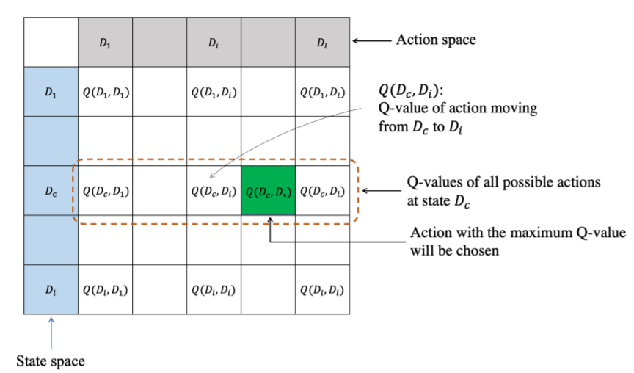
Update Q table

Slide 25
Catalogue
1. Introduction
2. Related Works
3. Problem Model
4. Fuzzy Q-Charging Algorithm
5. Performance Evaluation
6. Conclusion

Slide 26
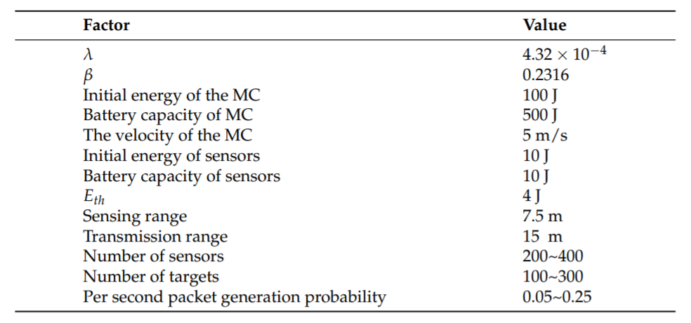
Performance Evaluation

Slide 27
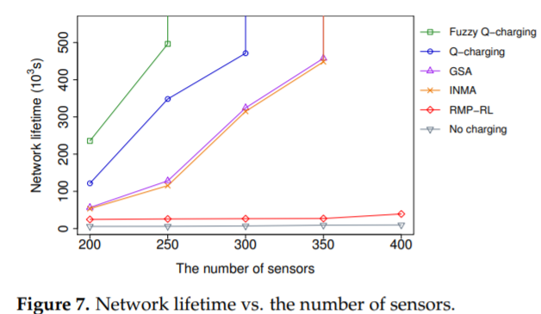
Performance Evaluation

Slide 28
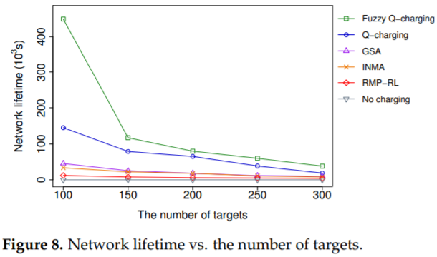
Performance Evaluation

Slide 29
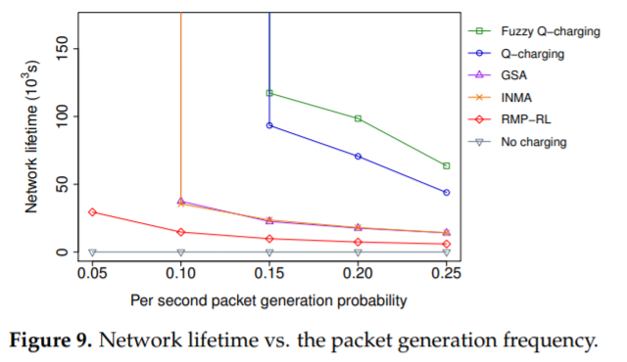
Performance Evaluation

Slide 30
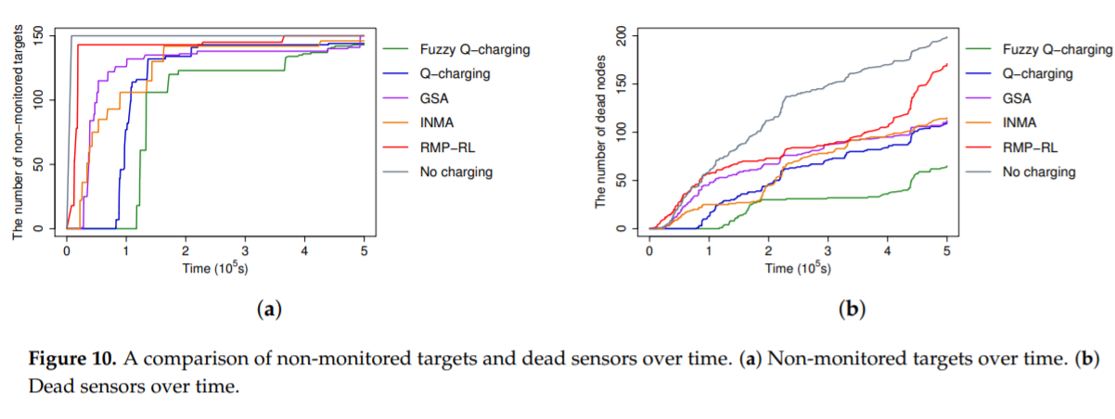
Performance Evaluation

Slide 31
Catalogue
1. Introduction
2. Related Works
3. Problem Model
4. Proposed Algorithm
5. Performance Evaluation
6. Conclusion

Slide 32


