Slide 1
Lehigh Valley AI
Regina R. Monaco PhD
13 Oct 2020
Artificial Intelligence – CS221 (Stanford)
Lecture 2

Slide 2
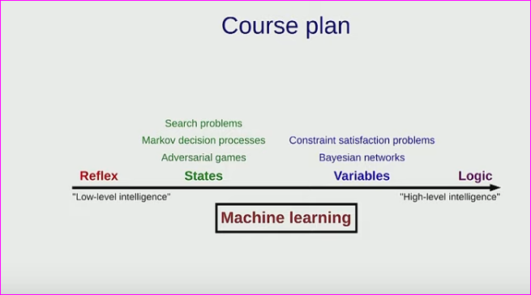
Machine Learning
“Machine learning
allows you to tune the
parameters of the
model to gain information
on the model”
Reflex model – linear predictors, loss minimization (training), stochastic gradient descent.
Data driven (NN) vs. model-driven (structured, symbolic) AI.
Spam example - Lecture snippet here.

Slide 3
One of the Resource from Stanford for CS 221
From a “cheatsheet” page at Stanford for CS 221 - Artificial Intelligence:
CS 221 Overview
Variables-based models with CSP and Bayesian networks

Slide 4
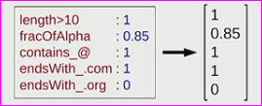
ML: Linear Prediction → Feature extraction
LINEAR CLASSIFIERS -makes predictions from linear combination of features
Predict from y - Is string x an email address?
How – what properties indicate an email address?
Build a feature extractor
Translate this into a feature column vector
WARNING LINEAR ALGEBRA ALERT!!!
f(x) E R^{d}

Slide 5
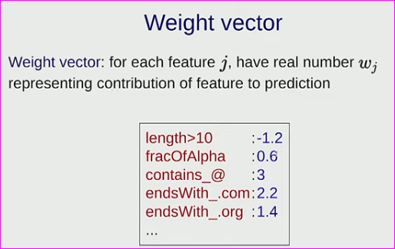
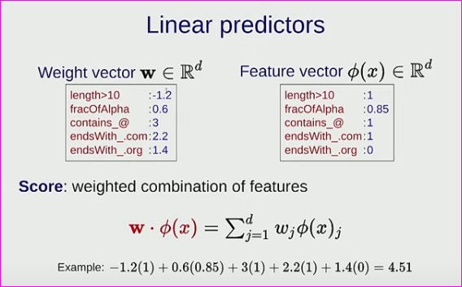
Feature Vector for each data point,
One Weight Vector to Rule Them All
13:10 – “in general mathematically,
you can’t say much about the
precise numbers in weight vector
(...)little person who makes a vote…”
One feature vector for each
data point. One weight vector for
entire system - sign, magnitude of
w^{i} each gives info.

Slide 6
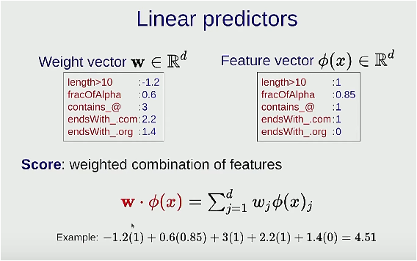
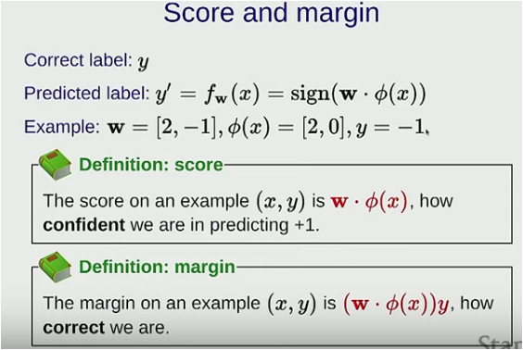
Linear Predictors:
Score and Margin
This topic is at 11:25. Score is given as the dot product between the weight column vector and the feature column vector.
Classification: Margin < 0, incorrect. M = score * {y: [+/- 1]}. If y is negative, and score is positive, you will be confidently wrong :(

Slide 7
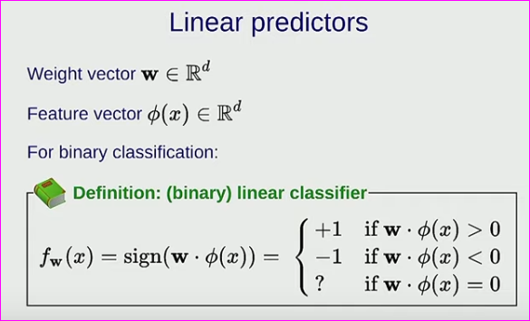
Linear Predictors
Score = w . φ(x) Ε R
Pretty geometry -
the orthogonal to the
weight vector is the (hyperplane in n dimensions) decision boundary for the classifier.

Slide 8
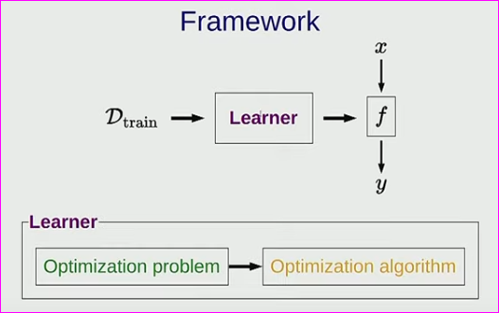
We Haz A Simple Decision Boundary -
Now to Start Learning!
Lecture snippet 1 here.
Lecture snippet 2 here.
Extra 1 – new technique of
“affective coupling” - used to simulate empathetic AI.
Compare to Syntience, Numenta approaches)
Extra 2 – nice blog on SD, nice blog 2.
Extra 3 – neural networks find PES: computational chemistry!

Slide 9
Basics – An Aside on Linear Models
Least squares begins with using the equation of a line,
y = mx + b
This model tells us everything about a line in Cartesian plane – its slope and y-intercept, including identifying all (x,y) pairs lying on it.
This model is the target for linear regression. You have ordered pairs of data and you want to fit the best line to these data points.
The concept (not the model) works in higher dimensions.

Slide 10
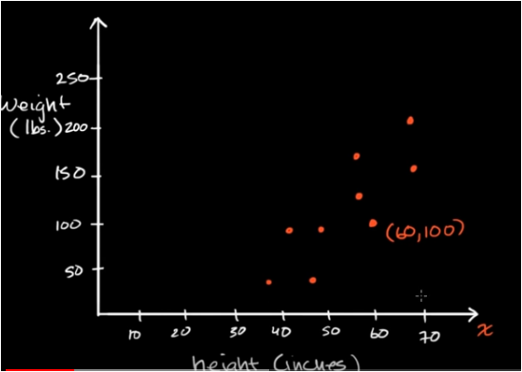
Least Square Error
1) Line (model or prediction): y = mx + b
2) “error” between y1 of ordered pair (x1, y1) and line =
Err = y1 – (mx + b)
3) Least square error: Err² = (y1 – (mx + b))²
4) Over n data points, take sum:
Σ (Err²) = 1/n Σ (y_{n} – (m + b)) ²
5) m is the slope and in this linear model serves as w, the parameter weight. You
can see that varying the slope varies the fit to the data.
[PS – this is about the y coordinate, same
approach using x coordinate yields variance, or b (y-intercept).]

Slide 11
Thinking about Learning Rate (α)
Initialize data with m = 0, b = 0 (slope and y-intercept are 0. Terrible line. Must translate and rotate.)
Initialize α with a step size in range between (0, 1) (exclusive set), like 0.5
We found Σ (Err²) = least square error = 1/n Σ (y_{n} – (m + b)) ²
Substitute (w*m +b) in place of (m + b), differentiate wrt w.

Slide 12
Least squares yields parabolic relationships
The point where the value of the parabola = 0 is its minimum, hence invoking the use of a derivative.
For a line, take minima in the x and y direction to find b-intercept (“variance”, w) and y-coordinate.
This is an iteritive process -set step size to “walk” along parabola - α. Also called the learning rate.
Choose α wisely! Too big – miss minima. Too small – death by old age. Yours.
Prof Mark French, Purdue U – Applied Optimization lecs

Slide 13
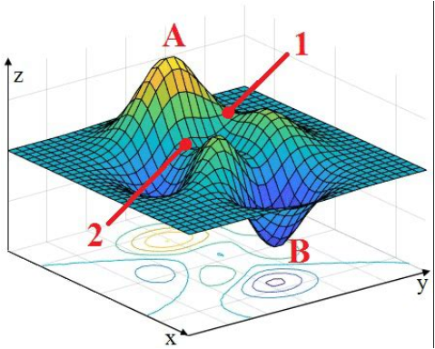
As Aside: PES and Gradient Descent
Finding the minima of a PES corresponds to finding the energy-minimized structure of the molecule. SITE.
Tools: (slope, force) steepest descent (Laplace, perpendiculars)/ gradient descent (Cauchy), conjugate gradient; (force constants, curvature) BFGS, Newton-Raphson, quasi-NR.
Find minima of multi-dimensional equation – like ML
Pretty:

