Slide 1
Lehigh Valley AI -
Regina R. Monaco, PhD
Artificial Intelligence – CS221(Stanford)
Lecture 1

Slide 2
Resources
Lectures are on YouTube - https://youtu.be/J8Eh7RqggsU
Textbooks and optional HW (with solutions) and previous exams are available on https://stanford-cs221.github.io/autumn2019/
Completed projects from previous classes are available to view
If you want to do assignments, install Python 3 (https://www.python.org/downloads/)
We will NOT follow Stanford’s Honor Code – in fact, the more discussion and sharing the better! We’re not getting credit here, but increasing knowledge and our own skills. Learn however you wish.

Slide 3
Procedural Information
As per Meetup announcement, you MUST listen to the lecture before class. There are 19 total lectures, we can do one a week or half a week.
We will chat about AI from 6:30 – 7, I will review lecture and lead discussion from 7-7:45, from 7:45 – 8:30 we will discuss papers (“3-Minute Videos”), concepts, HW, or relevant code.
HW is not required but should be reviewed. I will not prepare HW solutions. They are available on the Stanford site. If people are interested we will review the HW in an informal manner.

Slide 4
Why am I talking up here?
I am a computational chemist with an interest in AI. I team-taught FastAI (https://www.fast.ai/) (Blog: https://medium.com/ai-saturdays/ai-saturdays-ai6-lehigh-valley-pa-group-forges-forward-week-1-f99844fe3f5f) in 2018.
FastAI is an open online course that allows you to actually use AI without knowing all the nitty-gritty, and is a nice tool for getting started while you are learning the nits and the grits
Editor of Deep Reinforcement Learning in Python by Laura Graesser, Keng Wah Loon, 2019
My students at the Icahn School of Medicine at Mount Sinai used AI to correlate spiking data from mouse cortex, looking for correlations, finding distal as well as proximal areas of the cortex that fired together in response to particular stimuli.
I like AI. It is cool.

Slide 5
Lec 1 – part 1 History
Lecture 1 covered the basics, starting with history (Dartmouth Workshop 1956: Shannon, McCarthy (von Neuman, LISP), Nash, Newell, McCullough, Minsky, A. L. Samuel, etc. Mark I Perceptron, Checkers. In 1969 Minsky was sort of an utter idiot – “Perceptrons”
“First AI winter” – 1974-1981, knowledge-based expert systems DENDRAL (MassSpec → molecular structure), XCON, MYCIN, Eliza. Second AI winter 1987-1994. Intelligent agents (bots, now Siri, Alexa, etc), ML were developed, use of Bayesian Probabilies, decision theory - AI blew up again 1994-2001, then DL and RL took off 2001-present.
https://deepmind.com/research
https://en.wikipedia.org/wiki/History_of_artificial_intelligence

Slide 6
Examples of AI You Have Seen
Modern successes: Jeopardy, Go (AlphaGoZero https://deepmind.com/blog/article/alphago-zero-starting-scratch), facial recognition, NLP, translation, read documents and answer questions, sentiment analysis, AI-assisted radiology, etc
“Scary” but amazing robotic designs – Boston Dynamics
Books: Superintelligence by N. Bostrom, The Second Machine Age

Slide 7
“Expert Knowledge”- slow as program grows, doesn’t scale, manual
AI winter #2 was broken by breaking away from expert systems, adding flexibility of Bayesian probability to NN, most important tools were linear regression, gradient descent.
1943 McCulloch and Pitts – ANN, led to development of perceptrons and NN
Neurons could incorporate logic due to their “on/off” threshold, which can be modeled by a sigmoidal function
1969 - “Perceptrons” loss of confidence in linear models, book proved they cannot solve eqns using XOR (thank goodness), death of NN funding.
Neural Networks go underground until backpropagation is designed and implemented in late 80s. 1989 Yann LeCun – handwritten digits.
2012 deep learning, alexnet, AlphaGo, AlphaGoZero

Slide 8
def AI = sum{neuroscience, logic, neural nets...n}:
AI is sort of an advanced, hierarchical pastiche of the knowledge of many fields.
IMHO – nothing like NYC, or a melting pot. These fields don’t “blend” but rather specific knowledge in each field compliments and strengthens specific knowledge in other fields. I’d say this layering together of principles in disparate fields gives deeper insight to all the fields.
Summary slide to follow (from 14:10 in lecture)

Slide 9
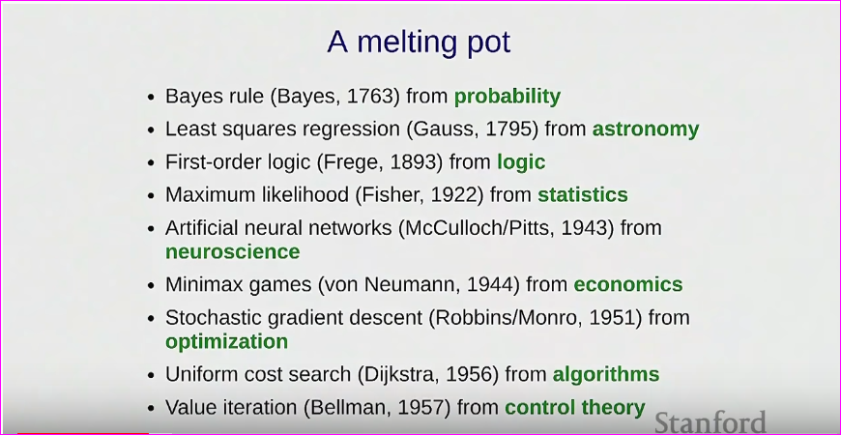

Slide 10
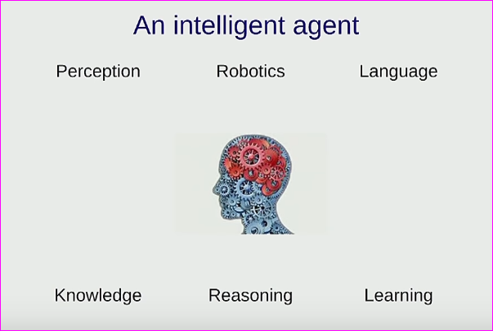
Goal – Why AI?
Intelligent agents – recreate
intelligence.
Tools – how utilize; benefit society (or
owners of the technology), robots to help
humans. Predict GDP from satellite photos of something (energy usage?), cool data centers, self driving cars
Adversarial examples (see paper; work by Jason Yosinski)

Slide 11
TAY Exposed “Biases in AI”...
No Kidding
Open area of research. Hm.
Social uses of AI are deployed whether citizens want this or not. Criminal sentence prediction, risk: COMPAS, sentence setting,bail setting by algo – in use.
Who defines “fairness” in these algos – we as a society must do this (hmm).
“We don’t want AIs to inherit biases”. Great! But where do you get clean data? If you don’t want AI to have biases, you must understand the origins of human bias deeply (hint - game theory). If you try to fix or adjust bias manually as Google did with their facial recognition debacle, you risk unexpected consequences – such as unintentionally introducing biases.
Lets not discuss the intentional introduction of bias into AI. Yet.
Goal – AGI. We are not there yet.

Slide 12
23:30 pause to breathe...
AI still far from human-level intelligence (But you won’t think so after going here!)
Using AI has real-world consequences and we must consider this.
Don’t inherit human biases.
...and while we’re at it...
Don’t Be Evil

Slide 13
Modeling Inference and Learning Paradigm
1) Make a good model. NOT EASY.
Manage resources, don’t throw away essential parameters
2) Make inferences using that model. Ex: map, simplify world using graph model of nodes and edges plus information (IE length of edges, cost of leg) – then use this to answer questions (inferring information from the model)
3) Learning. No manual encoding of information, so introduce parameters (maybe millions) fitted to the data - representing what the data is telling us. Learn from the data, fit parameters to model.
(Is this a sort of spying? Inferring information you may not choose to share about your behavior, for example – shopping habits, daily path, food preferences, etc etc etc)

Slide 14
Low level intelligence – High Level Intelligence
Continue from previous clip…
“Move complexity from code to data”. THIS IS AN AWESOME STATEMENT! This simple statement encapsulates the spirit and power of AI. Raw data is data, not algorithms or computing. It contains a huge amount of information and it always has – AI is a unique tool that leverages this by inferring this “encapsulated” information from raw data.
Of course, nothing valuable is free or easy. Costs are generalization (loss of some parts of the data),

Slide 15
Basic AI Approaches
Reflex models – fixed set of computations, fast
State based models – model world as set of states (chess),(vacuum world, Robbie the Robot can collection). Requires some information/foresight/plan.
Random searches (Markov - dynamic traffic, etc). Utilize search tree methodology (depth-first, breadth first, A*, etc).
Adversarial games - adversary has hidden information, motives. Pac-man, chess.

Slide 16
Variable Based Models
Constraint satisfaction – hard constraint satisfaction models. Suduku, scheduling. No order to moves.
Bayesian networks - soft constraints. Track car over time, map positions using sensor data. Infer where from, where going. Note this is an undergraduate-level problem to solve.

Slide 17
Robot Helper (like Nao)
NLP (NELL of Cornell University)
Simple text bot agent - “Alice and Bob of Phoenix do things in the cold, unhappy winter” example. Logic based. [Lecture: https://youtu.be/J8Eh7RqggsU?t=2361]. Brittle!!! Digest information and uses it
Review Prof Liang’s description of HW, exams, problems, project. Do as you wish, on your own or in working groups. Answers are on the Stanford GitHub website.

Slide 18
Optimization
Inference and learning using optimization. Time to review Python!
LOOK - lecture snippets - BETTER (~15 mins)
Discrete opt: min (p E paths) Cost(p). ex: best path on complex map. Straphangrr, Norvig path from text (desc.)
Continuous opt: min (w E R^{d}) TrainingError(w) ex: PES
One algorithmic tool to do continuous optimization is gradient descent

Slide 19
Python Coding of Examples HERE
Recursion! A major tool and concept in Python.
Prof Liang put the class code on the Github website, and Bryan created our class repository which also has the code from class.
Python recursion resources: here, here, here. Visualize code here. Test python code online here!

Slide 20
Lehigh Valley AI Repository for CS221
https://github.com/lehighvalley-ai/Stanford_CS221
Play with the code (Thanks Bryan!)
Stanford_CS221/Lec1/dynamic_programming_example.ipynb
by running it step-by-step in:
http://www.pythontutor.com/visualize.html#mode=display

Slide 21
Optimization: Gradient Descent
After string transformation example, regression and coding of one classic optimizer, gradient descent (a tutorial here).
Lecture snippet here.

