Slide 1
Artificial Intelligence CS221 Stanford
Lehigh Valley AI
Regina R. Monaco, PhD
20 October 2020
Lecture #3

Slide 2
Structure of Session 6:30pm – 8:15pm
1) Discuss related AI or ML topics of interest. Today, David will discuss computer vision.
2) Lecture Review
3) Focused discussion of AI or ML topics which may include: programming examples, news in AI developments, NIPS or other large conference papers or proceedings, Numenta, Syntience, Kaggle competition, CS221 homework solutions, textbook chapters. I can share textbooks if people do not have them. Please ask!
4) Weekly, watch “Two Minute Paper” + discuss. First or last. Today – GANs (Prof. Ian Goodfellow) in Computer Vision: “Teco GAN” - guided photo enhancement
5) Adjourn!

Slide 3
Building on Optimization; New Topics
Must be facile with: Chain rule for multivariate calculus, linear algebra because data, weights, features in these models, particularly neural networks, is represented by a matrix.
Optimzers: SD → gradient descent (GD), stochastic gradient descent. (not CG, NewtonRaphson, etc)
Linear classification: sigma function, logistic regression, hinge, ReLU...
Neural Nets
Backpropagation
Nearest neighbors model

Slide 4
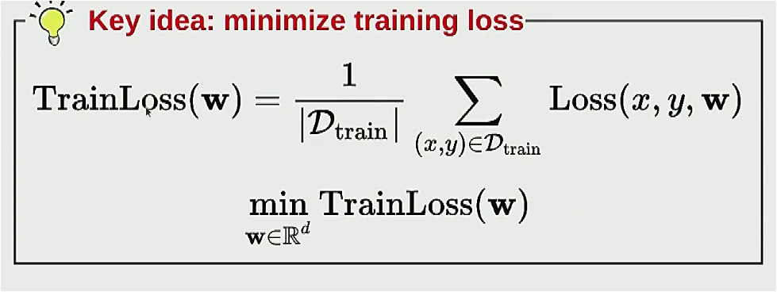
Base Model
D(training dataset) -- Learner -- [ x → f → y]
From some raw data training set, the Learner yields ak predictor function f, which takes input x (i.e., image) and pops out y (i.e., label).
Maximum likelihood helps choose loss function during training
Learner: optimization problem -> optimization algorithm (model)
The problem tells you what is
being solved for; algorithm from
set of general optimization tools.
Note role of weight vector, w.

Slide 5
There’s Lots of Cost or Loss Functions
Simplest ones were used early in this field, Perceptron in small networks→ sigmoidal function approximation for step function.
MNIST – Y. LeCun (dataset available at that link!)
Didn’t dwell on other approximations for step functions, look HERE. Note Gompertz function, used in epidemiological models of propagation (hello, covid!).
“Margin Maximizing Loss Functions”, “ T. Hastie et al.

Slide 6
Loss Fcns and Weights
Loss function should be best model of your “dream outcome”, target.
Weights, w -> scaling factors that move data points towards target (loss function, cost function, model).
Do you see a problem here? This method could be used “backwards” for outcome that yields a pre-determined target via steering or adjusting of the weight vector. A casual outsider (customer, patient, citizen, law-maker) wouldn’t be able to determine manipulation from the result or output. You’re not manipulating the data – you’re manipulating the model!

Slide 7
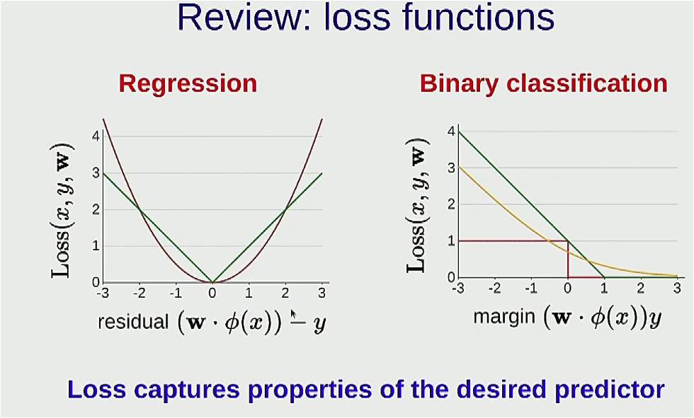
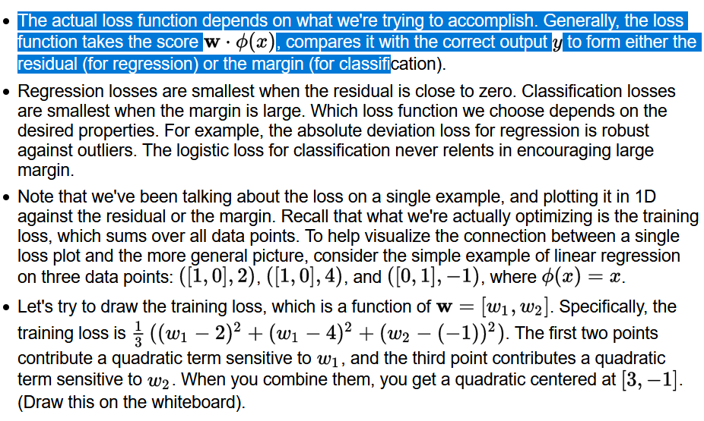
From Lecture

Slide 8
Mid Lec Summary:
Feature Extraction → Neural Networks
! Feature templates – extract, organize related sparse (or not) features
! Hypothesis class – defined by the features chosen, yields what is possible from learning.
! Linear Classifiers – sometimes give non-linear boundaries (like circles x2 + y2 = r2)
→ Try linear classifiers if simple, if not then try neural nets :)
Motivated a) by real neurons
Motivated b) by decomposing linear problems – mechanics/mathematical models
Car example – will they collide? Check trajectory and determine safe distance, anything greater than safe distance is safe (sign +), less than safe distance is NOT safe (sign -)

Slide 9
NN and Learning – Decompose Problem
Linear predictors are sooo 1960s - onward to more complexity.
The car problem is a toy problem, gives insight that complex problems can be broken into smaller pieces which can be individually solved. The sum of the solutions can add up to a seemingly complex solution but is simply a system of smaller solutions properly connected into a whole.
[Consider that this approach works very well in many situations. Ex: evolution, social decay. ~Ex: percolation, non-linear systems.]
Introduction of bias term, which allows normalization to +/- 1.
Now that we’re dealing with [0,1] functions, we introduce logistic functions. They smooth step function, allowing it to be differentiable.

Slide 10
Hypotheses, Bias
Create your model using summation of hypotheses, h_{x}. In this case, position of each car and their distance from one another.
Define feature vector: φ(x) = [1, x₁, x₂] → φ(x) = [1,v₁, v₂]
h1 = 1[v₁ . φ(x) >= 0] h2 = 1[v₂ . φ(x) >= 0]
v₁ = [-1, +1, +1] v₂ = [-1, +1, +1]
F _{V, w} (x) = sign(w₁, h₁ + w₂, h₂)
The bias term brings model thru origin, allowing calculation of likelihood of 1 vs. -1.{Bias (related to underfitting to feature set, learning too little from the data, ignoring noise) coupled with variance (overfitting, noise), will be covered in detail later}.
We can do Joint Learning! Linear combination of weights and the subproblems V
are learned simultaneously with this model.

Slide 11
The Balance of this Lecture – Next Time!
→ Around 56:10 in seminar…..

