Slide 1
Protect your brain from climate fiction.

Slide 2
Topic
Climate Goggles help you to find the truth from the world's most respected scientists.

Slide 3
Problem
It is difficult for normal people to classify the background of scientific statements and what is serious.
Climate change is a very complex subject with a lot of misinformation circulating.
This misinformation creates uncertainty.
Some incorrect information is scattered by climate skeptics, with the aim to sow doubt and ultimately to prevent climate protection.

Slide 4
Problem
http://www.rhok.org/problems/validity-detectorchecker-aggregation-and-validation-statements-about-climate-change-deen

Slide 5
Challenges
Sorting and ranking scientific papers is hard
Scientific papers are written in technical language
Few resources provide proper APIs

Slide 6
Solution
User enters search query
Lookup on Google Scholar
Match the authors against ISI
Compute a score for the authors
Find easy-to-read resources of the author

Slide 7
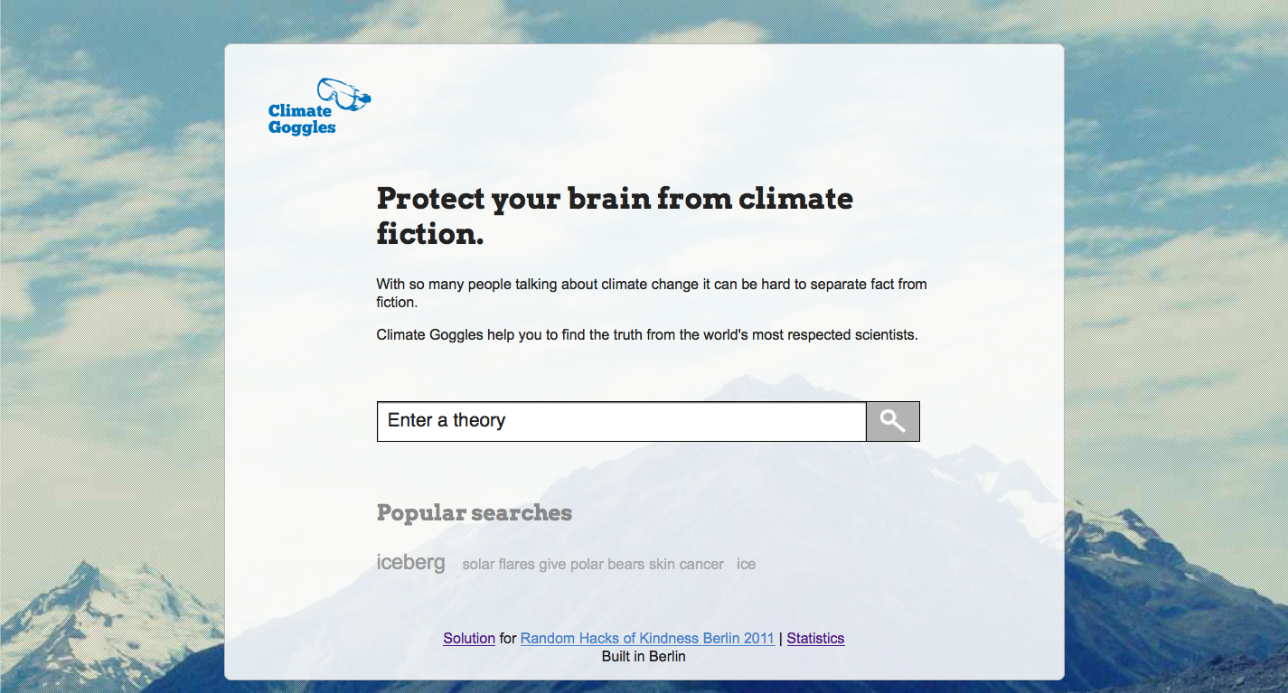

Slide 8
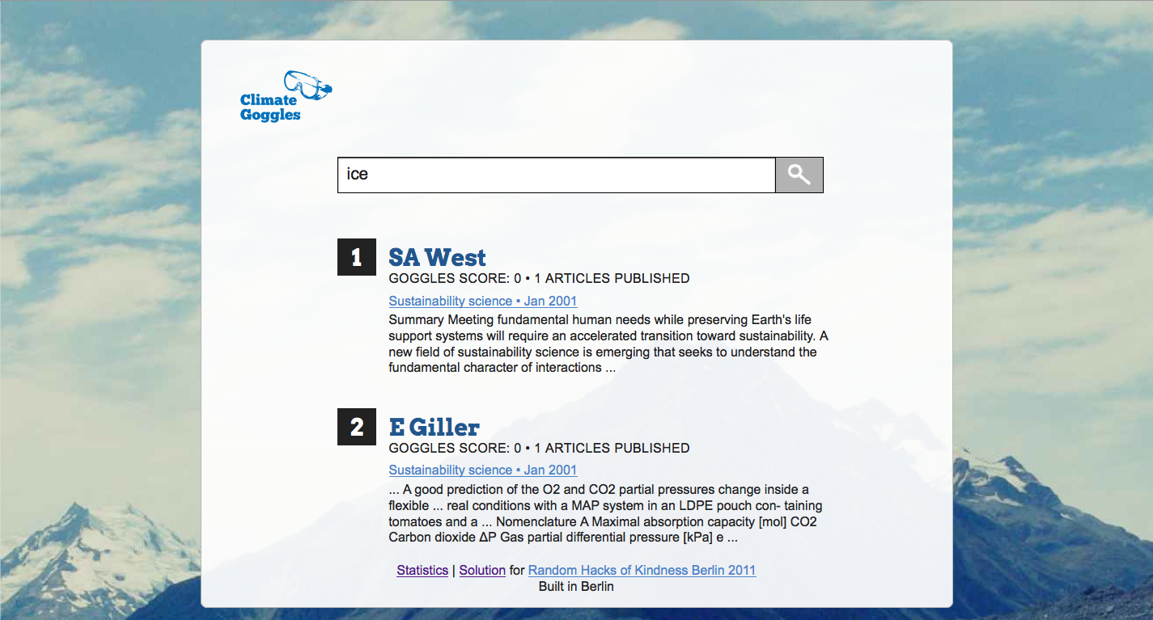

Slide 9
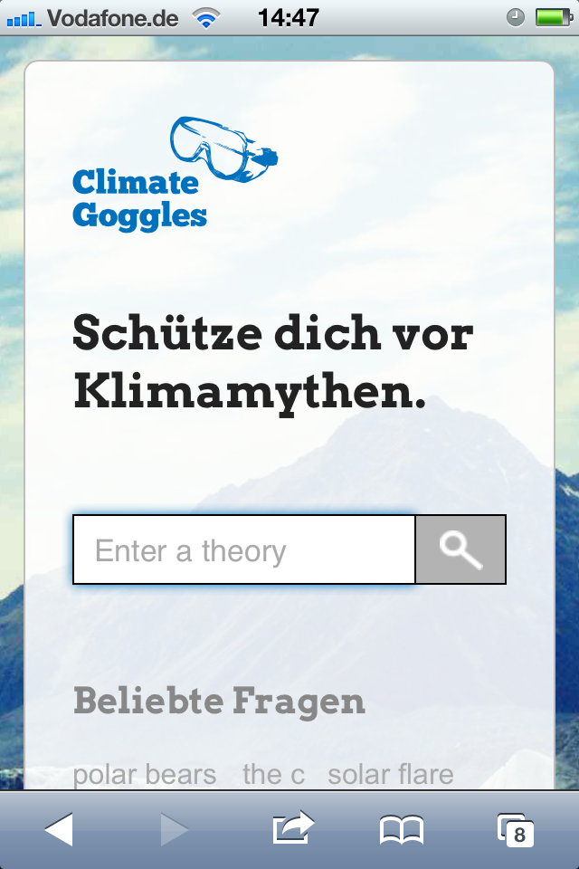

Slide 10
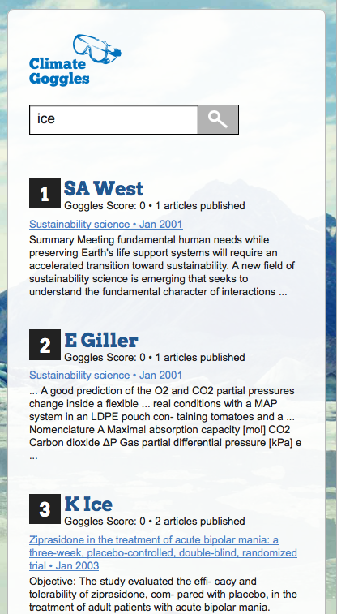

Slide 11
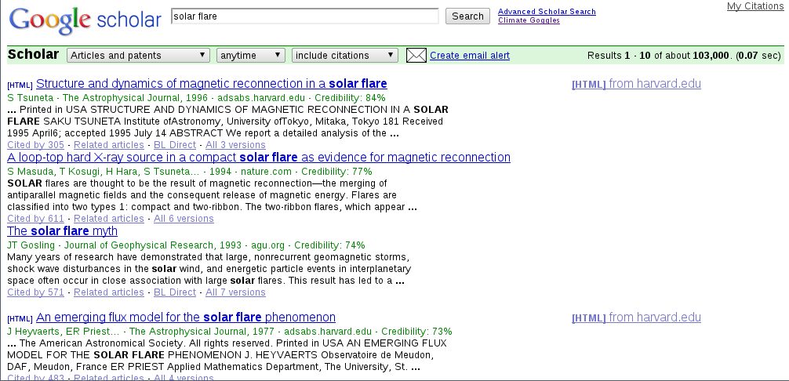

Slide 12


Technical architecture
Server
Client
Python
HTML 5
Sqlite
Django
jQuery
CSS 3

Slide 13
User experience
The user experience is designed to be simple
Seamless browser integration with Greasemonkey script
Available in English and German
Adaptive Design for smaller screen sizes

Slide 14
Remaining issues
Register for the ISI Web of Knowledge API and implement the hooks
Digestible article summaries

Slide 15
Team
Backend
Robert Lehmann
Dominik Moritz
André Rieck
Thomas Werkmeister
Frontend
David Owens
Norman Rzepka
Design
Milena Glim

