Slide 1
Database System Session 1
Chapter1: The Worlds of Database Systems
Database Systems

Slide 2
Objectives
1
Understand the role of Database Systems
2
Understand the method to learn Database Subject

Slide 3
Contents
1
The Evolution of Database Systems
Overview of a Database and
Database Management System
2

Slide 4
1.The Evolution of Database Systems
File
Management
System
From the earliest days of computers, storing and manipulating data have been a major application focus.
The first general-purpose DBMS was designed by Charles Bachman at General Electric in the early 1960s and was called the Integrated Data Store. It formed the basis for the network data model, which was standardized by the Conference on Data Systems Languages (CODASYL) and strongly influenced database systems through the 1960s.
In the late 1960s, IBM developed the Information Management System (IMS) DBMS. IMS formed the basis for an alternative data representation framework called the hierarchical data model.
In 1970, Edgar Codd, at IBM's San Jose Research Laboratory, proposed a new data representation framework called the relational data model.
Network
Data
Model
Hierarchical
Data
Model
Relational
Data
Model

Slide 5
a. Network data model
CUSTOMER
SALESPERSON
OWNER
OWNER
CUSTPO SET
SALES PO SET
PURCHASE-ORDER
OWNER
MEMBER
One-to-one relationship
POITEM SET
LINE-ITEMS
MEMBER
One-to-many relationship

Slide 6
Problems with the networked model
links between records of the same type are not allowed
while a record can be owned by several records of different types, it cannot be owned by more than one record of the same type (patient can have only one doctor, only one ward)

Slide 7
b. Hierarchical data model
Student
S1
S2
Course
C1
C2
C2
C3
C4
Instructor
I1
I2
I2
I3
I1

Slide 8
Pros and cons
data must possess a tree structure
tree structure is natural for geographical data
data access is easy via the key attribute, but difficult for other attributes
in the business case, easy to find record given its type (department, part or supplier)
in the geographical case, easy to find record given its geographical level (state, county, city, census tract), but difficult to find it given any other attribute

Slide 9
Pros and cons (cont’d)
e.g. find the records with population 5,000 or less
tree structure is inflexible
cannot define new linkages between records once the tree is established
e.g. in the geographical case, new relationships between objects
cannot define linkages laterally or diagonally in the tree, only vertically
Notes:
inflexible : không thay đổi

Slide 10
Pros and cons (cont’d)
the only geographical relationships which can be coded easily are "is contained in" or "belongs to"
DBMSs based on the hierarchical model (e.g. System 2000) have often been used to store spatial data, but have not been very successful as bases for GIS

Slide 11
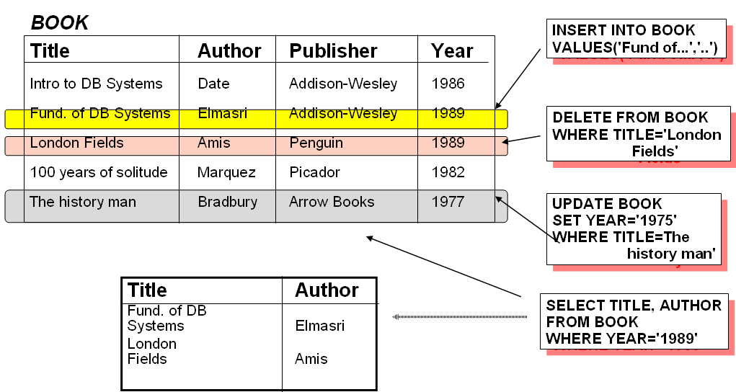
c. Relational database

Slide 12
Pros and cons
the most flexible of the database models
no obvious match of implementation to model - model is the user's view, not the way the data is organized internally
is the basis of an area of formal mathematical theory

Slide 13
Pros and cons (cont’d)
most RDBMS data manipulation languages require the user to know the contents of relations, but allow access from one relation to another through common attributes Example: Given two relations: PROPERTY(ADDRESS,VALUE,COUNTY_ID) COUNTY(COUNTY ID,NAME,TAX_RATE)
to answer the query "what are the taxes on property x" the user would:

Slide 14
Pros and cons (cont’d)
retrieve the property record
link the property and county records through the common attribute COUNTY_ID
compute the taxes by multiplying VALUE from the property tuple with TAX_RATE from the linked county tuple

Slide 15
2. Outline of Database-System Studies
We divide the study of databases into 2 parts:
  Part I: How to design a database
    Chapter 2: Relational Data Model
    Chapter 3&4: Design database by two different approach.
  Part II: Manipulation with a database
    Chapter 6: The database language SQL
    Chapter 7: Constraints and Triggers
    Chapter 9: Stored Procedure.

Slide 16
How to learn Database subject?
FDs
Normal
Forms
ERD
SQL

Slide 17
What are the core concepts?
1
2
3
Functional Dependencies
6-Relational Algebra Operators
Constraints on relations

Slide 18
What are the core concepts?
4
5
6
Close Sets
Algorithms to find Close Sets
- Keys
- Super Keys
Normal Forms (1NF, 2NF, 3NF, BCNF, MVD)
Algorithm to decompose a relation into 3NF, BCNF
-ERD
-ERD design principles

Slide 19
What are the core concepts?
7
8
9
Extra operators on Bag Relations:
-Grouping
-Duplicate Elimination
-Outer Join
…
DML:
-SELECT
-INSERT
-UPDATE
-DELETE
DDL, Transactions,
Triggers,
Procedures

Slide 20
Thank You !

