Slide 1
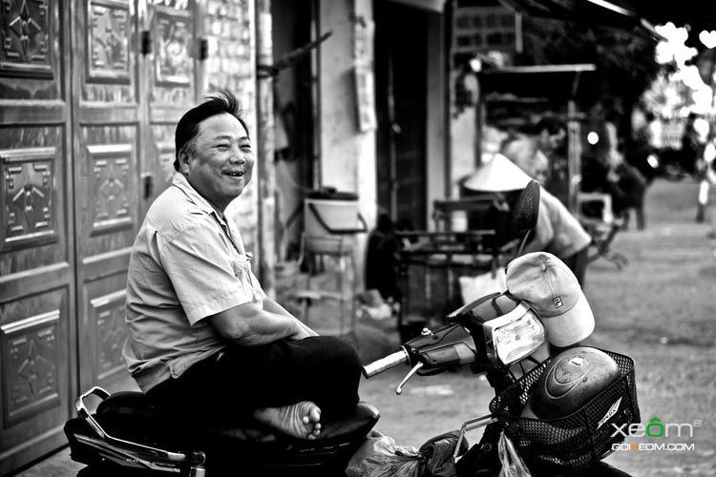
“XE OM” TRIP
Our Xe om – Your experience
Support number: 0907843224
Email: xeomtrip@gmail.com

Slide 2

Đây là logo của công ty, bạn giúp mình chèn vô.
TRIP
X E
M

Slide 3
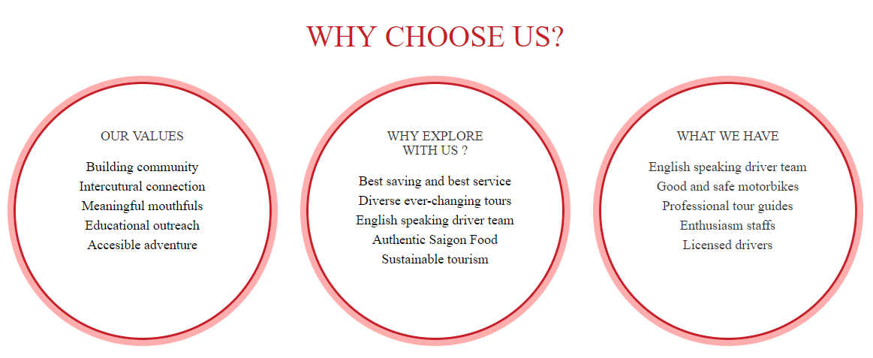
Welcome to “XE OM” TRIP
"Traveling by car is so crazy - it limits you, preventing you from venturing down a narrow road and alleyways, which contain so many amazing things. You will miss everything around you by a broken glass. Here, the joy of walking or sitting behind a motorbike is that you will become part of the crowd, constantly moving, crossing paths, crabs and turning on intersections like blood. the circuit of a city "- Anthony Bourdain
Our trip
Your own trip

Slide 4


Đây là số màu
#e36a5f
Contact us
Office address: 128A D2 Street, Binh Thanh district, TP Ho Chi Minh
Hotline
Support number: 090784xxx
Email: xeomtrip@gmail.com

