Slide 1
Diem+Insert
Name: Lê Hoàng Bảo Chung
Class: 60tH3
ID: 1851061805
CONTENT: Diem+INSERT

Slide 2
theoretical content
Create a JSP application (webform)
Design webforms:
Table
Text Input
Button
Form

Slide 3
theoretical content
Create a package contains:
Objects class: diem
Connecting class: DB_Connection
Processing class: DB_Process

Slide 4
theoretical content
Create a connection method to MySQL (in DB_Connection class):
public static Connection getCon()
Create a method to insert Diem into table (in DB_Process class):
<modifiers> boolean db_Insert_<table name> (parameters)

Slide 5
theoretical content
Declare connection variable:
Connection cn = DB_Connection.getCon();
Declare SQL query:
String sql = “Insert into diem values (‘”+MaSV+”’, ‘”+MaHP+”’, “+Diem+”)”;

Slide 6
theoretical content
Declare the execution commands:
try {
PreparedStatement ps = (PreparedStatement)cn.prepareStatement(sql);
ps.executeUpdate();
cn.close();
}
catch (SQLException e) {}

Slide 7
theoretical content
Embed Java code in JSP file:
<%
(Java code)
%>
Get the value of a method in Java:
<%= <database name>.<method>.(parameters) %>

Slide 8
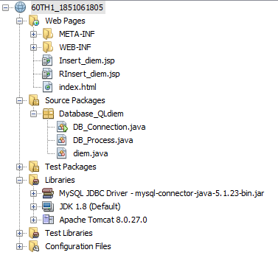
The Design of webform

Slide 9
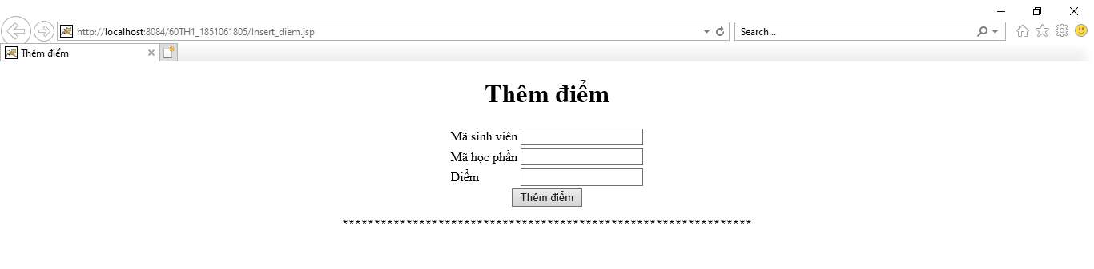
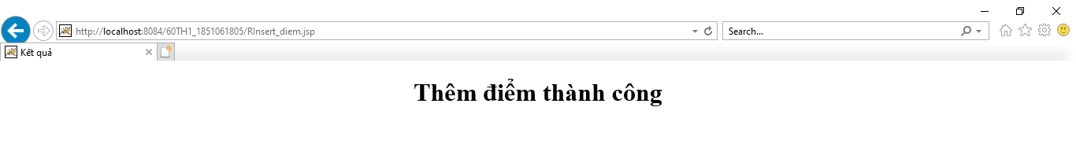
The Result of webform

