Slide 1
TAICHE-CuocVanChuyen
File created on: 5/4/2026 7:31:55 PM

Slide 2
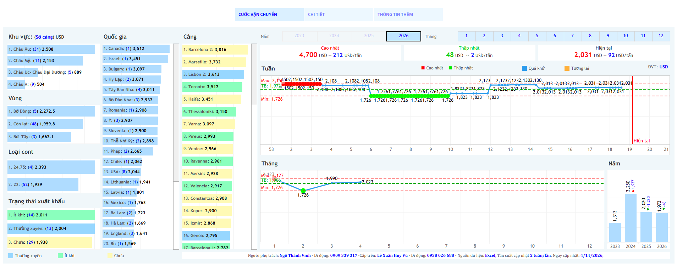

Slide 3
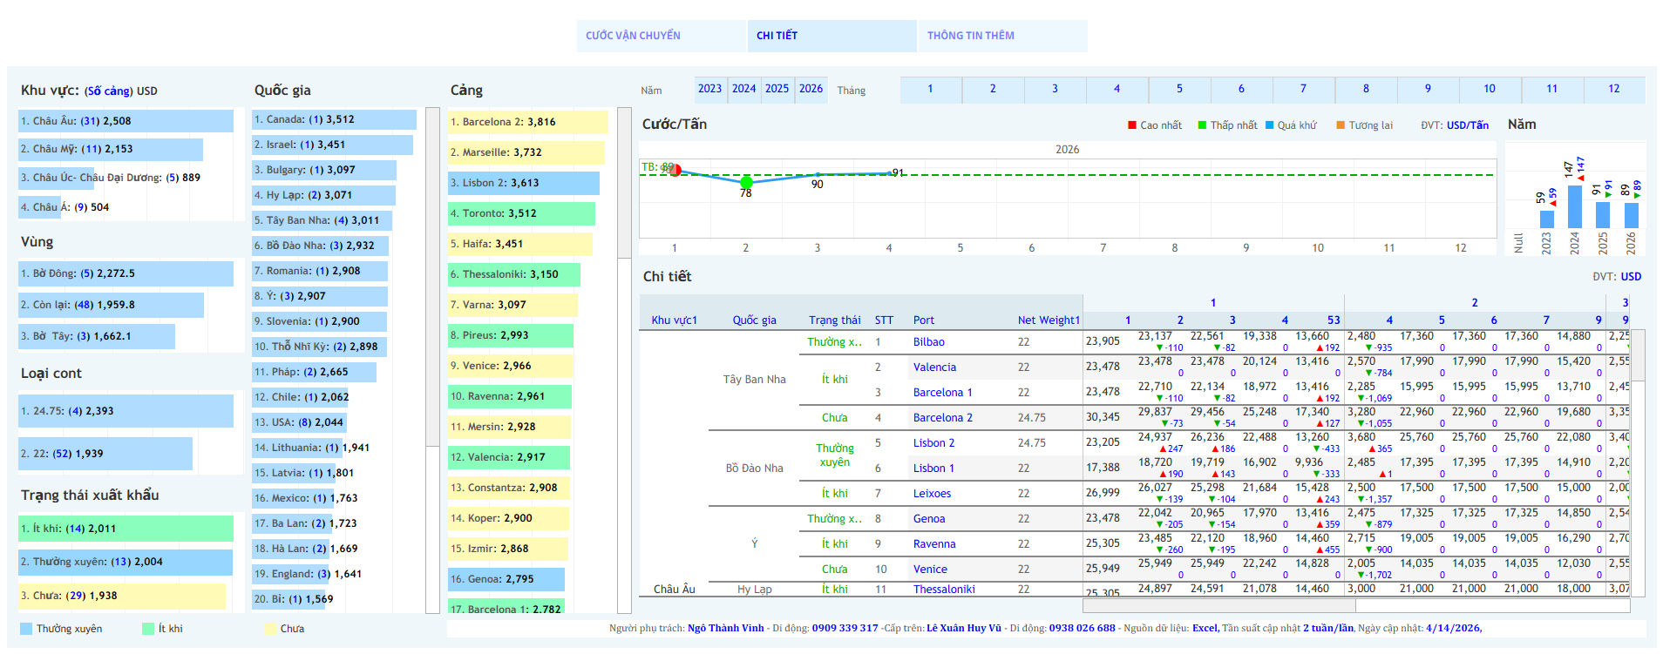

Slide 4
