Slide 1
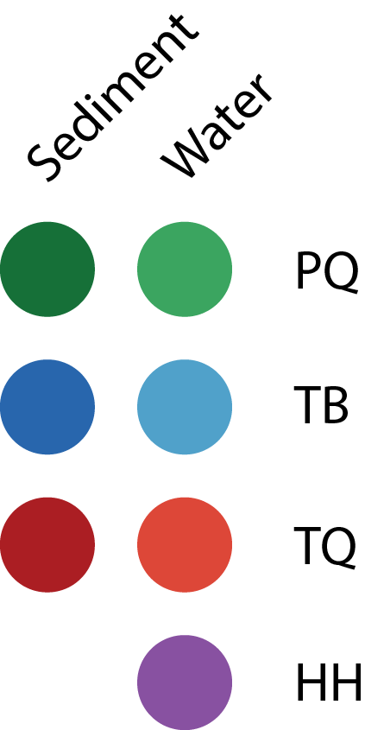
a)
c)
b)
d)

Slide 2

Water
Both
Sediment

