Slide 1
NEWS APP

Slide 2
We are the team that includes
Thai Ba Hiep
01
Nguyen Dang Minh
02
Le Hong Phong
03
ID: 20CE003
CLASS: 20CE
ID: 20CE009
CLASS: 20CE
ID: 20CE011
CLASS: 20CE

Slide 3
About Us
We just learned mobile programming. Excellent subject, creativity in applied learning is very high. In this exercise, we do NewsApp. Nowadays, if you want to read newspapers, there are many ways to do it. Our NewsApp also serves to update news with RSS links of many major VTV newspapers, providing accurate information. But because of shortcomings and limited capabilities, NewsApp is not perfect, thanks to the teacher's contribution. You will help us to improve.

Slide 4
Our Evolution
Learn about android studio
Learn RSS
Implement the topic
Listen to comments and improve

Slide 5
What Sets NewsApp Apart?
More news sources
Delete news source
Easy to use
Because of using RSS links, users add their own favorite news sources
Users can delete it when they don't want to read it anymore
Simple design useful for users

Slide 6
Nice feature
You can choose from many RSS links to diversify the news according to your interests

Slide 7
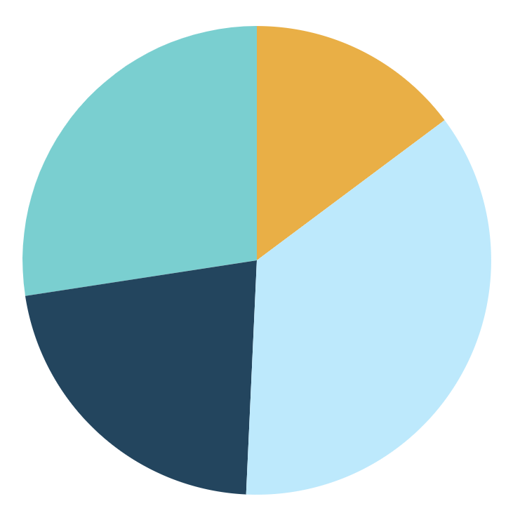
What Do We Do?
First
Select the news you want to read
Fourth
Second
Add favorite genres or delete when you don't want to read what you don't like
Read news updates
Third
Switch back to your favorite genre

Slide 8
How News App works
Add RSS link
Read the paper
Click item
Warning
Add newspaper name and RSS link of VTV RSS newspaper
Item display details include: Photo, title and posting date
When clicking on the New App item, it will go to WEBVIEW and display the article details
The application will give a warning when the internet is lost

Slide 9
Unadvantage
Limitations of the group in the process of learning and absorbing negatively affect the topic
The design is not beautiful or attractive
The topic is still quite simple, there is no breakthrough and innovation
Many errors in the code and limited functionality for users

Slide 10
Advantage
Increase the ability to do group work
Acquiring knowledge
Increase the ability to self-study and work in groups
Learn how to design useful android apps for later and need to learn to improve and develop more

Slide 11
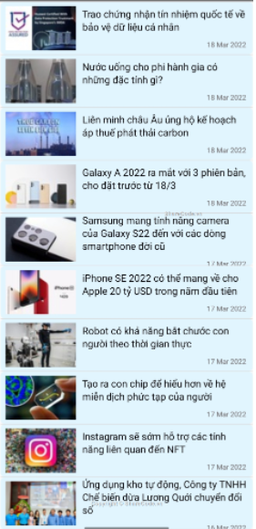
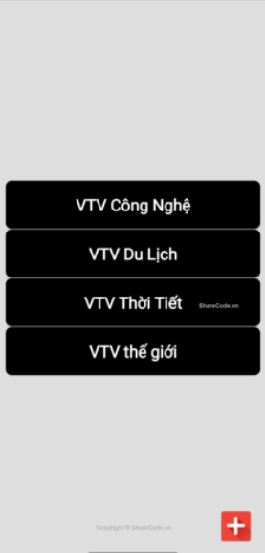
Our News App!
Some app demos

Slide 12
THANKS FOR LISTENING
Thank you teachers for watching the presentation. Here is the introduction. Please comment so that we can improve our app more

