Slide 1
Android
SESSION 01 – Introduction
Edited by Hoàng Văn Hậu – VTC Academy – THSoft co.,ltd
https://play.google.com/store/apps/developer?id=THSoft+Co.,Ltd
Mail: hau999@gmail.com

Slide 2
OBJECTIVES
Overview
History of Android
Android architecture
Development environment
Create an Android project using Eclipse
Project structure
Building an application
Debugging an application

Slide 3

Overview
Android is an open-source software platform created by Google and the Open Handset Alliance
Android is a complete stack: OS, Middleware, Applications
Android relies on Linux version 2.6 for core system services
Open source under the Apache 2 license
The Android SDK provides the tools and APIs necessary to begin developing applications on the Android platform using the Java programming language.
Notes:
Android relies on Linux version 2.6 for core system services such as security, memory management, process management, network stack, and driver model

Slide 4

What is Open Handset Alliance?
The Open Handset Alliance (OHA) is a business alliance of 80 firms to develop new mobile platform (Android):

Slide 5








History of Android
Android Inc. acquired by Google
Early look
SDK released
Android Market announced
Android 1.0 SDK release
Android 3.1
2003
Android Inc. founded
November 5th, 2007
April 17th, 2008
September 23rd, 2008
October 21st, 2008
August, 2005
November 12th, 2007
August 28th, 2008
September 23rd, 2008
10 May 2011
Open Handset Alliance announces Android
Android Developer Challenge I
T-Mobile G1 World's first Android-powered
Android Open Source Project

Slide 6

Android version release timeline
30 April 2009
26 October 2009
6 December 2010
1.5
2.0
2.3
Honeycomb
23 September 2008
Cupcake
Donut
Eclair
Froyo
Gingerbread
1.0
1.6
2.2
3.1
15 September 2009
20 May 2010
10 May 2011

Slide 7
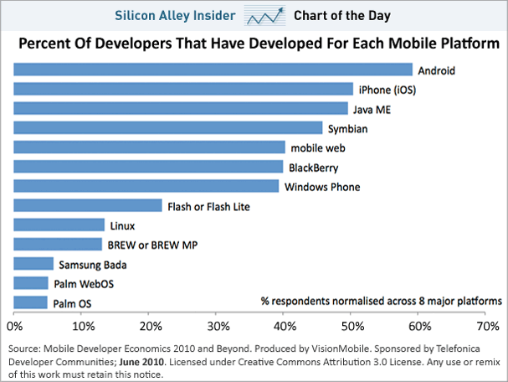
Mobile Platform

Slide 8


The Android Platform
Android is a software environment built for mobile devices.
Android includes:
  Linux kernel-based OS
  A rich UI
  Telephone functionality
  End-user applications
  Code libraries
  Application frameworks
  Multimedia support, ...
User applications are built for Android in Java.

Slide 9
Android architecture
APPLICATIONS
Home
Contacts
Contacts
Phone
Calendar
Browser
APPLICATION FRAMEWORK
Activity Manager
Window Manager
Location Manager
View System
Package Manager
Telephony Manager
Resource
Manager
Content Provides
Notification Manger
LIBRARIES
ANDROID RUNTIME
Surface Manager
SGL
libc
SQLite
Core libraries
OpenGL ES
SSL
Media
Framework
FreeType
WebKit
Dalvik Virtual Machine
LINUX KERNEL
Display Driver
Camera Driver
Flash Memory Driver
Binder (IPC) Driver
Keypad Driver
Wifi Driver
Audio Drivers
Power Management

Slide 10
Android architecture (cont)
Linux Kernel:
  Android relies on Linux version 2.6 for core system services such as security, memory management, process management, network stack, and driver model.
  The kernel also acts as an abstraction layer between the hardware and the rest of the software stack.
LINUX KERNEL
Display Driver
Camera Driver
Flash Memory Driver
Binder (IPC) Driver
Keypad Driver
Wifi Driver
Audio Drivers
Power Management

Slide 11
Android architecture (cont)
Libararies:
  Android includes a set of C/C++ libraries used by various components of the Android system.
  These capabilities are exposed to developers through the Android application framework. Some of the core libraries are listed below:
LIBRARIES
Surface Manager
SGL
libc
SQLite
OpenGL ES
SSL
Media
Framework
FreeType
WebKit

Slide 12
Android architecture (cont)
Android Runtime:
  Dalvik VM:
    Dex files
    Compact and efficient than class files
    Limited memory and battery power
  Core Libraries:
    Java 5 Std edition
    Collections, I/O etc…
ANDROID RUNTIME
Core libraries
Dalvik Virtual Machine

Slide 13
Android architecture (cont)
Application Framework:
Developers have full access to the same framework APIs used by the core applications.
The application architecture is designed to simplify the reuse of components
APPLICATION FRAMEWORK
Activity Manager
Window Manager
Location Manager
View System
Package Manager
Telephony Manager
Resource
Manager
Content Provides
Notification Manger

Slide 14
Android architecture
APPLICATIONS
Home
Contacts
Contacts
Phone
Calendar
Browser
Applications:
  Android will ship with a set of core applications including an email client, SMS program, calendar, maps, browser, contacts, and others.
  All applications are written using the Java programming language.

Slide 15
Android architecture (cont)
APPLICATIONS
Home
Contacts
Contacts
Phone
Calendar
Browser
APPLICATION FRAMEWORK
Activity Manager
Window Manager
Location Manager
View System
Package Manager
Telephony Manager
Resource
Manager
Content Provides
Notification Manger
LIBRARIES
ANDROID RUNTIME
Surface Manager
SGL
libc
SQLite
Core libraries
OpenGL ES
SSL
Media
Framework
FreeType
WebKit
Dalvik Virtual Machine
LINUX KERNEL
Display Driver
Camera Driver
Flash Memory Driver
Binder (IPC) Driver
Keypad Driver
Wifi Driver
Audio Drivers
Power Management

Slide 16
The Dalvik VM
Dalvik is an open source VM technology developed by Google for the Android operating system
Unlike many VM technologies that rely on stack-based architectures, the Dalvik VM is a register-based virtual architecture
All applications written in Java and converted to the Dalvik executable .dex
Simple architecture of a Dalvik software stack:
Linux proces
Android (Java)
application
Davik executable (dex)
Dalvik virtual machine
Dalvik virtual machine
Dalvik virtual machine
Notes:
http://www.ibm.com/developerworks/linux/library/l-virtual-machine-architectures/index.html

Slide 17
Development environment: Eclipse & ADT
The Android Development Tools (ADT) pluginfor Eclipse adds extensions to the Eclipse IDE.
It allows you to create and debug Android applications easier and faster.
Advantages:
  Access to other Android development tools from inside the Eclipse IDE, such as: Take screenshots, Debug / set breakpoints, view thread and process …
  Project Wizard
  Automate and simplifie the process of building Android applications.
  It provides a code editor that helps to write valid XML for your Android manifest and resource files.
  Export the project into a signed APK, which can be distributed to users.

Slide 18
Installing SDK
Step 1: Preparing Your Development Computer
Step 2: Downloading the SDK Starter Package
Step 3: Installing the ADT Plugin for Eclipse
Step 4: Adding Platforms and Other Components

Slide 19



Step 1: Preparing Your Development Computer
System Requirements.
Install the JDK
Download and install Eclipse

Slide 20
Step 2: Downloading the SDK Starter Package
Download the Android SDK:
Platform | Package | Size | MD5 Checksum
Windows | android-sdk_r11-windows.zip | 32837554 bytes | 0a2c52b8f8d97a4871ce8b3eb38e3072
 | installer_r11-windows.exe (Recommended) | 32883649 bytes | 3dc8a29ae5afed97b40910ef153caa2b
Mac OS X (intel) | android-sdk_r11-mac_x86.zip | 28844968 bytes | 85bed5ed25aea51f6a447a674d637d1e
Linux (i386) | android-sdk_r11-linux_x86.tgz | 26984929 bytes | 026c67f82627a3a70efb197ca3360d0a

Slide 21
Step 3: Installing the ADT Plugin for Eclipse
Start Eclipse, then select Help > Install New Software....
Click Add, in the top-right corner.
In the Add Repository dialog that appears, enter "ADT Plugin" for the Nameand the following URL for the Location: https://dl-ssl.google.com/android/eclipse/
In the Available Software dialog, select the checkbox next to Developer Tools and click Next.
In the next window, you'll see a list of the tools to be downloaded. Click Next.
Read and accept the license agreements, then click Finish.
When the installation completes, restart Eclipse.

Slide 22
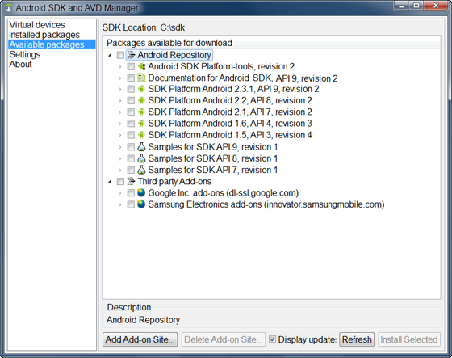
Step 4: Adding Platforms and Other Components

Slide 23
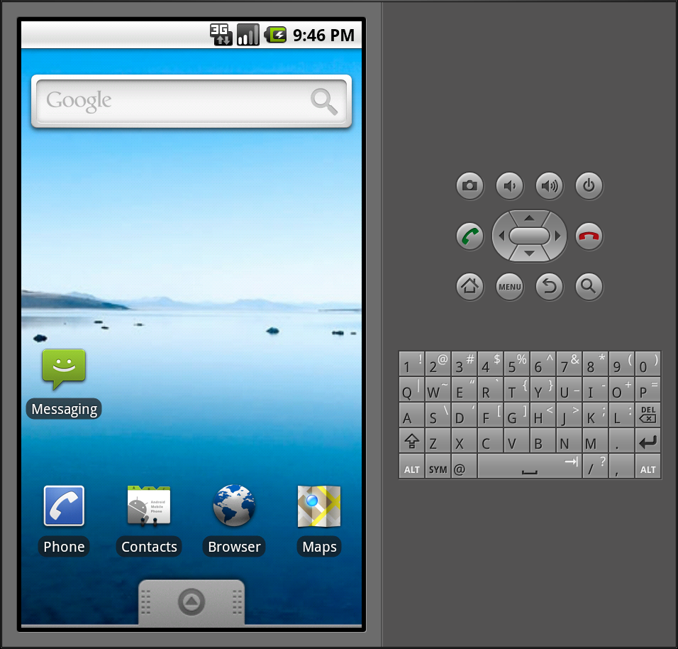
Emulator

Slide 24
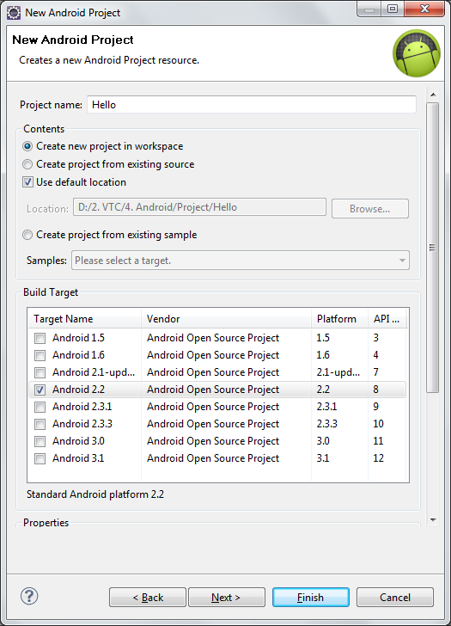
Create an Android project using Eclipse
Start Eclipse
Select File> New>Project.
Select Android > Android Project
  Enter Project name: xxxxxxxx
  Select Target: xxxxxxxx
  Application name: xxxxxxxx
  Package name: xxxxxxxx
  Create Activity: xxxxxxxx
  Min SDK Version: xxxxxxxx
Click Finish

Slide 25
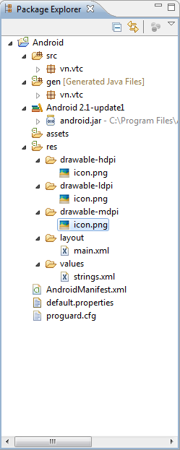
Project structure
Using New Project Wizard, ADT creates the following folders and files in a new project:
  src/
  <Android Version>/
  gen/
  assets/
  res/
  AndroidManifest.xml
  default.properties
  proguard.cfg

Slide 26
Android sample application code
package vn.vtc;
import android.app.Activity;
import android.os.Bundle;
import android.widget.TextView;
public class HelloAndroid extends Activity {
/** Called when the activity is first created. */
@Override
public void onCreate(Bundle savedInstanceState) {
super.onCreate(savedInstanceState);
TextView tv = new TextView(this);
tv.setText("Hello, Android");
setContentView(tv);
}
}

Slide 27
Building and Running an application
During the build process, your Android projects are compiled and packaged into an .apk file
It contains all of the information necessary to run your application:
  Compiled .dex files (.class files converted to Dalvik byte code)
  Binary version of the AndroidManifest.xml file
  Compiled resources (resources.arsc)
  Uncompiled resource files for your application.
To run an application on an emulator or device, the application must be signed using debug or release mode

Slide 28
Building and Running and application (cont)
Application Resources
R.Java
*.class
*.dex
Androi-maniest.xml
*.java
Android Package (.apk)
Signed & aligned .apk

Slide 29
Debugging an application
The Android SDK provides most of the tools that you need to debug your applications
The main components that comprise a typical Android debugging environment are:
  adb
  Dalvik Debug Monitor Server
  Device or Android Virtual Device
  JDWP debugger
More technique for debugging:
http://android-sdk.appspot.com/guide/developing/debugging/index.html

Slide 30
Summary
In this session, we learnt:
  Android platform – history and architecture
  The Dalvik VM
  Setup Android SDK to build Android applications
  Create a Android project
  Writing a simple Android application
  Building and running an Android application
  Debugging

