Slide 1
Android
SESSION 03 – Building User Interface

Slide 2
OBJECTIVES
The View Class
Basic Widgets
  Labels
  Buttons
  Images
  EditText
  CheckBox
  RadioButtons
Android Layouts
Five basic types of Layouts
Attaching Layouts to Java Code

Slide 3
The View Class
The View class represents the basic building block for user interface components.
A View occupies a rectangular area on the screen and is responsible for drawing and event handling.
View is the base class for widgets, which are used to create interactive UI components (buttons, text fields, etc.).
The ViewGroup subclass is the base class for layouts, which are invisible containers that hold other Views (or other ViewGroups) and define their layout properties.

Slide 4
Using Views
All of the views in a window are arranged in a single tree
You can add views either from code or by specifying a tree of views in one or more XML layout files.
Once you have created a tree of views, there are typically a few types of common operations you may wish to perform:
  Set properties:
  Set focus
  Set up listeners
  Set visibility

Slide 5
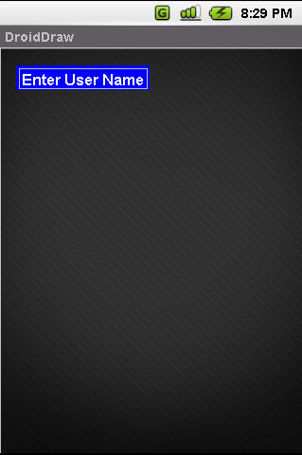
Basic Widgets: Labels
A label is called in android a TextView.
TextViews are typically used to display a caption.
TextViews are not editable, therefore they take no input.

Slide 6
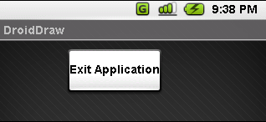
Basic Widgets: Buttons
A Button widget allows the simulation of a clicking action on a GUI.
Button is a subclass of TextView. Therefore formatting a Button’s face is similar to the setting of a TextView.
<Button android:id="@+id/btnExitApp"
android:layout_width="wrap_content"
android:layout_height="wrap_content"
android:padding="10px"
android:layout_marginLeft="5px"
android:text="Exit Application"
android:textSize="16sp"
android:textStyle="bold"
android:gravity="center"
android:layout_gravity="center_horizontal">
</Button>

Slide 7
Basic Widgets: Images
ImageView and ImageButton are two Android widgets that allow embedding of images in your applications.
Both are image-based widgets analogue to TextViewand Button, respectively.
Each widget takes an android:src or android:background attribute (in an XML layout) to specify what picture to use.
Pictures are usually reference a drawable resource.
You can also set the image content based on a URI from a content provider via setImageURI().
ImageButton, is a subclass of ImageView. It adds the standard Button behavior for responding to click events.

Slide 8
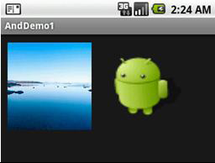
Basic Widgets: Images (cont)
<ImageButton
  android:id="@+id/myImageBtn1" android:background="@drawable/default_wallpaper" android:layout_width="125px" android:layout_height="131px"
>
</ImageButton>
<ImageView
  android:id="@+id/myImageView1" android:background="@drawable/ic_launcher_android" android:layout_width="108px" android:layout_height="90px“>
</ImageView>

Slide 9
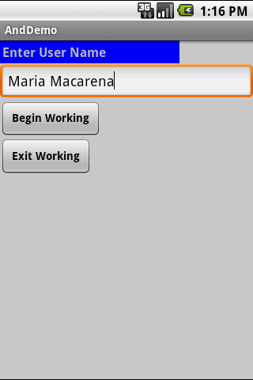
Basic Widgets: EditText
The EditText (or textBox) widget is an extension of TextViewthat allows updates.
The control configures itself to be editable.
Important Java methods are: txtBox.setText(“someValue”) and txtBox.getText().toString()

Slide 10
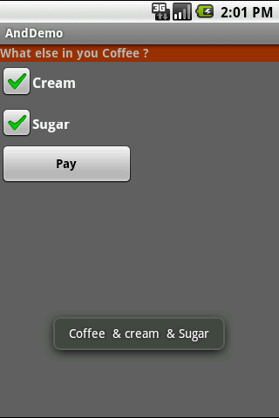
Basic Widgets: CheckBox
A checkbox is a specific type of two-states button that can be either checked or unchecked.
A example usage of a checkbox inside your activity would be the following:

Slide 11
Basic Widgets: RadioButtons
A radio button is a two-states button that can be either checked or unchecked.
When the radio button is unchecked, the user can press or click it to check it.
Radio buttons are normally used together in a RadioGroup.
When several radio buttons live inside a radio group, checking one radio button unchecks all the others.
RadioButtoninherits from … TextView. Hence, all the standard TextViewproperties for font face, style, color, etc. are available for controlling the look of radio buttons.
Similarly, you can call isChecked() on a RadioButtonto see if it is selected, toggle() to select it, and so on, like you can with a CheckBox.

Slide 12
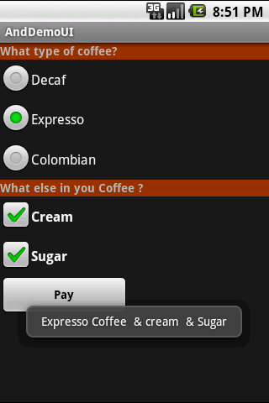
Basic Widgets: RadioButtons (cont)
Example:

Slide 13
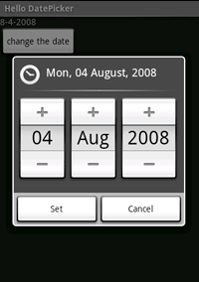
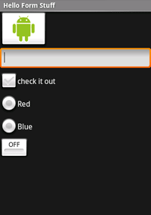
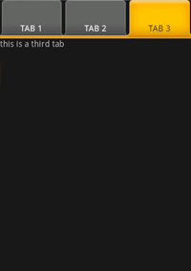
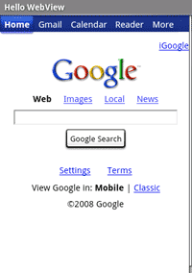
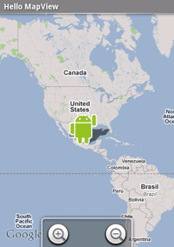
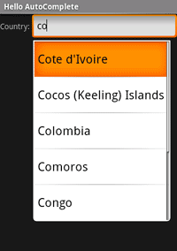
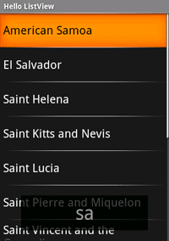
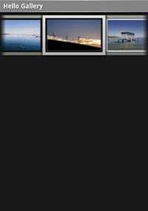
A brief sample of UI components
DatePicker
Form Controls
TabWidget
WebView
MapView
AutoComplete
ListView
GalleryView

Slide 14
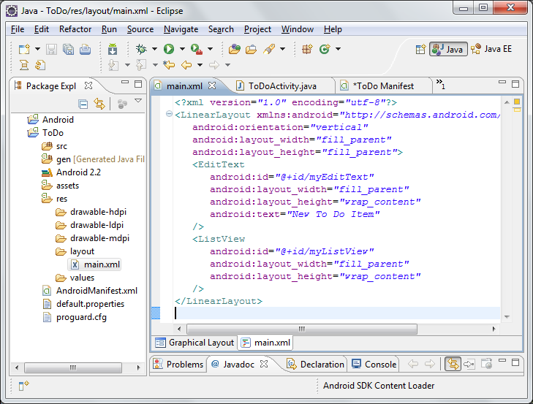
XML Layout
An XML-based layout is a specification of the various UI components (widgets) and the relationships to each other –and to their containers – all written in XML format
Android considers XML-based layouts to be resources, and as such layout files are stored in res/layout directory inside your Android project

Slide 15
XML Layout (cont)
Each XML file contains a tree of elements specifying a layout of widgets and containers that make up one View
The attributes of the XML elements are properties, describing how a widget should look or how a container should behave.
Example:
  If a Buttonelement has an attribute value of android:textStyle= "bold" that means that the text appearing on the face of the button should be rendered in a bold face font style.

Slide 16
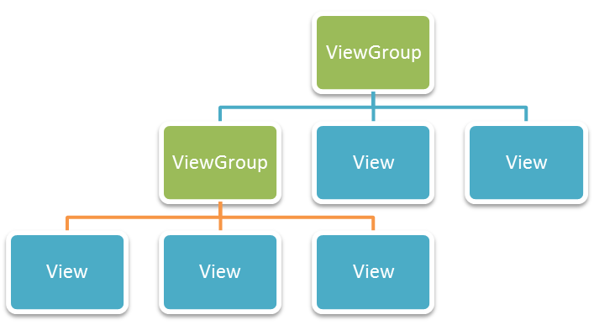
Android Layouts
The most common way to define your layout and express the view hierarchy is with an XML layout file.
XML offers a human-readable structure for the layout, much like HTML.
Each element in XML is either a Viewor ViewGroupobject

Slide 17
Android Layouts (cont)
Displaying the Application’s View
  The Android UI Framework paints the screen by walking the View tree by asking each component to draw itself in a pre-order traversal way.
  In other words, each component draws itself and then asks each of its children to do the same.
  When the whole tree has been rendered, the smaller, nested components that are the leaves of the tree –and that were, therefore, painted later –appear to be drawn on top of the components that are nearer to the root and that were painted earlier.

Slide 18
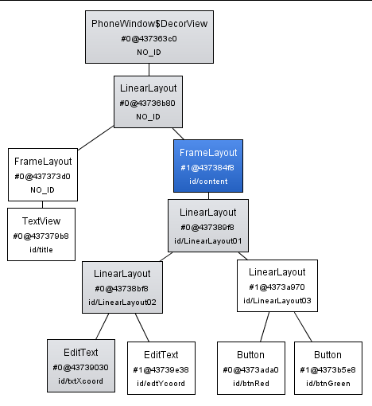
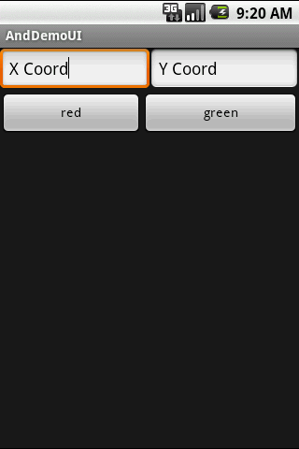
Android Layouts (cont)
Example: Display UI Hierarchy:

Slide 19
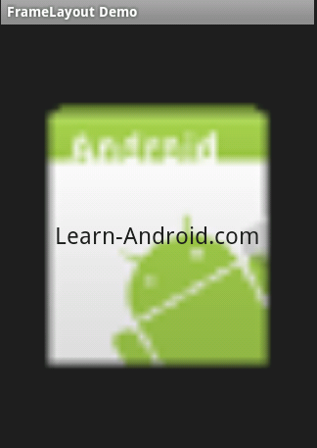
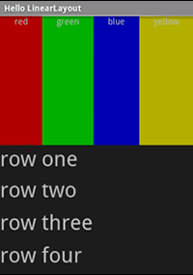
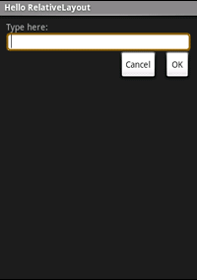
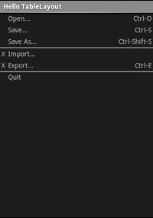
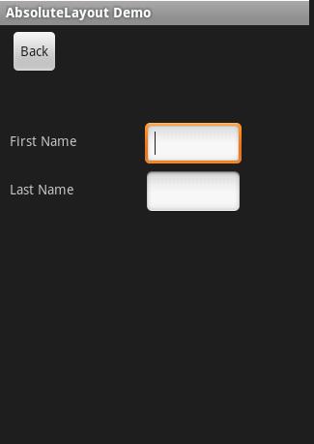
Common Layouts
There are five basic types of Layouts:
Frame, Linear, Relative, Table, and Absolute.
Frame Layout
Linear Layout
Relative Layout
Table Layout
Absolute Layout

Slide 20
1. FrameLayout
FrameLayout is the simplest type of layout object.
It's basically a blank space on your screen that you can later fill with a single object
All child elements of the FrameLayoutare pinned to the top left corner of the screen;
You cannot specify a different location for a child view.
Subsequent child views will simply be drawn over previous ones, partially or totally obscuring them (unless the newer object is transparent).

Slide 21
2. LinearLayout
LinearLayout aligns all children in a single direction –vertically or horizontally depending on the android:orientation attribute
All children are stacked one after the other,
  A vertical list will only have one child per row, no matter how wide they are
  A horizontallist will only be one row high (the height of the tallest child, plus padding).
A LinearLayout respects margins between children and the gravity (right, center, or left alignment) of each child.

Slide 22
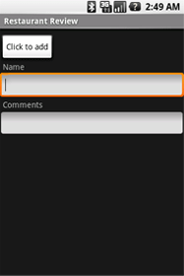
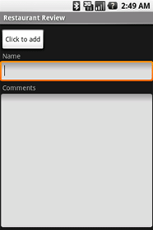
2. LinearLayout (cont)
You may attribute a weight to children of a LinearLayout.
Weight gives an "importance" value to a view, and allows it to expand to fill any remaining space in the parent view.
Example:
weight values unset (0 by default)
comments text box weight set to 1
If the Name textbox had also been set to 1, the Name and Comments text boxes would be the same height.

Slide 23
3. TableLayout
TableLayout positions its children into rows and columns.
TableLayoutcontainers do not display border lines for their rows, columns, or cells.
The table will have as many columns as the row with the most cells.
A table can leave cells empty, but cells cannot span columns, as they can in HTML.
TableRow objects are the child views of a TableLayout (each TableRow defines a single row in the table).
Each row has zero or more cells, each of which is defined by any kind of other View. So, the cells of a row may be composed of a variety of View objects, like Image View or TextView objects.
A cell may also be a ViewGroupobject (for example, you can nest another TableLayout as a cell).

Slide 24
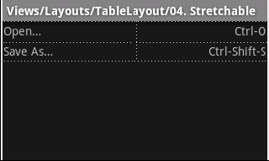
3. TableLayout (cont)
<?xml version="1.0" encoding="utf-8"?>
<TableLayout xmlns:android=http://schemas.android.com/apk/res/android android:layout_width="fill_parent" android:layout_height="fill_parent" android:stretchColumns="*">
  <TableRow>
    <TextViewandroid:text="Open…" android:padding="3dip" />
    <TextViewandroid:text="Ctrl-O" android:gravity="right" android:padding="3dip" />
  </TableRow>
  <TableRow>
    <TextViewandroid:text="Save As…" android:padding="3dip" />
    <TextViewandroid:text="Ctrl-Shift-S" android:gravity="right" android:padding="3dip" />
  </TableRow>
</TableLayout>

Slide 25
4. Relative Layout
RelativeLayout lets child views specify their position relative to the parent view or to each other (specified by ID).
You can align two elements by right border, or make one below another, centered in the screen, and so on.
Elements are rendered in the order given, so if the first element is centered in the screen, other elements aligning themselves to that element will be aligned relative to screen center.
Also, because of this ordering, if using XML to specify this layout, the element that you will reference (in order to position other view objects) must be listed in the XML file before you refer to it from the other views via its reference ID.

Slide 26
4. Relative Layout (cont)
The defined RelativeLayoutparameters are (android:layout_...) :
  width, height,
  below, above
  alignTop, alignParentTop,
  alignBottom, alignParentBottom
  toLeftOf, toRightOf
  padding [Bottom|Left|Right|Top], and
  margin [Bottom|Left|Right|Top].
For example, assigning the parameter
android:layout_toLeftOf=“@+id/my_button"
to a TextViewwould place the TextViewto the left of the View with the ID my_button

Slide 27
4. Relative Layout (cont)
<?xml version="1.0" encoding="utf-8"?>
  <RelativeLayout xmlns:android=http://schemas.android.com/apk/res/android android:layout_width="fill_parent" android:layout_height="wrap_content" android:background="#ff0000ff" android:padding="10px" >
  <TextView android:id="@+id/label" android:layout_width="fill_parent" android:layout_height="wrap_content" android:background="#ffff0077" android:text="Type here:" />
  <EditText android:id="@+id/entry" android:layout_width="fill_parent" android:layout_height="wrap_content" android:layout_below="@id/label" />
  <Button android:id="@+id/ok" android:layout_width="wrap_content" android:layout_height="wrap_content" android:layout_below="@id/entry" android:layout_alignParentRight="true" android:layout_marginLeft="10px" android:text="OK" />
  <Button android:text="Cancel" android:layout_width="wrap_content" android:layout_height="wrap_content" android:layout_toLeftOf="@id/ok" android:layout_alignTop="@id/ok“ />
</RelativeLayout>

Slide 28
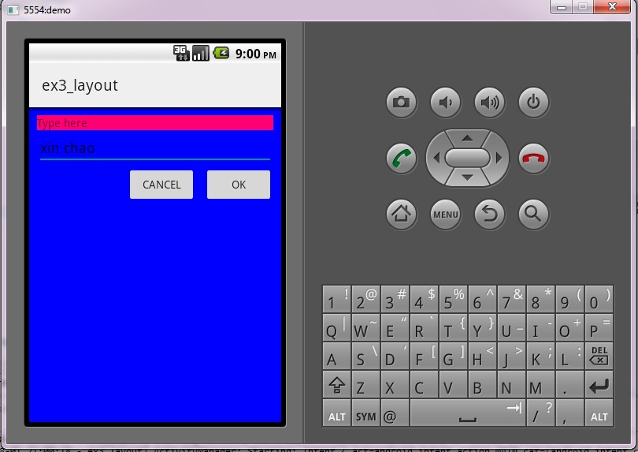

Slide 29
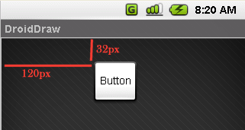
5. Absolute Layout
A layout that lets you specify exact locations (x/y coordinates) of its children.
Absolute layouts are less flexible and harder to maintain than other types of layouts without absolute positioning.
<?xml version="1.0" encoding="utf-8"?>
<AbsoluteLayout android:id="@+id/myAbsoluteLayout" android:layout_width="fill_parent" android:layout_height="fill_parent" xmlns:android="http://schemas.android.com/apk/res/android" >
  <Button android:id="@+id/myButton" android:layout_width="wrap_content" android:layout_height="wrap_content" android:text="Button" android:layout_x="120px" android:layout_y="32px">
  </Button>
</AbsoluteLayout>

Slide 30
Attaching Layouts to Java Code
Assume res/layout/main.xml has been created. This layout could be called by an application using the statement
setContentView(R.layout.main)
Individual widgets, such as myButtoncould be accessed by the application using the statement findViewByID(...) as in
Button btn= (Button) findViewById(R.id.myButton)
Where Ris a class automatically generated to keep track of resources available to the application. In particular R.id... is the collection of widgets defined in the XML layout.

Slide 31
Summary
In this session, we learnt:
  The View Class
  Basic Widgets
    Labels
    Buttons
    Images
    EditText
    CheckBox
    RadioButtons
  Android Layouts
  Five basic types of Layouts
  Attaching Layouts to Java Code

