Slide 1




ConCORD: Easily Exploiting Memory Content Redundancy Through the Content-aware Service Command
Lei Xia, Kyle Hale, Peter Dinda
Hobbes: http://xstack.sandia.gov/hobbes/
Notes:
In my talk, I will present Concord, a distributed memory content tracking system and demonstrate how it can help us to easily exploit memory content redundancy in HPC system.

Slide 2
Overview
Claim: Memory content-sharing detection and tracking should be built as a separate service
Exploiting memory content sharing in parallel systems through content-aware services
Feasibility: Implementation of ConCORD: A distributed system that tracks memory contents across collections of entities (vms/processes)
Content-aware service command minimizes the effort to build various content-aware services
Collective checkpoint service
Only ~200 line of code
Notes:
This is the main take away from my talk.
First of all, We believe that content sharing tracking should be …..
This gives us more opportunity for exploiting memory content sharing in parallel systems, through content aware services.
To demonstrate the feasibility of such service, we have implementation ConCORD,
In addition, to further simplify the build of content-aware services,
we proposed and implemented a content-aware service command framework
Which allows build of content-aware services with minimal efforts.
Finally, with the service command, we are able to build a content-aware checkpoint service in very few lines of code, which performs very well in parallel system.

Slide 3
Outline
Content-sharing in scientific workloads
Content-aware services in HPC
Content-sharing tracking as a service
Architecture of ConCORD
Implementation in brief
Content-aware service command
Collective checkpoint on service command
Performance evaluation
Conclusion

Slide 4
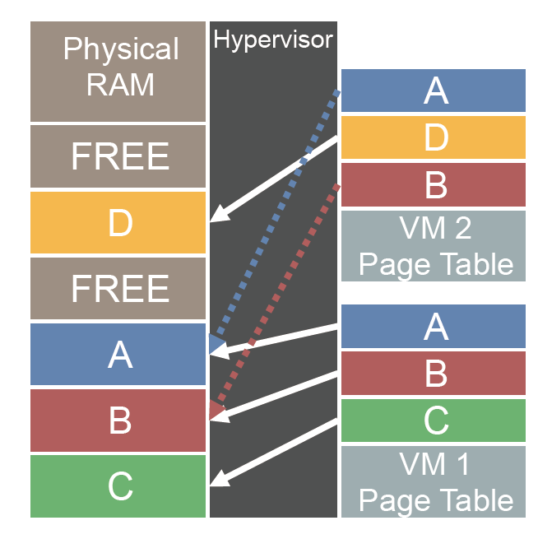
Content-based Memory Sharing
Eliminate identical pages of memory across multiple VMs/processes
Reduce memory footprint size in one physical machine
Intra-node deduplication
[Barker-USENIX’12]

Slide 5
Memory Content Sharing is Common in Scientific Workloads in Parallel Systems [previous work published at VTDC’12]
Notes:
Meanwhile, our previous work has shown that memory content sharing is also very common in scientific workloads running in parallel systems, include both intra-node sharing and inter-node sharing.
Here is a graph grab from our previous paper, we show a range of applications running across node, compare their memory footprint, with raw size,
The size if we remove intra-node sharing, and the memory size needed if we remove inter-node sharing.

Slide 6
Memory Content Sharing in Parallel Workloads [previous work published at VTDC’12]
Both Intra-node and inter-node sharing is common in scientific workloads,
Many have significant amount of inter-node content sharing beyond intra-node sharing
[A Case for Tracking and Exploiting Inter-node and Intra-node Memory Content Sharing in Virtualized Large-Scale Parallel Systems, VTDC’12]

Slide 7
Content-aware Services in HPC
Many services in HPC systems can be simplified and improved by leveraging the intra- /inter-node content sharing
Content-aware service: service that can utilize memory content sharing to improve or simplify itself
Content-aware checkpointing
Collectively checkpoint a set of related VMs/Processes
Collective virtual machine co-migration
Collectively moving a set of related VMs
Collective virtual machine reconstruction
Reconstruct/migrate a VM from multiple source VMs,
Many other services ….
Notes:
By leveraging this content sharing, many services can be simplified and improved.
For example, by collectively checkpointing or migrating a number of related VMs ,
Or reconstruct a single VM from multiple source VMs.

Slide 8
Content-aware Collective Checkpointing
P1
P2
P3
A
A
A
B
B
C
C
D
D
E
E
C
C
A
A
B
B
E
E
F
F
A
A
B
B
C
C
C
D
D
G
G
Checkpoint
Notes:
As an example, to checkpoint a set of process, a simple and traditional way would be dump each process’ memory into file individually.
However, if there are memory content sharing across these processes, we can leverage the sharing by saving only one copy of the memory
with distinct content, this is how content-aware collective checkpoint works. It can greatly reduce the checkpoint size if there is much cross-node sharing.

Slide 9
Content-aware Collective Checkpointing
P1
P2
P3
A
A
A
B
B
C
C
D
D
D
E
E
C
C
A
A
B
B
B
E
E
E
F
F
F
A
A
B
B
C
C
C
C
D
D
G
G
G
Checkpoint
A
B
C
D
E
C
A
B
E
F
A
B
C
D
G
Collective-checkpoint
Reduce checkpoint size by saving only one copy of each distinct content (block) across the all processes
Notes:
By leveraging this content sharing, many services can be simplified and improved.
Here I will briefly show three examples of them.
Add more illustration on the collective checkpointing/migration.

Slide 10
Collective VM Reconstruction
Host-1
VM-1
Host-2
VM-2
Host-3
VM-3
A
B
C
D
E
C
A
B
E
F
A
B
C
D
G
Host-4
Single VM Migration
Notes:
Similarly, when we migrate a single VM across hosts, it take times to copy the
Whole memory from the old host to new one, and reconstruct the VM.
Instead, in a collective VM reconstruction, we allow VM to be reconstructed from multiple source VMs. This can potentially fasten this migration process if other VMs sharing some
Memory content with the migrated VMs.

Slide 11
Collective VM Reconstruction
Host-1
VM-1
Host-2
VM-2
Host-3
VM-3
A
A
B
C
D
D
E
C
A
B
B
E
F
A
B
C
C
D
G
G
Host-4
Collective VM Reconstruction

Slide 12
Collective VM Reconstruction
Host-1
VM-1
Host-2
VM-2
Host-3
A
A
B
C
D
D
E
C
A
B
B
E
F
A
B
C
C
D
G
G
Host-4
VM-3
Collective VM Migration
A
B
C
D
G
Fasten VM migration by reconstructing its memory from multiple sources

Slide 13
Content-sharing Detection and Tracking
We need to detect and track memory content sharing
Continuously tracking with system running
Both intra-node and inter-node sharing
Scalable in large scale parallel systems with minimal overhead

Slide 14
Content-sharing Tracking As a Service
Content sharing tracking should be factored into a separate service
Maintain and enhance a single implementation of memory content tracking
Allow us to focus on developing an efficient and effective tracking service itself
Avoid redundant content tracking overheads when multiple services exist
Much easier to build content-aware services with existing tracking service

Slide 15
ConCORD: Overview
A distributed inter-node and intra-node memory content redundancy detection and tracking system
Continuously tracks all memory content sharing in a distributed memory parallel system
Hash-based content detection
Each memory block is represented by a hash value (content hash)
Two blocks with the same content hash are considered as having same content

Slide 16
ConCORD: System Architecture
node
node
VM
Memory Update Monitor
Process
…
…
…
inspect
ptrace
Content-aware
Service
Hypervisor
(VMM)
OS
Memory Update Monitor
Content-sharing
Query Interface
Content-aware Service Command Controller
Memory Content Update Interface
ConCORD
Service Command Execution Engine
Distributed Memory Content Tracer
nodes
Notes:
This is the overall high level achitecture
ConCORD works in both virtualized environments, which applications are running inside VMs
Or no virtualized enviroments, which application runs in native os.
ConCORD deploys Memory update monitor in each VMM or physical node,
to collect and monitor the memory updated in all VMs or processes.
And then it uses a Distributed memory content tracer to maintain and track the content sharing, and the location of contents,
across the whole system.
ConCORD provides two interfaces for use by application service, a query interface and the content-aware service command interface.

Slide 17
Distributed Memory Content Tracer
Uses customized light-weight distributed hash table (DHT)
To track memory content sharing, and location of contents in system-wide
 | Conventional DHT | DHT in ConCORD
Target System | Distributed Systems | Large-scale Parallel Systems
Type of key | variable length | fixed length
Type of object | variable size, variable format | small size
Fault Tolerance | Strict | Loose
Persistency | Yes | No
Notes:
ConCORD uses a customized lightweighted distributed hash table to tracks memory content sharing, and the location of contents.
These differences allow us to greatly simplify our DHT design, and let us to focus on improving the performance the DHT.

Slide 18
DHT in ConCORD
DHT Entry: <content-hash, Entity-List>
DHT content is split into partitions, and distributed (stored and maintained) over the ConCORD instances
Given a content hash, computing its partition and its responsible instance is fast and straightforward:
zero-hop
no peer information is needed

Slide 19
Content-sharing Queries
Examine memory content sharing and shared locations in system
Node-wise queries
Given a content hash:
Find number of copies existing in a set of entities
Find the exact locations of these blocks
Collective Queries
Degree of Sharing: Overall level of content redundancy among a set of entities
Hot memory content: contents duplicate more than k copies in a set of entities

Slide 20
How can we build a content-aware service?
Runs content-sharing queries inside a service
Uses sharing information to exploit content sharing and improve service
Requires many effort from service developers
how efficiently and effectively utilize the content sharing
Notes:
With the query interface, how can we build a content-aware service?
Obviously, we can run queries inside a service, and use the content-sharing information to exploit content sharing and improve service.
However, this still require many effort from service developers, who has to build their service to efficiently and effectively utilize the this content sharing.

Slide 21
How can we build a content-aware service?
Runs a service inside a collective query
ConCORD provides query template
Service developer defines a service by parametering the query template
ConCORD executes the parameterized query over all shared memory content
During run of the query, ConCORD completes the service while utilizes memory content sharing in the system
Minimize service developers’ effort
Notes:
We go future to think how ConCORD can makes this much easier. An idea here instead of running query inside a service, we runs a service inside a query.
In such case, ConCORD provide a query template, and service developers define its service by parametering a query template.
Then ConCORD executed the parameterized query over all shared memory content.
When the query completes, ConCORD completes the service
While utilizes memory content sharing in the system.

Slide 22
Content-aware Service Command
A service command is a parameterable query template
Services built on top of it are automatically parallelized and executed by ConCORD
partitioning of the task
scheduling the subtasks to execute across nodes
managing all inter-node communication
Notes:
Build from the idea, we proposed the content-aware service command, and build it into ConCORD. A service command is a parameteriable query template as we just discussed.
It enables effective con…..
Services built on top of it are automatically parallelized and executed by ConCORD. ConCORD managers the

Slide 23
Challenge: Correctness vs. best-effort
ConCORD provides best-effort service
ConCORD DHT’s view of memory content may be outdated
Application services require correctness
Ensure correctness using best-effort sharing information

Slide 24
Service Command: Two Phase Execution
Collective Phase:
Each node performs subtasks in parallel on locally available memory blocks
Best-effort, using content tracked by ConCORD
Stale blocks are ignored
Driven by DHT for performance and efficiency
Local Phase
Each node performs subtasks in parallel on memory blocks ConCORD does know of
All fresh blocks are covered
Driven by local content for correctness

Slide 25
Collective Checkpoint: Initial State
Memory content in processes
P-1
A
B
C
D
E
P-2
C
A
B
E
F
P-3
A
B
C
D
G
Notes:
We will take a example service to see how this works, recall that
Recall that, as I showed at the beginning of my talk, In a collective checkpoint,
It tries to minimize the checkpoint size by saving only one copy of distinct memory content over all entities.

Slide 26
Collective Checkpoint: Initial State
Memory content in processes
Memory content in ConCORD’s view
A
B
C
D
E
P-1
A
B
C
D
E
P-1
C
A
B
E
F
P-2
C
A
B
E
F
P-2
A
B
C
D
G
P-3
A
B
C
D
H
P-3

Slide 27
Collective Checkpoint: Initial State
Memory content in processes
Memory content in ConCORD’s view
A
B
C
D
E
P-1
A
B
C
D
E
P-1
C
A
B
E
F
P-2
C
A
B
E
F
P-2
A
B
C
D
G
P-3
A
B
C
D
H
P-3
Content Hash | Process Map
A | {p1, p2, p3}
B | {p1, p2, p3}
C | {p1, p2, p3}
D | {p1, p3}
E | {p1, p2}
F | {p2}
H | {p3}
ConCORD’s DHT

Slide 28
Collective Checkpoint: Collective Phase
P-1
A
B
C
D
E
ConCORD
Service
Execute
Engine
P-2
C
A
B
E
F
P-3
A
B
C
D
G

Slide 29
Collective Checkpoint: Collective Phase
Save {A,D}
P-1
A
B
C
D
E
ConCORD
Service
Execute
Engine
Save {B, E, F}
C
A
B
E
F
P-2
Save {C,H}
P-3
A
B
C
D
G

Slide 30
Collective Checkpoint: Collective Phase
P-1
A
B
C
D
E
ConCORD
Service
Execute
Engine
P-2
C
A
B
E
F
P-3
A
B
C
D
G

Slide 31
Collective Checkpoint: Collective Phase
{A,D} saved
P-1
A
B
C
D
E
ConCORD
Service
Execute
Engine
{B, E, F} saved
C
A
B
E
F
P-2
{C} saved
P-3
A
B
C
D
G

Slide 32
Collective Checkpoint: Collective Phase
{A,D} saved
P-1
A
B
C
D
E
ConCORD
Service
Execute
Engine
{B, E, F} saved
C
A
B
E
F
P-2
{C} saved
P-3
A
B
C
D
G
Completed: {A, B, C, D, E, F}

Slide 33
Collective Checkpoint: Local Phase
{A, B, C, D, E, F}
P-1
A
B
C
D
E
ConCORD
Service
Execute
Engine
{A, B, C, D, E, F}
P-2
C
A
B
E
F
{A, B, C, D, E, F}
P-3
A
B
C
D
G
Local Phase:
P-1: Do Nothing
P-2: Do Nothing
P-3: Save G

Slide 34
Example Service: Collective Checkpoint
User-defined Service Specific Functions:
Function executed during collective phase:
For request content hash:
If (a local block exists locally):
save the memory block into user-defined file
Function executed during local phase:
For each local memory block
if(block is not saved):
saves the block to user-defined file
Implementation: 220 lines of C code. (Code in Lei Xia’s Ph.D Thesis).
Notes:
All the service developer has to do is to implement two simple methods that got to be executed during collective phase
And local phase for each required memory block.
The whole implementation contains only 220 line of C code, which, if you are instereted to take a look at, can be found in my phd thesis.

Slide 35
Performance Evaluation
Service Command Framework
Use a service class with all empty methods (Null Service Command)
Content-aware Collective Checkpoint
Testbed
IBM x335 Cluster (20 nodes)
Intel Xeon 2.0 GHz/1.5 GB RAM
1 Gbps Ethernet NIC (1000BASE-T)
HPC Cluster (500 nodes)
Two quadcore 2.4 GHz Intel Nehalem/48 GB RAM
InfiniBand DDR network

Slide 36
Null Service Command
Execution Time Linearly Increases with Total Memory Size
Execution time is linear with total process’ memory size
Notes:
The first graph shows the execution time of a null service command over a fix number of nodes, with increasing memory size per node.
We run 6 process on 6 nodes, with each node contains increasing number of memory.
X axis shows the total memory size, in log scale. While y axis shows the execution time.
The results shows that execution time is linearly increases with total memory size.

Slide 37
Null Service Command
Execution Time Scales with Increasing Nodes
Notes:
Next, we show the execution time of null service command running over a increasing number of nodes,
The x axis shows the number of nodes, in log scale, y axis shows the execution time.
As we can tell from the graph, the execution time increases very slowly as the node size increases.

Slide 38
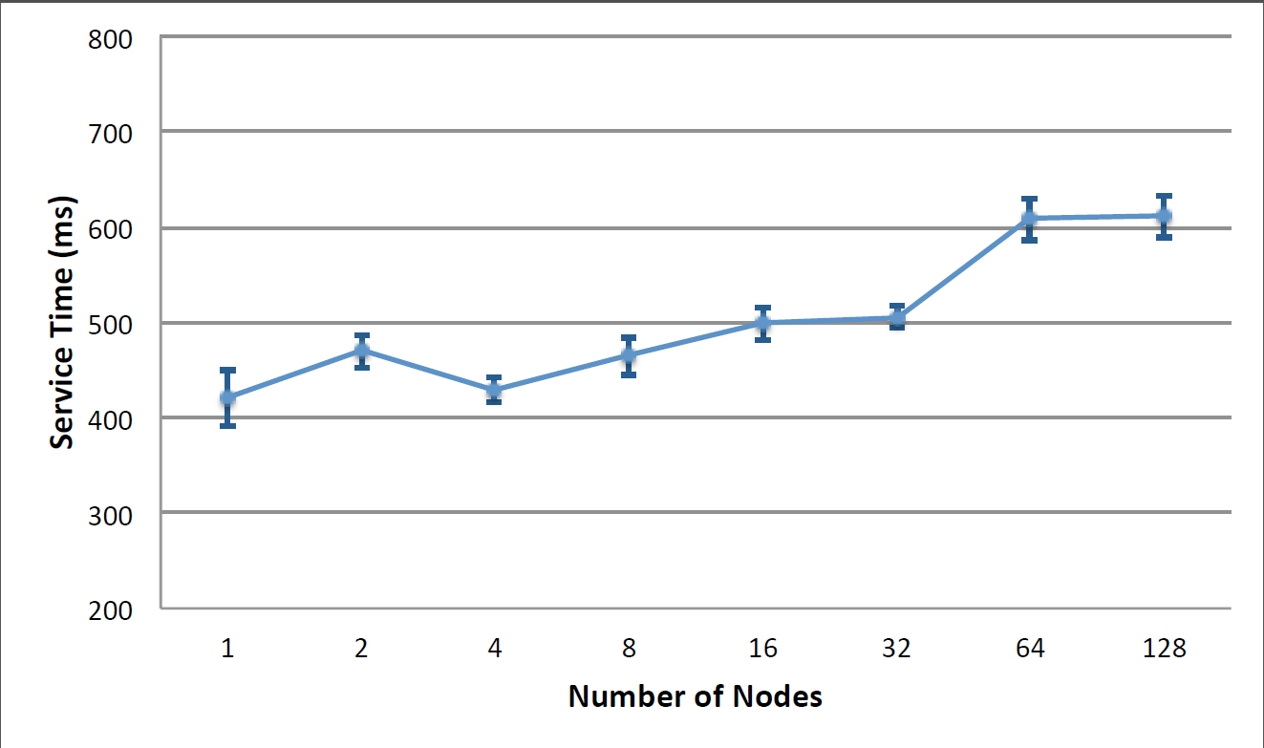
Null Service Command
Execution Time Scales in Large Testbed
Notes:
Finally, we show the execution time of running null service command over an increasing number of nodes,
From single node to upto 128 node.
We can see, when the node increases from 1 node to 128 nodes, the execution time increases only from 400 ms to 600 ms.
This results suggests that the service command framework’s performance scales in large testbed.

Slide 39
Checkpoint Size:
Runs application with plenty of inter-node content sharing, ConCORD achieves better compression ratio
Notes:
Next, I will show the performance results from the collective checkpoint.
We have run a lot of tests to evaluate our collective checkpoint implementation,
In this graph, we shows the checkpoint compress ratio by running an scientific application with plenty of inter-node sharing.
The graph compares the compression ratio of two strategies,
The light blue shows the by simply dump all process’s memory to a file and then apply gzip on the file,
The dark blue column shows compression ratio achieved by collective checkpoint on ConCORD.
X axis shows two numbers on different number of nodes, we can see collective checkpoint can achieve better compression ratio as number of nodes increases.

Slide 40
Checkpoint Size:
ConCORD achieves better compression ratio
Content-aware checkpointing achieves better compression than GZIP for applications with many inter-node content sharing

Slide 41
Collective Checkpoint
Checkpoint Time Scales with Increasing Nodes
Notes:
Service time running collective checkpoint over an increasing number of nodes.
X axis shows the number of nodes, upto 20 nodes, while y axis shows the checkpoint time.

Slide 42
Collective Checkpoint
Checkpoint Time Scales with Increasing Nodes
Content-aware checkpointing scales well in increasing number of nodes.
Content-aware checkpointing uses significantly less checkpoint time than memory dump+GZIP while achieving same or better compression ratio.
Notes:
Service time as the number of participating VMs and nodes. 1VM/node, 1GB/VM

Slide 43
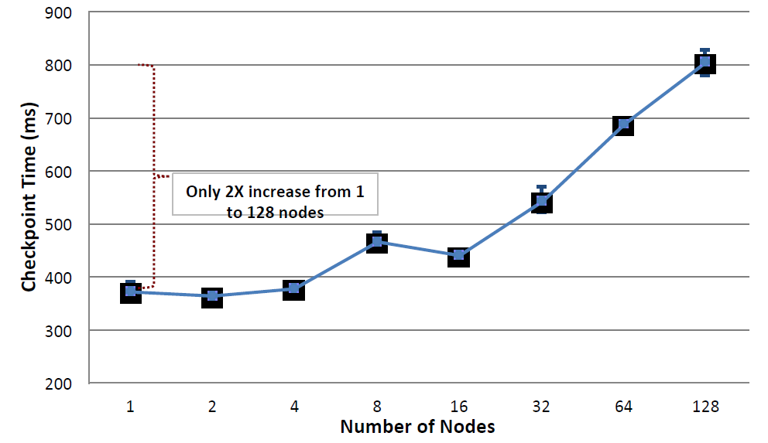
Checkpoint Time Scales Well in Large Testbed
Notes:
Lastly, this graph shows the checkpoint time running in the large testbed, upto 128 nodes.
The x axis show the node number, in log scale, y axis shows the checkpoint time.
Overall, we can see the checkpoint time doubles from single node to 128 node.
Which suggests our collective checkpoint service scales well in large testbed.

Slide 44
Conclusion
Claim: Content-sharing tracking should be factored out as a separate service
Feasibility: Implementation and evaluation of ConCORD
A distributed system that tracks memory contents in large-scale parallel systems
Content-aware service command minimizes the effort to build content-aware services
Collective checkpoint service
Performs well
Only ~200 line of code
Notes:
At beginning of my talk, I claimed that content sharing tracking should be …..
We verify it by demonstrates our implementation and evaluation of such memory tracking system, called ConCORD.
In addition, to further simplify the build of content-aware services,
we proposed and implemented a content-aware service command framework
Which allows effective build of content-aware services with minimal efforts.
With the service command, we are able to build a content-aware checkpoint service in 200 line of code, which performs very well in large-scale parallel system.

Slide 45

Lei Xia
leix@vmware.com
http://www.lxia.net
http://www.v3vee.org
http://xstack.sandia.gov/hobbes/

Slide 46
Backup Slides

Slide 48
Memory Update Monitor
Collects and monitors memory content updates in each process/VM periodically
Tracks updated memory pages
Collects updated memory content
Populates memory content in ConCORD
Maintains a map table from content hash to all local memory pages with corresponding content
Allows ConCORD to locate a memory content block given a content hash
Notes:
Identifying memory location given a content hash
In each scan round,
May get rid of this slide.

Slide 49
Code Size of ConCORD
ConCORD Total: 11326
Distributed content tracer: 5254
Service Command Execution Engine: 3022
Memory update monitor: 780
Service command execution agent: 1946
Content-sharing query library: 978
Service command library: 1325
Service command terminal: 1826
Management panel: 1430

Slide 50
ConCORD running instances
ConCORD Service Daemon (xDaemon)
Content queries
Query Interface
Content Tracer
(DHT)
Hash updates
Update Interface
xCommand
synchronization
xCommand Controller
xCommand
Execution Engine
System Control
Control Interface
ConCORD-VMM interface
Palacios Kernel Modules
ConCORD Control
xCommand VMM
Execution Agent
Send hash updates
Memory Update
Monitor
xCommand Controller
xCommand Synchronization
Notes:
Internal component of xDaemon instance
And VMM
Two content tracer,

Slide 51
Service Command: Run-time Parameters
Run-time Parameters
Service Virtual Machines (SVMs): VMs this service is applied to
Participating Virtual Machines (PVMs): VMs that can contribute to speed up the service
Service mode: Interactive vs. Batch mode
Timeout, Service data, Pause-VM

Slide 52
Checkpoint: Significant Inter-node Sharing
Notes:
Moldy, Many sharing, mostly from inter-node share
chkpt_moldy_percent

Slide 53
Checkpoint: Significant Intra-node Sharing
Notes:
HPCCG, Many share, mostly from intra-node share
chkpt_hpccg_percent

Slide 54
Checkpoint: Zero Sharing
In worst case with zero sharing, checkpoint generated by content-aware checkpointing is 3% larger than raw memory size
Notes:
Moldy independent running instances, no share at all,
chkpt_noshare_percent

Slide 55
Service Command: Fault tolerance
Communication failure
Message loss between
xDaemon and VM: UDP
xDaemon and library: reliable UDP
xDaemon instance failure
Lost of effort done during collective phase
Client library failure
Command is aborted
Notes:
ConCORD passive query interface

Slide 56
Zero-hop DHT: Fault Tolerance
Communication Failure
Update message loss between memory update monitor and DHT instance is tolerable
Causes inaccuracy, which is ok
xDaemon instance Failure
Let it fail, no replication in current implementation
Hash partitions on the instance is lost
Assume the failed instance is coming back soon (in the same or different physical node)
Lost content hashes on that instance will eventually be added again
Causes inaccuracy, which is ok

