Slide 1
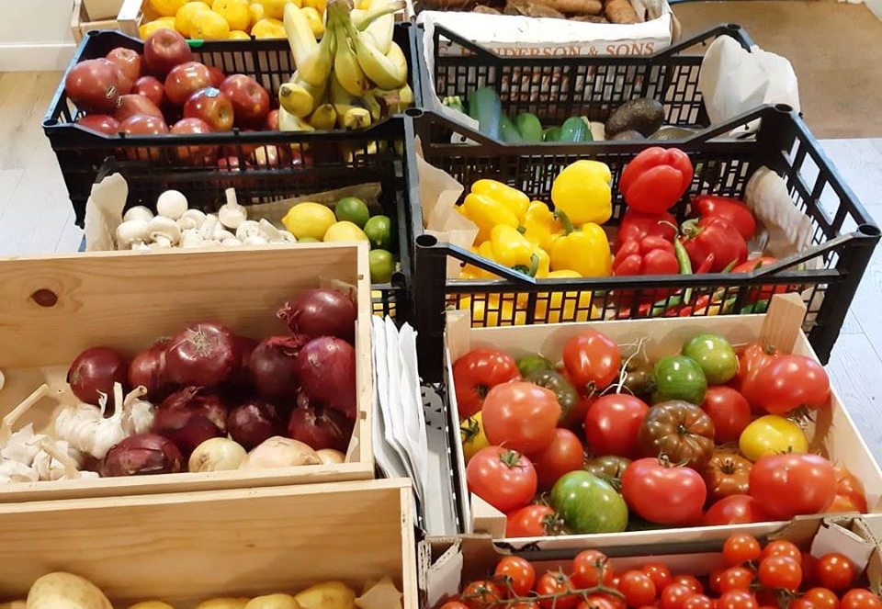



The Little Green Larder Map Web App
Leia Ainscough, Stuart Florence, Struan Robertson, Joel Yule, Shaun Warden

Slide 2
Target Audience
Interests in Sustainable/Zero Waste Living and Healthy eating
School Children

Slide 3
Our idea
Interactive Map
Text-To-Speech

Slide 4
Research
Primary Research:
Visit of The Little Green Larder
Secondary Research:
Magdalens Magazine
Online Research of each location added to map

Slide 5
Live Demo
One of us will now show you our web app
Example of markers
Demo of text to speech

Slide 6
Value and Purpose
Assistance outwith opening hours
Ease of use
Accessibility

