Slide 1
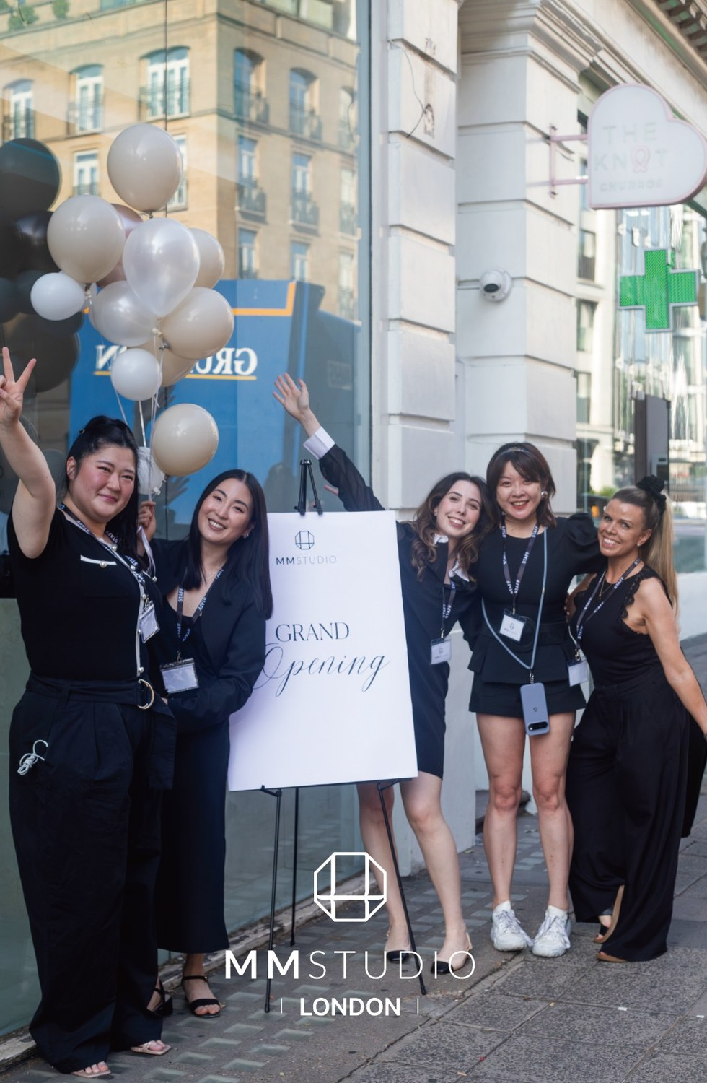
MM STUDIO
Digital cosmetics,
personalised for the world.
Korean R&D and 30+ years of product design, a UK training hub, and an AI-ready client ecosystem.
Investor brief · UK programme · Discussion draft · October 2026
Notes:
Positioning headline reflects the owner's goal (digital cosmetics) and mission (personalised solutions as the deliverable to the world), 4 Oct 2026. Photo: London opening, from the v1 deck.

Slide 2




Digital cosmetics: where MM Studio is going
OUR GOAL
Digital cosmetics
Personal, not generic
Science with discipline
Cosmetic care that is measured, personalised and tracked over time, so every product and protocol is chosen from data about the individual.
Every plan starts from the individual's own scan, goals and history.
We explain mechanisms and keep evidence separate from marketing claims.
OUR MISSION
Deliver personalised solutions to the world.
Craft guided by data
One shared standard
Trained professional hands, supported by AI-assisted imaging, never replaced by it.
A single method, product range and training path across every studio.
Notes:
Goal and mission are the owner's wording (key-elements archive, items 2 and 3). The four values are drafted from the brand book's stated approach and need owner confirmation.

Slide 3





A leadership bench no single-discipline rival can match
Scientists
Physicians
Entrepreneurs
Corporate executives
Engineering experts
Formulation and vesicle research behind IT-EXO and SynExo.
Clinical judgement and evidence from physician shareholders.
Built a trading business into an R&D-led biotech group.
Technology, finance and brand leadership for global markets.
Production and development, from formula to tested product.
Dr. Keith Kwong, Chief Scientist
David Shim, VP R&D
K-Doctor network
Theresa Jang, CEO
Dr. Sidney Tam, CTO
Sylvia Wong, CMO
Kwongjae Park, CEO, WellBester (GMP and QC)
Why it matters
One cross-border team (Seoul, Hong Kong, London) covers invention, safe delivery, scale-up and capital discipline, so no link in the chain depends on an outside party.
Notes:
Leadership disciplines are the owner's wording (key-elements archive, item 1). Named leaders and titles come from WBI_Investor_Deck_2026.pptx (team slide). Mapping each person to one of the five disciplines is an inference from title and must be confirmed; the K-Doctor network is described there as physician shareholders and partner clinics. Add one proof point per person before circulation.

Slide 4
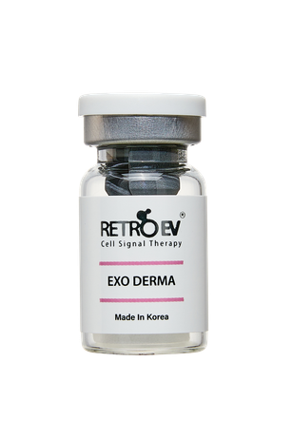
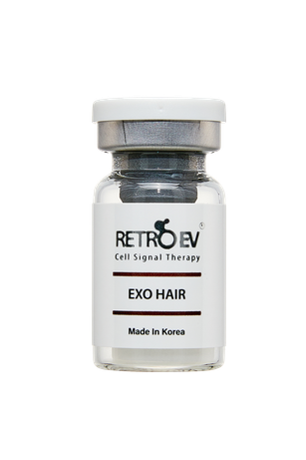
IT-EXO and SynExo: our baseline for resilient, regenerative care
01
02
03
IT-EXO®
SynExo
RetroEV ExoShot
Exosome research and formulation for professional aesthetic products, including licensed human-derived exosome technology for hair and skin.
Synthetic exosome with HLA-G immune shielding and EGF/bFGF cargo. Korean patent registered 2026; manuscript under peer review.
Needle-free device platform with compatible EXO DERMA and EXO HAIR formulations and care protocols.
Baseline platform for resilience.
Baseline platform for regenerative biotech.
Makes the science a repeatable studio service.
SynExo in-vitro results (submitted manuscript)
>95%
24-36 h
4 of 4
2.2-2.9×
cell viability, 0 to 15 µg/mL
peak EGF/bFGF expression
pro-inflammatory cytokines lowered
target-cell proliferation
Laboratory (in vitro) data only. Mechanisms and clinical outcomes need separate evidence; product documentation defines intended use.
Notes:
IT-EXO and SynExo as baseline innovations for resilience and regenerative biotech is the owner's wording (item 4). SynExo details (HLA-G, EGF/bFGF cargo, Korean patent 2026, manuscript under review at Biomolecules MDPI) and the in-vitro figures come from WBI_Investor_Deck_2026.pptx slides 6 and 8. These are cell-based results from a submitted manuscript, not clinical results. The WBI deck cites the human-derived exosomes as licensed technology; confirm that IT-EXO is that platform. Exosome-based items in any Seoul clinic programme offered through the immersion are clinic protocols, not evidence; this slide's in-vitro caveat applies to them.
Sources: Brand book slides 6, 9 and 10. IT-EXO® is an exosome research and formulation platform. SYN-EXO is a biomimetic extracellular vesicle platform; the brand materials describe its HLA-G design. RetroEV ExoShot is a needle-free device and care platform. The brand book distinguishes mechanism education from established clinical evidence. HLA-G concepts, research mechanisms and ingredient information are not presented as proven clinical efficacy, and no absolute claims of zero redness, risk or downtime are made. Original EXO DERMA and EXO HAIR product images come from RetroEV One Pager.pdf; package artwork remains unchanged.

Slide 5
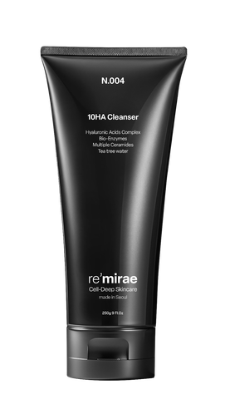
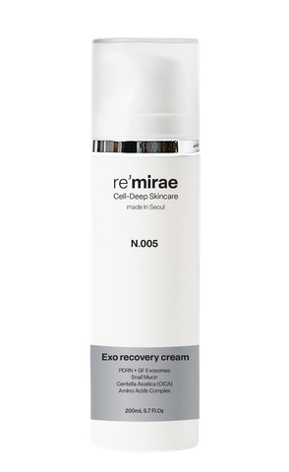


Why our design is different: 30+ years from supply chain to studio
Design
Formulate
Manufacture
Train
Serve
30+ years of product design
Decades of product design experience through Korean supply chains means formats, packaging and ranges are engineered with manufacturing in mind.
Designed as a system
Formulations, device and care protocol are developed together, so a studio service is a repeatable method, not a loose set of products.
Own GMP/ISO manufacturing
In-house production and QC labs (WellBester) with batch release and stability testing. 53 registrations across 20 export markets.
re'mirae · MORIMANA · RetroEV
Notes:
30+ years of product design through Korean supply chains is the owner's wording (item 5). Product forms come from the supply price table in the v1 notes. Owner to confirm which entities and factories the 30 years refer to. GMP/ISO production, QC labs and the 53 registrations in 20 markets come from WBI_Investor_Deck_2026.pptx (slides 4 and 15); certificates and capacity should sit in the data room.
Sources: Brand book slides 5, 6, 9 and 10 describe WBI's Korean R&D, formulation, manufacturing and supply role. RetroEV One Pager.pdf identifies EXO DERMA and EXO HAIR as freeze-dried products, with ACTIVA as a companion product. The supply price table lists professional vials at 100 mg, several liquid serums at 5 mL, and re'mirae and MORIMANA ranges. The slide summarises documented product forms and supply processes; it does not invent cell-culture, purification, filling or sterilisation parameters, GMP/ISO certifications, batch test results or factory capacity. Detailed production processes, testing and release standards, and capacity require technical documentation. Supply table Table 1!B11 lists 10 hours of theory and 5 hours of hands-on training as an example of partner launch training; this is separate from the proposed UK 12-month certificate course. Original product images come from RetroEV and Re'Mirae One Pager.pdf.

Slide 6
Against named exosome players, SynExo owns the whitespace
Player | Approach | Constraint | Positioning
ExoCoBio | Human-derived (ASC exosomes); category leader | Donor-dependent batches; no engineered immune tolerance | Premium clinic channel, about 2× WBI supply price
Prostemics | Human-derived; clinic-channel pioneer | Same biology constraints; no owned consumer channel | Clinic and derma channel, about 2× price tier
BioFD&C, GFC | Plant-derived exosomes | Lower target-cell delivery than regeneration-grade claims | Functional-cosmetic pricing, mass retail
WBI SynExo | Synthetic, designed; patented HLA-G immune tolerance | In cell tests, efficacy similar to human-derived (in vitro) | Mid price, plus own GMP plant and owned studio channel
No marketed competitor we have found combines engineered immune tolerance, synthetic batch consistency, an owned plant and an owned studio channel. Korean aesthetic-exosome market: ₩35bn (2024), ₩55bn (2025), ₩75bn (2026E).
Competitor positioning: public price lists and disclosures 2025-26, as compiled by WBI. Market size: Grand View Research, KoBIA. A head start, not an absence of rivals.
Notes:
Source: WBI_Investor_Deck_2026.pptx slide 7 (named competitors, price tiers, market size) and slide 16 (moat). The 'about 2×' price comparison and the 'no competitor combines' statement are WBI management claims; verify against current public price lists before circulation. Cell-test equivalence is in vitro only.

Slide 7
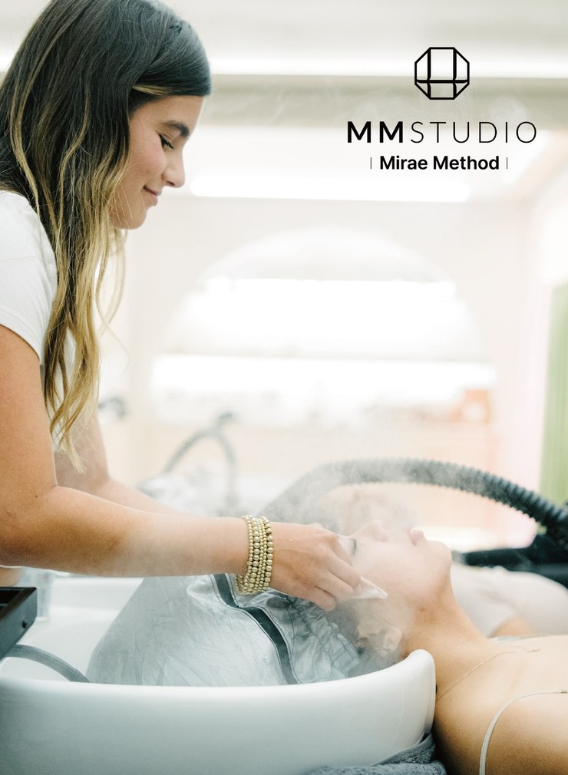




One managed client journey, not a one-off treatment
1 Imaging assessment
2 Personalised consultation
AI-assisted scans record skin and scalp condition.
A care plan built around the individual's needs and goals.
3 Professional care
4 Follow-up and homecare
Korean head spa, needle-free care and facials.
Compare follow-up images; membership and homecare.
What makes the ecosystem unique
The loop closes: each follow-up scan tests the plan, refines the next visit and informs product development in Korea. Studios, the K-Doctor physician network, partners and R&D share one consented client record.
Notes:
The Mirae Method steps summarise the brand materials. AI analysis is not a medical diagnosis; medical diagnosis, prescriptions and procedures remain with qualified medical professionals. Ecosystem framing (closed loop across studios, clinics, partners and R&D) is the owner's request to articulate why the client-management ecosystem is unique.
Sources: Brand book slides 3, 10, 11, 13, 16 and 17. AI-assisted scanning supports care assessment and consultation. Head spa, needle-free care and facials are studio services. Membership and homecare products support ongoing management. The four steps summarise the brand materials and do not establish individual treatment efficacy. AI analysis is not a medical diagnosis; medical diagnosis, prescriptions and medical procedures are the responsibility of appropriately qualified medical professionals. The care photograph is original image3.jpg from brand book slides 1/11.

Slide 8
Where MM Studio is different from the alternatives
Capability | MM Studio | Typical salon or spa | Product-only brand | Clinic-only
Personalised plan from an individual scan | Core | Partial | Rarely | Partial
Own formulation and manufacturing chain | Core | Rarely | Partial | Rarely
Professional training and shared standards | Core | Partial | Rarely | Partial
Follow-up comparison and data continuity | Core | Rarely | Rarely | Partial
Homecare linked to the care plan | Core | Partial | Core | Rarely
Medical oversight where needed | Via clinic format | Rarely | Rarely | Core
Global distribution and partner network | Core | Rarely | Partial | Rarely
No single competitor type combines all seven. MM Studio's advantage is the combination, held together by one trained method and one client record.
Illustrative management view of typical market formats, not a market study. Named competitors and evidence to be added.
Notes:
Qualitative positioning table prepared to meet the 'no competitive advantages' feedback. It generalises about formats and should be validated with named competitor examples and customer evidence before circulation.

Slide 9
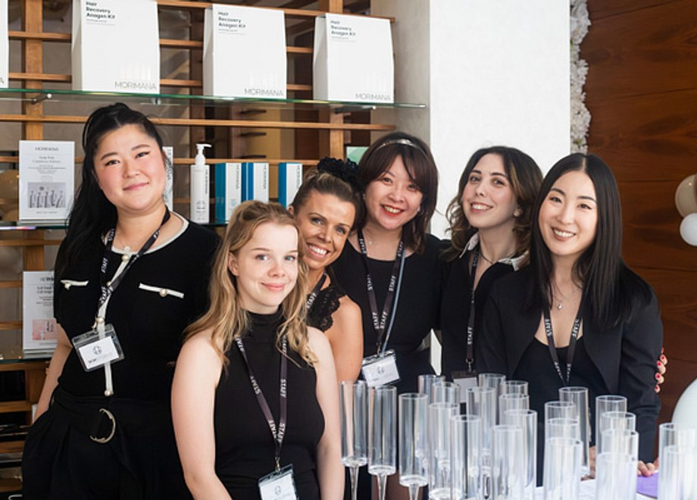
The UK: global centre of hair care and our training hub
Global centre of hair care
The UK sets the standard that the world's hair and scalp professionals look to.
World leader as coach and trainer
UK educators train professionals globally, which is the skill our partner model needs.
Seoul
London
Global network
R&D, GMP/ISO manufacturing, Seongsu studio
Knightsbridge flagship, academy-trained therapists
OEM/ODM contracts in 20 countries; HK Central and LA mapped next
Our global sales network carries the method outward: London trains, Seoul supplies, partners sell and serve. UK sales use the cosmetic route already secured (16 SCPN registrations).
Notes:
UK as global hair-care centre and world leader as coach and trainer, and the global sales network, are the owner's wording (items 6 and 7). Network facts (20 export countries, 53 registrations, SCPN 16, London Knightsbridge and Seoul Seongsu studios, HK Central and LA Century City mapped) come from WBI_Investor_Deck_2026.pptx slides 3, 4, 6, 10 and 15. Still needed: UK industry evidence for the trainer claim. The proposed UK certificate course is not confirmed: certification body, accreditation, internship roles and terms remain open.
Sources: Brand book slides 5, 6, 11, 13 and 17 for WBI CEO Theresa Jang and Korean R&D, manufacturing and training support. NeuNova's proposed UK course planning and operational role follows MM Studio Incubation Program(1).pdf, pages 2–3, and the Sources & Notes and Neunova P&L sheets of Neunova_Founding_Partnership_Investor_Model_v2.xlsx. The course is a proposal; the certification body, accreditation, internship roles and employment terms are not confirmed. Private investors' unit-based funding and equity allocation follow the user's instructions. The team photo is original image1.jpg from brand book slide 1; no individual roles are inferred from the photograph.

Slide 10


Next: AI and data that make care measurably personal
Scanner data
Service data
Client experience
Standardised skin and scalp images at every visit.
Which protocol, products and frequency were used.
Goals, feedback, comfort and homecare habits.
One consented client record, shared across studios, clinics and R&D (proposed data platform)
TODAY
In place
NEXT
Proposed
LATER
Proposed
AI-assisted imaging at assessment
Follow-up image comparison
Membership and homecare reorders
Client AI app: scan, protocol, homecare, rebooking
Common data model across studios
Anonymised protocol benchmarking
Recommendations matching protocol and formula to profile
AI-designed peptides in the formulation pipeline
Made-to-measure digital cosmetic products
WBI plan: 25,000 engaged, consented users across the studio network within two years. Built on explicit consent and UK GDPR; AI supports professionals and does not diagnose.
Notes:
Addresses the missing future-development gap: AI and data from the scanner, services and client experience. 'Today' reflects AI-assisted scanning and follow-up comparison described in the brand materials; 'Next' and 'Later' are proposed development, not shipped features. The client AI app (scan, protocol, homecare compliance, rebooking), the Engage-Capture-Learn-Compound loop, AI peptide design and the 25,000-user target are from WBI_Investor_Deck_2026.pptx slides 6 and 11; the app is described there as funded by WBI's own round, so confirm its timing for MM Studio UK. Skin and scalp images are personal data (possibly special-category); a consent, retention and DPIA plan is needed. Owner to confirm the current scanner hardware and what data it stores. If the Seoul immersion involves participants' health information, consultation records or images, that is special-category data under UK GDPR (explicit consent, a privacy notice naming the controllers, minimisation, retention limits, a DPIA); transfers to Korea rely on the UK's 2022 adequacy regulations for the Republic of Korea.

Slide 11



Three operating formats share one brand and product standard
Format | Operating model | Revenue sources
Flagship Studio | Demonstration studios in Seoul and London | Care services, memberships and product sales
Studio in a Clinic | Agreed responsibilities with doctors and healthcare providers | Care packages and product sales
Partner Studio / Distribution | Training, brand standards and product supply support | Startup packages and reorders, plus agreed service fees
Recurring by design
Training builds loyalty
US$3,800 a year
Ongoing care, membership and homecare support repeat business.
Partners complete training, follow shared standards and reorder as needed.
Estimated annual spend per engaged client.
Notes:
Per-client spend (about US$3,800: skin programme $1,800, hair/scalp programme $1,200, homecare $800) is a management estimate from WBI_Investor_Deck_2026.pptx slide 9. WBI's 15% supplier capture is WBI revenue, not a return to MM Studio UK unit holders. The Seoul immersion memo asks WBI for 'diverse and flexible routes' into the ecosystem and a 'lightest and fastest' entry option; the three formats here and the UK unit are the documented routes, and none is ranked by speed or ease.
Sources: Brand book slides 5, 10, 13, 16 and 17 for flagship, in-clinic and partner/distribution models, membership, packages, retail, training and supply support. Launch equipment packages and reorders follow MM studio EXO SHOT PRO and products supply price.xlsx (dated 8 September 2026; USD; EXW) and WBI Exo Shot Distribution Term Sheet.pdf. Service fees depend on individual partner agreements; US and 555 project fees are not automatically applied to the UK programme. Course revenue and equity subscriptions are different in nature. Equity returns depend on the issuer's actual operations and the shareholder agreement. WBI factory revenue, UK studio revenue and third-party 555 project revenue are not consolidated on this slide.

Slide 12


Who does what: Korean R&D, UK operations and investors
WBI Korea technical team
NeuNova UK team
MM Studio service team
Private investors
CEO Theresa Jang
Product development, manufacturing and supply
Seoul immersion: hosting and content (to be confirmed)
London operations and course planning
Support for studio partners
Seoul immersion: programme planning (proposed)
Client consultation and professional care
Ongoing service management
Seongsu studio walk-through (to be confirmed)
Programme funding through units
Agreed MM Studio equity allocation
Study visit: Seoul immersion (proposed)
Clear responsibilities let each partner do what it does best, while the client sees one MM Studio.
Notes:
Seoul immersion roles follow the planning memo received 5 Oct 2026 (author Rocky Chi, addressed to Theresa Jang and Sidney Tam). The memo asks WBI to confirm academy speakers, R&D and manufacturing access, the treatment programme and route options, and asks for a Seongsu walk-through; those bullets are labelled 'to be confirmed'. The memo does not state which entity runs or sells the programme; the planning role sits on the NeuNova card as 'proposed' because NeuNova already carries course planning and the memo's costing sheet names NeuNova as a party. Owner to confirm: who runs and sells the immersion, who contracts with the investor for each unit component, and who attends the trip. Commercial arrangements between the parties are not deck content.
Sources: Brand book slides 5, 6, 11, 13 and 17 for WBI CEO Theresa Jang and Korean R&D, manufacturing and training support. NeuNova's proposed UK course planning and operational role follows MM Studio Incubation Program(1).pdf, pages 2–3, and the Sources & Notes and Neunova P&L sheets of Neunova_Founding_Partnership_Investor_Model_v2.xlsx. The course is a proposal; the certification body, accreditation, internship roles and employment terms are not confirmed. Private investors' unit-based funding and equity allocation follow the user's instructions. The team photo is original image1.jpg from brand book slide 1; no individual roles are inferred from the photograph.

Slide 13
Illustrative London studio model: EBITDA positive from Year 2
£50,000
Initial London investment
£46,000
First-year sales revenue
₩16.4bn
WBI group FY2025 revenue, about US$11.7M
Management data, unaudited. London first-year period and profitability to be confirmed. Single-studio illustration; excludes UK head-office costs and the proposed internship budget. Capacity needs review: 56 monthly visits projected against capacity for 44 treatments.
EBITDA = earnings before interest, tax, depreciation and amortisation. Sales alone do not establish an investment return; full P&L and cash balances are pending.
Notes:
WBI group FY2025 combined revenue of ₩16.4bn (about US$11.7M) is from WBI_Investor_Deck_2026.pptx slide 13 (management data, with net income ₩291M, 5.1% margin). It describes the supplier group, not MM Studio UK. WBI's separate US$2.0M-for-10% round and its franchise forecasts are deliberately not part of this UK programme.
Source: Neunova_Founding_Partnership_Investor_Model_v2.xlsx. London initial investment of £50,000 and first-year sales of £46,000 come from Sources & Notes!B5, are management-provided and unaudited, and do not identify the exact first-year period. The five-year table uses Route 1 Operator!C6:G6 (revenue) and C17:G17 (EBITDA). Underlying values, recalculated and checked against cached results, are: 148104/-13742.532; 188496/20342.232; 228888/52986.996; 269280/85631.76; 282744/94593.348. Displayed figures are rounded to whole pounds. Incorrect references in Investor Summary!B27:B30 were not used. Base assumptions come from Assumptions!C17:C22, C31:C38 and B44:F45: 20 mature members spending £300 per month in total, 36 monthly non-member visits at £400, 10% retail uplift, consumables at 12.05% of revenue, annual rent of £75,000, therapist costs of £24,000, reception costs of £30,000, plus utilities, amenities, insurance and marketing. The single-studio illustration excludes UK head-office costs and the proposed 12-month internship/work budget. Its EBITDA is not consolidated company profit, a cash dividend or a return per funding unit. Unit Economics!C43/C42 shows 56 projected monthly visits and capacity for 44 treatments; reconcile the definitions, scheduling and staffing costs. The existing 49% SPV structure, 3× Year-5 EBITDA valuation and earlier tuition prices have not been adopted as terms for this funding proposal. The ReadMe in MM_Studio_Entity_PL_Consolidated.xlsx identifies actual-data gaps and restrictions on investment valuation use, so its consolidated profit figures are not cited.

Slide 14
Funding programme: each unit combines training and MM Studio equity
Use of funds per unit | Amount (GBP)
Study visits, training and practical sessions (proposed: the four-day Seoul immersion) | £15,000
12-month professional certificate course | From £25,000
12-month internship and work programme | £XXXX
MM Studio equity allocation | £50,000
£XXX
Per funding unit
N units × £XXX
Total funding target; unit count to be confirmed
£90,000+
Indicative minimum, plus internship and work budget
£15,000 excludes travel, hotel and transport; the Seoul immersion's price and inclusions are being confirmed with WBI. MM Studio's 2026 baseline value: £XXXX. Final ownership percentage to be confirmed. The equity budget provisionally assumes an equal cash subscription.
Certification, internship and work terms, timing, share issuer and shareholder rights require confirmation. No recognised qualification, job, visa, immigration outcome or investment return is guaranteed.
Notes:
Seoul immersion. The planning memo received 5 Oct 2026 (author Rocky Chi, addressed to Theresa Jang and Sidney Tam; internal source file sources/seoul-immersion-memo.md, not for circulation) describes a four-day Seoul programme. This deck proposes it as the study-visit component of each unit; the memo itself does not mention the UK unit programme, so the link is an owner decision and is labelled 'proposed'. The memo's working price is in USD, on the earlier three-day basis, covers treatments, academy sessions and meals, and asks WBI for a four-day total including hotel nights; the deck's £15,000 is in GBP and excludes travel, hotel and transport. These are different numbers with different inclusions, so no memo figure is shown or converted here. Owner decisions: (1) whether the £15,000 component is the Seoul immersion alone or the immersion plus UK practical sessions; (2) the GBP price and inclusions of the four-day version; (3) who attends (the investor, a nominated trainee, or both) and whether the trip precedes or follows the unit subscription; (4) whether a stand-alone trip fee is credited against a later unit. Day 4 involves business and investment conversations with prospective participants: take advice on UK financial-promotion rules before those sessions. Internal costing detail from the memo is not deck content.
Source: The user's programme instructions and explicit choice to retain unspecified figures as placeholders. Each unit is £XXX. Study visits, training and practice cost £15,000, excluding travel, hotel accommodation and transport. The 12-month professional certificate course starts at £25,000. The 12-month internship/work budget is £XXXX. Each unit includes MM Studio equity valued at £50,000, calculated against its 2026 baseline/original value of £XXXX. All amounts are in GBP. Earlier family-route totals of £165k/£275k/£395k are not adopted. The allocation provisionally treats the equity element as an equal £50,000 cash subscription. The minimum listed components total £15,000 + £25,000 + £50,000 = £90,000, plus the internship/work budget and any course cost above the starting price. If equity is allocated by transfer, non-cash arrangement or another mechanism, fundraising and cash flows must be recalculated. The meaning of “original value”, the 2026 baseline value, share issuer, share class, subscription or transfer mechanism, fully diluted ownership percentage and shareholder rights remain unconfirmed. No pre-money/post-money formula or Year-5 exit value is applied. Total fundraising equals N units multiplied by the final amount paid per unit; N is unconfirmed. The two 12-month elements are not assumed to run consecutively or concurrently. No recognised qualification, job, visa, immigration outcome or investment return is guaranteed.

Slide 15
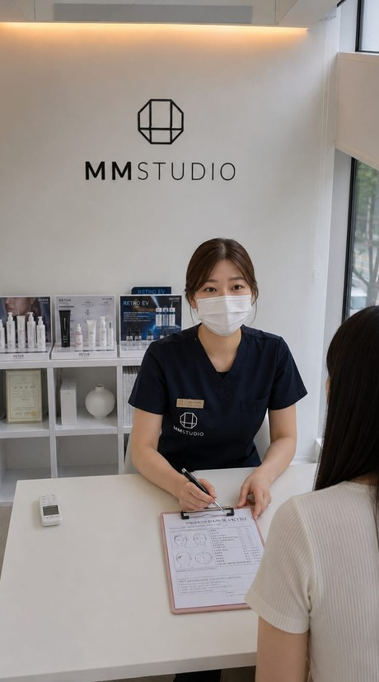
Four days in Seoul: from the treatment room to the boardroom
Proposed as the study-visit component of each funding unit: experience, science, business, opportunity.
DAYS 1-2
Access being arranged (to be confirmed)
Experience the treatments
A personalised treatment programme in Seoul, subject to clinical suitability. Treatments may be substituted within a fixed programme fee (policy proposed).
R&D and manufacturing facility visit
Meet the scientists and product team
Formulation-to-protocol demonstration
MM Studio Seongsu walk-through
Academy speakers and their bios
DAY 3
Discover the science, understand the business
Presentations and site visits: the science and products behind the treatments; regenerative aesthetics and biotech; exosomes, peptides and protocols; product development; treatment and homecare economics; consumer insights; scaling a consumer business.
DAY 4
Explore the opportunity
Presentations, one-to-one conversations and Q&A on routes into the ecosystem: the operating formats and the UK unit programme (options to be confirmed).
Why it matters: participants see for themselves what this brief describes: the treatments, the science behind them and how a studio operates.
Programme in planning: content, site access, price and inclusions to be confirmed with WBI. Proposed as the study-visit component of each unit, not the certificate course; no qualification conferred. Treatments are given in Korea, subject to clinical suitability; no outcome is claimed; exosome evidence is in vitro only.
Notes:
Source: planning memo 'Seoul K-Beauty Ecosystem Immersion: From the Treatment Room to the Boardroom', author Rocky Chi, addressed to Theresa Jang and Sidney Tam, received 5 Oct 2026 (internal file sources/seoul-immersion-memo.md, not for circulation). Set out in the memo and shown as such: the programme name and tagline; the four-step narrative (experience the treatments, discover the science, understand the business, explore the opportunity); the four-day structure, extended from three days to weight Days 3 and 4 towards academy and business content; the Day 3 topic list, delivered by presentation and site visits; Day 4 as presentations and one-to-one conversations with business and investment Q&A. The memo's own framing: it is not primarily selling a beauty holiday, a two-day academy, a corporate investment seminar or a package of individual medical treatments, but access to the full journey behind Korean beauty, from personal experience and clinical innovation to business creation and international growth. Requested from WBI on 5 Oct 2026 and not yet answered: everything in the dashed panel, confirmation of the treatment programme and its supporting price list, the substitution policy and matrix, the four-day price and inclusions (hotel nights, meals, transport, dinners), pre- and post-trip extensions, the routes WBI will present on Day 4, WBI highlights, Seoul photography and a CEO welcome note for the brochure. Replace the dashed panel with confirmed wording, or remove it, before external circulation; name speakers and print dates only once confirmed; use 'exclusive' only if WBI confirms the access is not offered to other groups. Presenter guidance: do not name any treatment, product or medicine and do not use outcome words; the clinic sets the programme at consultation, and UK-originated material must not promote prescription-only medicines. Substitution wording proposed in the memo for the booking pack: 'The programme fee remains fixed. Individual treatments may be substituted based on personal preference and clinical suitability, subject to the available treatment programme.' The memo's costing sheet is on a seven-participant, three-day basis and predates the four-day extension; its figures and internal arrangements are not deck content. Photo: MM Studio Seongsu consultation, from WBI's investor deck. The link between the immersion and the £15,000 study-visit component is this deck's proposal, not a statement in the memo; see the Funding programme notes for the owner decisions.

Slide 16




Why invest, and what happens next
A team no rival has
Defensible innovation
A client ecosystem
Reach from the UK
Named scientists, physicians, entrepreneurs, executives and engineers.
IT-EXO and a patented SynExo, backed by 30+ years of Korean product design and GMP/ISO manufacturing.
One method and one client record from scan to homecare.
A global training hub and sales network.
NEXT STEPS
Confirm unit price, unit count and 2026 baseline value
Share leadership profiles and AI and data governance plan
Arrange visits to the London studio and, once the programme is confirmed, the four-day Seoul immersion
MM Studio · Discussion draft · October 2026
Notes:
Closing summary of the four owner-supplied differentiators and the open items listed in the key-elements archive. Seoul immersion dates are not printed until WBI confirms the programme. Open asks to WBI from the planning memo of 5 Oct 2026, kept here so next steps and the memo stay aligned: WBI highlights for the cohort (cross-check against the sourced facts on the Leadership, Innovation, Design, whitespace and UK hub slides); Seoul photography assets and a CEO welcome note for the brochure; academy speakers and bios; R&D and manufacturing access; meeting the scientists and product team; a formulation-to-protocol demonstration; the Seongsu walk-through; confirmation and price list for the treatment programme; the substitution policy and matrix; the four-day price and inclusions; the policy on pre- and post-trip extensions; the route options for joining the ecosystem. The memo's guest-to-guest referral benefit is kept out of the deck pending advice on UK financial-promotion rules, because a referred guest may subscribe for a unit that includes equity. Keep 'golden opportunity', 'fast-growing' and 'franchisee' off slides.

