Slide 1
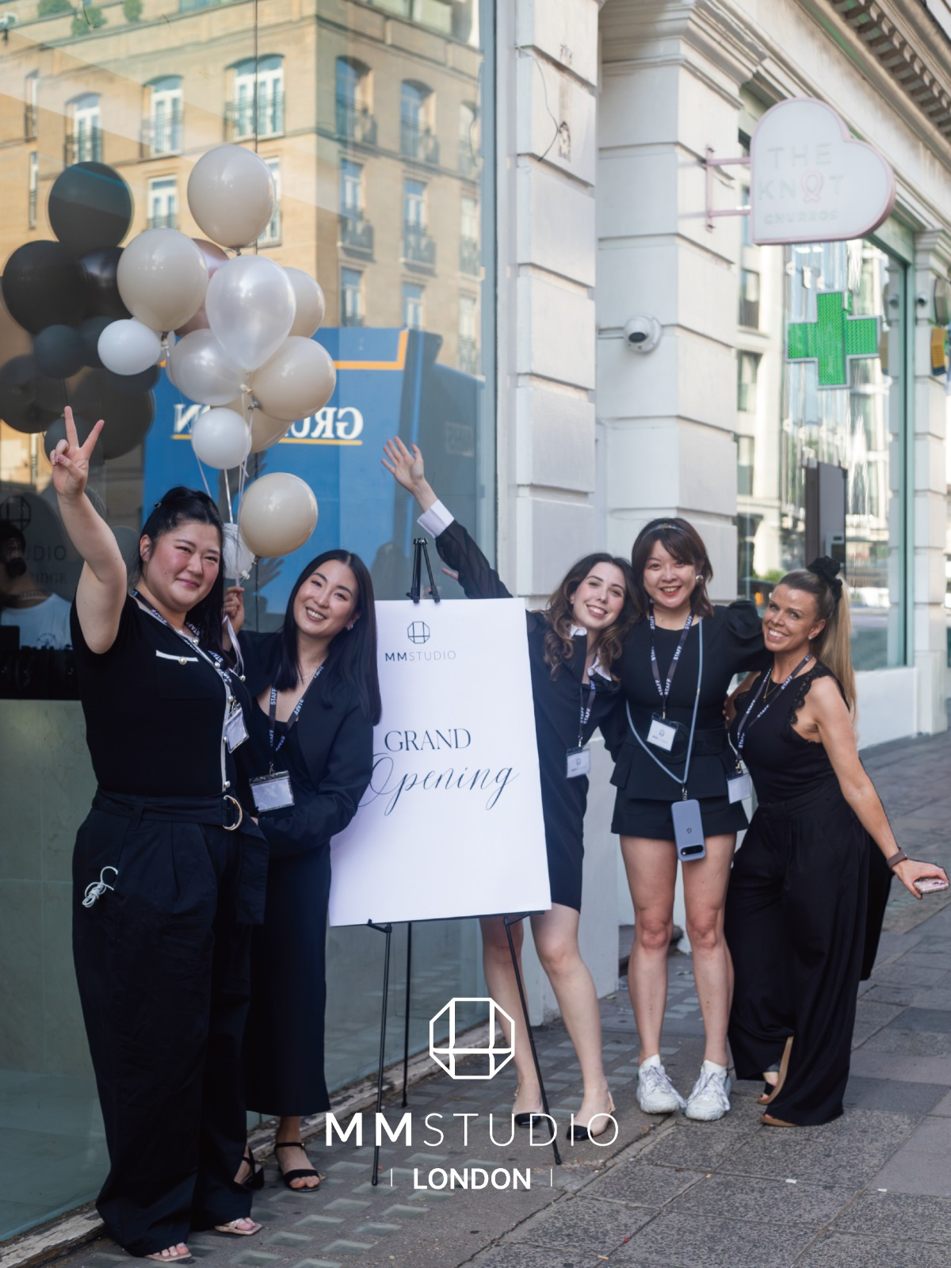
MM STUDIO
Investor Brief
Why Us
Korean R&D and manufacturing
working with UK operations
Skin and scalp care, professional training
and a proposed MM Studio shareholding
UK programme / Discussion draft / October 2026
01
Notes:
Sources: MMStudio Brand Book v3 Global Partner Edition.pptx, slides 5, 6, 7, 13 and 17, covering WBI's Korean R&D, formulation and manufacturing responsibilities, the London and Seoul demonstration studios, and partnership models. The original London opening photo is image4.jpg embedded on slides 1/7 of that brand book. Funding and equity allocation follow the user's proposed UK programme and are not final transaction terms. The deck contains eight slides; this cover also carries the “Why Us” topic.

Slide 2
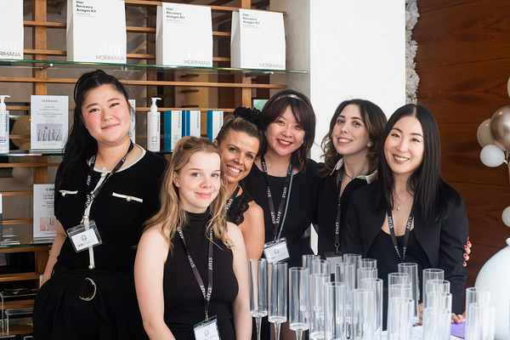
Team Collaboration
Clear responsibilities for Korean R&D and UK studio operations
WBI Korea Technical Team
CEO Theresa Jang
Product development and formulation
Manufacturing and supply
NeuNova UK Team
London operations and course planning
Support for studio partners
MM Studio Service Team
Client consultation and professional care
Ongoing service management
Private Investors
Programme funding through units with an agreed MM Studio equity allocation
02
Notes:
Sources: Brand book slides 5, 6, 11, 13 and 17 for WBI CEO Theresa Jang and Korean R&D, manufacturing and training support. NeuNova's proposed UK course planning and operational role follows MM Studio Incubation Program(1).pdf, pages 2–3, and the Sources & Notes and Neunova P&L sheets of Neunova_Founding_Partnership_Investor_Model_v2.xlsx. The course is a proposal; the certification body, accreditation, internship roles and employment terms are not confirmed. Private investors' unit-based funding and equity allocation follow the user's instructions. The team photo is original image1.jpg from brand book slide 1; no individual roles are inferred from the photograph.

Slide 3
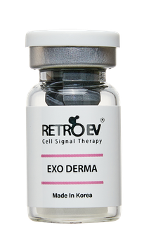
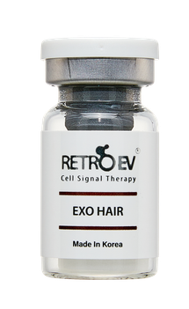
Technology Innovation
Exosome and biomimetic platforms for professional skin and scalp care
01
IT-EXO®
Exosome research and formulation
for professional aesthetic products
02
SYN-EXO
Biomimetic extracellular vesicles
combining carriers, actives and HLA-G design
03
RetroEV ExoShot
Needle-free device platform
with compatible formulations and care protocols
EXO DERMA
EXO HAIR
Mechanisms and clinical outcomes need separate evidence. Product documentation defines the intended use.
03
Notes:
Sources: Brand book slides 6, 9 and 10. IT-EXO® is an exosome research and formulation platform. SYN-EXO is a biomimetic extracellular vesicle platform; the brand materials describe its HLA-G design. RetroEV ExoShot is a needle-free device and care platform. The brand book distinguishes mechanism education from established clinical evidence. HLA-G concepts, research mechanisms and ingredient information are not presented as proven clinical efficacy, and no absolute claims of zero redness, risk or downtime are made. Original EXO DERMA and EXO HAIR product images come from RetroEV One Pager.pdf; package artwork remains unchanged.

Slide 4
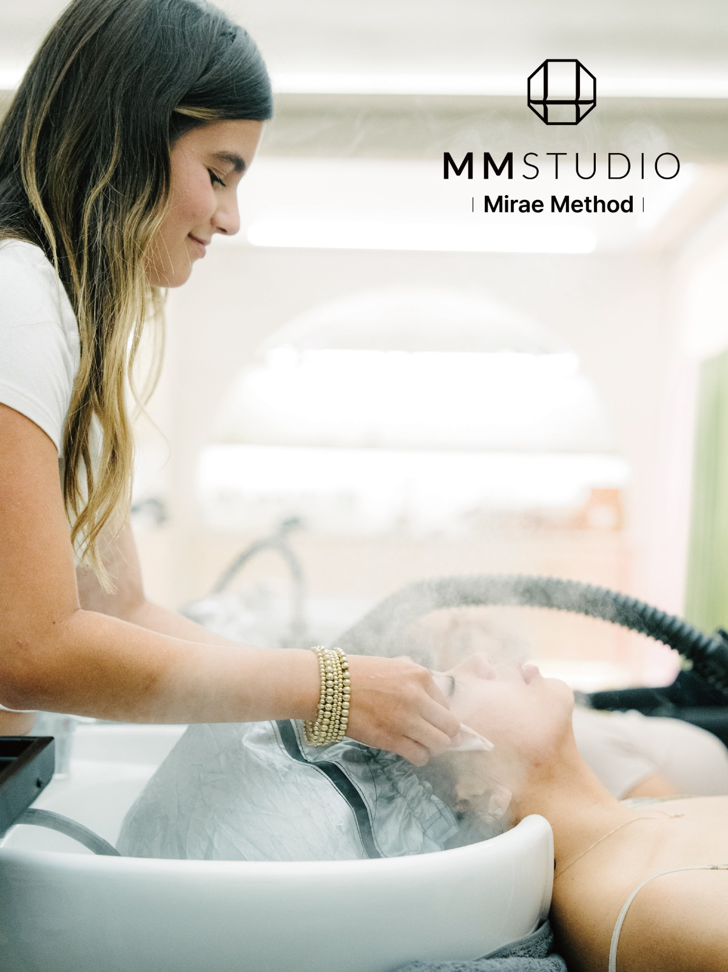
Technology Applications
The Mirae Method® client care process
01
Imaging Assessment
AI-assisted scans record skin and scalp condition
02
Personalised Consultation
Care plans reflect individual needs and goals
03
Professional Care
Korean head spa, needle-free care and facials
04
Regular Follow-up
Compare follow-up images and review homecare
within membership programmes
04
Notes:
Sources: Brand book slides 3, 10, 11, 13, 16 and 17. AI-assisted scanning supports care assessment and consultation. Head spa, needle-free care and facials are studio services. Membership and homecare products support ongoing management. The four steps summarise the brand materials and do not establish individual treatment efficacy. AI analysis is not a medical diagnosis; medical diagnosis, prescriptions and medical procedures are the responsibility of appropriately qualified medical professionals. The care photograph is original image3.jpg from brand book slides 1/11.

Slide 5
Business Models
Three operating formats share MM Studio brand and product standards
Format | Operating Model | Revenue Sources
Flagship Studio | Demonstration studios in Seoul and London | Care services, memberships and product sales
Studio in a Clinic | Agreed responsibilities with doctors and healthcare providers | Care packages and product sales
Partner Studio / Distribution | Training, brand standards and product supply support | Startup packages and reorders plus agreed service fees
Ongoing care and homecare support repeat business
Partners complete training, follow shared care standards and order products as needed
05
Notes:
Sources: Brand book slides 5, 10, 13, 16 and 17 for flagship, in-clinic and partner/distribution models, membership, packages, retail, training and supply support. Launch equipment packages and reorders follow MM studio EXO SHOT PRO and products supply price.xlsx (dated 8 September 2026; USD; EXW) and WBI Exo Shot Distribution Term Sheet.pdf. Service fees depend on individual partner agreements; US and 555 project fees are not automatically applied to the UK programme. Course revenue and equity subscriptions are different in nature. Equity returns depend on the issuer's actual operations and the shareholder agreement. WBI factory revenue, UK studio revenue and third-party 555 project revenue are not consolidated on this slide.

Slide 6
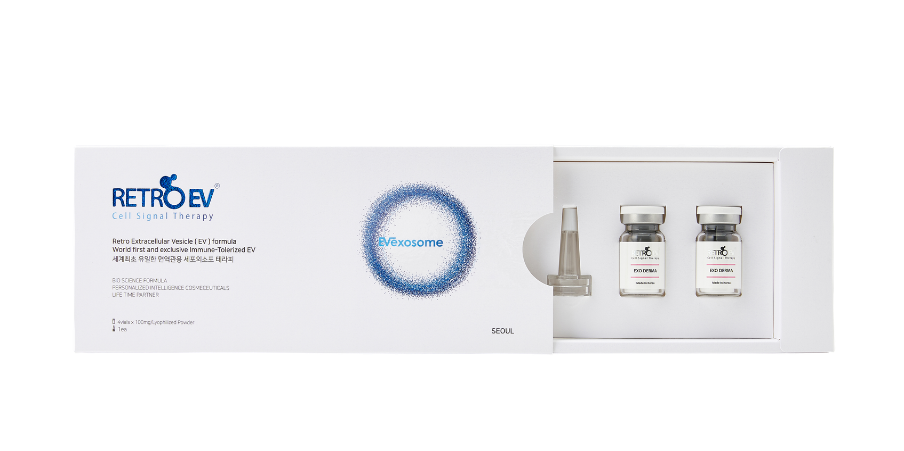
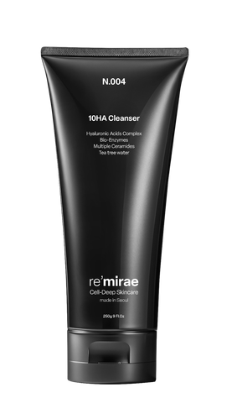
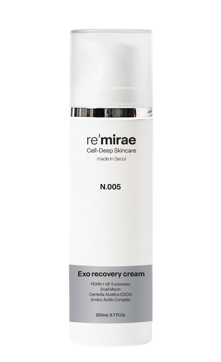
Manufacturing and Product Supply
WBI's Korean R&D and manufacturing support the studio's product ranges
01
Formulation Development
Vesicle platforms, peptides and actives
for skin and scalp care needs
02
Freeze-dried and Liquid Products
RetroEV professional vials and active serums
with re'mirae and MORIMANA product lines
03
Professional Training and Supply
Equipment, products, theory and practice
Reorders support studio operations
Technical documentation must confirm production parameters, testing standards and capacity
06
Notes:
Sources: Brand book slides 5, 6, 9 and 10 describe WBI's Korean R&D, formulation, manufacturing and supply role. RetroEV One Pager.pdf identifies EXO DERMA and EXO HAIR as freeze-dried products, with ACTIVA as a companion product. The supply price table lists professional vials at 100 mg, several liquid serums at 5 mL, and re'mirae and MORIMANA ranges. The slide summarises documented product forms and supply processes; it does not invent cell-culture, purification, filling or sterilisation parameters, GMP/ISO certifications, batch test results or factory capacity. Detailed production processes, testing and release standards, and capacity require technical documentation. Supply table Table 1!B11 lists 10 hours of theory and 5 hours of hands-on training as an example of partner launch training; this is separate from the proposed UK 12-month certificate course. Original product images come from RetroEV and Re'Mirae One Pager.pdf.

Slide 7
Financial Position
London pilot figures and an illustrative five-year UK studio model
London Pilot
Year | Revenue (GBP) | EBITDA (GBP)
Year 1 | 148,104 | -13,743
Year 2 | 188,496 | 20,342
Year 3 | 228,888 | 52,987
Year 4 | 269,280 | 85,632
Year 5 | 282,744 | 94,593
£50,000
Initial Investment
£46,000
First-year Sales Revenue
Management data, unaudited.
First-year period and profitability
to be confirmed.
The model excludes UK head-office costs and the proposed internship/work budget.
Capacity assumptions need review: 56 monthly visits versus capacity for 44 treatments.
EBITDA = earnings before interest, tax, depreciation and amortisation.
Full P&L and cash balances remain pending. Sales alone do not establish an investment return.
07
Notes:
Source: Neunova_Founding_Partnership_Investor_Model_v2.xlsx. London initial investment of £50,000 and first-year sales of £46,000 come from Sources & Notes!B5, are management-provided and unaudited, and do not identify the exact first-year period. The five-year table uses Route 1 Operator!C6:G6 (revenue) and C17:G17 (EBITDA). Underlying values, recalculated and checked against cached results, are: 148104/-13742.532; 188496/20342.232; 228888/52986.996; 269280/85631.76; 282744/94593.348. Displayed figures are rounded to whole pounds. Incorrect references in Investor Summary!B27:B30 were not used. Base assumptions come from Assumptions!C17:C22, C31:C38 and B44:F45: 20 mature members spending £300 per month in total, 36 monthly non-member visits at £400, 10% retail uplift, consumables at 12.05% of revenue, annual rent of £75,000, therapist costs of £24,000, reception costs of £30,000, plus utilities, amenities, insurance and marketing. The single-studio illustration excludes UK head-office costs and the proposed 12-month internship/work budget. Its EBITDA is not consolidated company profit, a cash dividend or a return per funding unit. Unit Economics!C43/C42 shows 56 projected monthly visits and capacity for 44 treatments; reconcile the definitions, scheduling and staffing costs. The existing 49% SPV structure, 3× Year-5 EBITDA valuation and earlier tuition prices have not been adopted as terms for this funding proposal. The ReadMe in MM_Studio_Entity_PL_Consolidated.xlsx identifies actual-data gaps and restrictions on investment valuation use, so its consolidated profit figures are not cited.

Slide 8
UK Team Funding Requirements
Multiple private investors fund the UK programme through participation units
Per Funding Unit
Use of Funds per Unit | Amount (GBP)
Study visits, training and practical sessions | £15,000
12-month professional certificate course | From £25,000
12-month internship and work programme | £XXXX
MM Studio equity allocation | £50,000
£XXX
Total Funding Target
N units × £XXX
Unit count: to be confirmed
Indicative minimum: £90,000 + internship/work budget
MM Studio's 2026 baseline value: £XXXX. Final ownership percentage: to be confirmed.
£15,000 excludes travel, hotel accommodation and transport. The equity budget provisionally assumes an equal cash subscription.
Certification, internship/work terms, timing, share issuer and shareholder rights require confirmation
08
Notes:
Source: The user's programme instructions and explicit choice to retain unspecified figures as placeholders. Each unit is £XXX. Study visits, training and practice cost £15,000, excluding travel, hotel accommodation and transport. The 12-month professional certificate course starts at £25,000. The 12-month internship/work budget is £XXXX. Each unit includes MM Studio equity valued at £50,000, calculated against its 2026 baseline/original value of £XXXX. All amounts are in GBP. Earlier family-route totals of £165k/£275k/£395k are not adopted. The allocation provisionally treats the equity element as an equal £50,000 cash subscription. The minimum listed components total £15,000 + £25,000 + £50,000 = £90,000, plus the internship/work budget and any course cost above the starting price. If equity is allocated by transfer, non-cash arrangement or another mechanism, fundraising and cash flows must be recalculated. The meaning of “original value”, the 2026 baseline value, share issuer, share class, subscription or transfer mechanism, fully diluted ownership percentage and shareholder rights remain unconfirmed. No pre-money/post-money formula or Year-5 exit value is applied. Total fundraising equals N units multiplied by the final amount paid per unit; N is unconfirmed. The two 12-month elements are not assumed to run consecutively or concurrently. No recognised qualification, job, visa, immigration outcome or investment return is guaranteed.

